Slide 1
Module 4 Usability and Reliability
Dr. Priyanjali Gogikar
SEEE, VIT Bhopal

Slide 2

What is usability?
Usability is a measure of how well a specific user in a specific context can use a product/design to achieve a defined goal effectively, efficiently and satisfactorily.
What is Usability?
Ease of learning
Ease of use
Ease of remembering
Subjective satisfaction
Efficiency of use
Effectiveness of use

Slide 3
Learnability: How easy is it for users to accomplish basic tasks the first time they encounter the design?
Efficiency: Once users have learned the design, how quickly can they perform tasks?
Memorability: When users return to the design after a period of not using it, how easily can they reestablish proficiency?
Errors: How many errors do users make, how severe are these errors, and how easily can they recover from the errors?
Satisfaction: How pleasant is it to use the design?

Slide 4
One of the key attribute to usability is utility, which refers to the design's functionality: Does it do what users need?
Usability vs. Utility
Good utility and usability are closely related, yet they are not the same thing.
Utility and usability are similar in that they are both critical in producing a quality product; the product needs to be operated easily and intuitively (usability) to accomplish the given task (utility) (Nielsen 2003).
There are however subtle differences; utility is solely concerned with usefulness; however usability includes not only utility, but also efficiency, safety, memorability, learnability and satisfaction (Nielsen 2003).
Definition of Utility = whether it provides the features you need.
Definition of Usability = how easy & pleasant these features are to use.
Definition of Useful = usability + utility.

Slide 5
User requirement
Understanding user requirements is an integral part of information systems design and is critical to the success of interactive systems.
It is now widely understood that successful systems and products begin with an understanding of the needs and requirements of the users.
As specified in the ISO 13407 standard (ISO, 1999), user-centered design begins with a thorough understanding of the needs and requirements of the users.
The benefits can include:
increased productivity
enhanced quality of work
reductions in support and training costs
improved user satisfaction

Slide 6
Process for user requirement analysis
Information Gathering
User needs identification
Envisioning and evaluation
Requirements specification

Slide 7
Information Gathering
Stake holder analysis
Secondary market research
Context use of analysis
Task analysis
Rich pictures
Field study and observational analysis
Dairy calling
Video recording

Slide 8
Stakeholder analysis
identifies all the users and stakeholders who may influence or be impacted by the system.
This helps ensure that the needs of all those involved are taken into account.
If required, the system is tested by them.
User groups may include end users, supervisors, installers, and maintainers.
Other stakeholders include recipients of output from the system, marketing staff, purchasers and support staff (Taylor, 1990).
Stakeholder analysis identifies, for each user and stakeholder group, their main roles, responsibilities and task goals in relation to the system.
Secondary market research
Involves researching published sources such as research reports, census data, demographic information, that throw light upon the range of possible user markets.
Context of use analysis
used when a system or product is developed. The quality of a system, including usability, accessibility and social acceptability factors, depends on having a very good understanding of the context of use of the system.

Slide 9
Task analysis
Involves the study of what a user is required to do in terms of actions and/or cognitive processes to achieve a task. A detailed task analysis can be conducted to understand the current system, the information flows within it, the problems for people, and opportunities that indicate user needs.
Rich pictures
can help stakeholders map, explore and understand a complex problem space and thereby help to identify hidden requirements (Checkland, 1981).
The technique involves creating a series of sketches to show how people and systems relate to each other in an organization.
They may show peoples' roles, power structures, communications and reporting mechanisms. Drawing simple figures of people with thought and speech bubbles linked to them can show particular problem areas in the current environment that may lead to new user requirements.

Slide 10
Field study and observational methods
Involve an investigator viewing users as they work and taking notes of the activity that takes place.
Observation may be either direct, where the investigator is actually present during the task, or indirect, where the task is recorded on videotape by the analysis team and viewed at a later time.
The observer tries to be unobtrusive during the session and only poses questions if clarification is needed.
Obtaining the co-operation of users is vital so the interpersonal skills of the observer are important.
Diary keeping
provides a record of user behavior over a period of time.
They require the participant to record activities they are engaged in throughout a normal day that may lead to the identification of user requirements for a new system or product.
Diaries require careful design and prompting if they are to be employed properly be participants.

Slide 11
Video recording
can be used to capture human processes in a stakeholder's workplace or other location.
The results can then be revised for the purpose of understanding more about the work and generating relevant questions relevant to user needs.
Video can also be a useful supplement to other method e.g. to demonstrate new system concepts to users during user/stakeholder discussion groups.

Slide 12
User needs identification
User surveys
Focus groups
Scenarios, use cases and personas
Future workshops
Existing system or competitor analysis

Slide 13
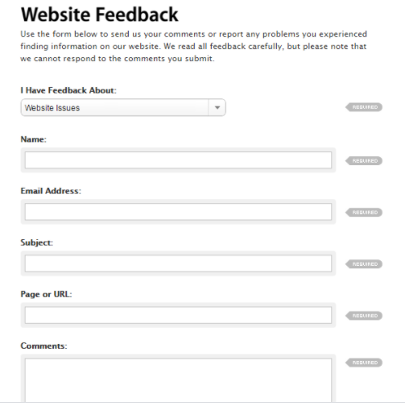

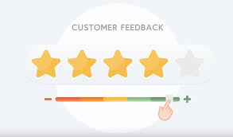
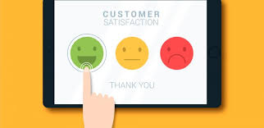
User surveys
Involve administering a set of written questions to a sample population of users.
Surveys can help determine the needs of users, current work practices and attitudes to new system ideas.
Surveys are normally composed of a mix of 'closed' questions with fixed responses and 'open' questions, where the respondents are free to answer as they wish.
This method is useful for obtaining quantitative as well as some qualitative data from a large number of users about the problems of existing tasks or the current system.

Slide 14
Focus groups
bring together a cross-section of stakeholders in a discussion group format.
This method is useful for requirements elicitation and can help to identify issues that need to be tackled.
The general idea is that each participant can act to stimulate ideas in the other people present, and that by a process of discussion, the collective view becomes established which is greater than the individual parts.
Interviewing
commonly used technique where users, stakeholders and domain experts are questioned to gain information about their needs or requirements in relation to the new system.
Interviews are usually semi structured based on a series of fixed questions with scope for the user to expand on their responses.

Slide 15

Scenarios, use cases
give detailed realistic examples of how users may carry out their tasks in a specified context with the future system.
The primary aim of scenario building is to provide examples of future use as an aid to understanding and clarifying user requirements and to provide a basis for later usability testing.
Scenarios can help identify usability targets and likely task completion times.
The method also promotes developer buy-in and encourages a human-centred design approach.
Scenarios of use are sometimes called 'use cases', although the term is also used by software engineers to refer to the use of functions.
Personas

Slide 16

Future workshops
are a way to help users and designers 'break out' from a current situations and thinking.
Evaluating an existing or competitor system
can provide valuable information about the extent to which current systems meet user needs and can identify potential usability problems to avoid in the new system.
Useful features identified in a competitor system can also be fed into the design process as potential user requirements.
Measures of effectiveness, efficiency and satisfaction can be used as a baseline for the new system.
To obtain accurate measures a controlled user test should be used, but valuable information can still be obtained from less formal methods of testing.

Slide 17
Envisioning and evaluation
Brainstorm
Card sorting and affinity diagrams
storyboards
prototyping
Allocation of function and user cost benefit analysis
Design guidelines and standards
Parallel design

Slide 18
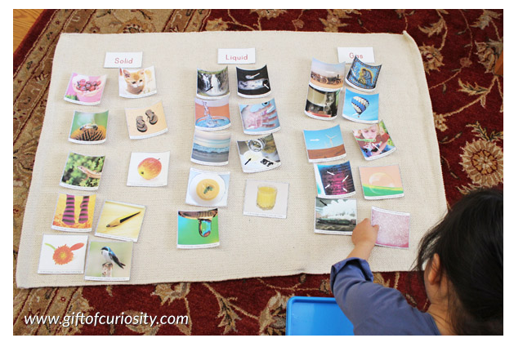
Brainstorm sessions
Bring together a set of design and task experts to inspire each other in the creative, idea generation phase of the problem solving process.
They are used to generate new ideas by freeing the mind to accept any idea that is suggested, thus allowing freedom for creativity.
The method has been widely used the early phases of design.
The results of a brainstorming session are, it is hoped, a set of good ideas and a general feel for the solution area to meet user needs.
Card sorting

Slide 19
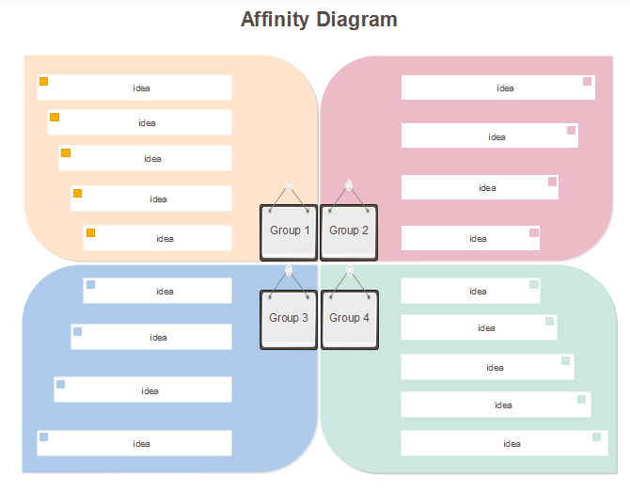
Affinity Diagram

Slide 20
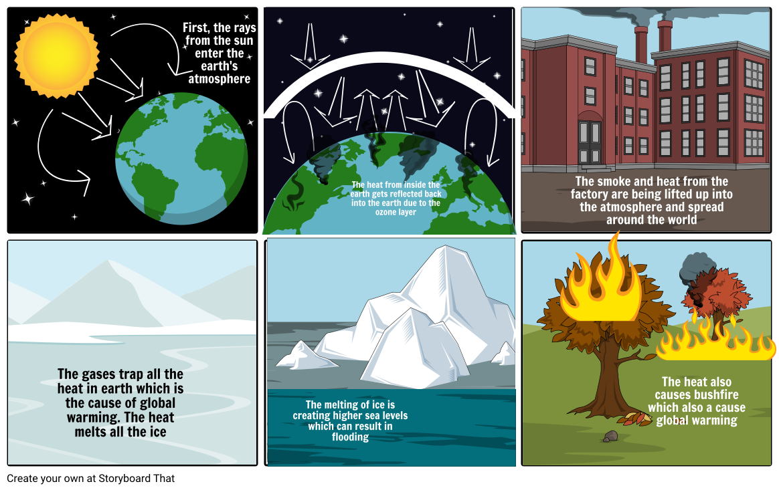
STORY BOARD

Slide 21
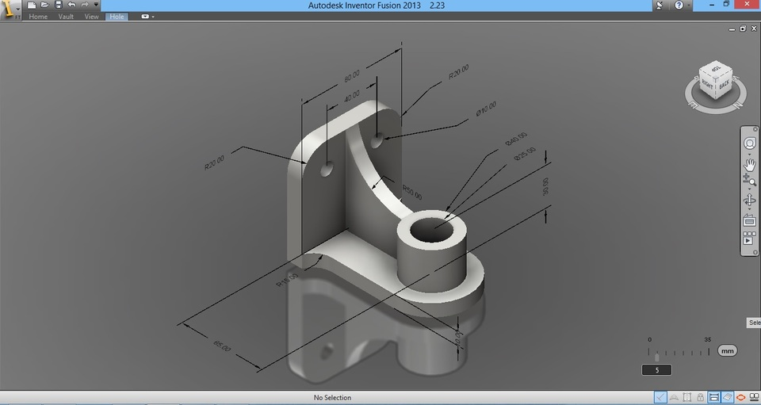
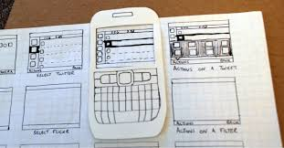
Prototyping
Software Prototyping
Paper Prototyping

Slide 22
Allocation of function
As ISO 13407 (1999) states in clause 7.3.2, allocation of function is "the division of system tasks into those performed by humans and those performed by technology" to specify a clear system boundary.
A range of options is established to identify the optimal division of labor, to provide job satisfaction and efficient operation of the whole work process.
User cost benefit analysis can then be carried out to determine how acceptable each user group will find the new arrangement.
The use of task allocation charts and cost-benefit analysis is most useful for systems that affect whole work processes rather than single user, single task products.
They also provide the opportunity to rethink the system design or user roles to provide a more acceptable solution for all groups.

Slide 23
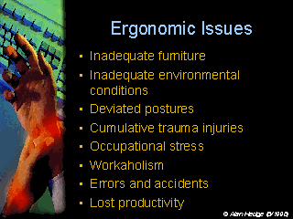
Design guidelines and standards
Parallel design sessions
involve a few small groups of designers working independently, to generate a range of diverse solutions.
The aim is to develop and evaluate different system designs before choosing a solution (possibly drawing from several solutions) as a basis for the implemented system

Slide 24
Requirement specification
Task/function mapping
User, usability and organizational requirements
Prioritization
Criteria setting

Slide 25
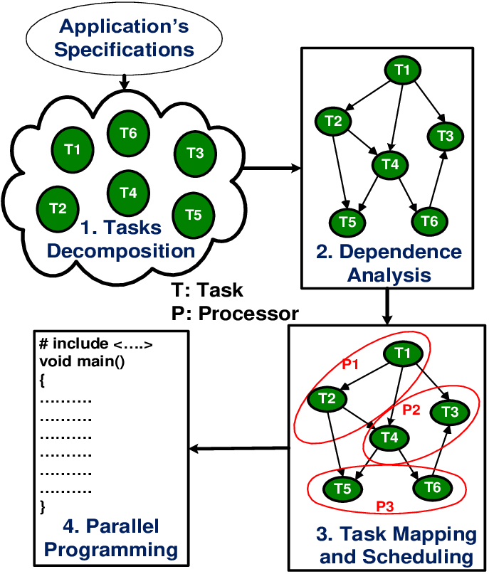
Task/function mapping
Specifies the system functions that each user will require for the different tasks that they perform.
By showing the relationship between the tasks and the corresponding functional requirements linked in matrix form, trade-offs can be made between different functions, or to add and remove functions depending on their value for supporting specific tasks.
It is also useful for multi-user systems to ensure that the tasks of each user type are supported.

Slide 26
Requirements categorization
User requirements
Usability requirements
It is important to establish and document the user requirements so that they lead into the process of designing the system itself.
User requirements will include summary descriptions of the tasks that the system will support and the functions that will be provided to support them.
Generally agreed usability goals to define are:
Effectiveness
Degree of success with which users achieve their task goals
Efficiency
time it takes to complete tasks and satisfaction
user comfort and acceptability

Slide 27
Organizational requirements
An understanding of organizational requirements will help to create systems that can support the management structure of the organization and communications within it, as well as group and collaborative working.
Defining and grouping the tasks in an appropriate way will help to create motivating and satisfying jobs, ideally allowing users autonomy, flexibility, provision of good feedback on their performance and the opportunity to develop their skills and careers.

Slide 28
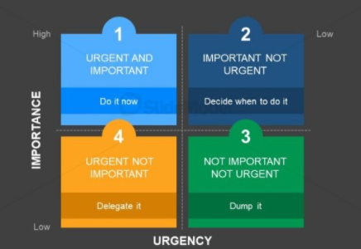
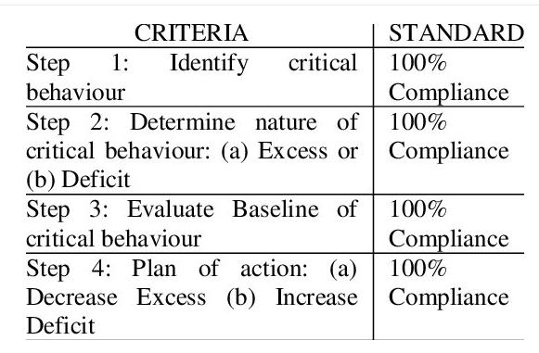
Prioritization
Criteria setting

Slide 29
User experience
User experience (UX) focuses on having a deep understanding of users, what they need, what they value, their abilities, and also their limitations.
It also takes into account the business goals and objectives of the group managing the project.
UX best practices promote improving the quality of the user’s interaction with and perceptions of your product and any related services.

Slide 30
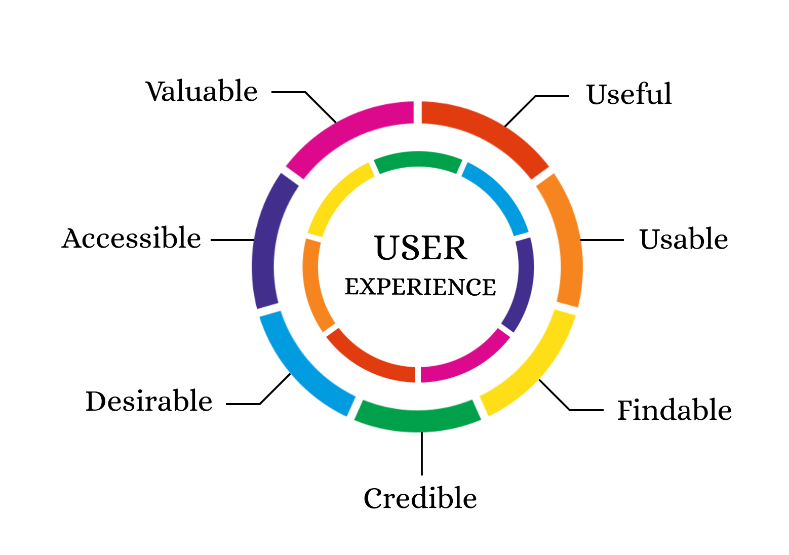
“Design is not just what it looks like and feels like. Design is how it works.”
— Steve Jobs.

Slide 31
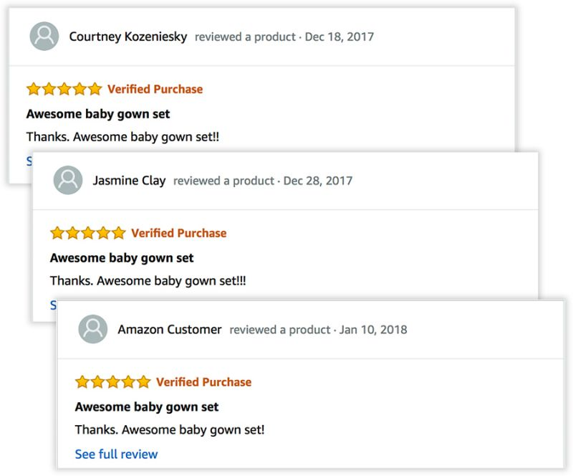
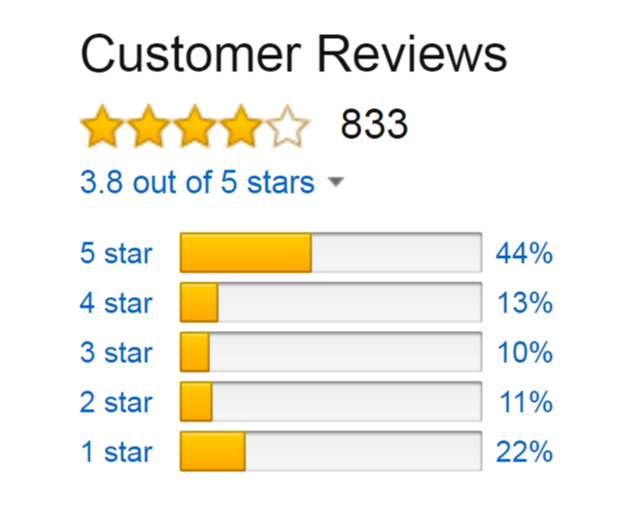
Good user experience adds to the beauty of the product while a cumbersome user experience does just the opposite of it.
USEFUL
One of the useful features would be Reviews, showing users appropriate information about products.

Slide 32
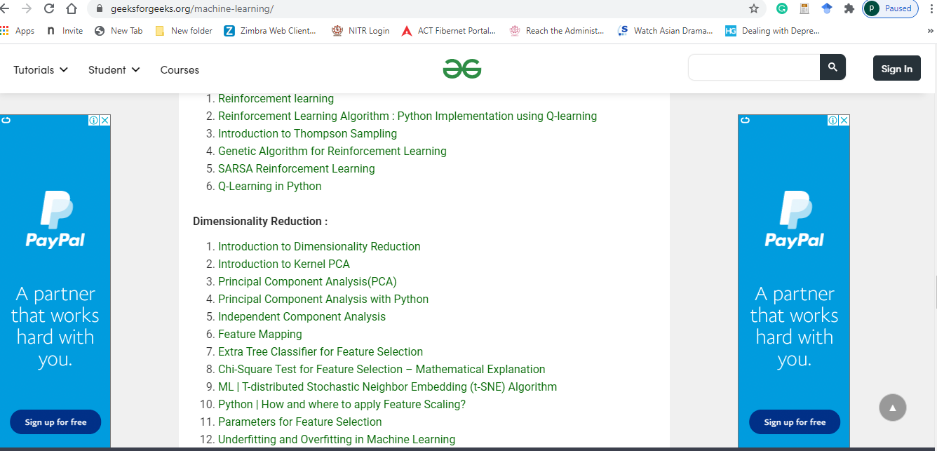
Bad examples : auto-playing videos and pop-up ads right after opening a website.

Slide 33
Usable
Credible
Designers must make sure that all the features and options added are easily usable. It’s never a good idea to give your users a half-baked design.
Credibility directly translates to how trust-worthy the information on your website or app is.
A credible website presents honest facts and information, refraining from anything incorrect.
An easy and quite obvious example could be user reviews on a website or platform. All reviews on your website should be credible and honest instead of fake ones to paint the real picture.
Findable
“If you find an element of your interface requires instructions, then you need to redesign it.” — Dan Rubin
A bad example of this would be splitting the user journey into various stages when it could’ve been achieved in one go.

Slide 34
Desirable
Desirable means that your website or app is used and appreciated by someone who found it extremely well made.
A good user experience leaves a positive impression of your website or app on its users.
Several factors contribute to the desirability of a website or an app. They are:
● Aesthetics
● Branding
● Identity
● Design
It is recommended to put efforts into creating a well-planned design to help expand its reach.
Customer satisfaction is key to being desirable as users are always on the lookout for good user experience.
“Want your users to fall in love with your designs? Fall in love with your users.” — Dana Chisnell

Slide 35
Accessible
Valuable
If a user is able to achieve his goal easily while working on your product, then you have designed something which is easy to use.
A design’s worth can be measured by the cost of the problems it solves. Nothing’s more effective than an inexpensive design solving an expensive design problem.
Information intended for everyone should be accessible by everyone.
It’s as simple as that. People with limited capabilities should never be left out while planning design.
Adopting an accessible user experience also shows that you care about everyone and elevates your brand reputation.
“Good design is the most important way to differentiate ourselves from our competitors.” — Yun Jong Yong

Slide 36
User testing
Usability testing refers to evaluating a product or service by testing it with representative users.
Typically, during a test, participants will try to complete typical tasks while observers watch, listen and takes notes.
The goal is to identify any usability problems, collect qualitative and quantitative data and determine the participant's satisfaction with the product.

Slide 37
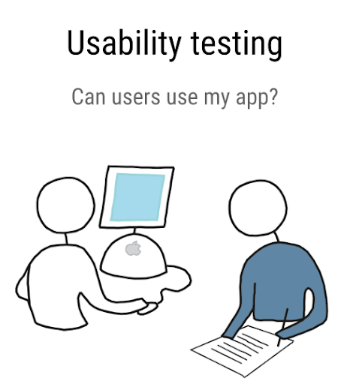
Benefits of Usability Testing
Usability testing lets the design and development teams identify problems before they are coded.
The earlier issues are identified and fixed
During a usability test, you will:
Learn if participants are able to complete specified tasks successfully
Identify how long it takes to complete specified tasks
Find out how satisfied participants are with your Web site or other product
Identify changes required to improve user performance and satisfaction
Analyze the performance to see if it meets your usability objectives

Slide 38
Customer Co-creation
Customer co-creation, in short, is open innovation with customers.
It is a product (or service) development approach where users and customers are actively involved and take part in the design of a new offering.
More specifically, we define customer co-creation as an active, creative, and social process, based on collaboration between producers (retailers) and customers (users).
The idea of co-creation is to actively involve customers in the design or development of future offerings, often with the help of tools that are provided by the firm.

Slide 39
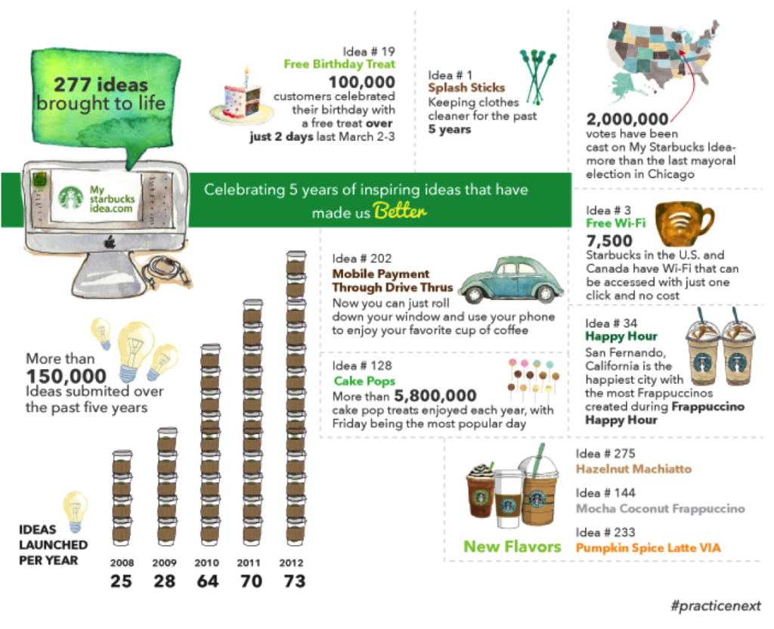
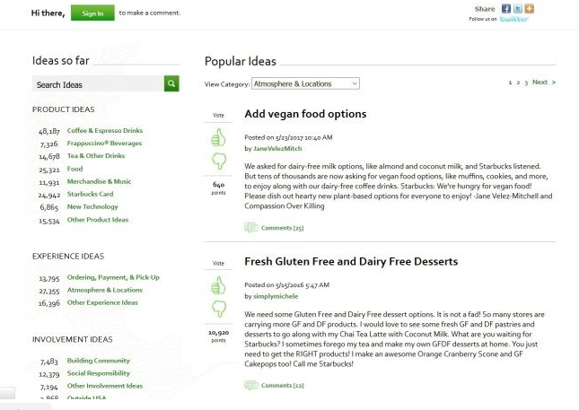
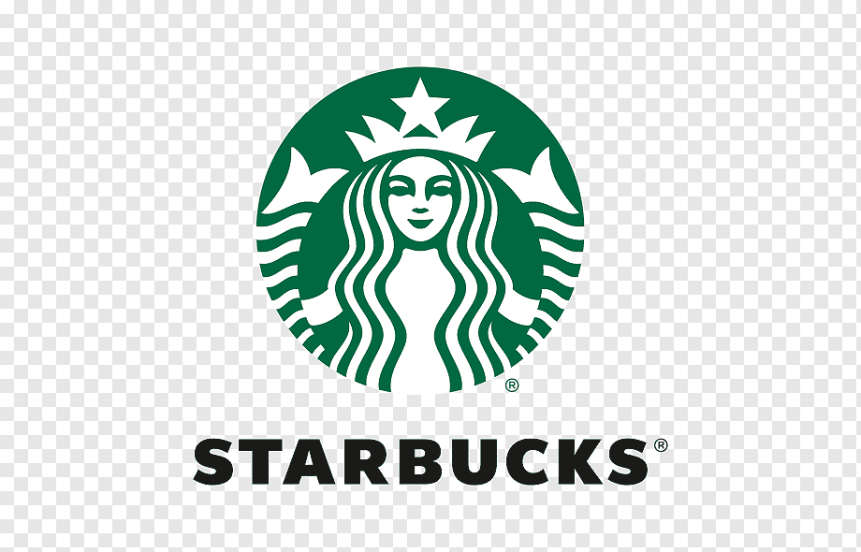
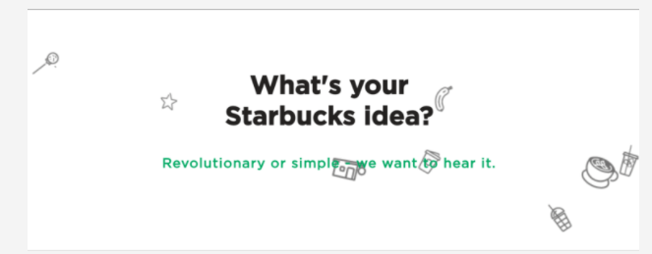
Example for customer co-creation

