Slide 1
Module 2 Design Thinking for Innovation
-Dr. Priyanjali Gogikar
Assistant Professor
SEE, VIT Bhopal
Email: priyanjali.gogikar@vitbhopal.ac.in

Slide 2
Design Thinking as Mindset, Process, and Toolbox
Design Thinking, defines it as “a discipline that uses the designer’s sensibility and methods to match people’s needs with what is technologically feasible and what a viable business strategy can convert into customer value and market opportunity” (proposed by Tim Brown, 2008)
Design Thinking as “a way of finding human needs and creating new solutions using the tools and mindsets of design practitioners.” (Kelly and Kelly, 2013)
Design Thinking starts with human needs and uses suitable technologies with the aim of creating entrepreneurial value through customer value. (Brenner et al., 2017)

Slide 3
Design Thinking is defined as:
mindset
process
toolbox
Design thinking as mindset?
Design thinking as process?
Design thinking as toolbox?

Slide 4
Design thinking as mindset?
What is mindset?
a set of assumptions, methods, or notations held by one or more people or groups of people.
As a mindset, Design Thinking is characterized by several key principles: a combination of divergent and convergent thinking, a strong orientation to both obvious and hidden needs of customers and users, and prototyping.

Slide 5
Design thinking as mindset principles
Innovation is made by humans for humans
Combining of divergent and convergent thinking
Fail often and early
Build prototypes that can be experienced
Test early with customers
Design never ends
Design Thinking needs a special place

Slide 6
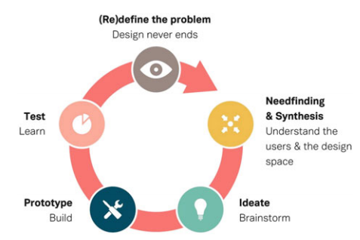
Design Thinking as Process
Micro
Macro
Design thinking

Slide 7
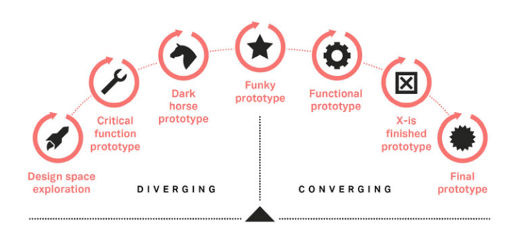
Macro Process

Slide 8
Design thinking as toolbox
As a toolbox, Design Thinking refers to the application of numerous methods and techniques from various disciplines: design, but also engineering, informatics, and psychology
47 methods and tools described by Schindlholzer

Slide 9
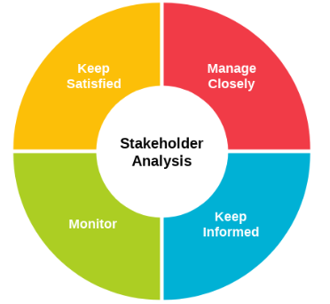
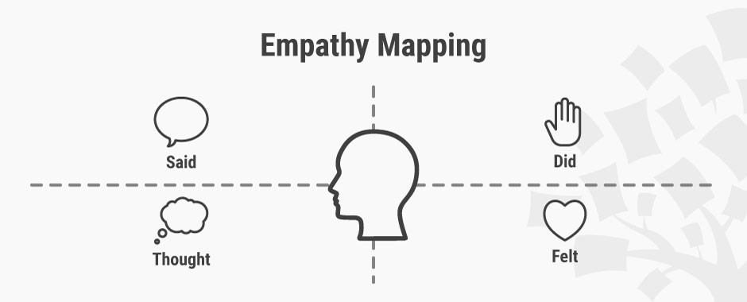
Tools and methods
Stakeholder Map
Empathy Map

Slide 10
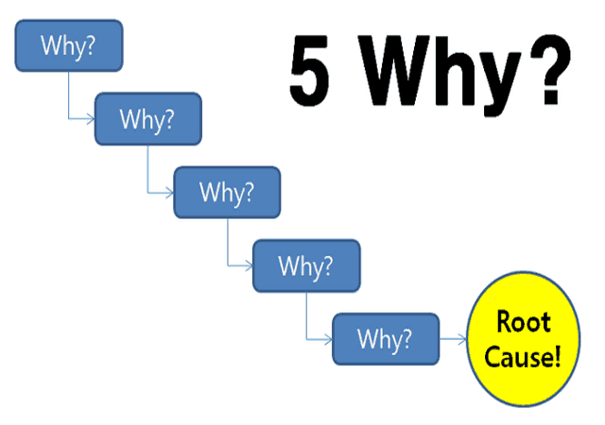
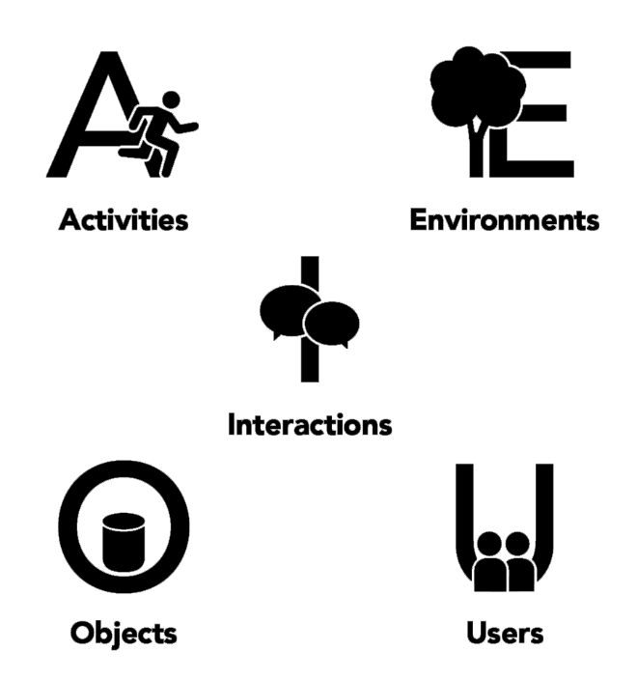
5-Whys
AEIOU-Method

Slide 11


Persona-Method
Observation

Slide 12
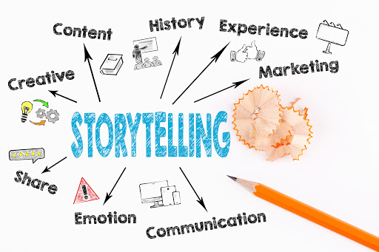
Story telling

Slide 13
Enhancing Design Thinking Through, Empathy, Interviewing, Questioning and Brainstorming

Slide 14
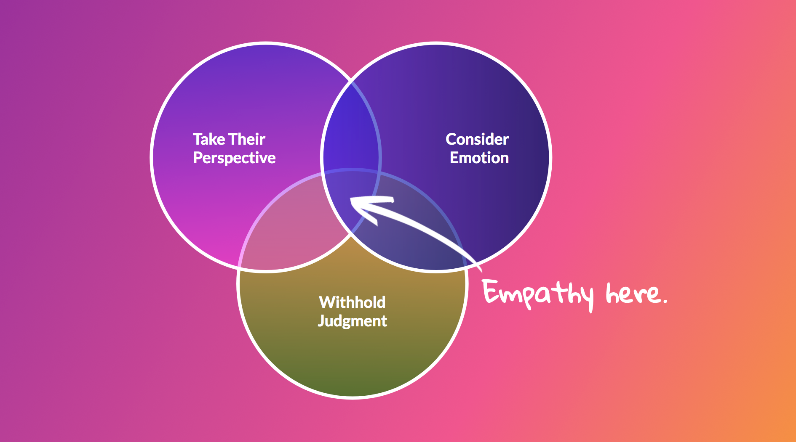
Empathy

Slide 15
Interviewing, Questioning
Set a goal for the interview
Make the user feel as comfortable as possible. Create a rapport with the user
Have a video call or phone call (or at least some interaction) with the user before the interview itself.
Explain the reason for the interview, and how the data from it will be used.
Make the user feel heard by taking notes, nodding, frequent eye contact, offering acknowledgments like “I see,” and repeating the words the user said.
Let users finish their thoughts. Do not interrupt them.
Don’t rush the user.
Start with questions that are easy to answer and that are unlikely to be interpreted as personal or judgmental.

Slide 16
Interviewing, Questioning
For example, instead of “What was the last book you read?” try “What do you like to do in your spare time?” The latter is open-ended, while the former assumes the user read a book recently; those who did not may feel stupid.
Show some empathy by asking related questions.

Slide 17
Brainstorming
Brainstorming is the most common method used by design teams for generating ideas.
This method was developed by Alex Osborn to stimulate creative magazine advertisements, but it has been widely adopted in other areas such as design.
The word brainstorming has come into general usage in the language to denote any kind of idea generation.
Brainstorming is a carefully orchestrated process. It makes use of the broad experience and knowledge of groups of individuals.
The brainstorming process is structured to overcome many of the mental blocks that curb individual creativity in 6 team members who are left to generate ideas on their own.
Active participation of different individuals in the idea generation process overcomes most perceptual, intellectual, and cultural mental blocks.

Slide 18
Six Key Questions
Who? Who uses it, wants it, will benefit by it?
What? What happens if X occurs? What resulted in success? What resulted in failure?
When? Can it be speeded up or slowed down? Is sooner better than later?
Where? Where will X occur? Where else is possible?
Why? Why is this done? Why is that particular rule, action, solution, problem, failure involved?
How? How could it be done, should it be done, prevented, improved, changed, made?

Slide 19

Checklists
Fantasy or Wishful Thinking
Wouldn’t be nice if . . . . ?
What I really want to do is . . . .
If I did not have to consider cost, . . .
I wish . . .

Slide 20




Slide 21
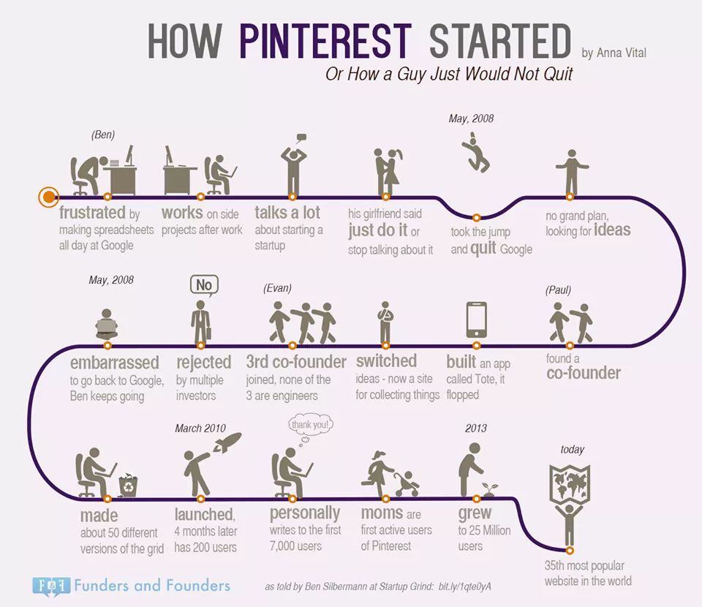

Slide 22
Tools of design thinking

Slide 23
Innovation flowchart
The Innovation Flowchart gives a detailed overview of the various stages in an innovation process, listing the activities, requirements and goals of each stage.
These include an overview of the different people, skills, activities and finances that a project or an organisation might need in order to succeed.
This tool helps to review where you are in the process, and to organise the next steps in your work.
This tool helps you to spot opportunities for growth by helping understand which resources to focus on.
You can see this by checking where you are in the process and whether you have thought of all the aspects that need consideration.

Slide 24
Stages | Specialist skills required | Example activities and tools | Risk level and handling | Finance required | Kinds of evidence generated | Goal
Exploring opportunities and challenges
Generating ideas
Developing and testing
Making the case
Delivering and implementing
Growing scaling and spreading
Changing systems

Slide 25
Question ladder
How do you know the right question to ask? Sometimes reaching the right answer means thinking more about the kind of questions you’re asking.
It might sound simple, but focusing on what you’re asking someone is essential for reaching a deeper understanding.
The Question Ladder is an interview technique that helps you to hone in on a certain topic by asking a series of questions about different aspects related to that topic.
This tool is a quick and easy way to start asking your questions in a few different ways, and to start combining questions in order to reach more complex answers.
It provides a structured overview of what goes in to a question; it shows how to combine a range of who, what, where, when, why and how questions coupled with the words like is, did, can, will, would and might.
This makes it much easier to think about the best way to get to the heart of the issue at hand, and to build chains of questions that will allow you to gradually reach the heart of more complex issues.

Slide 26
Simple questions
Complex questions
 | Is | DID | Can | will | Would | might
Who | Who is | Who did | Who can | Who will | Who would | Who might
What | What is | What did | What can | What will | What would | What might
Where | Where is | Where did | Where can | Where will | Where would | Where might
When | When is | When did | When can | When will | When would | When might
Why | Why is | Why did | Why can | Why will | Why would | Why might
How | How is | How did | How can | How will | How would | How might

Slide 27
SCAMPER
The SCAMPER brainstorming technique uses a set of directed questions to resolve a problem (or meet an opportunity).
It can also turn a tired idea into something new and different.
A problem is a situation, condition, or issue that remains unresolved and makes it difficult to accomplish a desired objective.
A problem is perceived when an individual, group, or organization becomes aware of a significant difference between what is desired and what actually is.

Slide 28
Trying to find a solution to a problem is known as problem solving.
Problem solving is the process by which a situation is analyzed, a workable solution is determined, and corrective action is taken. The common milestones of problem solving are to:
Define (or clarify) the problem.
Analyze causes.
Generate ideas (identify alternatives).
Weigh up ideas (assess alternatives).
Make a decision (select an alternative).
Determine next steps to implement the solution.
Evaluate whether the problem was solved or not.

Slide 29
Substitute
Components, materials, people
Combine
Mix, combine or integrate
Adapt
Alter, change function, use part of another element
Magnify/Modify
Increase/reduction in scale, change shape, modify attributes
Put to other uses
SCAMPER
Eliminate
Remove, simplify, reduce
Rearrange/
Reverse
turn inside out or upside down

Slide 30
Substitute | Think about substituting part of the product or process for something else. Typical questions: What else instead? Who else instead? What other materials, ingredients, processes, power, sounds, approaches, or forces might I substitute? Which other place?
Combine | Think about combining two or more parts of the product or process to make something new or to enhance synergy. Typical questions: What mix, assortment, alloy, or ensemble might I blend? What ideas, purposes, units, or appeals might I combine?
Adapt | Think about which parts of the product or process could be adapted or how you might change the nature of the product or process. Typical questions: Does the past offer a parallel? What else is like this? What other idea does this suggest? What might I adapt for use as a solution? What might I copy? Who might I emulate?
Magnify, Modify | Think about changing part or all of the product or process, or distorting it in an unusual way. Typical questions: What other meaning, color, motion, sound, smell, form, or shape might I adopt? What might I add?
Put to Other Use | Think of how you might put the product or process to another use or how you might reuse something from somewhere else. Typical questions: What new ways are there to use this? Might this be used in other places? Which other people might I reach? To what other uses might this be put if it is modified?
Eliminate | Think of what might happen if you eliminated parts of the product or process and consider what you might do in that situation. Typical questions: What might I understate? What might I eliminate? What might I streamline? What might I make smaller, lower, shorter, or lighter?

Slide 31
Rearrange, Reverse | Think of what you might do if parts of the product or process worked in reverse or were sequenced differently. Typical questions: What might be rearranged? What other pattern, layout, or sequence might I adopt? Can components be interchanged? Should I change pace or schedule? Can positives and negatives be swapped? Could roles be reversed?
https://medium.theuxblog.com/how-to-generate-ideas-using-scamper-technique-d2e50de6402c

