Slide 1
Java’s String

Slide 2
1)Using String Function in a single Statement, convert the following such that the first letter is in upper case and rest all in lowercase.
String s=“iNfoRmAtion”;

Slide 3
Ans;
S=s.subString(0,1).toUpperCase().concat(s.subString(1).toLowerCase();

Slide 4
2)What is the output of the following java code
String s=“Misdfsiasadghdfgf”;
S.O.P(s.lastIndexOf(”df”);

Slide 5
3)What is the output of the following
String s1=“java”;
String s2=“java”;
String s3=new String(s1);
S.O.P(s1.equals(s2);
S.O.P(s1.equals(s3);
S.O.P(s1==s2);
S.O.P(s1==s3);

Slide 6
4.What is the output of the following java code
System.out.println(“Page No.”+45+2);
System.out.println(34+5+“Page No.”+45+2);

Slide 7
5.If char x=‘m’; write a java program to check whether x is having char cater or not

Slide 8
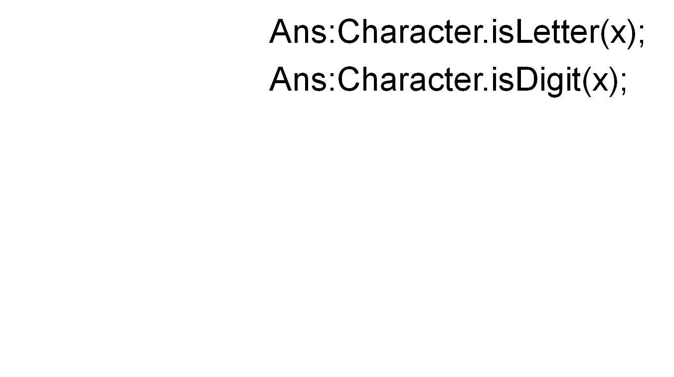

Slide 9
6. How do you check whether int converted as string or not
Int x=25;
System.out.println(Interger.toString(x)+5);

Slide 10
7. IF String s=“20”;Write a statement to convert to a primitive double type

Slide 11
Write a java program to input character using scanner class

Slide 12
Java program to count no of words and print only initials of the name
String s=“Hello Welcome To Cbe”;

Slide 13
S=s+” ”;
Int count=0;
For(int i=;i<s.length();i++
{
If(s.charAt(i)==‘ ‘)
{
Count++
}
}

Slide 14
Print the initials of the word
String str=“Hello welcome to dubai”;
String str1=“ ”+str;
For(int i=;i<str.length;i++)
{
If(str1.charAt(i)==‘ ‘)
{
str1=(str1.charAt(i+1);
}
S.O.P(str1);
}

Slide 15
Reversing String
String s1=“Hello”;
String s2=“”;
For(int i=0;i<s1.length();i++)
{
S2=s1.charAt(i)+s2;
}
i=0; s2=H+””; s2=H;
i=1; s2=e+H s2=eH
i=2; s2=l+eH s2=leh;
i=3; s2=l+leH s2=lleH;
i=4; s2=o+lleH s2=olleH;

Slide 16
String s=“Hello”;
For(int i=s.length()-1;i>=0;i—)
{
}

Slide 17
Replace all vowels with ‘Z’ of the given String
public class replacewithz {
public static void main(String ss[])
{
String s="hello welcome";
System.out.println(s.replaceAll("[aeoiu]", "z"));
}
}

Slide 18
Method-2
public class replacewithz {
public static void main(String ss[])
{
String s="hello welcome";
String f="";
for(int i=0;i<s.length();i++)
{
if(s.charAt(i)=='a'|| s.charAt(i)=='e'|| s.charAt(i)=='i'|| s.charAt(i)=='o'|| s.charAt(i)=='u')
{
f=f+s.replace(s.charAt(i),'z');
}
}
System.out.println("final"+f);
}
}

Slide 19
Java program to remove the duplications of the given string
String d="welcome to java class welcome to tutorials";

Slide 20
public class removeduplicates {
public static void main(String dd[])
{
String d="welcome to java class welcome to tutorials";
String[] s=d.split(" ");
for(int i=0;i<s.length;i++)
{
if(s[i]!=null)
{
for(int j=i+1;j<s.length;j++)
{
if(s[i].equals(s[j]))
{
s[j]=null;
} } } }
for(int k=0;k<s.length;k++)
{
if(s[k]!=null)
{
System.out.println(s[k]);
}
} } }

Slide 21
write a java program to extract unique character from the given String
Input;
String s=”Programming”

Slide 22
public class countchar {
public static void main(String ss[])
{
String s="programming";
// int flag=0;
for(int i=0;i<s.length();i++)
{
int flag=0;
for(int j=0;j<i;j++)
{
// System.out.println("i value\t"+i+"j value\t"+j);
if(s.charAt(i)==s.charAt(j))
{
flag=1;
break;
} }
if(flag==0)
{
System.out.println(s.charAt(i));
}
} } }

Slide 23
Extract Digits and char from the given String
Input String d="sfdgd777jj";
Output1=sfdgdjj;
Output2=777;

Slide 24
public class seperatedigit {
public static void main(String aa[])
{
String d="sfdgd777jj";
String sd="";
String nd="";
char[] c=d.toCharArray();
for(int i=0;i<c.length;i++)
{
if(Character.isLetter(c[i]))
{
sd=sd+Character.toString(c[i]);
}
else
nd=nd+Character.toString(c[i]);
}
System.out.println(sd);
System.out.println(nd);
}
}

Slide 25
public class count {
public static void main(String aa[])
{
String f="334kj5454";
String fg="";
for(int i=0;i<f.length();i++)
{
if(f.charAt(i)<48 || 57>(f.charAt(i)))
{
fg=fg+f.charAt(i);
}
}
System.out.println(fg);
}
}

Slide 26
Print the sequence as given
If m=3 ,n=4 then
3, 4, 33,34,43,333,334,343,344……
If m=0, n=1 then
0,1,10,11,100,101,110,111,1000,1001….

Slide 27
Sort max and minimum in odd and even positions as listed below
1,3,2,6,5,7,4
Then 1,2,3,4,5,6,7
Final out put is 7,1,6,2,5,3,4

Slide 28
Write a java program to sum of all numeric’s from the given String
Input1: hello234welcometo876

Slide 29
public class numersum {
public static void main(String d[])
{
String s="hello234welcometo876";
int sum=0;
for(int i=0;i<s.length();i++)
{
if(Character.isDigit(s.charAt(i)))
{
int ss=Character.getNumericValue(s.charAt(i));
sum=sum+ss;
}
}
System.out.println(sum);
}
}

Slide 30
Find the common and uncommon characters of two strings
Input1 : str1 = "characters"
Input2 :str2 = "alphabets"
Output : b c l p r
Output:a,s,t,e,h

Slide 31
public class uncommonchar {
public static void main(String aa[])
{
String str="charcaters";
String str2 = "alphabets";
String s="";
Set<String> se=new HashSet<String>();
for(int i=0;i<str.length();i++)
{
for(int j=0;j<str2.length();j++)
{
if(str.charAt(i)==str2.charAt(j))
{
se.add(str.charAt(i)+"");
} } }
System.out.println(se);
}
}

Slide 32
Write a java program to find the similar and dissimilar character in the given two strings and make the uppercase for similar and lower case for similar char
Input1=”coimbatore”;
Input2=”chennai”;
Output1:CoImbAtorE
Output2:ChEnnAI

Slide 33
Print the output as Given below
String input1 = "PROJECT BASED LEARNING";
Output must be
Result:POETRJC BSDAE LANNERIG

Slide 34
Count the number of vowels in the given string
public static void main(String[] args) {
String s="I am in a position to answer";
char r;
int count=0;
for(int i=0;i<s.length();i++){
r=s.charAt(i); if(r=='a'||r=='e'||r=='i'||r=='o'||r=='u'||r=='A'||r=='E'||r=='I'||r=='O'||r=='U')
count++;
}
System.out.println("No. of vowels is "+count);
} }

Slide 35
Print as given
If A1b2 then
Abb
If k3m0y2 then
Kkkyy

Slide 36
Some more examples –
Input string = “I Am alWays 24#7 Busy.”
With case-option = 0, reversed string will be “I mA syaWla 7#42 .ysuB”
With case-option = 1, reversed string will be “I Ma syAwla 7#42 .ysuB”
With case-option = 2, reversed string will be “i Ma SYAwLA 7#42 .YSUb”

Slide 37
Simple Encoded Array: Maya has stored few confidential numbers in an array (array of int). To ensure that others do not find the numbers easily, she has applied a simple encoding.
Encoding used: Each array element has been substituted with a value that is the sum of its original value and its succeeding element’s value.
i.e. arr[i] = arr[i] + arr[i+1]
e.g. value in arr[0] = original value of arr[0] + original value of arr[1]
Also note that value of last element i.e. arr[last index] remains unchanged.
Example:
If the original array is –
{2, 5, 1, 7, 9, 3}
The encoded array would be –
{7, 6, 8, 16, 12, 3}

Slide 38
Addition using Strings
Write a function that takes two numbers in string format and forms a string containing sum(addition)of these two numbers
Example
1)if input strings as "1234" and "56" output should be "1290"
2)if input strings are "56" and "1234" output should be "1290"
if input strings are "123456732128989543219" and "987612673489652"
Output should be
"123457719741663032871"

Slide 39
Write a program to initialize an integer array with values and check if a given number is present in the array or not. If the number is not found, it will print -1 else it will print the index value of the given number in the array
Ex1) Array elements are {1,4,34,56,7} and the search element is 90
O/P: -1
Ex2)Array elements are {1,4,34,56,7} and the search element is 56
O/P: 4

Slide 40
Return second word in UPPER CASE
String input1=”hello world”;
Output=”hello WORLD”;

Slide 41
public class primerange {
public static void main(String aa[])
{
String s="hello world";
String[] t=s.split(" ");
int flag=0;
String h="";
for(int i=0;i<t.length;i++)
{
if(i==1)
h=h+t[i].toUpperCase();
else
h=h+t[i];
}
System.out.println(h);
}
}

Slide 42
Write a java program to find most frequent digit in the given number
int most_frq(int input1,int input2,int input3,int input4)
int input1=123;
int input2=234;
int input3=345;
int input4=678;
3 occurs four times.

Slide 43
public class findarray {
public static void main(String[] args) {
int ad[]={12,34,56,78,99};
int flag=0; int search=8;int i;
for(i=0;i<ad.length;i++)
{
if(ad[i]==search)
{
flag=1;
break;
}
else
{
flag=0;
}
}
if(flag==1)
{
System.out.println("Index is"+(i+1));
System.out.println("Index is"+ad[i]);
}
else
{
System.out.println("Element not found");
} } }

Slide 44
Write a program to initialize an integer array and find the maximum and minimum value of an array
int max1=as[0];
for(int i=1;i<as.length;i++)
{
if(as[i]>max1)
{
max1=as[i];
} }
int min=as[0];
for(int j=1;j<as.length;j++)
{
if(as[j]<min)
min=as[j];
}

Slide 45
Initialize an integer array with ascii values and print the corresponding character values in a single row
int a[]={65,66,67,68,69};
for(int i=0;i<a.length;i++)
{
System.out.println((char)a[i]);
}
int b=a.length;
char[] c=new char[b];
for(int i=0;i<c.length;i++)
{
c[i]=(char)(a[i]);
}

Slide 46
Write a program which accepts string as input the entered string must be alpha numeric. The program must search for the numbers present in the entered string and display squares of those numbers as result
If input string is: Abc23xyz45
Output must be
4, 9, 16, 25

Slide 47
String d="Abc23xyz45";
char[] c=d.toCharArray();
for(int i=0;i<d.length();i++)
{
if(Character.isDigit(c[i]))
{
int s=Character.getNumericValue(c[i]);
System.out.println(s*s);
}
}

Slide 48
Write a java program to find weight of the String
String s=”abcde”;
Output must be:15

Slide 49
String s=”abcde”;
public class stringweight {
public static void main(String aa[])
{
String s="abcde";
int sum=0;
int j=1;
char c='a';
for(int i=0;i<s.length();i++)
{
for(c='a',j=1;c<='z'&&j<=26;c++,j++)
{
if(s.charAt(i)==c)
{
System.out.println(c+""+i);
sum=sum+j;
}
}
}
System.out.println(sum);
}
}

Slide 50
FACTORIAL NUMBER USING FOR LOOP
IF N=5;
int f=1;
for(int i=1;i<=5;i++
f=f*i;
S.O.P(f);

Slide 51
Sum of factorial
1!+2!+3!+4!+5!=
Int f=1;
Int sum=0;
For(int i=1;i<=5;i++)
{
F=f*I;
Sum=sum+f;
}

Slide 52
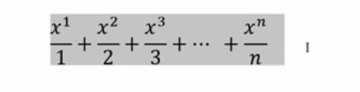
Pubic Int series(int x,int n)
{
Int sum=0;
For(int i=1;i<=n;i++)
{
Double y=Math.power(x,i)/I;
Sum=sum+y;
}
}

Slide 53
Sum of the digits until single digit
If the given no=9978564321
Output must be:8

