Slide 1
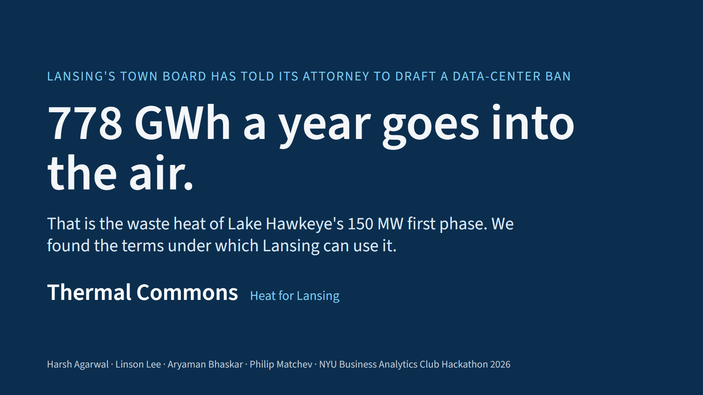
Notes:
SPEAKER: Harsh. 0:00-0:20. Lansing's Town Board just told its attorney to draft a ban on this data center. Meanwhile 778 gigawatt-hours of heat a year goes into the air. We are Thermal Commons: Harsh Agarwal, Linson Lee, Aryaman Bhaskar, Philip Matchev. We found the conditions under which Lansing should say yes.

Slide 2
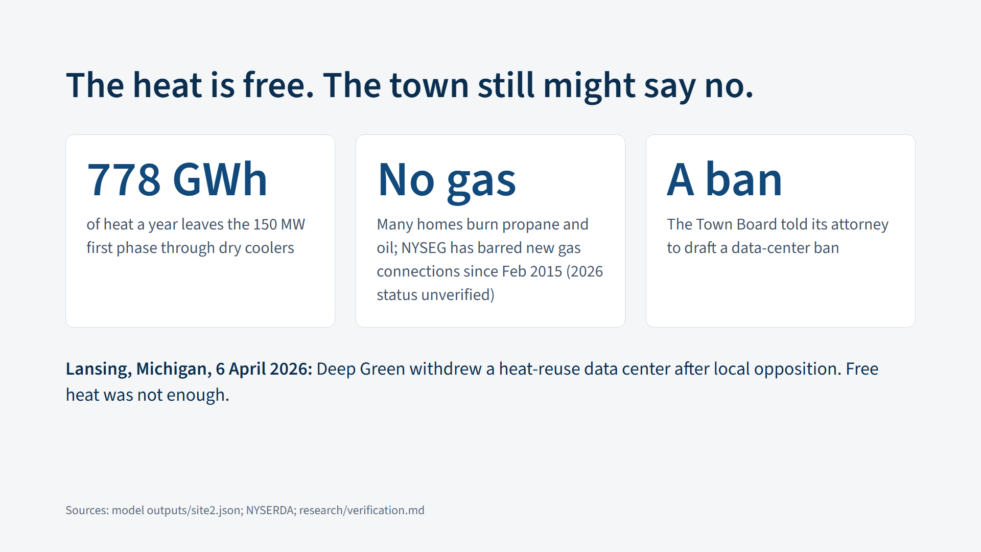
Notes:
SPEAKER: Harsh. 0:20-0:55. Lake Hawkeye is a proposed data center on the old Cayuga coal plant. NYSEG has barred new gas connections here since 2015, so many homes burn propane or oil. Free heat has not been enough before: Deep Green offered it to Lansing, Michigan, and withdrew in April. A promise will not carry this vote. The offer has to be binding.

Slide 3

Notes:
SPEAKER: Harsh. 0:55-1:25. Don't ban it. Set the terms. Three conditions, written into the approval. A Community Benefit Agreement and a Heat Supply Agreement, with step-in rights if the data center leaves. A co-op that owns the pipes, so the town controls the heat. And public proof: an open dashboard every month. Cooling never depends on us, and we claim no lake water saved.

Slide 4
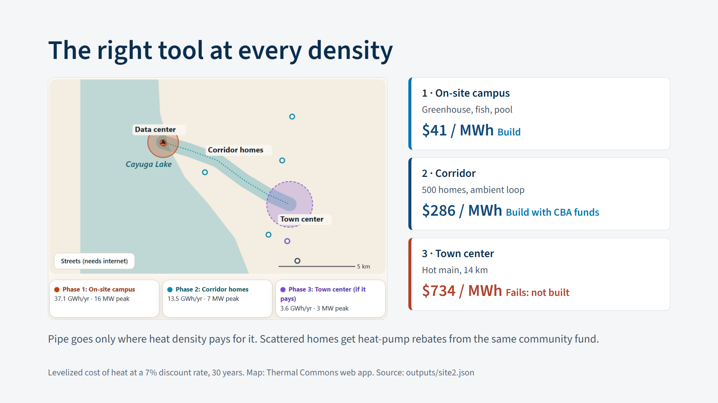
Notes:
SPEAKER: Linson. 1:25-2:05. Density picks the tool. Ring one, on site: a greenhouse, a fish farm and a pool, 41 dollars a megawatt-hour. Ring two, down the road: 500 homes with building heat pumps, 286 dollars. Ring three, the town center, 14 kilometers out: 734 dollars. It fails our own test, so we do not build it.

Slide 5
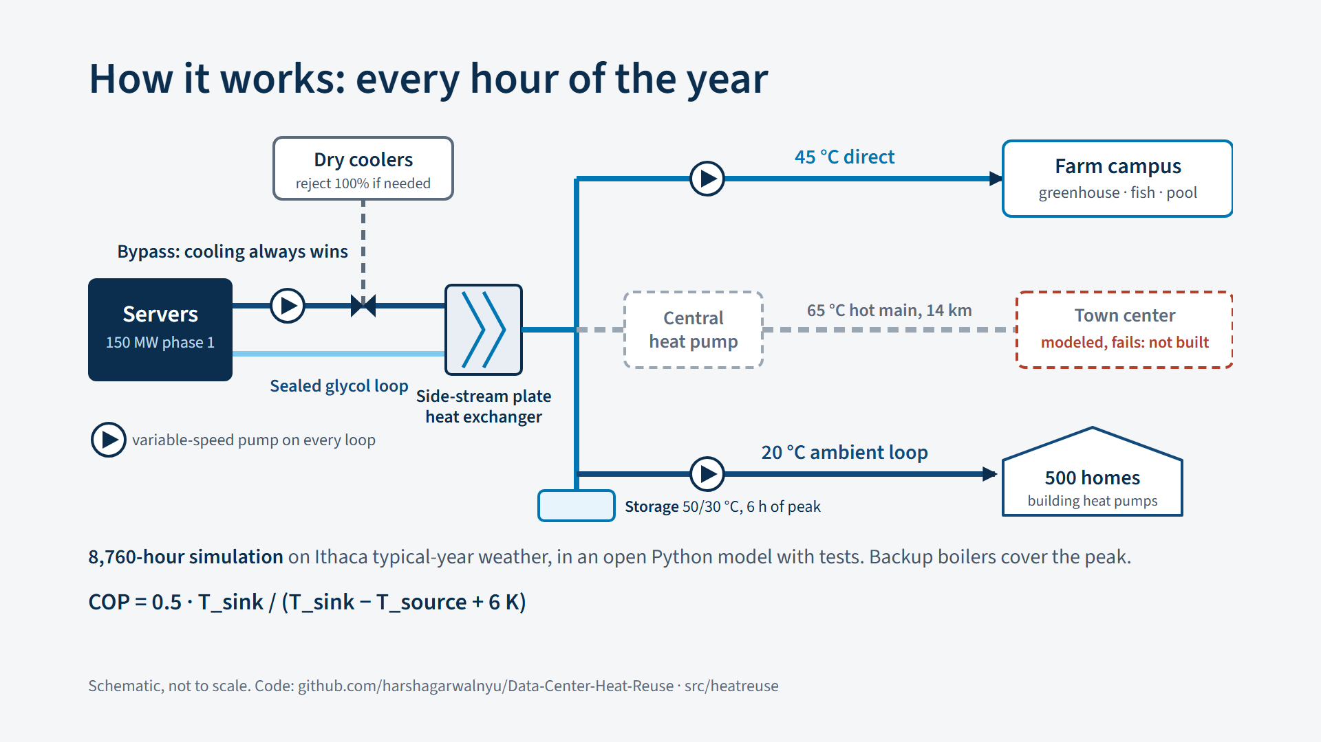
Notes:
SPEAKER: Linson. 2:05-2:40. How it works. A side-stream plate exchanger sits on their sealed glycol loop. If cooling ever needs it, a bypass sends everything to the dry coolers: cooling always wins. Forty-five degree heat goes straight to the farm campus. A central heat pump lifts heat to a 65 degree loop with storage. A 20 degree ambient loop reaches 500 homes, each with its own heat pump. Variable-speed pumps move every loop. We run every one of the 8,760 hours of an Ithaca year.

Slide 6
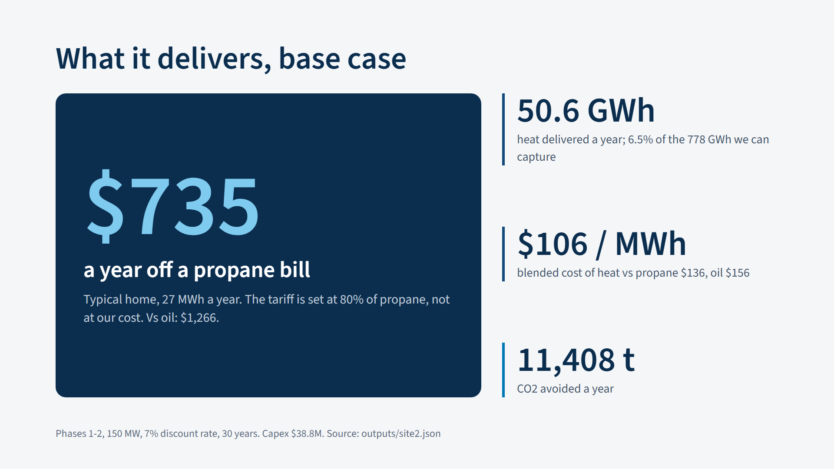
Notes:
SPEAKER: Aryaman. 2:40-3:15. Here is the number that matters. A typical propane home saves 735 dollars a year, because the tariff is 80 percent of propane. The system delivers 50.6 gigawatt-hours at a blended 106 dollars a megawatt-hour, and avoids 11,408 tonnes of carbon dioxide a year. That is 6.5 percent of the heat we can capture. The scarce thing is a signed customer.

Slide 7
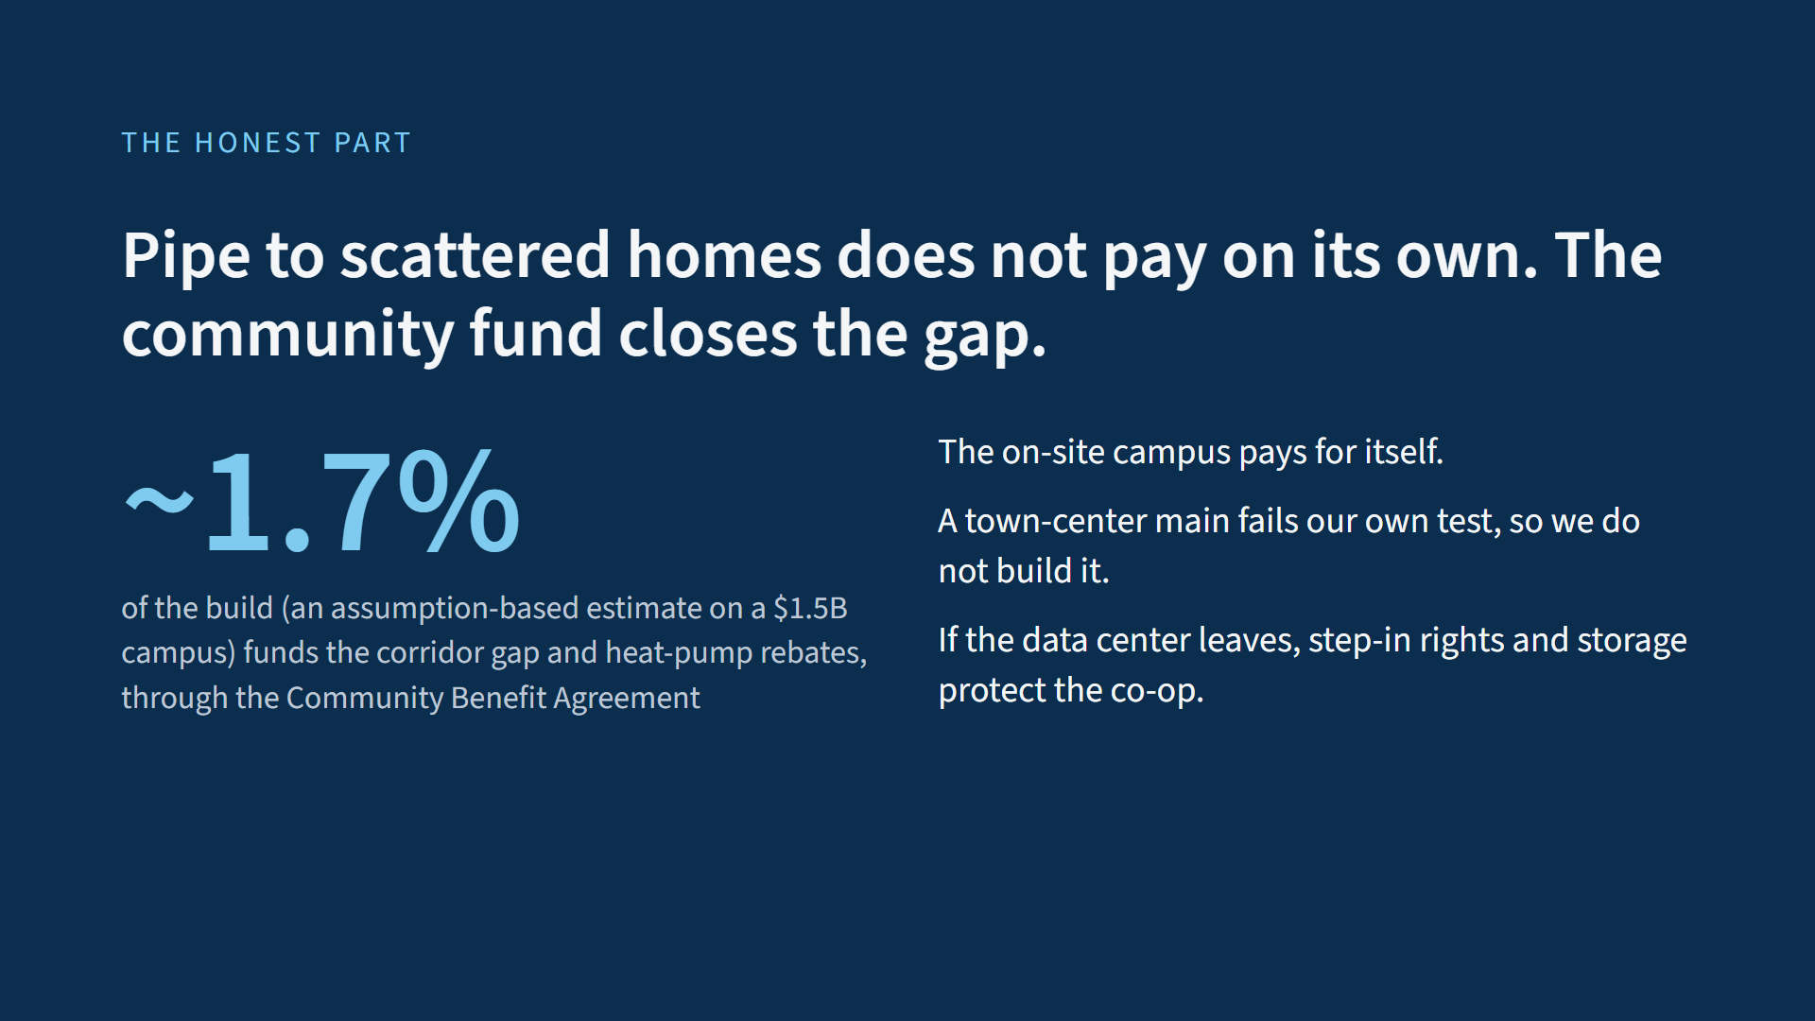
Notes:
SPEAKER: Aryaman. 3:15-3:50. The honest part. Selling below propane leaves a 26-million-dollar gap. The Community Benefit Agreement covers it with about 1.7 percent of the build. That is an estimate on an assumed 1.5-billion-dollar campus, not a disclosed budget. Federal tax credits are not in the base case. No signature, no trench.

Slide 8
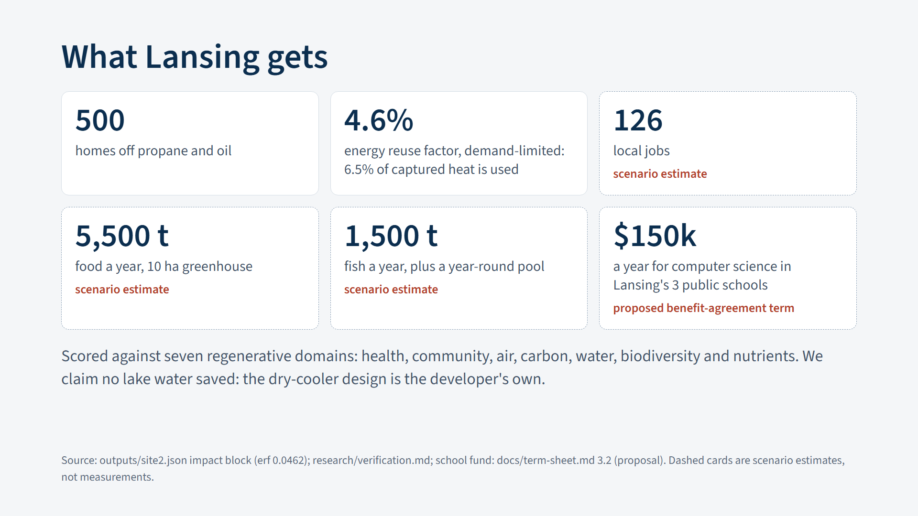
Notes:
SPEAKER: Philip. 3:50-4:25. What Lansing gets: 500 homes off propane and oil, a farm and a pool, and an energy reuse factor of 4.6 percent, limited by demand, not supply. Jobs and food are scenario estimates. We claim no lake water saved. And one more term we propose in the benefit agreement: 150 thousand dollars a year for computer science in Lansing's three public schools, on top of the heat money. Warm homes now, and the next generation of thinkers after them.

Slide 9
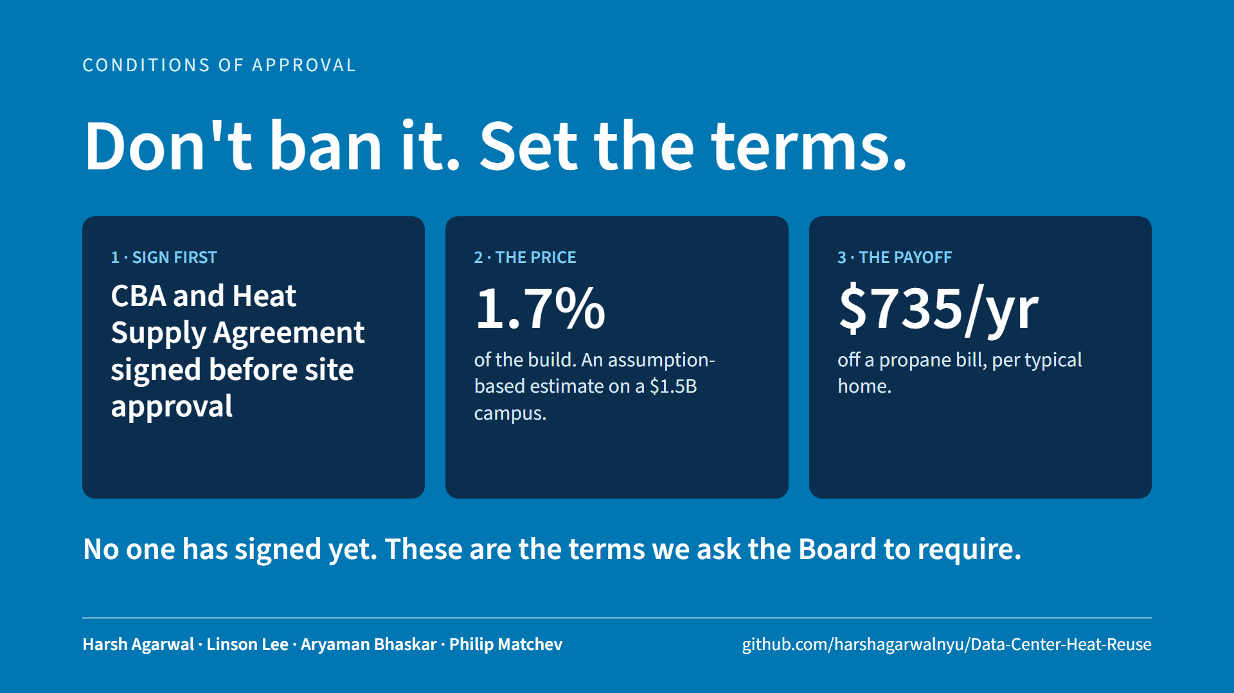
Notes:
SPEAKER: Philip (then Harsh runs the live demo). 4:25-5:00. Our ask, in three beats. One: sign the Community Benefit Agreement and the Heat Supply Agreement before site approval. No one has signed yet. Two: about 1.7 percent of the build, an estimate. Three: a 735-dollar cut to a propane bill. Don't ban it. Set the terms. Harsh, the model.

