Slide 1
Fast tag fraud detection

Slide 2
PROBLEM STATEMENT
This internship project focuses on leveraging machine learning classification techniques to develop an effective fraud detection system for Fast tag transactions. The dataset comprises key features such as transaction details, vehicle information, geographical location, and transaction amounts. The goal is to create a robust model that can accurately identify instances of fraudulent activity, ensuring the integrity and security of Fast tag transactions.

Slide 3
DATASET DESCRIPTION
Transaction ID: Unique identifier for each transaction.
Timestamp: Date and time of the transaction.
Vehicle Type: Type of vehicle involved in the transaction.
Fastag ID: Unique identifier for Fast tag.
TollBooth ID: Identifier for the toll booth.
Lane Type: Type of lane used for the transaction.
Vehicle Dimensions: Dimensions of the vehicle.
Transaction Amount: Amount associated with the transaction.
Amount paid: Amount paid for the transaction.
Geographical Location: Location details of the transaction.
Vehicle Speed: Speed of the vehicle during the transaction.
Vehicle Plate Number: License plate number of the vehicle.
Fraud indicator: Binary indicator of fraudulent activity (target variable).

Slide 4
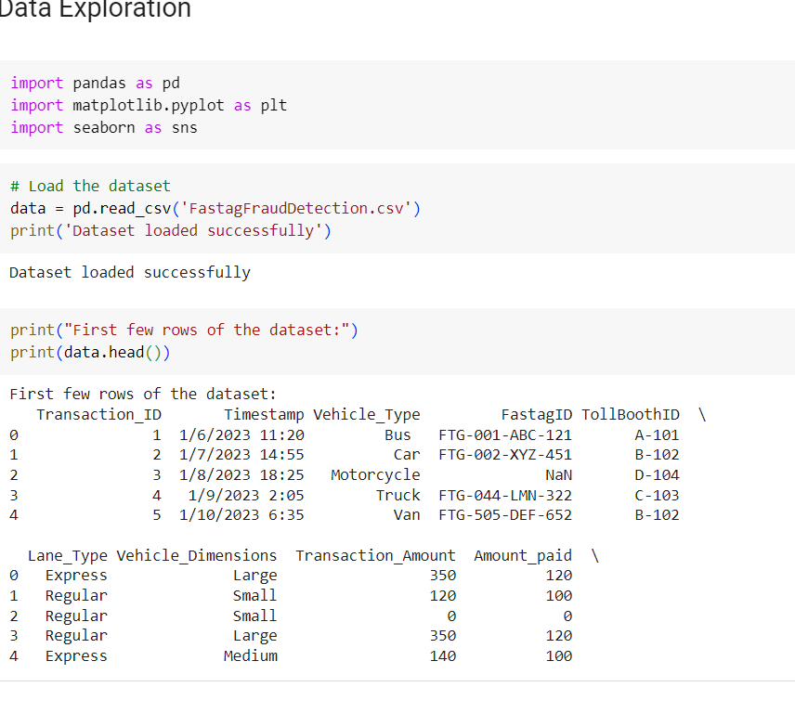
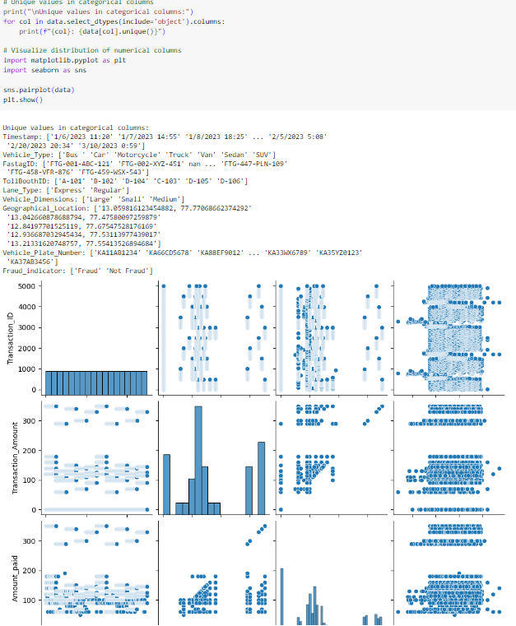
DATA EXPLORATION
Data exploration refers to the initial step in data analysis in which data analysts use data visualization and statistical techniques to describe dataset characterizations, such as size, quantity, and accuracy, in order to better understand the nature of the data.

Slide 5
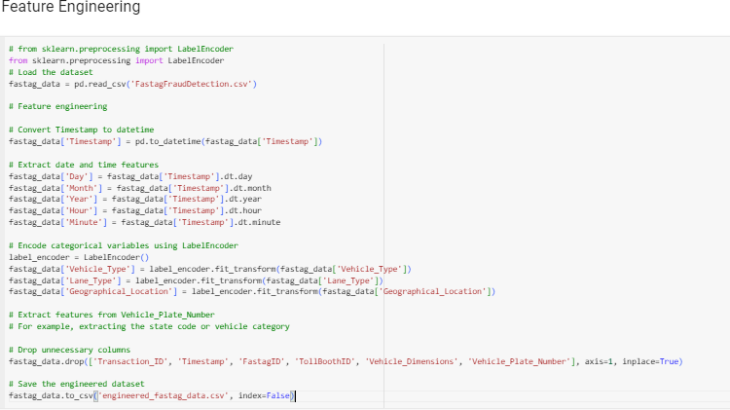
FEATURE ENGINEERING
Feature engineering is the process of selecting, manipulating and transforming raw data into features that can be used in supervised learning. It consists of five processes: feature creation, transformations, feature extraction, exploratory data analysis and benchmarking.

Slide 6
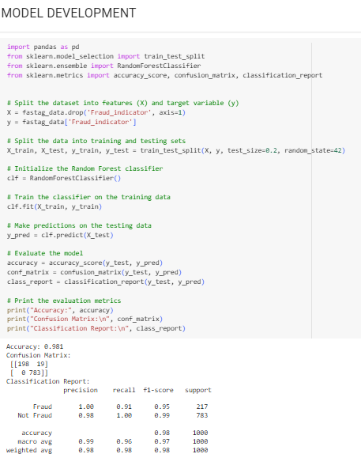
MODEL DEVELOPMENT
Model development is an iterative process, in which many models are derived, tested and built upon until a model fitting the desired criteria is built.

Slide 7
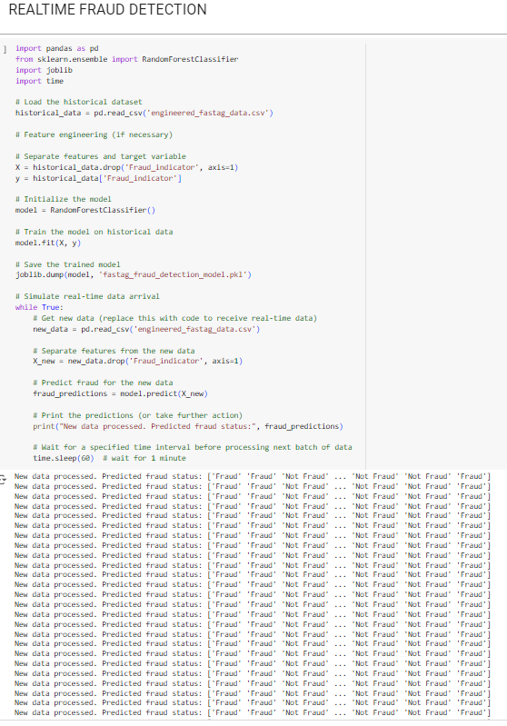
REAL TIME FRAUD DETECTION
Machine learning-based fraud detection systems rely on ML algorithms that can be trained with historical data on past fraudulent or legitimate activities to autonomously identify the characteristic patterns of these events and recognize them once they recur.

Slide 8
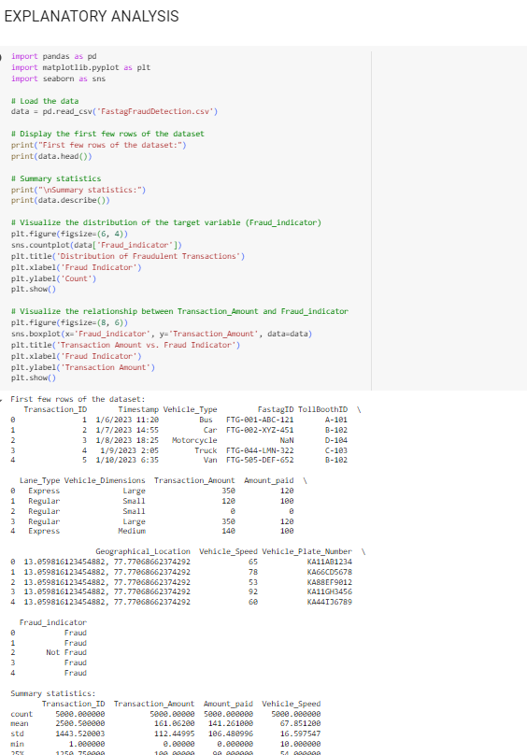
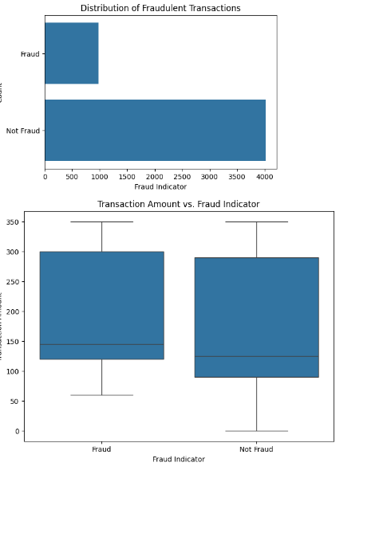
EXPLANATORY ANALYSIS
Explanatory analysis main outputs are insights, which, when used to guide decision-making and actions, create wisdom.

Slide 9
THANK YOU

