Slide 1
SALARY PREDICTIONS OF DATA PROFESSIONS

Slide 2
CONTENTS
EXPLORATORY DATA ANALYSIS(EDA)
FEATURE ENGINEERING
DATA PREPROCESSING
MACHINE LEARNING MODEL DEVELOPMENT
ML PIPELINES AND DEPLOYMENT

Slide 3
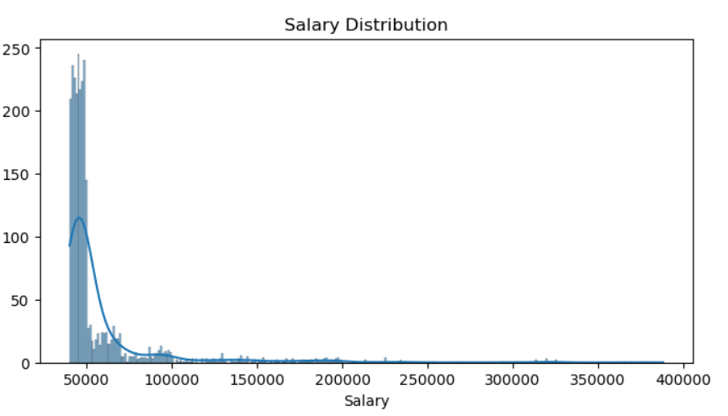
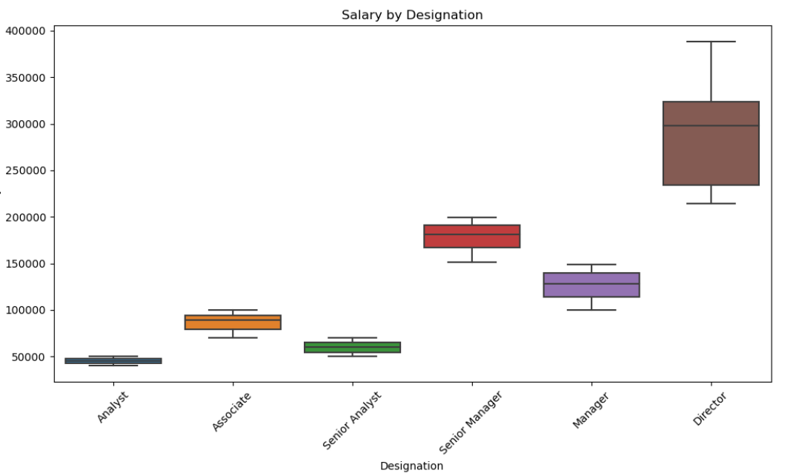
EXPLORATORY DATA ANALYSIS(EDA)
Exploratory Data Analysis (EDA) is a crucial initial step in data science projects. It involves analyzing and visualizing data to understand its key characteristics, uncover patterns, and identify relationships between variables refers to the method of studying and exploring record sets to apprehend their predominant traits, discover patterns, locate outliers, and identify relationships between variables. EDA is normally carried out as a preliminary step before undertaking extra formal statistical analyses or modeling.

Slide 4
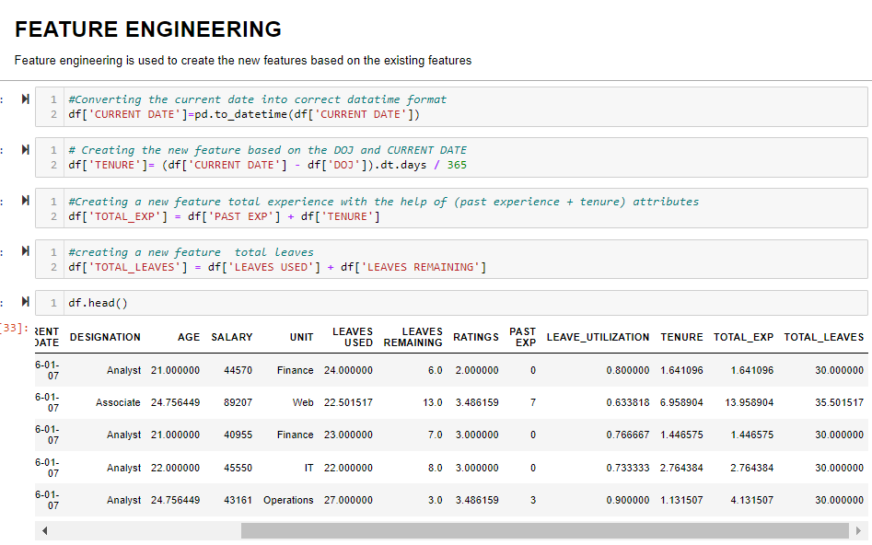
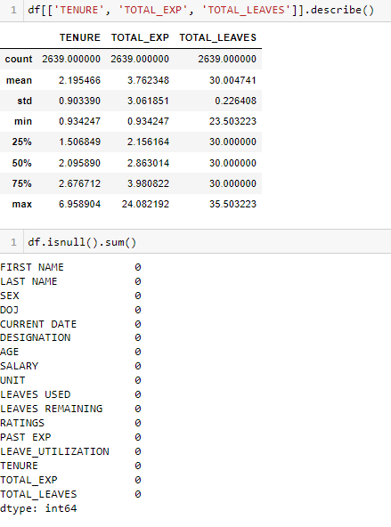
FEATURE ENGINEERING
Feature engineering is the process of selecting, manipulating and transforming raw data into features that can be used in supervised learning. It’s also necessary to design and train new machine learning features so it can tackle new tasks. A “feature” is any measurable input that can be used in a predictive model

Slide 5
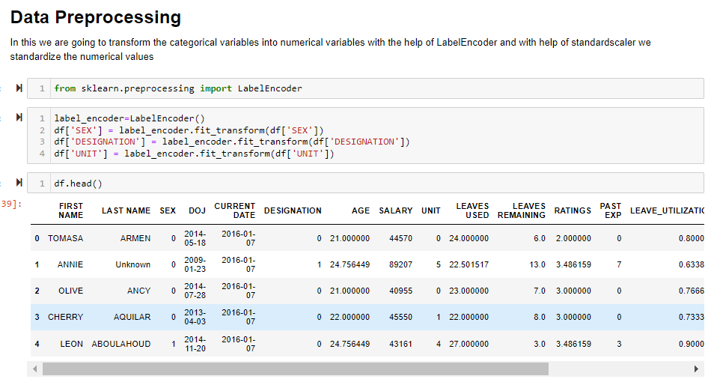
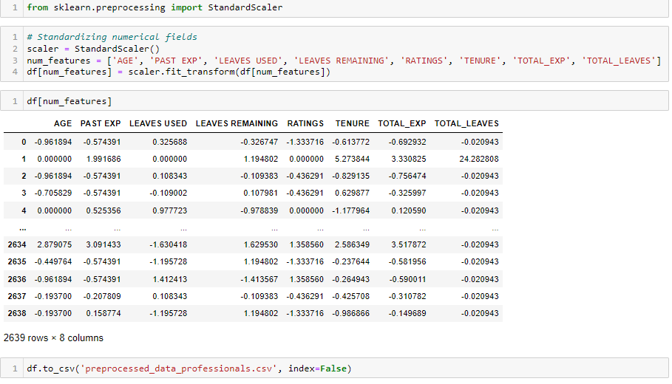
DATA PRE PROCESSING
Data preprocessing is a basic and primary step for converting raw data into useful information. In general raw data could be incomplete, redundant, or noisy

Slide 6
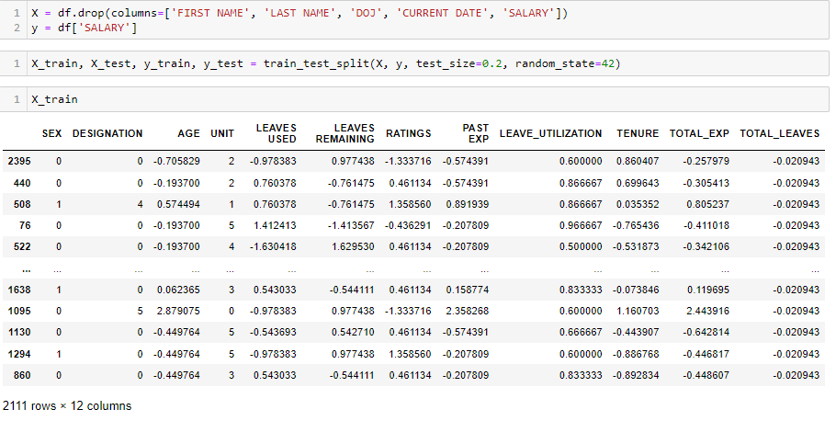
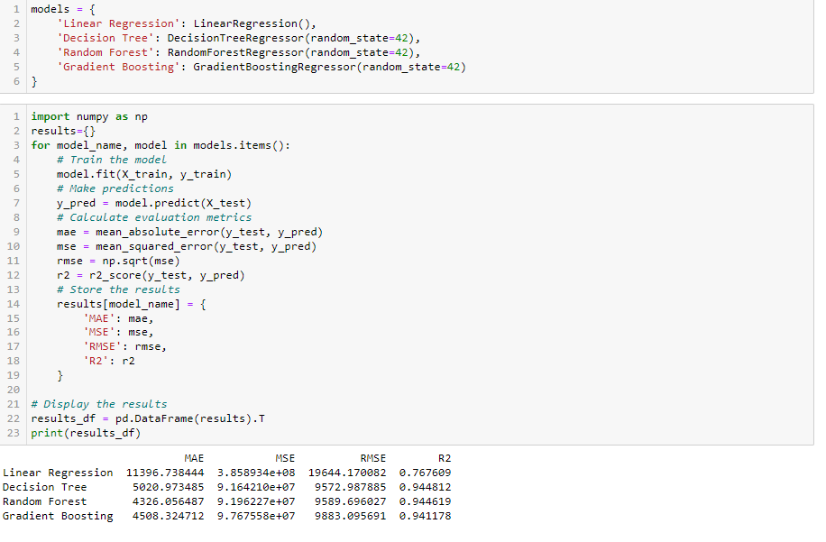
MACHINE LEARNING MODEL DEVELOPMENT
Machine learning operates on the principle of learning from data to make predictions or decisions. To build a machine learning model, the first step is to gather and prepare the data. The data is then divided into training and test sets. The training set is used to train the model, while the test set is used to evaluate its performance Machine learning algorithms are then applied to the training data.

Slide 7
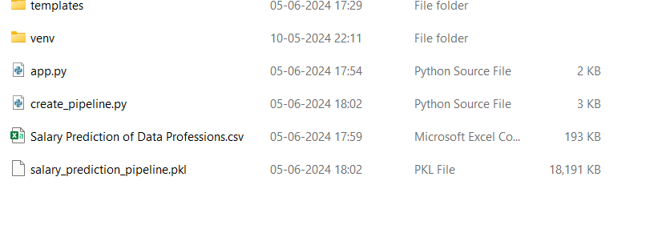
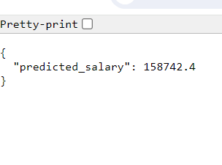
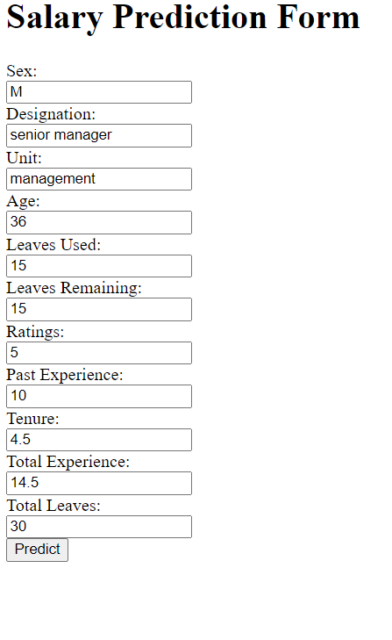
ML PIPELINES AND DEPLOYMENT
ML pipeline is a means of automating the machine learning workflow by enabling data to be transformed and correlated into a model that can then be analyzed to achieve outputs. This type of ML pipeline makes the process of inputting data into the ML model fully automated.
Model deployment in machine learning is the process of integrating your model into an existing production environment where it can take in an input and return an output. The goal is to make the predictions from your trained machine learning model available to others.

Slide 8
THANK YOU

