Slide 1
Lending Club Loan Data
kaggle.com/datasets/wordsforthewise/lending-club

Slide 2
Contents of This Template
Here’s what you’ll find in this Slidesgo template:
A slide structure based on a presentation for a meeting, which you can easily adapt to your needs. For more info on how to edit the template, please visit Slidesgo School or read our FAQs.
An assortment of illustrations and photos that are suitable for use in the presentation can be found in the alternative resources slide.
A thanks slide, which you must keep so that proper credits for our design are given.
A resources slide, where you’ll find links to all the elements used in the template.
Instructions for use.
Final slides with:
The fonts and colors used in the template.
A selection of illustrations. You can also customize and animate them as you wish with the online editor. Visit Storyset to find more.
More infographic resources, whose size and color can be edited.
Sets of customizable icons: general, business, avatar, creative process, education, help & support, medical, nature, performing arts, SEO & marketing, and teamwork.
You can delete this slide when you’re done editing the presentation.

Slide 3
Agenda
01
02
03
04
Introduction
Preprocessing
Dataset and feature description
Problem being tackled and statistical analysis
Data Analysis
Solution
Exploratory data analysis and statistical analysis
Results and inferences derived from machine learning

Slide 4
01
Introduction
Lending Club Loan Data

Slide 5
OBJECTIVE
Interested in exploring the ability to predict a borrower’s likelihood to pay back a loan based on available information at the origination of a loan.

Slide 6
Abstract
The task is to predict if a person borrowing money in the form of a loan, is more likely to pay the loan or forfeit the loan deadline.
The prediction will be based on information that is available to the lender at the time of allotting the loan amount at the origin.
All this information is used to predict if the loan will be paid off, or will there be dues remaining, hence making it a binary classification task.

Slide 7
Dataset Description
The lending club dataset is acquired from Kaggle, which consists of 2.2M records released in 2018. It consists of 150 columns of raw data including valuable customer and lender information as well as general information like loan_id, member_id etc.
Loan features such as monthly payment, interest rate, income, term of the loan, installments as well as borrower information features such as job title, home ownership, verification, annual income etc. are available
The target column is the loan_status divided into Fully Paid, Current, Charged Off, Grace Period, Late and Default.

Slide 8

Related work
LendingClub Wikipedia states that it is a financial services company headquartered in San Francisco, California. At its height, LendingClub was the world's largest peer to peer lending platform reporting that \$15.98 billion in loans had been originated through its platform up to December 31, 2015.

Slide 9
02
Preprocessing
Lending Club Loan Data

Slide 10
Preprocessing Summary
1
2
3
4
NaN Values
Dropping
Dimension Reduction
Sampling
Dealing with categorical and numerical NaNs
Dropping/merging unnecessary columns
Modifying features using under and oversampling
Techniques like LDA and PCA

Slide 11
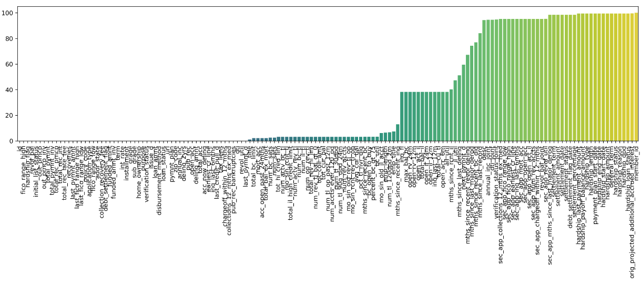
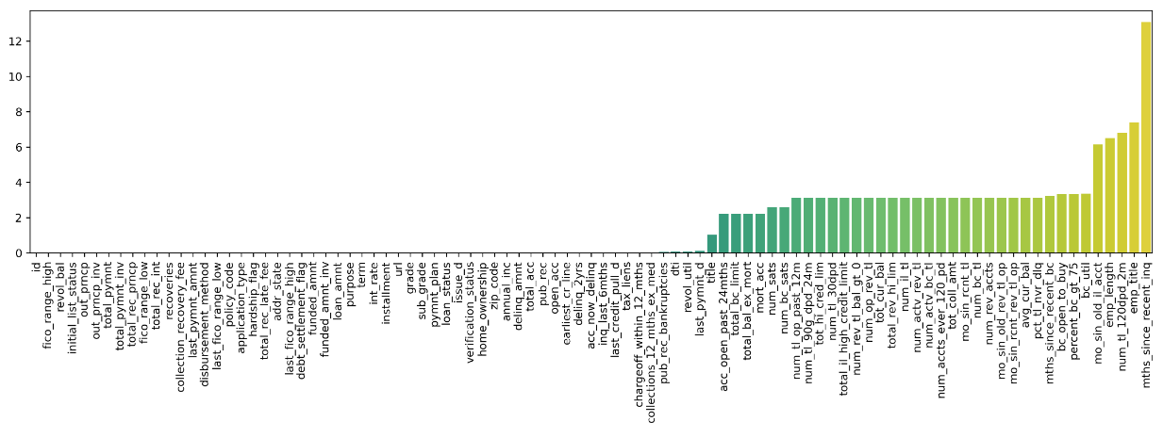
NaN values
Trying to plot the NaN value count against feature list:
Initially, multiple columns have very high NaN values
Remove columns having over 20% NaN values.
Dropping irrelevant columns like “id” and “url”
Numerical values replaced by mean

Slide 12
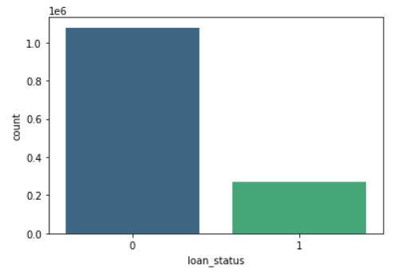
Target Values
Target values categories are combines and replaced by 0 and 1 for binary classification

Slide 13
03
Data Analysis
Lending Club Loan Data

Slide 14
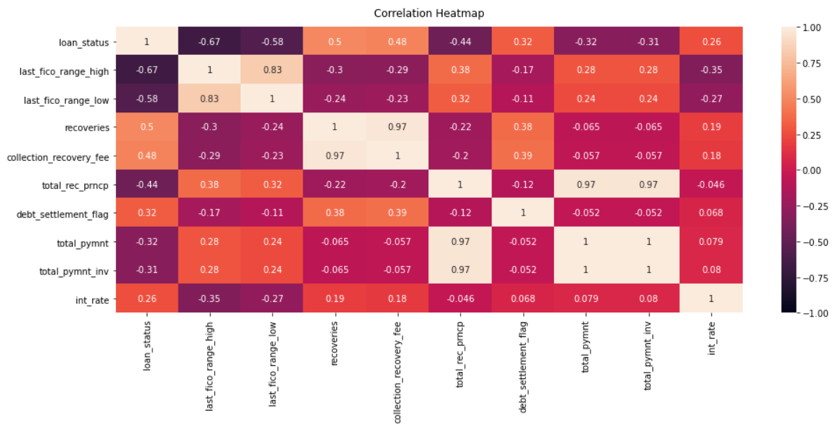
Correlation Matrix
0.67
0.58
0.26
0.31
High correlation -last_fico_range_high
High correlation -last_fico_range_low
Low correlation – int_rate
Low correlation – total_pymnt_inv

Slide 15
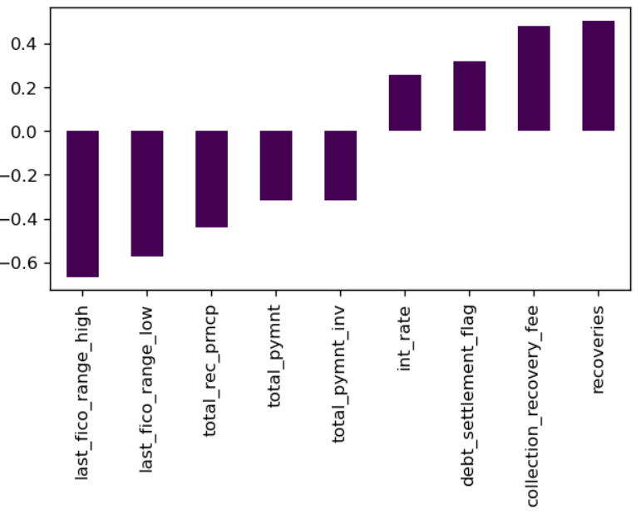
Correlation Conclusion
Fico values have a very negatively high correlation
Most values have a “0” or extremely low correlation with loan status
Some values like recoveries and collection recovery fee have a considerable positive correlation

Slide 16
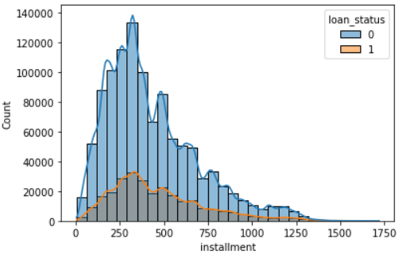
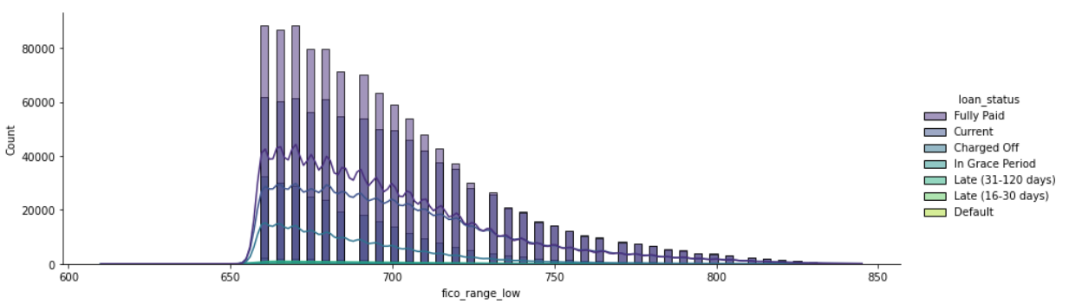
Exploratory Data Analysis
Installments
FICO RANGE HIGH
FICO RANGE LOW
Installments column seems to be normally distributed
FICO range is the most important column in the provided dataset
No normal distribution but a decreasing trend is observed

Slide 17
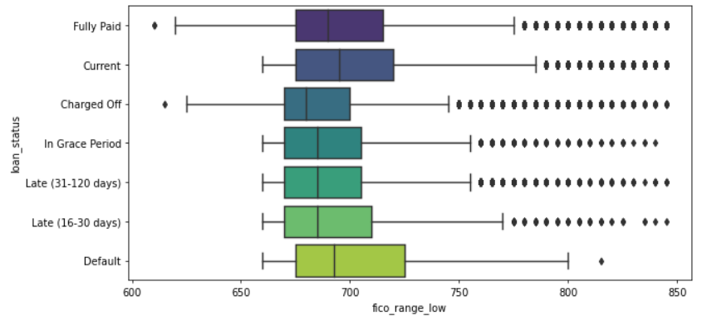
Outliers
A large number of outliers are observed, especially in fico range, implying the total range of the values around the mean is too high

Slide 18
04
Solution
Lending Club Loan Data

Slide 19
Machine Learning Models
Logistic Regression
PCA and LR
Linear Discriminant
Over / Under Sampling
Basic logistic regression provides a good model
Adding Principal component analysis boosts the efficiency of LR
Linear Discriminant Analysis improves the model accuracy to ~99%
Due to disproportionate target values, sampling is used

Slide 20
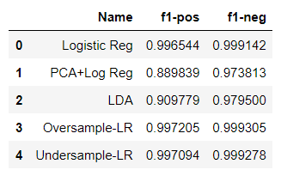
Machine Learning Results
01.
02.
Logistic Regression results in very high accuracy
PCA Does not improve the model, but results in less efficiency
03.
04.
LDA tanks the positive f1 value but does not affec the negative f1 value as much
Sampled Logistic Regression results in the best performing model

Slide 21
Statistical Analysis – Sample Z Test
Null Hypothesis: There is no significant difference between the mean loan amount of paid and charged off loans.
Alternate Hypothesis: There is a significant difference between the mean loan amount of paid and charged off loans.
NOTE - We can also use t-test but it is used to compare the mean of two given samples like the Z-test. However, It is implemented when the sample size is less than 30. It assumes a normal distribution of the sample. It can also be one-sample or two-sample.
Loan Status - '0' - Fully Paid
Loan Status - '1' - Charged Off

Slide 22
Meeting Objectives
Loan Amount
Interest Rate
Installment
z = -75.212
P = 0.0
Z = -296.074
P = 0.0
Z = -59.518
P = 0.0
We reject null hypothesis and accept Alternate Hypothesis

