Slide 1
Introduction to Programming Concepts & Overview of C
Unit-I

Slide 2
Syllabus
Chapter -1 : Introduction to Programming Concepts
Software
Classification of Software
Modular Programming
Structured Programming
Algorithms & Flowcharts with Eg.
Chapter -2 : Overview of C
History of C
Character set
C tokens : Identifiers,Keywords,Datatypes,Variables,Constants,Symbolic Constants,Operators in C
Heirarchy of operators
Expressions
Type conversions
Library Functions

Slide 3
About C
C is a general-purpose, structured, high-level language that was originally developed by Dennis M. Ritchie to develop the UNIX operating system at Bell Labs.
It is reliable,simple & easy to use

Slide 4
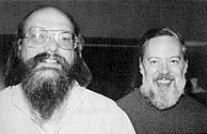
History of C
C is a programming language which born at “AT & T’s Bell Laboratory” of USA in 1972.
C was written by Dennis Ritchie, thats why he is also called as father of c programming language.
C language was created for a specific purpose i.e designing the UNIX operating system (which is currently base of many UNIX based OS).
Its use quickly spread beyond Bell Labs in the late 70’s because of its long list of strong features

Slide 5
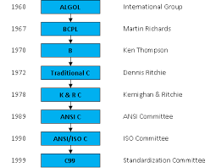
History of C

Slide 6
Why it is called C?
Many of C’s principles and ideas were derived from the earlier language B. (Ken Thompson was the developer of B Language.)
BCPL and CPL are the earlier ancestors of B Language
CPL is common Programming Language.In 1967, BCPL Language ( Basic CPL ) was created as a scaled down version of CPL
As many of the features were derived from “B” Language thats why it was named as “C”.

Slide 7
C- Features
Structured Programming
Procedure Oriented
Robustness
Platform Independent & portable
Easy to debug

Slide 8
Why to use C?
C was initially used for system development work, in particular the programs that make-up the operating system.
C was adopted as a system development language because it produces code that runs nearly as fast as code written in assembly language.
Some examples of the use of C might be:
Operating Systems
Language Compilers
Assemblers
Text Editors
Print Spoolers
Network Drivers
Modern Programs
Databases
Language Interpreters
Utilities

Slide 9
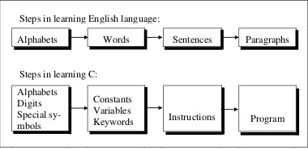
Starting C
Analogy of learning English Language with learning Programming language C

Slide 10
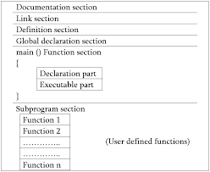
Basic Structure of C Program

Slide 11
Basic Program in C
Output :
Hello World
#include <stdio.h> int main() { /* Our first simple C basic program */ printf(“Hello World! “); getch(); return 0; }

Slide 12
Basic Program explained
1 | #include <stdio.h>
2 | int main() | main function from where execution of any C program begins.
3 | { | Beginning of the main function.
4 | /*_some_comments_*/ | Comment section ; not considered for compilation or execution
5 | printf(“Hello_World! “); | Output printing function
6 | getch(); | Command that waits for any character input from keyboard.
7 | return 0; | Command that terminates C program (main function) and returns 0.
8 | } | End of the main function.

Slide 13
Basic program explained
Link Section
#include <stdio.h> ; Preprocessor directive which are processed before a source program is compiled. They start with # and end without semicolon. Eg; stdio.h -standard Input output function ,math.h- for Mathematical functions
Definition Section : defines all the symbolic constants (generally written in uppercase) for use in the program
#define MONTHS 02 ; Once defined all the MONTHS variables at all places.

Slide 14
Basic Program explained
Global Declarations : variables to be used in more than one function .
int a =10 //
Main Function :
All the statements in the declaration and executions part must be written within { and }
All the statements should end with a semicolon
Sub-program :
User defined functions defined to be called in the main function

Slide 15
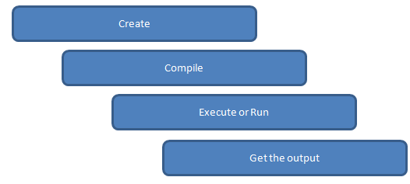
Executing a ‘C’ Program
Steps to be followed :
Creation of Program
Compilation & Linking of Program
Executing (Running ) Program

Slide 16
Executing a Program
Creation of Program : Programs written in C Editor and save with .c extension
Compilation & Linking a Program : Source program should be compiled using C compiler. If any syntax errors occurs ,the compiler checks it & converts the source code into object code .
Linking puts all the other program files and functions together that are required by the program.
Executing a Program: After compilation and linking ,the executable object code will be loaded in the computer’s main memory and the program is executed .

Slide 17
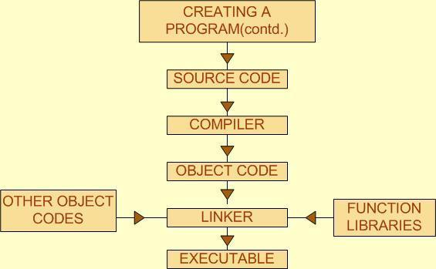

Slide 18
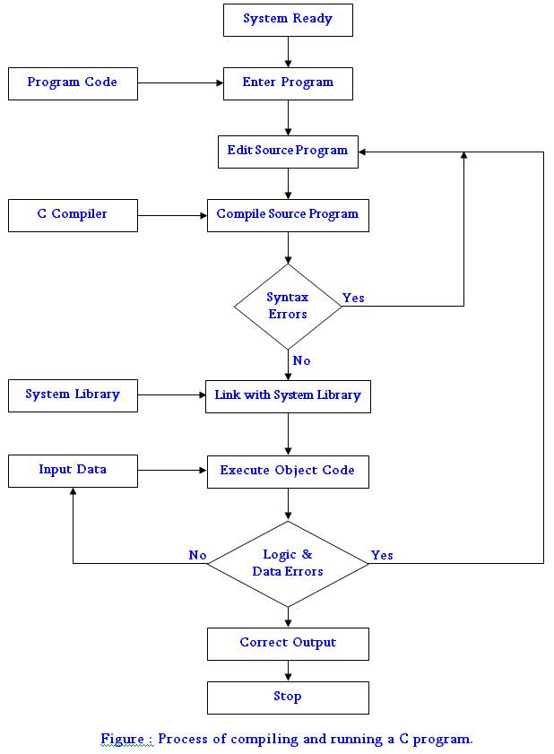

Slide 19
Shortcut Keys
To save Program : Press “F2”
To compile the program : Press “F9”
To Execute the program: Press “Ctrl+ F9”
To see the output :Press “Alt+ F5”

