Slide 1
Operators & Expressions
Unit-I

Slide 2
Operators & Operands
Operators indicates the operations to be performed
Operands are the units on which operations are performed
There can be unary , binary, as well as ternary operators depending upon the number of operands used.

Slide 3
Operators
Arithmetic
Increment/Decrement
Relational
Logical
Assignment
Conditional
Bitwise
Special

Slide 4
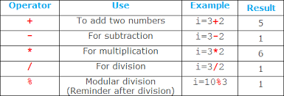
1. Arithmetic Operators
These are also called as Binary Arithmetic operators
% cannot be used on float or double

Slide 5
2. Unary Operators ( Minus & Increment –Decrement )
Unary operator | Description | Eg:
- | Unary minus | -10 -a
++ | Increment | ++a (Prefix) a++ (Postfix)
-- | Decrement | --a (Prefix) a– (Postfix)
Notes:
Oper2.cHaveto discuss more on unary

Slide 6
Increment Operator
These operators increase the value of a number by 1
Postfix Increment : x++
Prefix Increment : ++x
X=X+1 is same as X++ or ++X
If a=10 ;
b=a++ ; // b value is 10,a value is 11
If a=10 ;
b=++a ; // a value is 11,b is 11

Slide 7
Decrement Operator
These operators decreases the value of a number by 1
Postfix Decrement : x--
Prefix Decrement : --x
X=X-1 is same as X-- or --X
If a=10 ;
b=a-- ; // b value is 10,a value is 9
If a=10 ;
b=--a ; // a value is 9,b is 9

Slide 8
3. Relational operators
Operator | Meaning | Eg. | Result
> | Greater than | 10>8 | T(1)
< | Less than | 10<8 | F(0)
<= | Less than or equal | 8<=8 | T(1)
>= | Greater than or equal to | 6>=10 | F(0)
== | Equal to | 5==5 | T(1)
!= | Not equal to | 3!=2 | T(1)
Expr1 <relational operator> Expr2
Notes:
Oper3.c

Slide 9
4. Logical Operator
Operator | Description | Eg. | Return value
&& | Logical AND | 8>5 && 5<10 | T(1)
|| | Logical OR | 8>5 || 5<2 | T(1)
! | Logical NOT | ! (3>7) | T(1)
Logical AND
Logical OR
Logical NOT
Exp1 | Exp2 | Exp1 && Exp2
F(0) | F(0) | F(0)
F(0) | T(1) | F(0)
T(1) | F(0) | F(0)
T(1) | T(1) | T(1)
Exp1 | Exp2 | Exp1 || Exp2
F(0) | F(0) | F(0)
F(0) | T(1) | T(1)
T(1) | F(0) | T(1)
T(1) | T(1) | T(1)
Exp1 | ! Exp1
F(0) | T(1)
T(1) | F(0)
Notes:
Oper4.c

Slide 10
5.Assignment operator
Used to assign a value/result to a variable/ an expression
Assignment is always done from right to left
Variable= value (or) expression
a=10 ;
a=(2*5)%b ;
a=(a*c)+b ;

Slide 11
Compound Assignment
Operator | Example | Assignment | Meaning
+= | n+=10 | n=n+10 | Adds 10 to the number
- = | n-=10 | n=n-10 | Subtracts 10 from the number
*= | n*=10 | n=n*10 | Multiplies by 10
/= | n/=10 | n=n/10 | Divides by 10
%= | n%=10 | n=n%10 | Modulus by 10

Slide 12
6.Conditional Operator
Contains a conditions followed by two statements or values
For eg :
(expr1) ? expr2 : expr3;
To be executed
When condition
in expr1 is true
To be executed
When condition
in expr1 is false
Condition to be tested
n=5;
m=10;
Large=(n>m) ? n:m;
Notes:
Eg: Oper6.c

Slide 13
7.Bitwise Operators
These operators manipulate individual bits within a word
Bitwise manipulations are used for testing bits,or shifting them right or left.
Bit-level manipulations cannot be performed on float or double values (only integer values)
Notes:
Eg: Oper7.c

Slide 14
7.Bitwise Operators
Operator | Meaning | Description
& | Bitwise AND | Returns 1 if both bits are 1 else 0
| | Bitwise OR | Returns 1 if either or both bits are 1 else 0
^ | Bitwise exclusive OR | Returns 1 if exclusively one of the bits are 1 else 0
~ | Bitwise Complement | Inverts every bit (1 becomes 0 and vice-versa)
>> | Shift Right | Moves bits to right and drops far right bit ,adds 1(for –ve) or 0(+ve) to left
<< | Shift Left | Moves bits to left and drops far left bit ,adds 1(for –ve) or 0(+ve) to right
Eg: Solve for x=5,y=3 Binary values x= 00000101 y=0000011
x&y (iv) ~x
x|y (v) x>>3
x^y (vi) x<<2
Notes:
*The result of a right shift by n positions = Value of the operand / 2 to the power of n
* The result of a left shift by n positions = Value of the operand * 2 to the power of n

Slide 15
8.Special operators
Operator | Meaning | Usage
’ | Comma operator | Separating list of expressions
sizeof | Size in bytes | Size of datatypes
& | Address of operand | Pointer
* | Value at address | Pointer
. | Dot operator | Structure
→ | Member selection operator | Structures

Slide 16
8.Special operators
Comma Operator :
Syntax : var=exp1,exp2,…expn
Eg : res=(a=5,b=3,a+b) assigns the rightmost value (a+b) to res
It needs paranthesis(least priority)
It is used in for ,while loops and block of code for separating more than one statements.
Size of Operator :
Returns size in bytes of the operand
Syntax : sizeof(n)
Unary operator that works from right to left

Slide 17
Expressions
Combination of operators , constants & variables form the expressions
Constant
Arithmetic-Integer , Real, Mixed mode
Relational
Logical
Pointer
Bitwise

Slide 18
Expressions
Integer Expressions : Expressions with only integers .It yields integral results ,Even if the result is float, the value after decimal point is truncated
Real Expressions : If all values are of float forms ,then it is a real expression.
Mixed Mode Expressions : These contain a mix of both integral as well as float values . The result is always a float value. Operand of lower type (int) is converted to higher type (float)

Slide 19
Precedence of Arithmetic Operators
The sequence in which arithmetic operators in an expression are processed is known as Precedence
Precedence level | Operators | Associativity
1 | ( ) | L to R
2 | Unary +,Unary -,++,-- | R to L
3 | *,/,% | L to R
4 | +,- | L to R

Slide 20
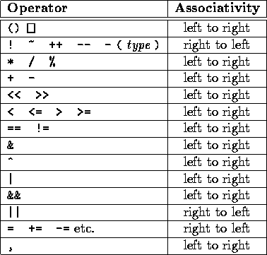
Precedence of Operators
-> .

Slide 21
Precedence of Operators
Parenthesis can be used to change the priority
In case of nesting of priority,the innermost brackets are evaluated first
For operators with equal priority,the expression is evaluated from left to right
Eg: (2+((5*3)+7)/4*6)

Slide 22
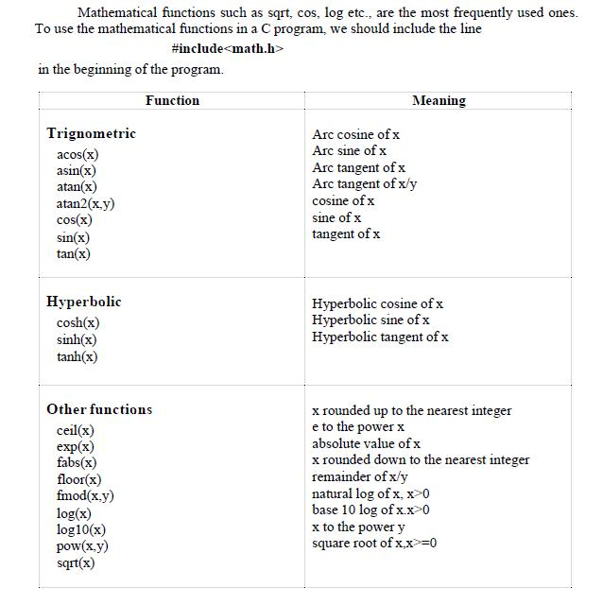
Mathematical Functions

Slide 23
Type Conversions
When variables and constants of different types are combined in an expression then they are converted to same data type.
The process of converting one predefined type into another is called type conversions
There are two types of conversions :
Implicit
Explicit
High
long double
double
float
long int
int
Low

Slide 24
1.Implicit type conversions
When the type conversion is performed automatically by the compiler without programmers intervention, such type of conversion is known as implicit type conversion or type promotion.
The compiler converts all operands into the data type of the largest operand.
Promotion
Demotion
int i=5;
float f;
f=i // f=5.0
float f=5.342;
int i ;
i=f // i=5

Slide 25
Implicit Type Conversions
Assignment | Result
Int=float | Int x; Float y=23.3456; X=y ; // x =25
Float=int | Float y;y=10;//y=10.00000
Double=float | Float x=5.123456;double y; y=x;//5.123456
Float=double | Float x; double y=2.33378689; X=y;//x=2.33379
Int =char | Int x; x=‘A’ ;x=65
Char =int | Char a;a=65; a=‘A’
Int=long int | Long x=12345678;int y; y=x;

Slide 26
2. explicit type conversions
The type conversion performed by the programmer by posing the data type of the expression of specific type is known as explicit type conversion.
The explicit type conversion is also known as type casting.
(data_type)expression;
Cast operator
Associativity : R to L
Precedence : below parenthesis

Slide 27
2. explicit type conversions
The following rules have to be followed while converting the expression from one type to another to avoid the loss of information:
All integer types to be converted to float.
All float types to be converted to double.
All character types to be converted to integer
int a=3 ,b=4,c=6;
x=(float)a+b*d;
Notes:
TypeConv.c

