Slide 1
Strings
Chapter 3.2

Slide 2
Contents
Strings –Introduction
Declaring and Initializing strings.
Operations on strings
Arrays of strings
Passing strings to functions

Slide 3
Strings-Introduction
Sequence of zero or more characters, terminated by NULL (literally, the integer value 0)
NULL terminates a string, but isn’t part of it
A string is defined within double quotes “ “
For Eg : “Mango”, “Hello world”

Slide 4
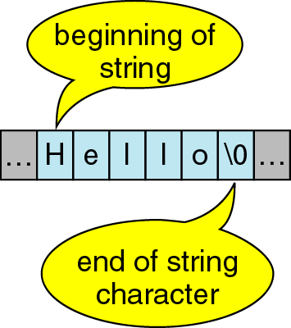
Character Strings

Slide 5
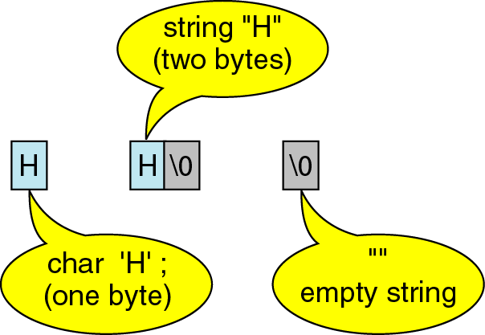
Character Strings
A string containing a single character takes up 2 bytes of storage.

Slide 6
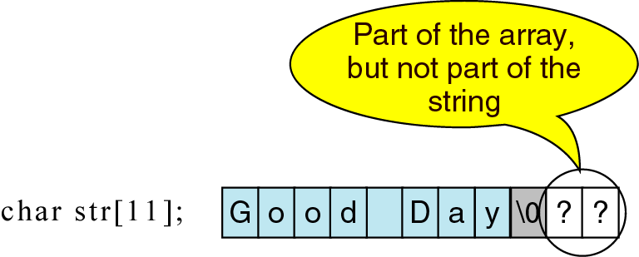
Character Strings

Slide 7
Character vs. String
A string constant is a sequence of characters enclosed in double quotes.
For example, the character string:
char s1[2]="a"; //Takes two bytes of storage.
s1:
On the other hand, the character, in single quotes:
char s2= `a`; //Takes only one byte of storage.
s2:
a | \0
a

Slide 8
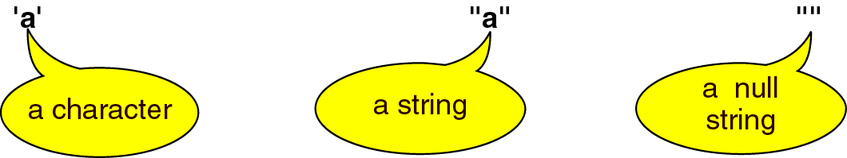
Character vs. String

Slide 9
Declaring Strings
String doesn’t have a special datatype
To hold a string of 9 characters ,siz e should be 10.Eg:
char str_name[size]
should be 1 more than the
required size
char str[10]

Slide 10
Initialization of strings
char str[6]={‘S’,’S’,’M’,’R’,’V’,’\0’}
char str[6]=“SSMRV”
char str[ ]=“SSMRV”
str[0]
str[1]
str[2]
str[3]
str[4]
str[5]
S | S | M | R | V | \0
3001
3002
3003
3004
3005
3006

Slide 11
Reading a string-scanf
char state[20];
scanf (“%s”,state);
KARNATAKA
K | A | R | N | A | T | A | K | A | \0
ANDHRA PRADESH
scanf terminates as it
finds blank space
A | N | D | H | R | A | \0 | ? | ? | ?
Notes:
Eg 1 . Strread.c

Slide 12
Reading a string-getchar()
getchar reads successive characters from the terminal and places it into the array.
As soon as it encounters ,\n or new line it terminates
Requires loop for taking characters
str[i]=getchar()
Notes:
Eg: Strgetchar.c

Slide 13
Reading a string-gets()
gets() reads the entire string till it encounters \n .
It inserts ‘\0’ by itself in the last position.
char city[30];
printf(“Enter the city name:”);
gets(city);
Notes:
Eg: Strgets.c

Slide 14
Writing Strings -printf
Requires %s to print the string
char city[30]=“New York”;
printf(“The city name is :%s ”,city);
Notes:
Eg: Strgets()

Slide 15
Writing Strings-putchar()
Prints only one character at a time
Requires loop to print the sequence of characters or string
char name[5]=“Ravi”
for (i=0;i<5;i++)
putchar(name[i]);

Slide 16
Writing Strings-puts()
Prints the entire string at a time
char name[5]=“Ravi”
puts(name);
Notes:
Eg. Strgets.c

Slide 17
Strings and numbers
Case 1 :
Case 2:
Case 3 :
char ch ;
ch=‘b’-1;
printf(“%c”,ch);
printf(“%d”,ch);
char ch;
ch=‘b’+1;
printf(“%c”,ch);
printf(“%d”,ch);
char str[5]=“12345”;
int n;
n=atoi(str);
n=n+1;
Notes:
Eg: Stratoi.c

Slide 18
Operations on Strings
Length of string
Concatenation
Comparison
Copying one string to another

Slide 19
1. length of string
Each character of the string is compared with ‘\0’ .
Till ‘\0’ the character is counted.
Notes:
Strlen.c

Slide 20
2. Concatenation of String
Concatenation means joining two strings into one string
For Eg :
str1[15]=“Good” str2[15]=“Morning”
str1[15]=“Good Morning”
Notes:
StrCon.c

Slide 21
String Concatenation
str1[15]
str2 [15]
G | O | O | D | \0
M | O | R | N | I | N | G | \0
0
1
2
3
4
str1[15]
Step1 :
while(str1[i]!=‘\0’)
i++;
G | O | O | D | \0
i=0
i=4
Notes:
StrCon.c

Slide 22
String Concatenation
while (str2[j]!=‘\0’)
str1[i]=str2[j];
i++;
j++;
Step2 :
M | O | R | N | I | N | G | \0
j=0
j=6
G | O | O | D | M
O
R
N
I
N
G
\0
i=4
i=5
i=6
i=7
i=8
i=9
i=10
i++
i=0
Notes:
StrCon.c

Slide 23
3. Comparing Strings
A string can be compared by checking each of the characters of two strings for equality.
This is also done using loop which breaks if any character is unequal.
Notes:
Strcom.c

Slide 24
String Comparison
str1[15]
str2 [15]
G | O | O | D | \0
G | O | O | D | \0
0
1
2
3
4
0
1
2
3
4
str1[15]
Step1 :
while(str1[i]==str2[j] && str1[i]!=‘\0’ )
{ i++;
j++
}
G | O | O | D | \0
i=0
str2 [15]
G | O | O | D | \0
Notes:
StrCom.c

Slide 25
4. Copying String
Copying one string into another till ‘\0’ is reached.
Eg : char source[30]=“bangalore”;
char target[30]
while(source[i]!=‘\0’)
{ target[i]=source[i];
i++;
}
target[i]=‘\0’;
Notes:
StrCop.c

Slide 26
String operations using Library functions
String Function | Description | Return value
strcat (s1,s2) | Concatenates s2 to s1 | Pointer to the concatenated string
strcmp(s1,s2) | Compares string s1 & s2 | Returns int value 0 ; equal <0; str1<str2 >0;str1>str2
strcpy(s1,s2) | Copies s2 to s1 | s1;destination string
strncpy(s1,s2,n) | Copies n-characters | s1;destination string
strlen(s1) | Returns the length of string | int
strcmpi(s1,s2) | Compares s1,s2 without case sensitivity | Same as strcmp
strncmp(s1,s2,n) | Compares only n-characters | -do-

Slide 27
String operations using Library functions
String Function | Description | Return value
strstr (s1,s2) | Scans a string for the first occurrence of a sub string s2 in s1 | Returns a pointer to the element in s1 where s2 begins
Strchr(s1,ch) & strrchr | Similar to strstr but searches for characters | Returns pointer to the first occurrence of character
strcpy(s1,s2) | Copies s2 to s1 | s1;destination string
strlwr(s1) | Converts all the letter characters to lowercase | Pointer to string
Strupr(s1) | Converts all the letter characters to uppercase | -do-
Strrev() | Reverses the order of characters of string | -do-

Slide 28
Arrays of Strings
An array of character arrays is “Array of Strings”
Size for each of the strings remains same
str[0]→ first string
str[1]→ second string …so on
char str [MAX][SIZE]
size of each string
;(size-1)
no. of strings or char arrays
Notes:
Eg: Strarray.c

