Slide 1
Unit-II
Managing I/O operations
Decision Making & Branching
Decision Making & Looping
Functions

Slide 2
Managing Input-Output Operations
Chapter-5

Slide 3
Contents :
Input-Output Operations
Reading/Writing a character
Formatted Operations
Unformatted I/O Operations

Slide 4
Input Output Operations
Input :
In any programming language input means to feed some data into program. This can be given in the form of file or from command line. C programming language provides a set of built-in functions to read given input and feed it to the program as per requirement.
Output :
In any programming language output means to display some data on screen, printer or in any file. C programming language provides a set of built-in functions to output required data.

Slide 5
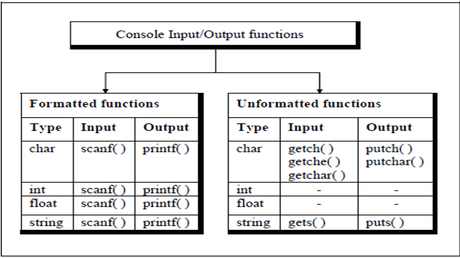

Slide 6
1. Formatted Input Output Functions
The Formatted I/O functions are used to read and write all types of data values.
They require conversion symbols(or format specifiers ) to identify the data type .
They read /write the data as per the format specifier used
Two functions : printf() and scanf().

Slide 7
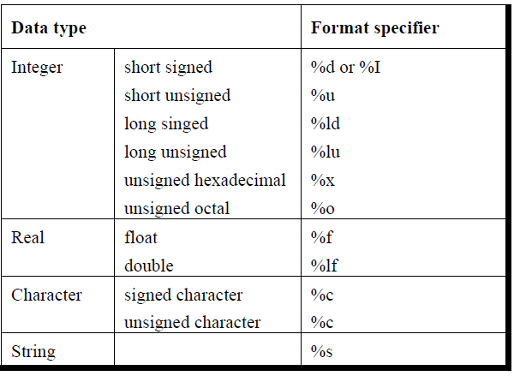
printf ()
Used to print in specific format given by the programmer
printf(“format string”,list of variables);
i. Conversion specifications that begin with a % sign ii. Characters that are simply printed as they are iii. Escape sequences that begin with a \ sign

Slide 8
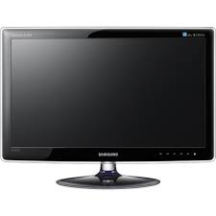
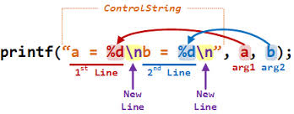
Example –printf()
Welcome
The number is 7
void main()
{ int a=7;
printf (“Welcome”);
printf(“The number is %d”,a);
}
Sample1.c

Slide 9
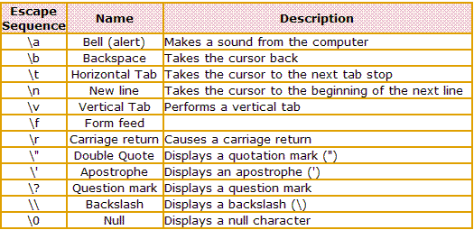
Escape Sequences
Advance downward to next page
(Return to beginning of current line)
Notes:
Eg :Escape.c

Slide 10
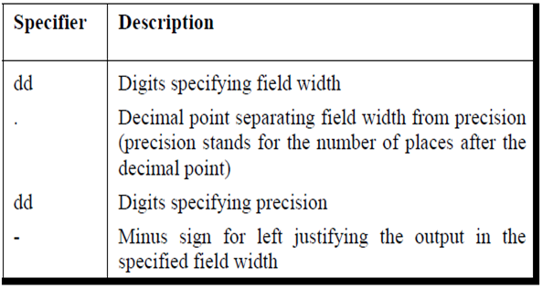
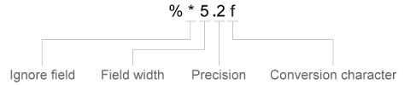
Field Width Specifiers (Optional Format Specifiers)
%wc
Format specifier
Width specifier

Slide 11
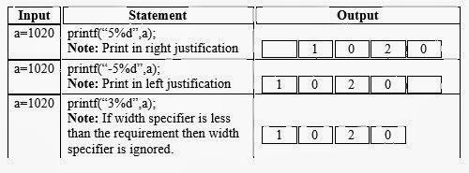
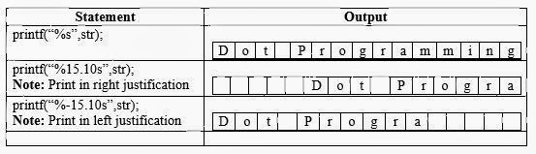
For Integers
%wc
For Strings
%w.xs
No. of characters to be printed
in right justified

Slide 12
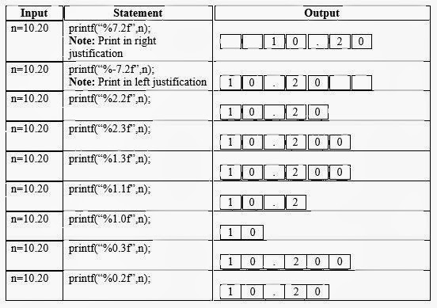
For Float
%w.xf
%-w.xf
OR
Notes:
Eg; Fieldwidth.c

Slide 13
scanf ()
Used to accept any values of any data type from the standard input device(keyboard ) to the address of variables
scanf(“format string”,&var1,&var2,…..,&varn);
Order & type of variables should match
with the same of format specifiers given
in format string
Contains % symbol followed by format specifier

Slide 14
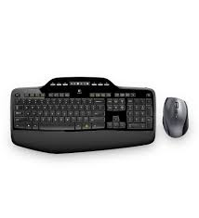
Example –scanf()
Enter a number
5
The number is 5
void main()
{ int a;
printf (“Enter a number”);
scanf (“%d”,&a);
printf(“The number is %d”,a);
getch();
}
Sample.c

Slide 15
scanf()
field width specifiers for only integers can be specified (care should be taken for input data)
%3d
Commas,space,colon can be used as delimiters
scanf(“%d,%d,%d”,&x,&y);
Ignores all blank spaces,tabs,newlines etc.
Returns an integer value specifying the no. of elements entered successfully
For strings ,no & symbol is used
scanf(“%s”,str);

Slide 16
2. Unformatted Input-Output Functions
getchar() : Reads one character (any character including enter key )& assigns it when enter key is pressed
putchar() : Outputs or prints single character
var=getchar();
char or int
putchar(var );
char variable or constant
Notes:
Eg: Getchar1.c , Upperlower.c

Slide 17
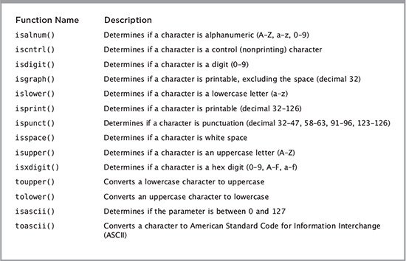
ctype.h

Slide 18
2. Unformatted Input-Output Functions
getch() : Inputs only one character . It doesn’t requires enter key
putch() : Outputs one character (or displays) it on the screen. Similar to putchar()
getche() : Inputs a character and echoes or displays it on the screen
var=getch();
char or int type
putch(var);
char variable or constant
var=getche();
Notes:
Eg: Getchputch.c

Slide 19
2. Unformatted Input-Output Functions
gets() : Inputs sequence of characters i.e strings (or line of text)
puts() : Inputs one character and echoes (or displays) it on the screen
gets(str);
string variable
puts(str);
String variable or string constant
Notes:
Eg: Stringgetput.c

