Slide 1
Unit-II
Managing I/O operations
Decision Making & Branching
Decision Making & Looping
Functions

Slide 2
Decision Making & Branching
Chapter-6.1

Slide 3
Contents :
Introduction
If statement
Nested if statement
Else-if ladder
Switch statement
Goto statement
Conditional Operator

Slide 4
Introduction
Instructions
Type Declaration
Arithmetic
I/O instructions
Control Instructions
Sequence Control
Decision Control
Loop control

Slide 5
Decision Control Structures
Decision control structures come into play when a decision has to be made based on certain conditions.
If the condition is true ,particular set of statements are executed else another set of instructions are executed.

Slide 6
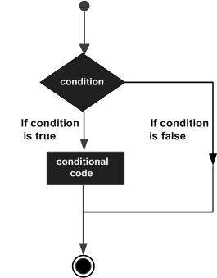
1.Simple if
It is a one-way branching statement which executes the statements if the condition is true
If (condition)
{ statement1;
}
statements2;
Notes:
Eg: If1.c, great20.c ,equal.c Practice : Marks.c , large.c

Slide 7
Eg : To print excellent if a students gets marks =200
Step1 : Start
Step2 : Input marks
Step3 : if (marks ==200) then output “Excellent”
Step4 : Print “End of Program”
Step5: Stop

Slide 8
Eg : To find largest of two numbers using simple if
Step1 : Start
Step2 : Input a,b
Step3 : if (a>b) then output “a is large”
Step4 : if (b>a) then output “b is large”
Step4 : Print “End of Program”
Step5: Stop

Slide 9
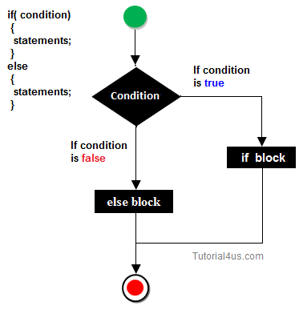
2.If..else
Two-way branching statement which executes a set of statements if the condition is true else executes another set of statements if it is false
Notes:
Eg: ifelse1.c, Practice : ifelselarge.c , Evenodd.c,

Slide 10
Eg : To find largest of two numbers using if else
Step1 : Start
Step2 : Input a,b
Step3 : if (a>b) then output “a is large” else output “b is large”
Step4 : Print “End of Program”
Step5: Stop

Slide 11
Eg : To find whether a number is even or odd
Step1 : Start
Step2 : Input num
Step3 : if (num %2=0) then print “Even” else
print “Odd”
Step5 : Print “End of Program”
Step6 : Stop

Slide 12
3.Nested if
If(condition1)
{
If (condition2)
{
statement1;
……..
}
else
{
statement2;
if(condition3)
statement3;
……..
else
statement4
}
}
Notes:
Eg: Nestedif1.c(+ve/-ve/0) ; Practice : Large.c,Interest.c XY.c and Youngest.c,

Slide 13
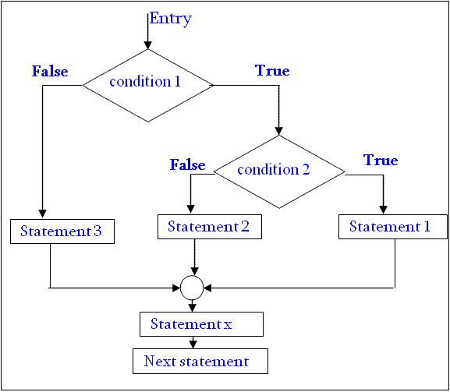
3.Nested if

Slide 14
Eg: To find a number is positive,negative or zero
X>0 ?
X<0 ?
False
False
Zero
True
True
Positive
Negative
Stop

Slide 15
Eg : To find largest of three numbers using if else
Step1 : Start
Step2 : Input a,b,c
Step3 : if (a>b) then
If (a>c)
output “a is large”
else
output “c is large”
[end of outer if]
else
if (b>c)
output “b is large”
else
output “c is large”
Step4 : Print “End of Program”
Step5: Stop

Slide 16
Eg : To calculate Simple Interest based on following conditions : Principle Rate of Interest >=10000 20% >5000 and <10000 15% >=1000 and <=5000 10%
Step1 : Start
Step2 : Input P ,T
Step3 : if (P>=10000) then
R=0.20
else
if (P>5000 AND P<10000)
R=0.10
else
R=0.15
Step4 : SI=(P*R*T)/100 [Calculate SI]
Step5: Output SI
Step5: Stop

Slide 17
Eg : To find whether a point lies on x-axis,y-axis or 0
Step1 : Start
Step2 : Input a point (x,y)
Step3 : if (x==0) AND (y==0) then
print “Point is zero”
else if (x==0)
print “Point lies on Y-axis”
else
print “Point lies on X-axis”
Step6 : Stop

Slide 18
Eg : To find the youngest of three persons
Step1 : Start
Step2 : Input age1,age2,age3
Step3 : if (age1<age2) AND (age1<age3) then
print “Person1 is youngest”
else if (age2<age3)AND (age2<age1)
print “Person2 is youngest”
else
print “Person3 is youngest”
Step6 : Stop

Slide 19
Different Nested if Examples
Condition : If gender is male and salary is greater than 5,000 Rs ,tax is cut else not
If (sex==‘M’)
{
if (salary >5000)
{
printf(“Pay tax”);
}
}
else
{
printf(“No tax”);
}

Slide 20
Different Nested if Examples
Condition : If gender is male and salary is greater than 5,000 Rs ,tax is cut else not.If gender is female no tax is cut
If (sex==‘M’)
{
if (salary >5000)
{
printf(“Pay tax”);
}
else
{
printf(“No tax”);
}
}
else
{ printf(“No tax”);
}

Slide 21
Different Nested if Examples
Condition : If a student has sports score as 50 then he is selected for admission (irrespective of academics) otherwise if his marks is greater than 400 then only admission takes place
If (sports==50)
{
printf(“Selected”);
}
else
{
if (tot>400)
printf(“Admission done”);
else
printf(“Sorry”);
}

Slide 22
Different Nested if Examples
If (sports==50)
{
if (marks>500)
printf(“Selected”);
else
printf(“Sorry”);
}
else
{
if (NCC>30)
{
if (marks>=400)
printf(“Admission done”);
}
else
printf(“Sorry”);
}
Condition : Admission of a student takes place under following conditions :
sports score =50 and marks >500
Or NCC marks>30 and marks >=400
Notes:
Eg:

Slide 23
4. Else..if Ladder
If (condition 1)
{
Statement 1;
}
elseif(condition2)
{
Statement 2 ;
}
elseif (condition3)
{
Statement 3 ;
}
else
{
Statement 4;
}

Slide 24
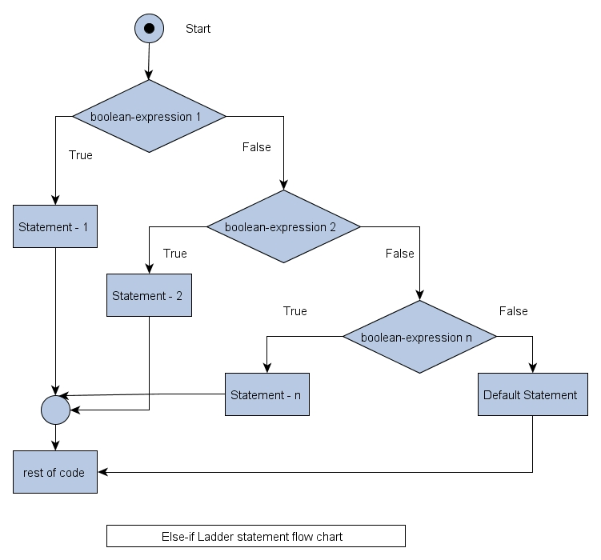
4.Else if Ladder

Slide 25
Eg : To accept the percentage of a student and print the class as follows : Percentage Category per>=75 Distinction per>=60 First Class per>=50 Second Class per>=40 Third Class Otherwise Fail
Step1 : Start
Step2 : Input per
Step3 : if (per>=75) then
print “Distinction”
else if (per>=60)
print “First Class”
else if (per>=50)
print “Second Class”
else if (per>=40)
print”Third Class”
else
print “Fail”
Step6 : Stop

Slide 26
5. Switch
Multiway branching construct
Can be used as an alternate to nested if or else if ladder for specific set of values
Switch (expression)
{
case label val 1: statement 1;
……...;
break ;
case label val 2: statement 2;
……...;
break ;
case label val3: statement 3;
……...;
break ;
case label val n: statement n;
……...;
break ;
default : default statement ; }
Only int or char
type
Constant or
constant
expression of int
type
Notes:
Eg: Day of week ,Result ; Practice : Vowels,Operations

Slide 27
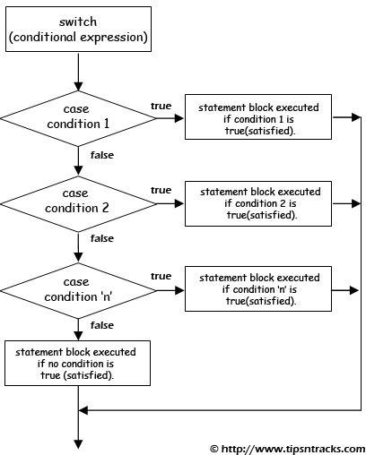
Flowchart for switch

Slide 28
Eg : To print the day of week using code values from 1 to 7
switch(ch)
{
case 1 : printf (“Sunday”); break;
case 2 : printf(“Monday”);break;
case 3 : printf(“Tuesday”);break;
case 4 : printf(“Wednesday”);break;
case 5 : printf(“Thursday”);break;
case 6 : printf(“Friday”);break;
case 7 : printf(“Saturday”);break;
default : printf(“Invalid code”);
}

Slide 29
Points to remember about switch
No two labels should have same values
More than one statements in a particular case need not be enclosed in case
It is not compulsory to have statements for all the cases
Nesting of switch is allowed
Default block can be placed at any place in switch (but generally preferred to be at last

Slide 30
Other Examples
To check whether a character is vowel or not
To perform arithmetic operations using different choices
To accept the percentage of a student and print the class as follows :
Percentage Category per>=70 Distinction per>=60 First Class per>=50 Second Class per>=40 Third Class Otherwise Fail

Slide 31
Eg : To check whether a character is vowel or not
switch(ch)
{
case ‘A’ :
case ‘E’:
case ‘I’ :
case ‘O’ :
case ‘U’:
case ‘a’:
case ‘e’:
case ‘i’:
case’o’:
case ‘u’ : printf ( “ It’s a vowel!”); break;
default : printf(“Its not a vowel ”);
}

Slide 32
6. GoTo statement
goto statement causes a direct branch to be made to a specified point called label in the program ,unconditionally .
Label can be located anywhere in a program but in same function where goto resides
Eg: goto name1;
goto label_name
-Name for a block of code
-to be ended by a colon
-Follows naming convention
for identifiers

Slide 33
Example : goto
main()
{
int x;
clrscr();
printf(“Enter a number”);
scanf(“%d”,&x);
If (x%2==0)
goto even;
else
goto odd;
even :
printf(“even number”);
return ;
odd:
printf(“Odd number”);
}

Slide 34
6.Conditional Operator
Contains a conditions followed by two statements or values
For eg :
(expr1) ? expr2 : expr3;
To be executed
When condition
in expr1 is true
To be executed
When condition
in expr1 is false
Condition to be tested
n=5;
m=10;
Large=(n>m) ? n:m;
Notes:
Eg: Oper6.c

Slide 35
Practice code for ?:
K=(num >5)?(num<=10 ? 100 :200):500
int j=4
!j!=1 ? printf(“Welcome”):printf(“good bye”)
int a=5,b=6;
(a==b? printf (“%d\n”,a));

Slide 36
Examples for ?:
To find the smallest of three numbers
To find a point lies on x-axis,y-axis or is zero.
To check if a year is leap year or not
To check whether a character entered is vowel or consonant .
Notes:
yr%4==0 && yr%100==0 &&yr%400 else yr%4

