Slide 1
Unit-II
Managing I/O operations
Decision Making & Branching
Decision Making & Looping
Functions

Slide 2
Decision Making & Looping
Chapter-6.2

Slide 3
Contents :
Introduction
While
Do-while
For
Different variations in for
Nested loops
Jumps in loops
Break and continue

Slide 4
Introduction
Looping constructs are constructs that executes the statements repeatedly for a certain number of times as long as the condition is true
Three types :
While
For
Do-while

Slide 5
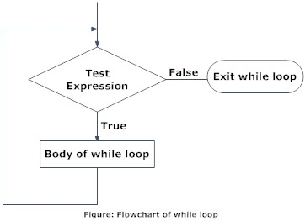
1. while
It is used to execute the statements repeatedly as long as the condition is true
It is an “entry controlled loop”
Decide
Intialisation of counter
(if any)
Condition
Updation of counter
Code for execution

Slide 6
1. while
i=1
Eg:
i=1;
while (i<=5)
{
printf(“%d”,i);
i++;
}
1
i++
2
i=2
i++
i=3
3
i++
i=4
4
i++
i=5
5
i++
i=6

Slide 7
Examples :
To generate first n- natural numbers
To find the sum of n-natural numbers
To find the factorial of a number
To find the reverse of a number
To find the sum of digits of a number
To find the LCM and GCD of a number

Slide 9
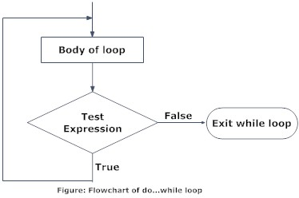
2. do..while
It is an exit controlled loop which executes at least once before a condition is tested .
If the condition is true , the statements within the loop continues to execute till it becomes false
do
{
statment1;
} while(condition);

Slide 10
2.do-while : Example
int num;
num=-2;
do
{
printf(“Number is %d”,num);
printf(“Enter a +ve number”);
scanf(“%d”,&num);
}while(num>=0);
int num;
num=-2;
while(num>=0)
{
printf(“Number is %d”,num);
printf(“Enter a +ve number”);
scanf(“%d”,&n);
}

Slide 11
Examples :
To print multiplication table of a number num
To find the sum of even numbers and odd numbers between the range 20 to 301
To find the numbers divisible by 2 and 5 between the range 1 to 100

Slide 12
Algorithm : To print multiplication table
Step1 : Start
Step 2 : Input a number num
Step 3 : i←1
Step 4 : do Step 5, Step 6,Step7 while i<=10
Step 5 : Prod←num*i
Step 6 : Output “num*i=Prod”
Step 7 : i←i+1
[End of Step 4 loop]
Step 8 : Stop

Slide 13
Algorithm : To find sum of all even numbers and odd numbers between 20 to 301
Step 1 : Start
Step 2 : i←20,esum←0,osum←0
Step 3 : do Step 4, Step 5 while i<=301
Step 4 : if i%2==0 then esum=esum+i
else osum=osum+i
Step 5 : i←i+1
Step 6 : Output esum,osum
[End of Step 3 loop]
Step 7 : Stop

Slide 14
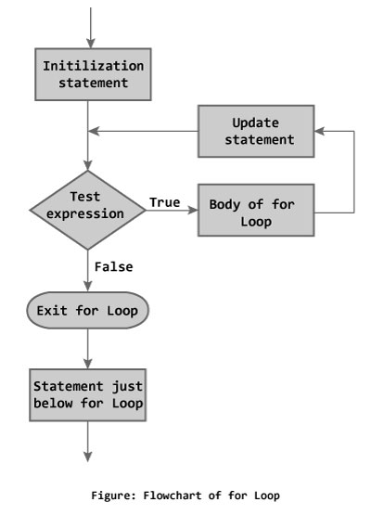
3. For
It is an entry-controlled
loop which has a fixed limit
of executing the statements.
for (expr1;expr2;expr3)
{
Statement1;
Statement2 ;
---
}
Statement-x;
Updation
Conditional expression
Initialisation

Slide 15
3. For Example :
int i;
for (i=0;i<5;i++)
{
printf(“%d”,i);
}

Slide 16
Examples
To print 5-numbers and its cubes.
To find the sum of only odd numbers between 1 to 20
To check whether a number is prime or not
To check a number is palindrome or not
To generate n-fibonacci series

Slide 17
Algorithm : To print 5-numbers and its cube
Step 1: Start
Step 2 : for i=1 to 5 do Step 3,Step 4,Step 5
Step 3 : Enter a number n
Step 4 : c=n*n*n [calculate cube]
[End of step2 loop]
Step 5 : output n,c
Step 6: Stop

Slide 18
Algorithm : To find the sum of only odd numbers
Step 1: Start
Step 2: sum←0
Step 3: for i=1 to 20 do Step 4
Step 4: if (i%2)<>0 then
sum=sum+i
[End of Step3 loop]
Step 5 : Output sum

Slide 19
Different ‘for’ loop variations
float f;
for (f=2.5;f<=12.4;f=f+1.1)
{
printf (“%f”,f);
}
int i;
i=1;
for ( ; i<=5;i++)
{
printf (“%d”,i);
}
int i;
i=1;
for ( ; i<=5;)
{
printf (“%d”,i);
i++;
}
int i;
i=1; (Infinite loop)
for ( ; ; )
{
printf (“%d”,i);
}

Slide 20
Different for loop variations
for ( i=1; ;)
{
printf (“%d”,i);
i++;
}
If (i==6)
break;
for ( i=1; i<=5;i++);// empty body
{
printf (“%d”,i);
}//prints 6
(Multiple initialisation and updation )
for (i=1,j=5 ;i<=5 ; i++,j-- )
{
printf (“%d”,i);
}

Slide 21
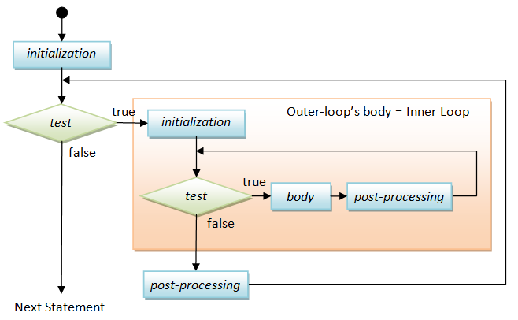
Nested loops

Slide 22
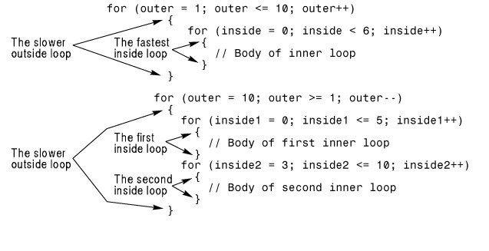
1. Nested for

Slide 23
2. Nested while
while (condition 1)
{
Statement 1;
while(condition 2)
{
statement 2;
}
}
Outer while
Inner
while

Slide 24
2. Nested while
do
{
Statement 1;
do
{
statement 2;
} while(condition 2);
} while (condition 1);
Outer
do while
Inner
do while

Slide 25
Example
To print a pattern till a limit
1
1 2
1 2 3
1 2 3 4 …

Slide 26
Algorithm : To print a pattern
Step 1 : Start
Step 2 : Input n
Step 3 : for i=1 to n do step 4 ,step 5,step 6
Step 4 : for j=1to i do step 5
Step 5 : Output j
[End of step5 loop]
Step 6 : Output new line character
[End of step 3 loop]
Step 7 : Stop

Slide 27
Other Examples
To print a pattern
$
$$
$$$
$$$$
To print a pattern
1234
123
12
1

Slide 28
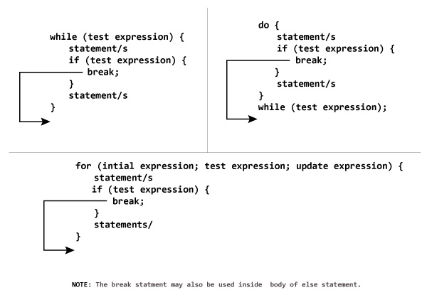
Jumps in loops :break
Break is used to terminate the execution of loop

Slide 29
Example :
int i=1,j=1;
while(i++<=100)
{
while (j++<=200)
{
if (j==150)
break;
else
printf(“%d %d\n”,i,j);
}
}
Notes:
Breakdemo.c

Slide 30
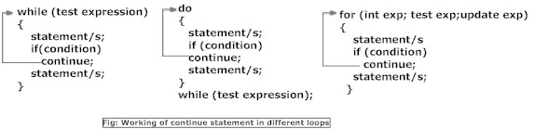
Jumps in loops : continue
Skipping a set of statements from a particular point in the body of the loop upto the end and taking the control back to the beginning of the loop for the next iteration is done using continue .
Continue can be used only in loops not in switch.

Slide 31
Example :
int i ;
for (i=1;i<=5;i++)
{
if (i==2)
continue;
printf(“%d \n”,i);
}
Notes:
Continuedemo.c

Slide 32
Example :
To print the sum of odd numbers
int i ,sum=0 ;
for (i=1;i<=20;i++)
{
if (i % 2==0)
continue;
sum=sum+i;
}
printf(“Sum of odd numbers=%d”,sum);

Slide 33
Example :
int i,j;
for (i=1;i<=2;i++)
{
for (j=1;j<=2;j++)
{
if (i==j)
continue;
printf(“%d %d\n”,i,j);
}
}
i=1,j=1

