Slide 1
MyNextA+?
A+
Harsha Ekanayake
Nimesh Pasan

Slide 2
Background
How important is my GPA to me, as a student?
How important are your students’ grades to you, as faculty/administration?
How often do we struggle selecting best course to improve our GPA?
How often do we drop certain courses to avoid failure despite no reimbursement?

Slide 3
Our solution
Our model predicts grades for students in the senior level courses based on their performance in freshman, sophomore and junior levels and majors.

Slide 4
Technologies
Python
Preprocessing
Numpy
Pandas
Machine Learning
Keras
Scikit Learn
IDE
Jupyter Notebook

Slide 5
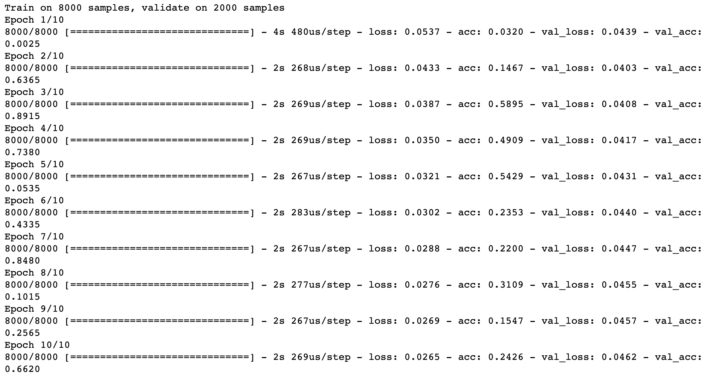
Our Achievement
Over 85%
Accuracy

Slide 6
Neural Network Architecture
Course 1 A
L1 Node 1
L2 Node 1
Senior Course 1 A
Course 1 B+
L1 Node 2
L2 Node 2
L3 Node 1
Senior Course 1 B+
Course 2 C+
L1 Node 3
L2 Node 3
L3 Node 2
Senior Course 2 C+
……..
……..
……..
……..
……..
CS Major
L1 Node 99
L2 Node 99
L3 Node 50
Senior Course 49 B
CSE Major
L1 Node 100
L2 Node 100
Senior Course 50 B
Input Layer
475 Features
Dense Hidden Layer - 100 Nodes
ReLu Act. Func.
Dense Hidden Layer - 200 Nodes
ReLu Act. Func.
Dense Hidden Layer - 50 Nodes
ReLu Act. Func.
Softmax Output Layer
50 Nodes

Slide 7
Challenges
Extracting courses taken only during a single level
Lack of information about instructors of particular courses

Slide 8
What we learnt
Importance of Plan B. This was our second plan in case we fail in our mobile app.
Learnt Scikit Learn Library in Python.

Slide 9
What’s Next
Incorporate instructor details as input features to improve accuracy
Filter out similar courses and build smaller neural networks for specialized majors

