Slide 1


Wire Arc Additive Manufacturing
Performance Index
By
Harsh Rana
Department of Mechanical Engineering
Indian Institute of Technology, Guwahati
Guwahati, Assam

Slide 2
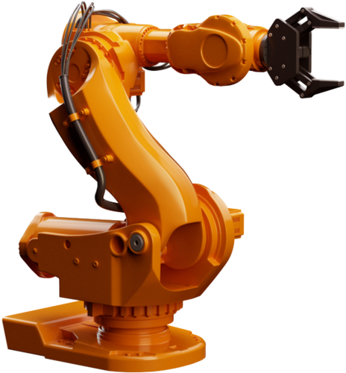
Dexterity and Manipulability
Dexterity: All possible orientations of the end-effector about a point in the manipulator workspace.
Manipulability: Ability of the manipulator to move and apply forces in arbitrary directions.

Slide 3

Classification of Performance Indices
Local vs Global Indices
Local Indices:
Dependent on the posture of the manipulator.
Scope is confined to a particular posture/position alone in the workspace.
Most Jacobian based performance indices are local indices.
Example: Manipulability Index, condition number, etc.
Global Indices:
Posture Independent Indices.
Represent a global characteristic of the manipulator workspace.
Have single value for a given manipulator workspace, hence can compare the structure and behaviour of two manipulators that perform the same task.
Example: Global Conditioning Index(GCI), etc.
Local indices can be adapted to global scale by integrating the local measures over the region of the configuration space.
It is important to note here that, high values of a local performance index do not always translate into high values for its global version, and the converse is also true.

Slide 4
Classification of Performance Indices
Kinematic vs Dynamic Indices
Kinematic Indices:
Quantify Kinematic behaviour.
Based on the Jacobian matrix, and also are structure-dependent.
Dynamic Indices:
Evaluate Dynamic performance.
Depends on Internal characteristics.
There are other indices that are neither kinematic nor dynamic, i.e., they are simple indices, such as dexterity index, service angle, etc.
Intrinsic vs Extrinsic Indices
Intrinsic Indices:
Unrelated to Manipulator’s task or application.
Example: Dexterity, manipulability and Condition number.
Extrinsic Indices:
Measure the ability of the Manipulator to perform a specific task.
Example: Robot-task conformance index, Power manipulability index.

Slide 5
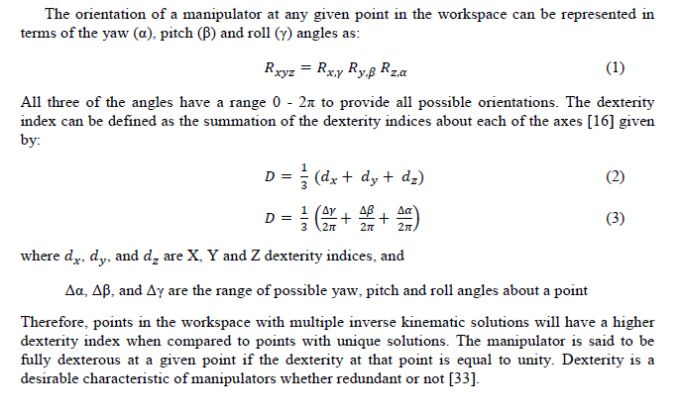
Dexterity Index
Dextrous Workspace : the volume within which every point can be reached by the manipulator end-effector with any desired orientation.
The dexterity index of a manipulator at a point in the workspace can be also defined as "a measure of a manipulator to achieve varying orientations at that point."

Slide 6
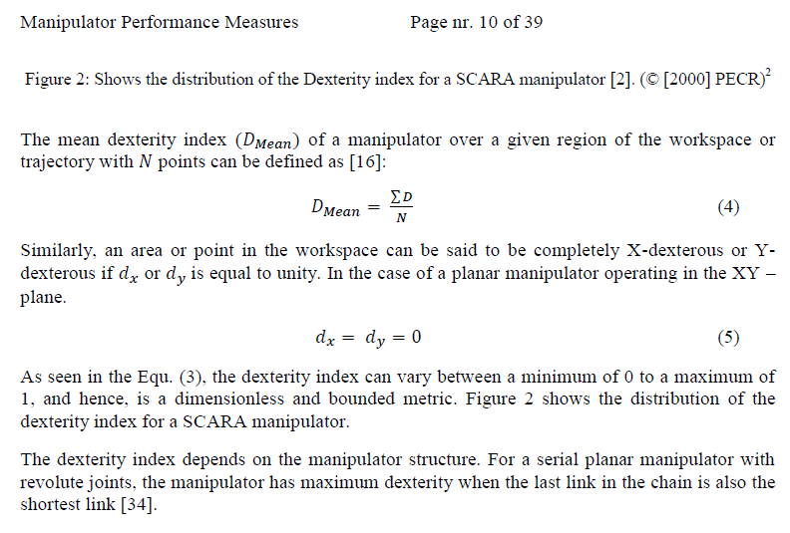
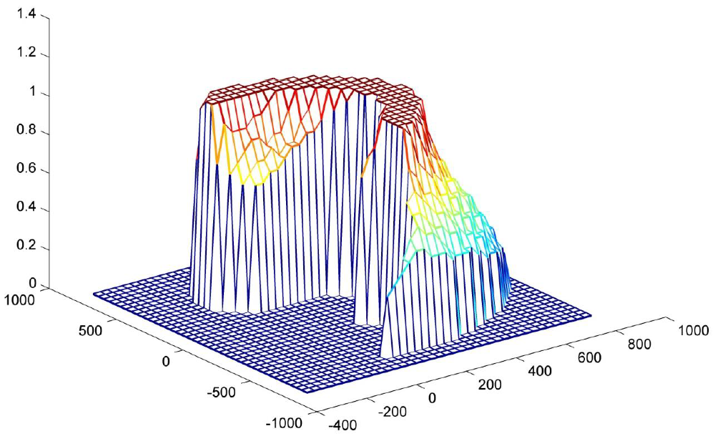
Dexterity Index

Slide 7
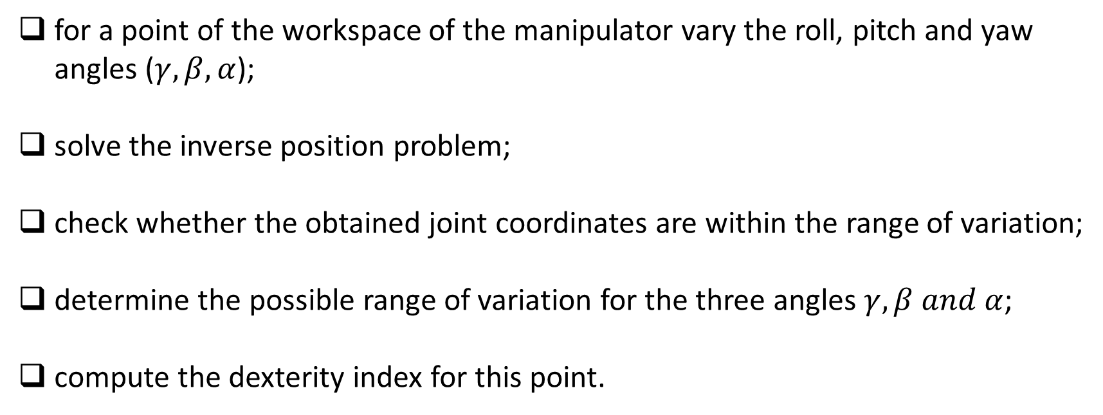
Dexterity Index
for a point of the workspace of the manipulator vary the roll, pitch and yaw angles ($γ,β,α$);
solve the inverse position problem;
check whether the obtained joint coordinates are within the range of variation;
determine the possible range of variation for the three angles $γ,β and α$;
compute the dexterity index for this point.

Slide 8
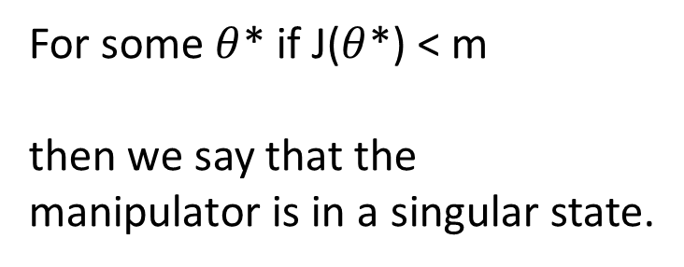

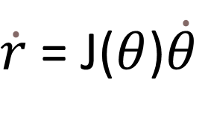
Manipulability Index
We can write the velocity of the end-effector vector in terms of the joint velocity vector using the Jacobian matrix
Where r is a m dimentional vector (m dimentional Eucledian space) and $θ$ is a n dimentional vector (n joint parameters. Hence J is a m*n matrix.
$\dot{r}$ = J($θ$)$\dot{θ}$
Max rank of J = m
Failing to satisfy this condition usually means that the selection of manipulation variables is redundant and that the number of these variables m can be reduced.
For some $θ$* if J($θ$*) < m
then we say that the manipulator is in a singular state.

Slide 9
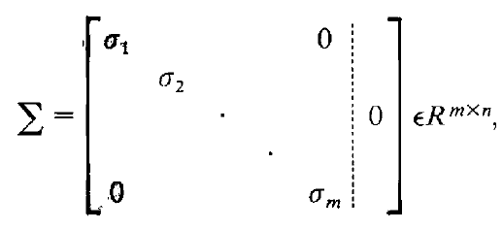

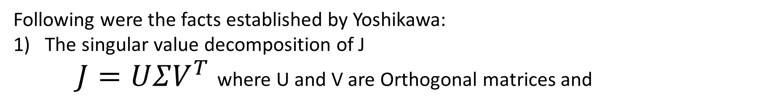
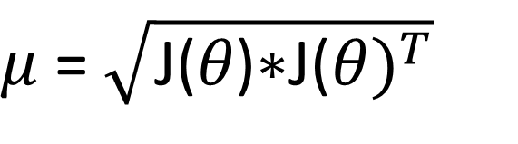
Manipulability Index
To analyze this problem, Yoshikawa (in 1983) proposed the following quantitative measure of manipulability.
$μ$ = $\sqrt{\text{J}\text{(}θ\text{)∗}{\text{J}\text{(}θ)}^{T}}$
Following were the facts established by Yoshikawa:
The singular value decomposition of J
$J=UΣV^{T}$ where U and V are Orthogonal matrices and
Then $μ$ = $σ_{1}∗σ_{2}$* $σ_{3}$* $σ_{4}$……. $σ_{m}$

Slide 10
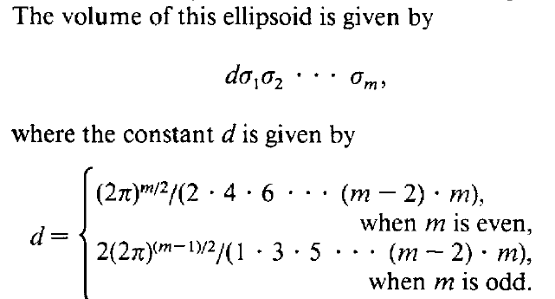
Manipulability Index
2) This forms an ellipsoid with principal axes$σ_{1}μ_{1},σ_{2}μ_{2}$, $σ_{3}μ_{3}$….. $σ_{m}μ_{m}$
This ellipsoid can be called the manipulability ellipsoid and could be a good means for the analysis, design, and control of robot manipulators.

Slide 11
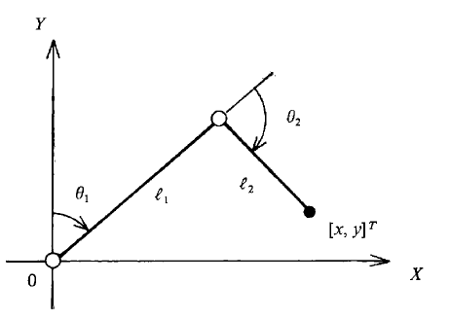


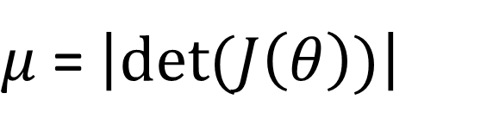
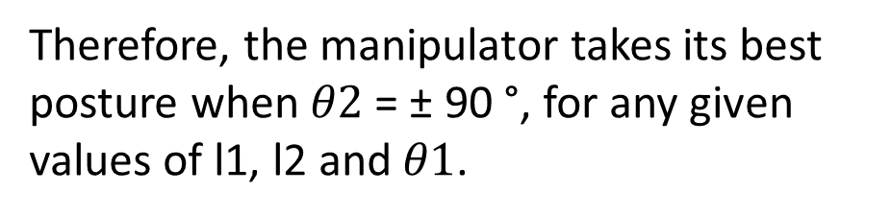
Manipulability Index
3) When m = n, that is, when we consider nonredundant manipulators, the measure $μ$ reduces to this
$μ$ = $\left|det⁡(J\left(θ\right))\right|$
Example: Two joint link mechanism
Therefore, the manipulator takes its best posture when $θ2$ = ± 90 °, for any given values of l1, l2 and $θ1$.

Slide 12
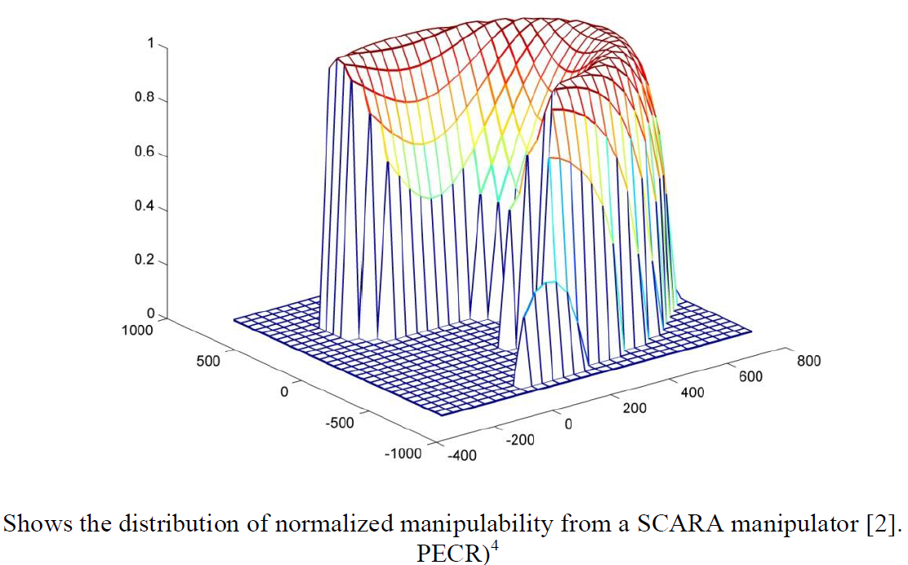
Manipulability Index

Slide 13
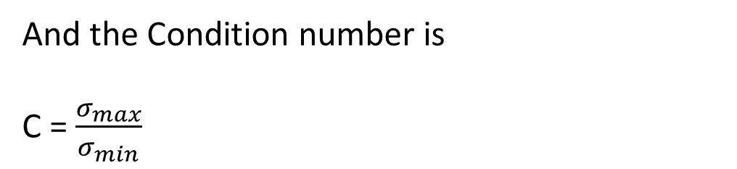
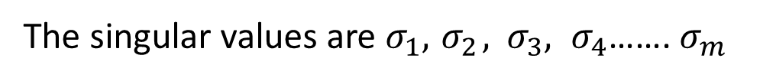
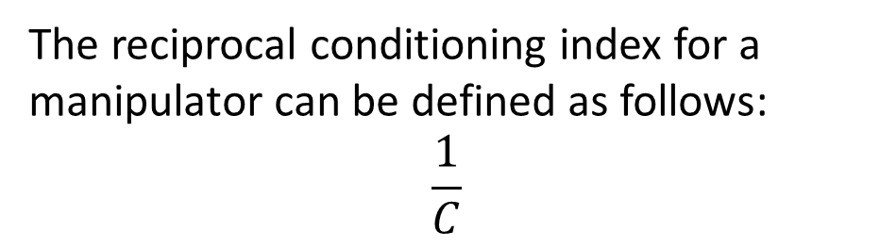
Condition Number
From Singular value Decomposion we had obtained
$J=UΣV^{T}$
The singular values are $σ_{1},{ σ}_{2},$ ${ σ}_{3}, σ_{4}$……. $σ_{m}$
And the Condition number is
C = $\frac{σ_{max}}{σ_{min}}$
Obviously the conditioning index depends on the joints coordinates of the manipulator and therefore it is posture-dependant.
The reciprocal conditioning index for a manipulator can be defined as follows:
$$\frac{1}{C}$$

Slide 14
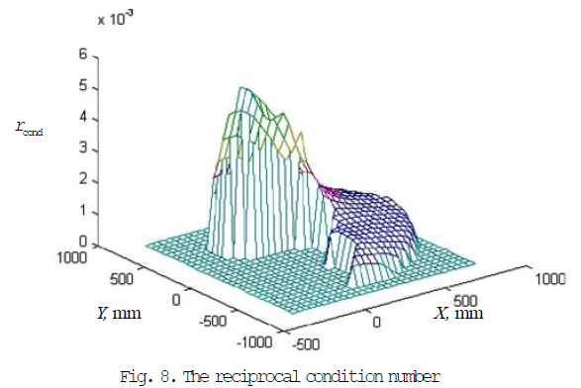
Condition Number

Slide 15
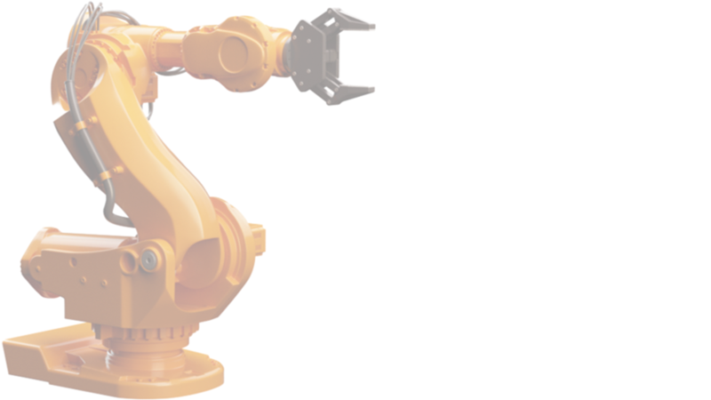
Thank You
Harsh Rana
BTech: Mechanical Engineering
Email: harsh.ajay@iitg.ac.in
Mobile Number: 9773102188
Department of Mechanical Engineering
Indian Institute of Technology, Guwahati
Guwahati, Assam

Slide 16


