Slide 1


Wire Arc Additive Manufacturing
Plots
By
Harsh Rana
Department of Mechanical Engineering
Indian Institute of Technology, Guwahati
Guwahati, Assam

Slide 2

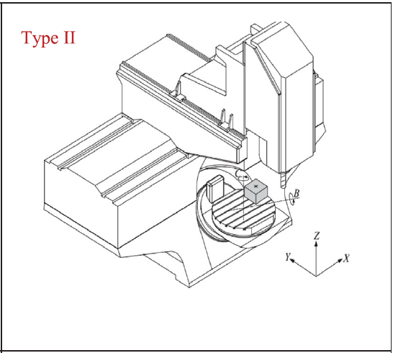
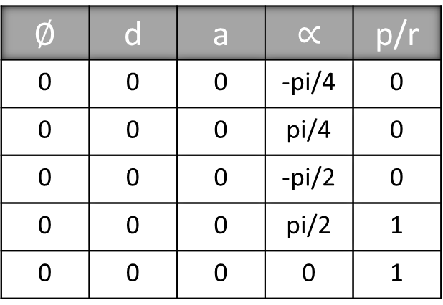
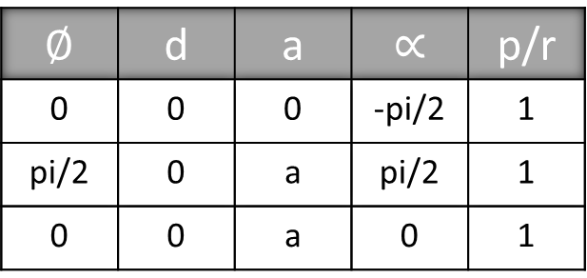
Trunnion table
For PPP tool plot
$$∅$$ | d | a | $$∝$$ | p/r
0 | 0 | 0 | -pi/2 | 1
pi/2 | 0 | a | pi/2 | 1
0 | 0 | a | 0 | 1
For Trunnion Table BC axis
$$∅$$ | d | a | $$∝$$ | p/r
0 | 0 | 0 | -pi/4 | 0
0 | 0 | 0 | pi/4 | 0
0 | 0 | 0 | -pi/2 | 0
0 | 0 | 0 | pi/2 | 1
0 | 0 | 0 | 0 | 1

Slide 3
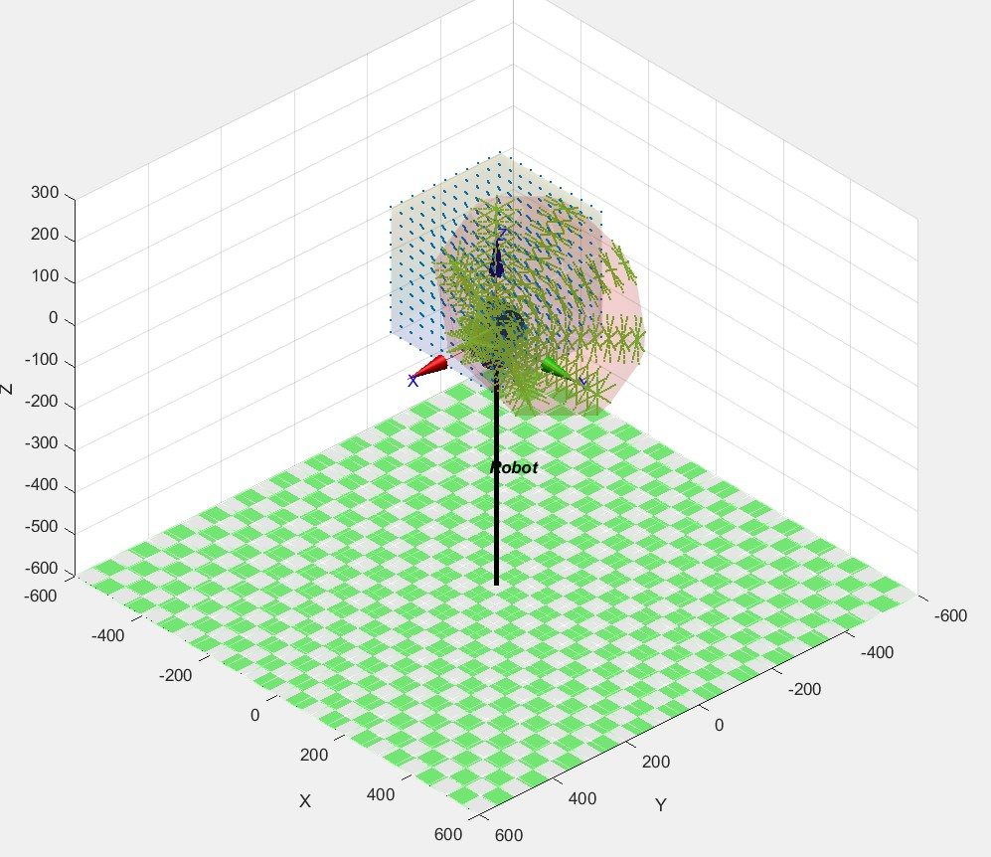
Trunnion table

Slide 4
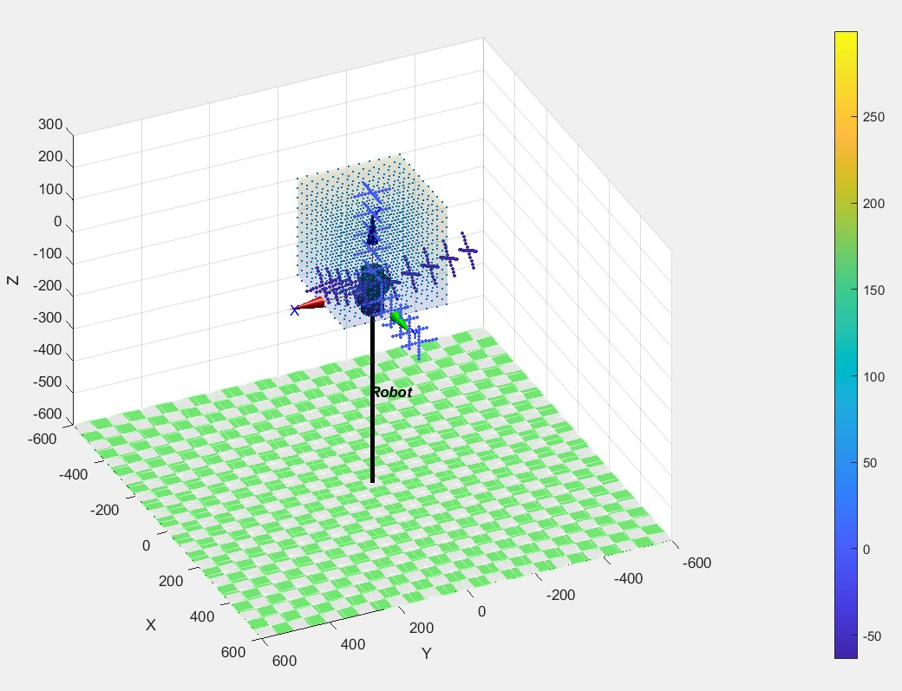
Trunnion table

Slide 5
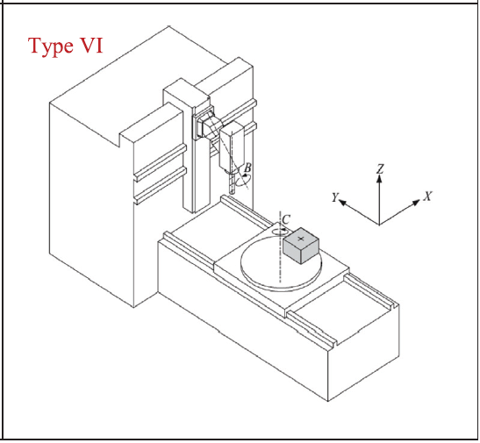
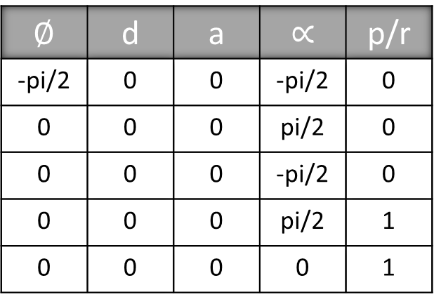
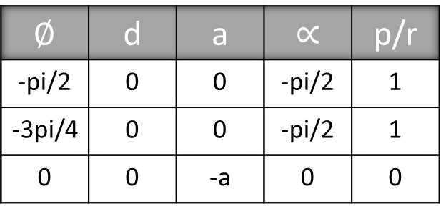
Swivel Head
For Swivel head tool plot
$$∅$$ | d | a | $$∝$$ | p/r
-pi/2 | 0 | 0 | -pi/2 | 1
-3pi/4 | 0 | 0 | -pi/2 | 1
0 | 0 | -a | 0 | 0
For Table C axis
$$∅$$ | d | a | $$∝$$ | p/r
-pi/2 | 0 | 0 | -pi/2 | 0
0 | 0 | 0 | pi/2 | 0
0 | 0 | 0 | -pi/2 | 0
0 | 0 | 0 | pi/2 | 1
0 | 0 | 0 | 0 | 1

Slide 6
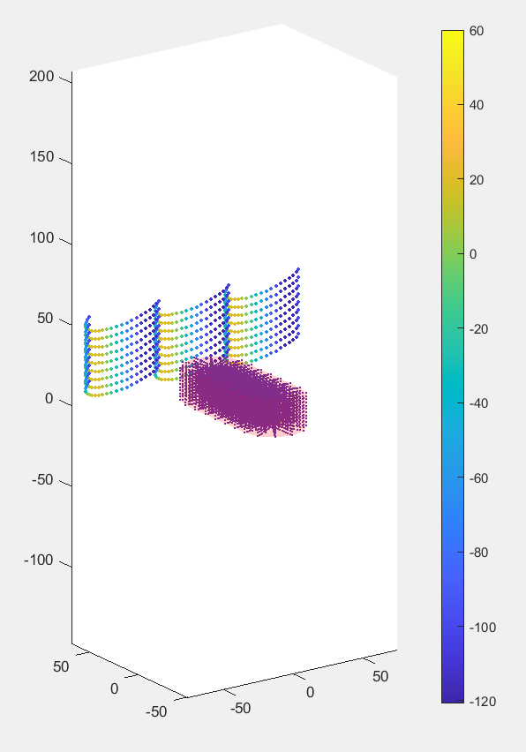
Swivel Head

Slide 7
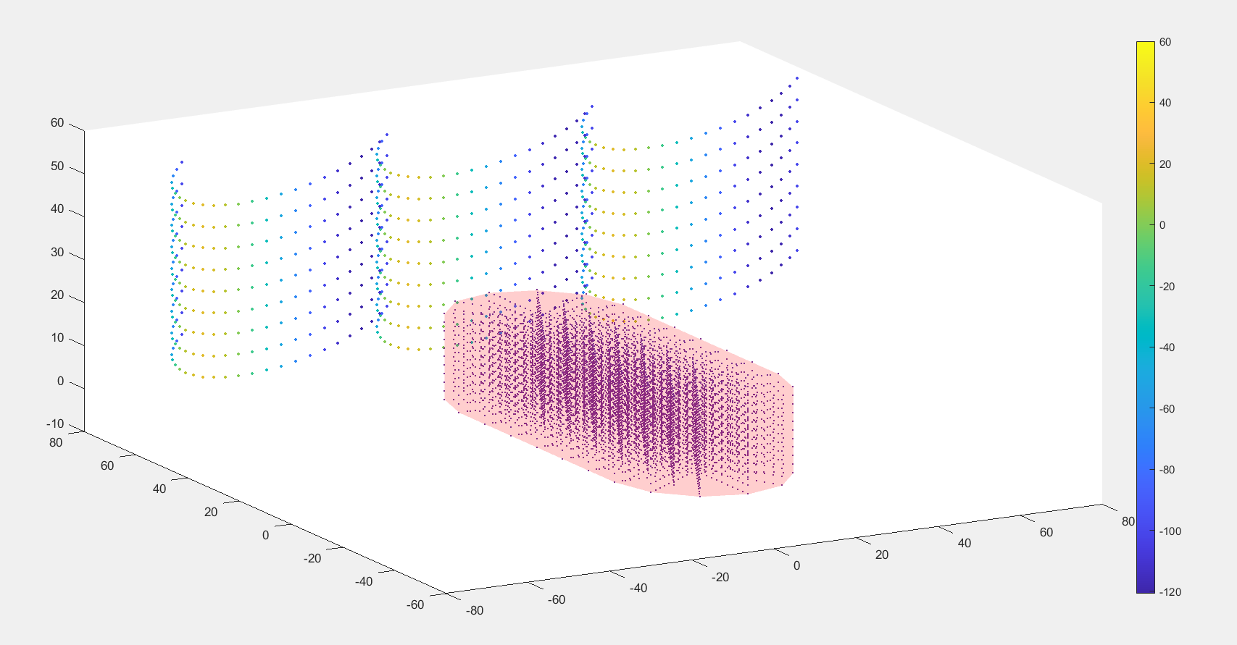
Swivel Head

Slide 8
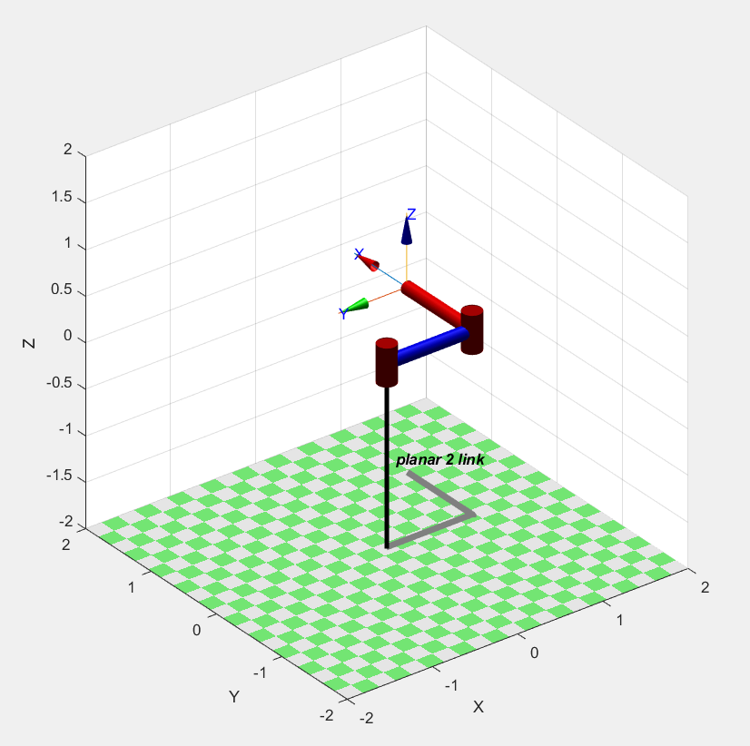
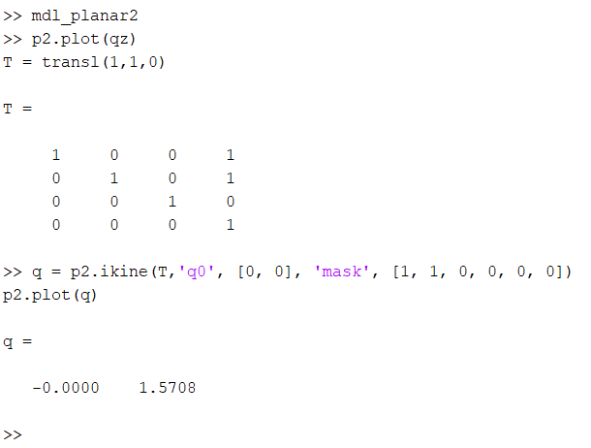
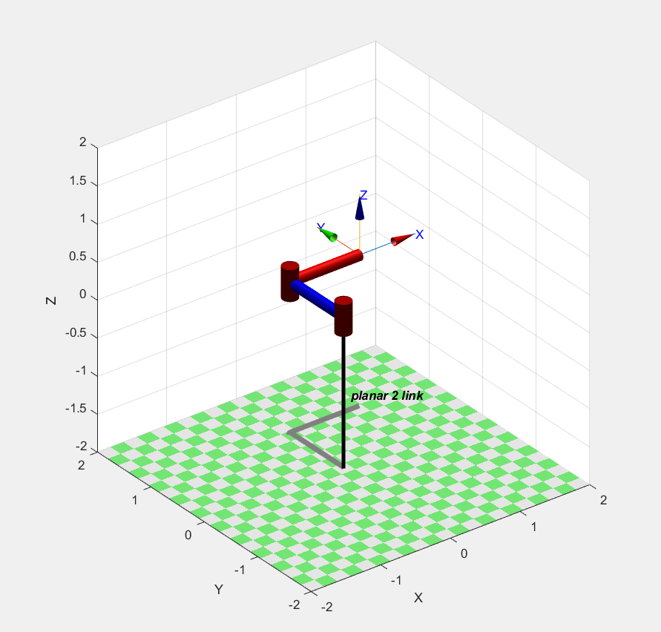
Inverse Kinematics

Slide 9
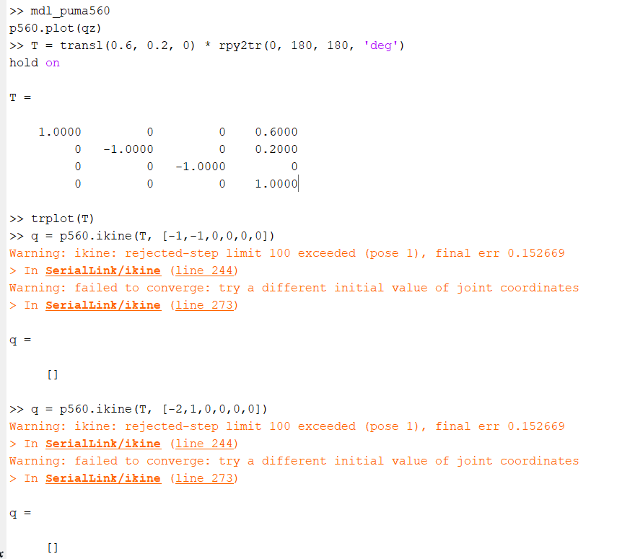
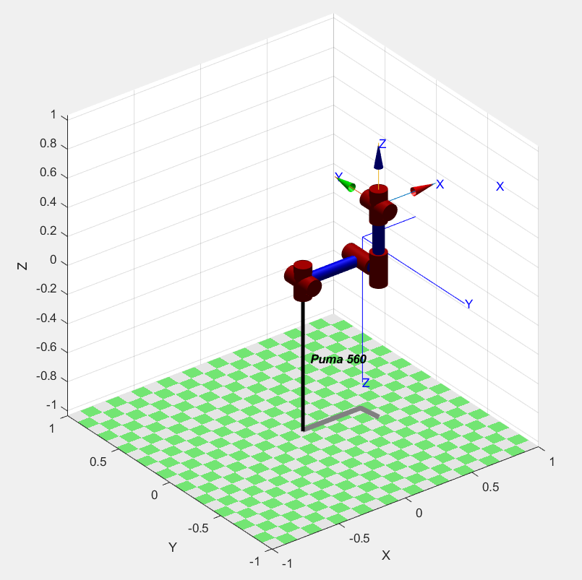
Inverse Kinematics

Slide 10
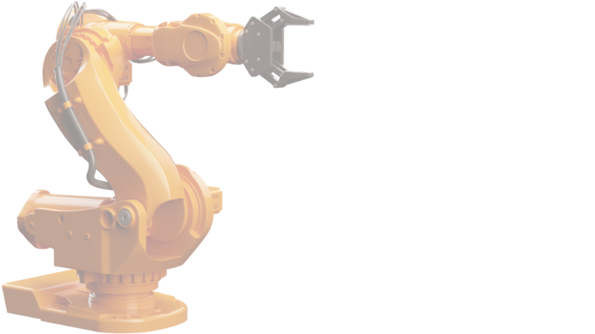

Slide 11


