Slide 1


Wire Arc Additive Manufacturing
Dexterity Algorithm
By
Harsh Rana
Department of Mechanical Engineering
Indian Institute of Technology, Guwahati
Guwahati, Assam

Slide 2

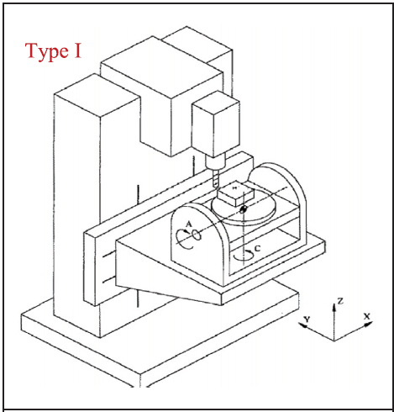
Trunnion table
The PPP Tool plot
This will not have any Dexterity as the Tool can point in only one direction (i.e. downwards)
But the Table can Orient itself, so we can calculate the dexterity of the points on the table!!!

Slide 3
Trunnion table
Wait ! Lets start simple . . . . . . Only C axis
h
Full Dexterity
Full Dexterity of points inside, No dexterity for points outside
<1 Dexterity of points above h, No dexterity for points below h

Slide 4
Trunnion table
Wait ! Lets start simple . . . . . . Only C axis
Right now this point can be reached
Right now this point can’t be reached
These points will always have Dexterity Zero
Remember: All points lying on the Circumference of a circle of radius “r” will have the same Dexterity!

Slide 5
Trunnion table
Now lets have C and A axis
Here also the dexterity for points on the circumference will be same, but now, it will depend on the A tilt also.
C
Z
Still the points on the circumference of the tilted cylinder will have same dexterity.
X
A
Y
B
We can get a 2D plot of dC varying with A tilt
Or we can get a 3D plot of dC varying with “A” tilt wrt height “h” of the cylinder.

Slide 6
Trunnion table
Now lets have C and A axis
Dexterity for points on the circumference will be same, but now, it will depend on the A tilt and B tilt also.
C
Z
X
A
Y
We can get a 3D plot of dC varying with “A” tilt and “B” tilt
We can get a 3D plot of dC varying with “A” tilt and “B” tilt
B
Or we can get a 4D plot of dC varying with “A” tilt and “B” tilt wrt height “h” of the cylinder.

Slide 7
Trunnion ka only A axis bhi karna hai !

Slide 8
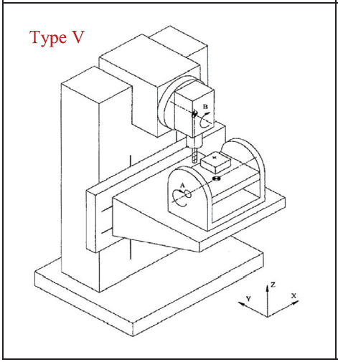
Swivel head table
The PPR Tool plot
Iska sochna baki hai !

Slide 9
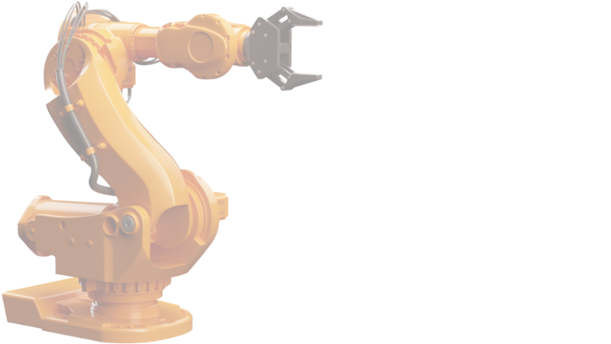
Thank You
Harsh Rana
Email: harsh.ajay@iitg.ac.in
Mobile Number: 9773102188
Department of Mechanical Engineering
Indian Institute of Technology, Guwahati
Guwahati, Assam

