Slide 1


Wire Arc Additive Manufacturing
Dexterity Algorithm
By
Harsh Rana
Department of Mechanical Engineering
Indian Institute of Technology, Guwahati
Guwahati, Assam

Slide 2

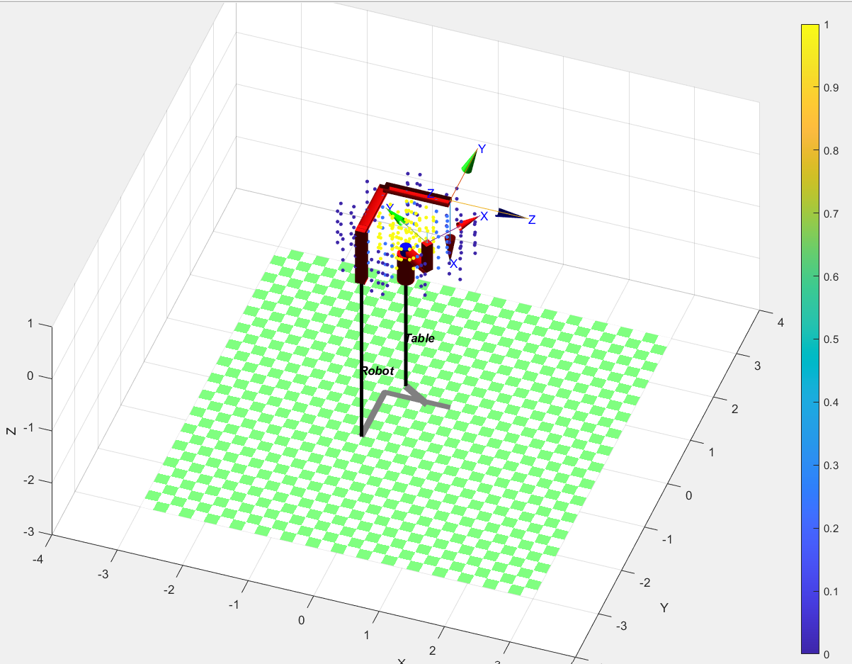
Trunnion table
Only C axis
We can only have dz calculated

Slide 3
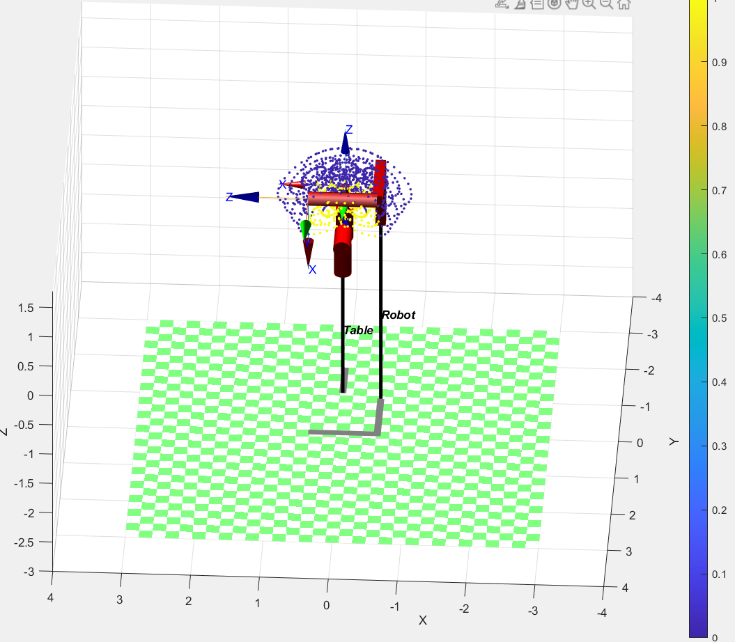
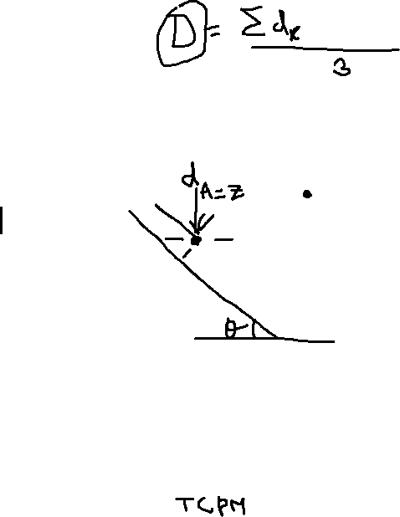
Trunnion table
Only A axis
What dexterity should we call this?
Should we call it dA ?

Slide 4
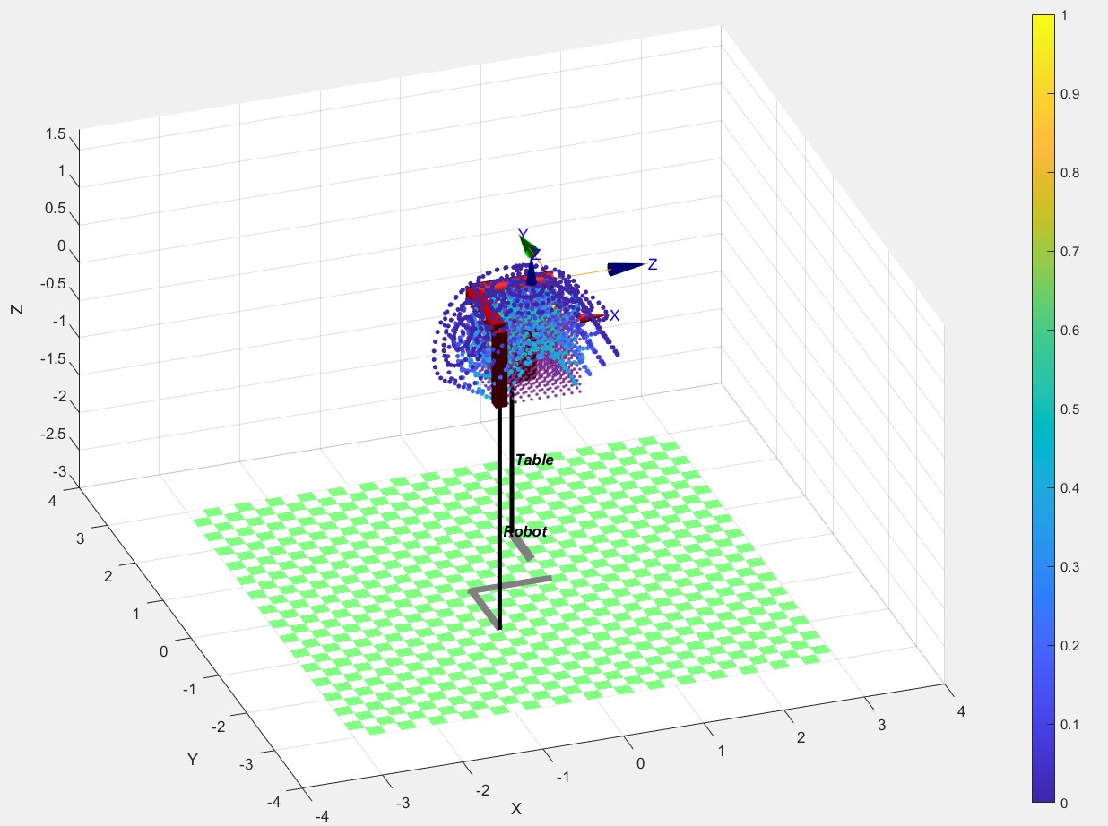
Trunnion table
A and C axis

Slide 6
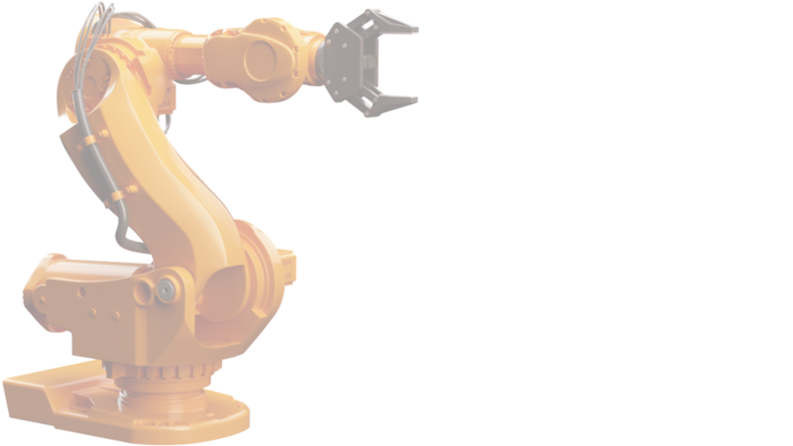
Thank You
Harsh Rana
Email: harsh.ajay@iitg.ac.in
Mobile Number: 9773102188
Department of Mechanical Engineering
Indian Institute of Technology, Guwahati
Guwahati, Assam

