Slide 1


Wire Arc Additive Manufacturing
Dexterity Algorithm
By
Harsh Rana
Department of Mechanical Engineering
Indian Institute of Technology, Guwahati
Guwahati, Assam

Slide 2

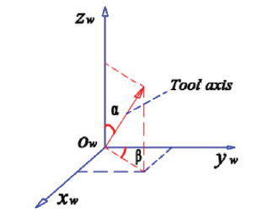
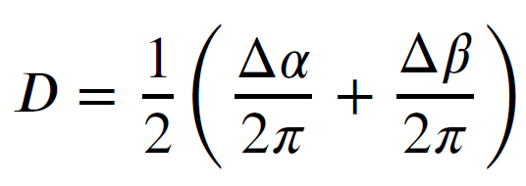
Dexterity Definition
The dexterity index is a measure of a 5-axis machine to achieve different orientations for each point within the workspace.
Similar to a robot manipulator, the orientation of the tool of a 5-axis machine can be described by a rotation matrix using parameters such as Euler angles, Roll-Pitch-Yaw angles, etc.
For 5-axis Machines a tilt angle 𝛼 and a roll angle 𝛽 should be considered to characterize the tool orientation relative to the workpiece

Slide 3
Trunnion table
Only C axis
Therefore: 0 ≤ D ≤ 0.5

Slide 4
Trunnion table
Only Aaxis
Therefore: 0 ≤ D ≤ 0.5

Slide 5
Trunnion table
Only Aaxis
All the points lying on this cylinder will have a fixed Dexterity that have already been calculated by varying 𝛼 and 𝛽 angles (i.e. by varying the rotary joint parameters)
0 ≤ D ≤ 1

Slide 6
Trunnion table
A and C axis
Here also all the points will have a fixed Dexterity that have already been calculated by varying the tilt and the rotatory table.

Slide 7
Trunnion table
A, B and C axis
Same for this…
But will the B axis have any contribution in dexterity?
Still there are only two angles that matter that are 𝛼 and 𝛽 .
Yes Obviously ☺
The primary benefit 6-axis CNC milling offers over the closely-related 5-axis configuration is faster cutting times. With an additional axis of freedom, certain tool movements and transitions can be executed with greater speed and efficiency.

Slide 8

Defining the angles
Z
𝛼
$$γ$$
𝛽
X
Y

Slide 9
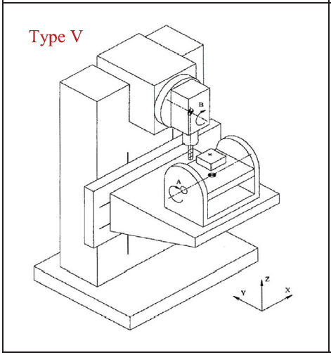
Swivel Head
Z
𝛽
𝛼
X
Y

Slide 10
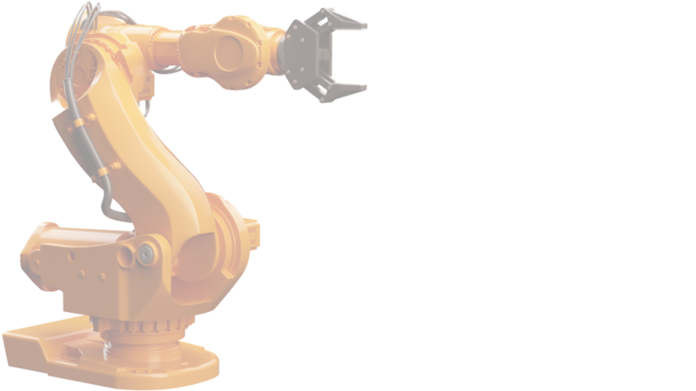
Thank You
Harsh Rana
Email: harsh.ajay@iitg.ac.in
Mobile Number: 9773102188
Department of Mechanical Engineering
Indian Institute of Technology, Guwahati
Guwahati, Assam

