Slide 1


Wire Arc Additive Manufacturing
Dexterity Plot
By
Harsh Rana
Department of Mechanical Engineering
Indian Institute of Technology, Guwahati
Guwahati, Assam

Slide 2

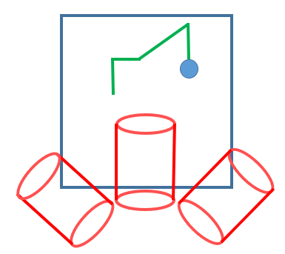
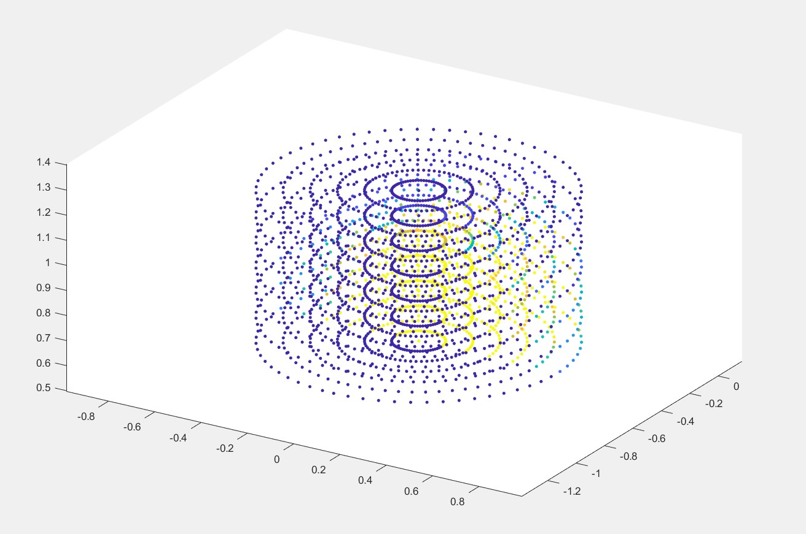
Dexterity for only A
Center is Yellow (Dex = 1) and it fades out to Blue (Dex = 0)
You can also see that the cluster of Yellow is situated little on the right side of the plot, this is due to the offset of the tool and the table.

Slide 3
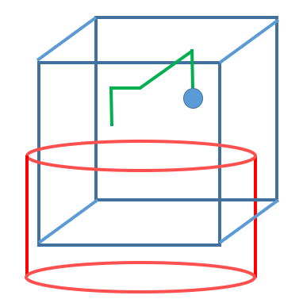
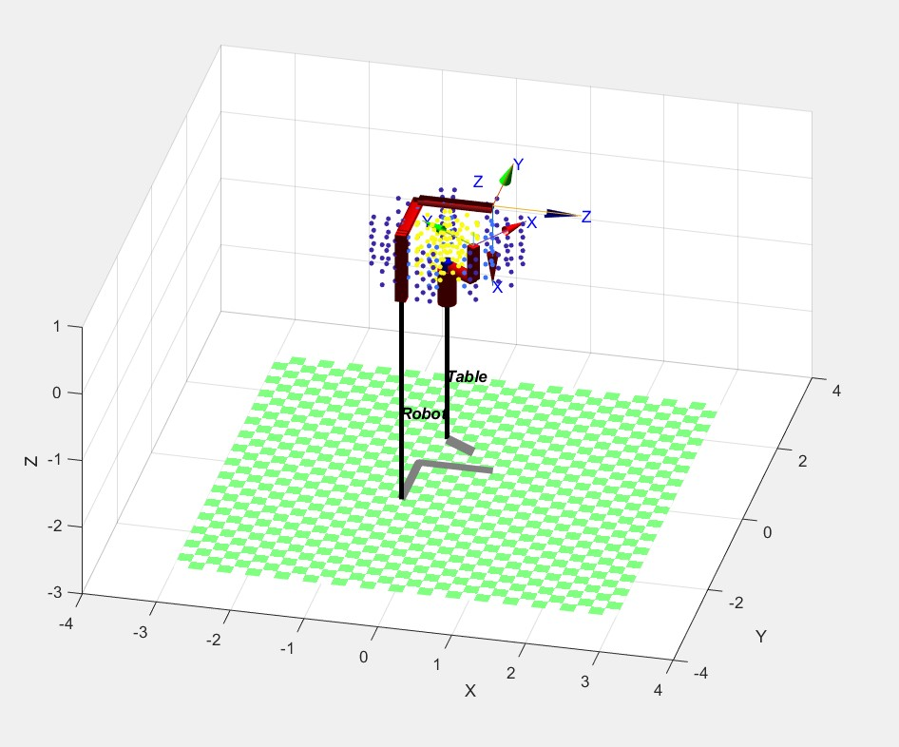
Dexterity for only C
Center is Yellow (Dex = 1) and it fades out to Blue (Dex = 0)------As Expected

Slide 4
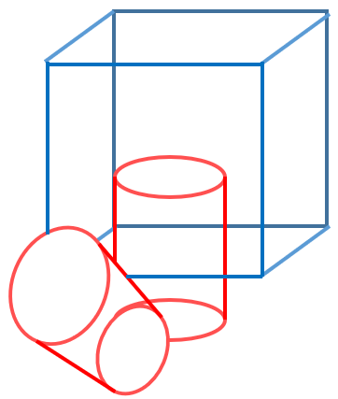
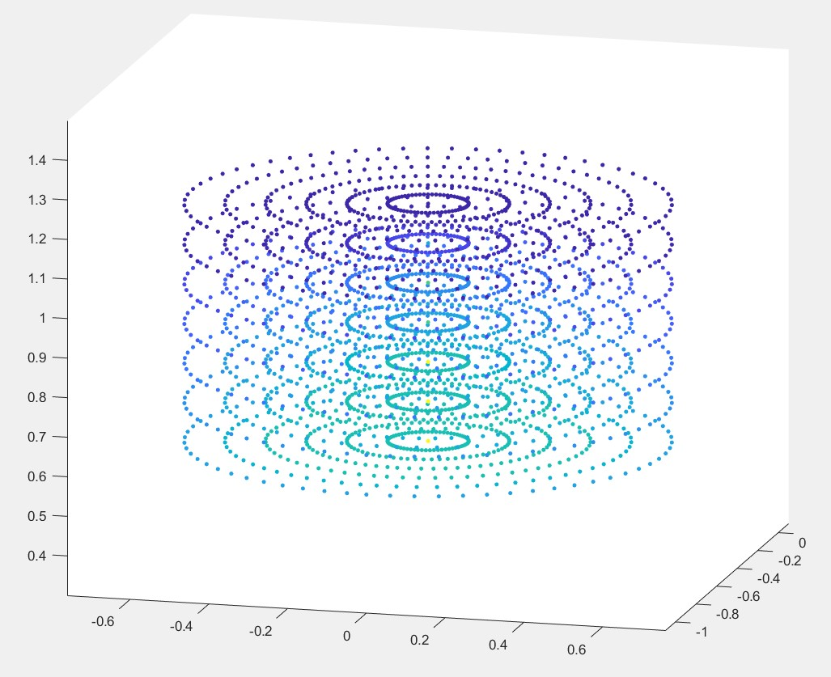
Dexterity for A and C
Few center dots are Yellow (Dex = 1) and the color fades out to Blue (Dex = 0)
You can also see that the top part is dark blue and bottom is light blue because when tilting, the top part will go out of the intersection more than the bottom part.

Slide 5
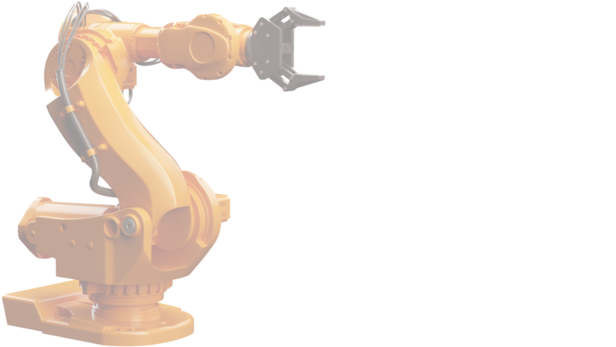
Thank You
Harsh Rana
Email: harsh.ajay@iitg.ac.in
Mobile Number: 9773102188
Department of Mechanical Engineering
Indian Institute of Technology, Guwahati
Guwahati, Assam

