Slide 1


AI
SmartCare
Explainable AI for Healthcare Appointment
No-Show Prediction
Option A -Appointment No-Show Prediction | Binary Classification
Group Members
Dewmi Abeykoon (CIT-23-02-0090)
Jayani Wathsala (CIT-23-02-0104)
Maliksha Pawani (CIT-23-02-0056)
Pabasara Maitipe (CIT-23-02-0138)

Slide 2

Overview
04
Preprocessing & Feature Engineering
Presentation Agenda
05
Exploratory Data Analysis
01
Problem Statement & Significance
06
Model Development & Tuning
02
Literature Review & Research Gap
07
Model Evaluation & Best Model
03
08
Explainable AI, Prototype & Conclusion
Dataset Overview

Slide 3

01. Problem Definition
Problem Statement
& Significance
Missed medical appointments disrupt healthcare resource planning, waste clinical capacity, and delay care for other
patients.
49.5%
  Goal: predict whether a patient will attend or miss (no-show) a scheduled appointment before it happens.
  Enables proactive interventions reminders, overbooking, or rescheduling for high-risk patients.
  Improves scheduling efficiency, reduces idle clinical time, and supports data driven healthcare management.
  Target variable:
no_show (0 = Attended, 1 = No-Show) -a binary classification problem.
of appointments in the sample data (495 / 1000) resulted in a no-show a near even split, ideal for classification.
------------------------------------------------------------
Why it matters ?
Healthcare systems worldwide lose significant clinical capacity to missed appointments early prediction supports preventive, resource efficient care.

Slide 4





02 · LITERATURE REVIEW
Literature Review & Research Gap
Reviewed five peer-reviewed studies on healthcare no-show and appointment attendance prediction.
Existing AI Approaches
Common Algorithms Found
  Logistic Regression as an interpretable baseline
  Tree-based ensembles (Random Forest, XGBoost)
  SHAP / LIME for post-hoc explainability
  Decision Trees & Random Forests
  Gradient boosting (XGBoost, LightGBM)
  Logistic Regression & SVM baselines
Limitations Identified
Research Gap Addressed
  Class imbalance rarely handled explicitly
  Limited model transparency in clinical use
  Small / single-site datasets limit generalisation
  Combines prediction with Explainable AI (SHAP)
  Compares 5 models on one consistent pipeline
  Delivers a usable clinical decision-support prototype

Slide 5
03. DATASET UNDERSTANDING
Feature Categories
Dataset Overview
Patient Demographics
Appointment Details
Previous Appointment History
Laboratory Information
1000
33
Vitals (BP, Sugar, Cholesterol, BMI)
Admission Information
Financial / Billing Information
Patient Records
Attributes
0
03
TARGET VARIABLE
no_show
Duplicate Records
Target Variables
(no_show)
0 = Attended
505 records
1 = No-Show
495 records
Two secondary datasets support bonus tasks: readmitted_30_days (readmission) and disease_risk_level (Low/Medium/High).

Slide 6

Missing Values
04. PREPROCESSING
906 missing entries handled with median / mode imputation, justified per attribute type.
Duplicates & Outliers
Duplicate check confirmed none present; outliers flagged in vitals & billing using the IQR method.
Encoding & Scaling
Categorical features one-hot / label encoded; numeric features standardised for scale-sensitive models.
Data Preprocessing
& Feature Engineering
Feature Engineering
New features created: Age_Group, High_BP flag, Missed_Rate, and previous-visit behaviour indicators.
Key Engineered Features
Age_Group
High_BP
Missed_Rate
Prior No-Show
Binned age into clinically meaningful groups
Flag derived from systolic / diastolic thresholds
Ratio of missed to total previous appointments
Indicator of past no-show behaviour

Slide 7

05. EXPLORATORY DATA ANALYSIS
Exploratory Data Analysis -
Key Insights
Visualisations Produced
Class Distribution Chart
Boxplots
Correlation Heatmap
Scatterplots
Histograms
Analysis Performed
What We Found
  Descriptive statistics across all numeric attributes
  Correlation analysis between vitals, billing & attendance
  Distribution analysis (histograms, boxplots)
  Class balance check on the target variable
Longer waiting_days strongly correlates with a higher
chance of no-show.
Patients with prior missed appointments are far more
likely to miss again.
No-show vs attended classes are nearly balanced
(49.5% vs 50.5%).

Slide 8
06 · MODEL DEVELOPMENT
Machine Learning Model Development
Five classification algorithms were trained and compared on an identical, stratified train/test split (80/20).
Logistic Regression
Decision Tree
Random Forest
K-Nearest Neighbors
XGBoost
Interpretable linear baseline; strong reference for feature relationships.
Non-linear, rule-based model capturing threshold effects (e.g. waiting days).
Ensemble of trees improving robustness and reducing overfitting.
Distance-based model predicting from similar historical patients.
Gradient boosting ensemble evaluated as an advanced, high-capacity model.
Best Model

Slide 9
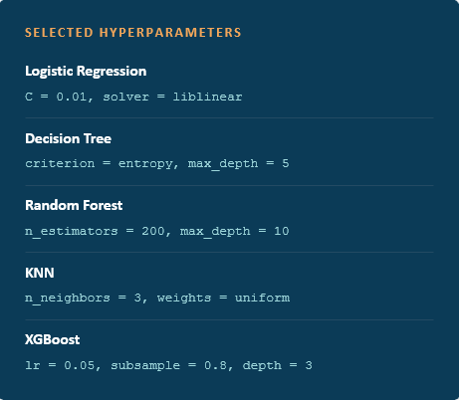

06. MODEL DEVELOPMENT
Hyperparameter Tuning & Validation Strategy
Stratified Split
80% train / 20% test, stratify=y to preserve class balance
GridSearchCV
Exhaustive search across candidate hyperparameter grids
5-Fold Cross-Validation
Each combination validated across 5 folds before selection
Best Params Selected
Highest cross-validated score refit on the full training set

Slide 10

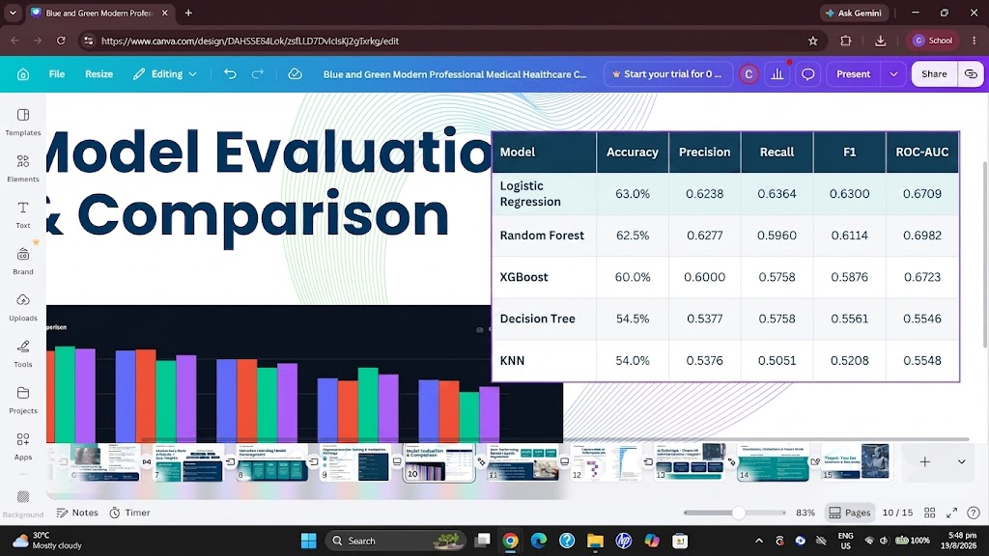
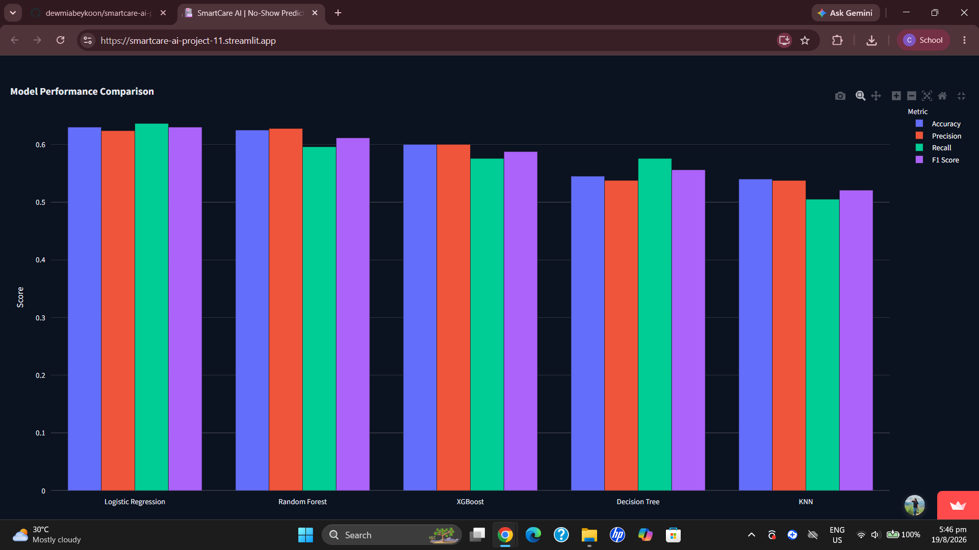
07. MODEL EVALUATION
Model Evaluation & Comparison
Best-performing model justified by the highest Accuracy, F1 and ROC-AUC among all five candidates on the held-out test set.

Slide 11

07. BEST MODEL
Best-Performing Model: Logistic Regression
63.00%
0.63
0.6709
Accuracy
F1-Score
ROC-AUC
Selected after comparing all five models across Accuracy, Precision, Recall, F1-Score and ROC-AUC on the held-out test set.
Why Logistic Regression Won
  Highest Accuracy, F1-Score and ROC-AUC of all five models
  Strong, near linear relationship between key features and no-show risk
  Fully interpretable coefficients - important for clinical trust
  Best generalisation with least evidence of overfitting

Slide 12
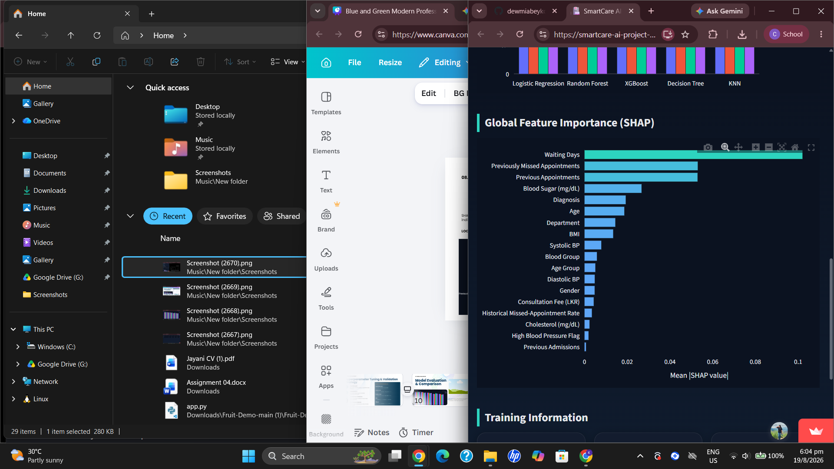
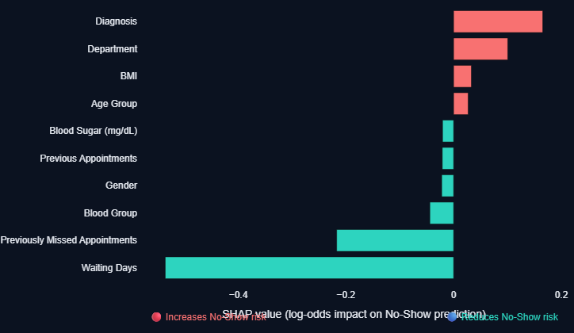
08. EXPLAINABLE AI
Explainable AI
SHAP Analysis
SHAP explains why the model makes each prediction both globally and for individual patients.
LOCAL EXPLAINABILITY
Top Global Drivers: waiting_days,
previous_appointments, missed_previous_appointments,
blood_sugar_mg_dl. Longer waits
and a history of missed visits push predictions
strongly toward no-show — supporting transparent,
ethically accountable clinical decisions.

Slide 13

08.PROTOTYPE
AI Prototype - Streamlit Clinical Decision Support
A working Streamlit web application lets a clinician enter patient &
appointment details and instantly receive a no-show risk prediction with
an explanation.
Accept Input
Process Data
Generate Prediction
Display Results
Clinician enters patient, appointment & clinical details
Inputs encoded & scaled to match the training pipeline
Trained Logistic Regression model scores no-show risk
Risk level + SHAP-based explanation shown to the user
Built With
Streamlit ·Plotly · Scikit-Learn· Joblib ·Pandas - deployed with a custom dark clinical-themed UI for real-time predictions.

Slide 14
CONCLUSION
Conclusion, Limitations & Future Work
WHAT WE ACHIEVED
LIMITATIONS & FUTURE WORK
  Built an end-to-end ML pipeline: preprocessing → EDA → modelling → evaluation → explainability
  Trained & compared 5 classification models with GridSearchCV tuning
  Selected Logistic Regression as the best model (63% accuracy, 0.6709 ROC-AUC)
  Delivered SHAP-based global & local explanations for transparency
  Deployed a working Streamlit prototype for real-time predictions
  Moderate accuracy (~63%) reflects a small, 1,000 record dataset a larger dataset should improve it
  Explore deep learning models and further class imbalance handling
  Apply model calibration and additional feature engineering
  Deploy via a hosted API with continuous monitoring
  Perform external validation on real hospital data

Slide 15



Thank You for
Questions & Discussion
GitHub Repository
Video Demonstration
github.com/dewmiabeykoon/smartcare-ai-project

