Slide 1
GAS SENSE
Compact Air Quality Monitor for CO, Smoke , and LPG
Harsha Kumari
Pranav Misra

Slide 2
What does it do?
Our gas detection project monitors and detects the levels of carbon monoxide (CO), Smoke(gas), and Liquefied Petroleum Gas (LPG) in the air.
The system is designed to provide real-time information about the concentration of these gases, helping users to ensure a safe and healthy environment.
Our project contributes to enhancing safety and air quality.

Slide 3
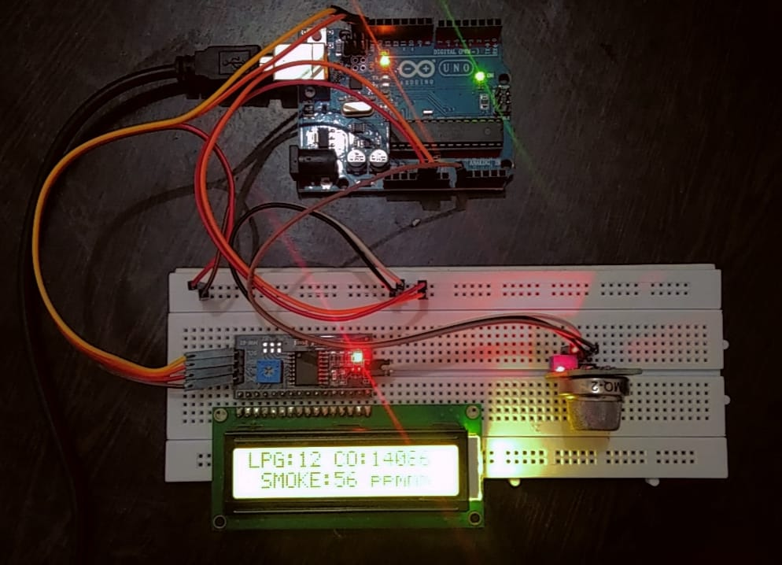
The Circuit

Slide 4
How is it different from the conventional Smoke Detector?
The Traditional Smoke Detector operates on the idea that if it detects fire or smoke, the buzzer makes a sound and we know that there is a fire. But fire is an “immediate hazard”, and we already have a lot of safety systems and awareness.
But, What about the chronic or long term hazards like CO poisoning?
Carbon Monoxide(CO) is a “Silent Killer”. It gradually accumulates in a person’s body, it cannot be sensed, unconsciousness and then death.
On an average there are about 3600 unintentional CO poisoning deaths in India.
So our aim here is provide a framework for monitoring Carbon Monoxide levels to ensure a safe and healthy work environment.

Slide 5
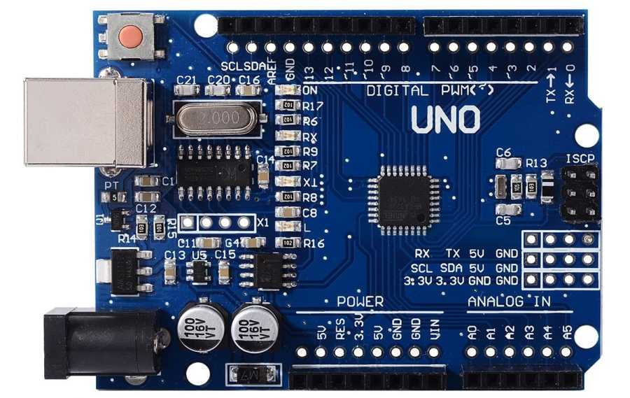
What are the components used?
1. Arduino Uno :
A microcontroller is an integrated circuit (IC) device used for controlling other portions of an electronic system, usually via a microprocessor unit (MPU), memory, and some peripherals.

Slide 6
Arduino Code:
void loop(){
float* values= mq2.read(true);
lpg = mq2.readLPG();
//co = values[1];
co = mq2.readCO();
//smoke = values[2];
smoke = mq2.readSmoke();
lcd.setCursor(0,0);
lcd.print("LPG:");
lcd.print(lpg);
lcd.print(" CO:");
lcd.print(co);
lcd.setCursor(0,1);
lcd.print("SMOKE:");
lcd.print((smoke*100)/1000000);
lcd.print(" %");
delay(1000);
}
#include <MQ2.h>
#include <Wire.h>
#include <LiquidCrystal_I2C.h>
//I2C pins declaration
LiquidCrystal_I2C lcd(0x27, 16, 2);
int Analog_Input = A0;
int lpg, co, smoke;
MQ2 mq2(Analog_Input);
void setup(){
Serial.begin(9600);
lcd.begin();
lcd.backlight();
mq2.begin();
}

Slide 7
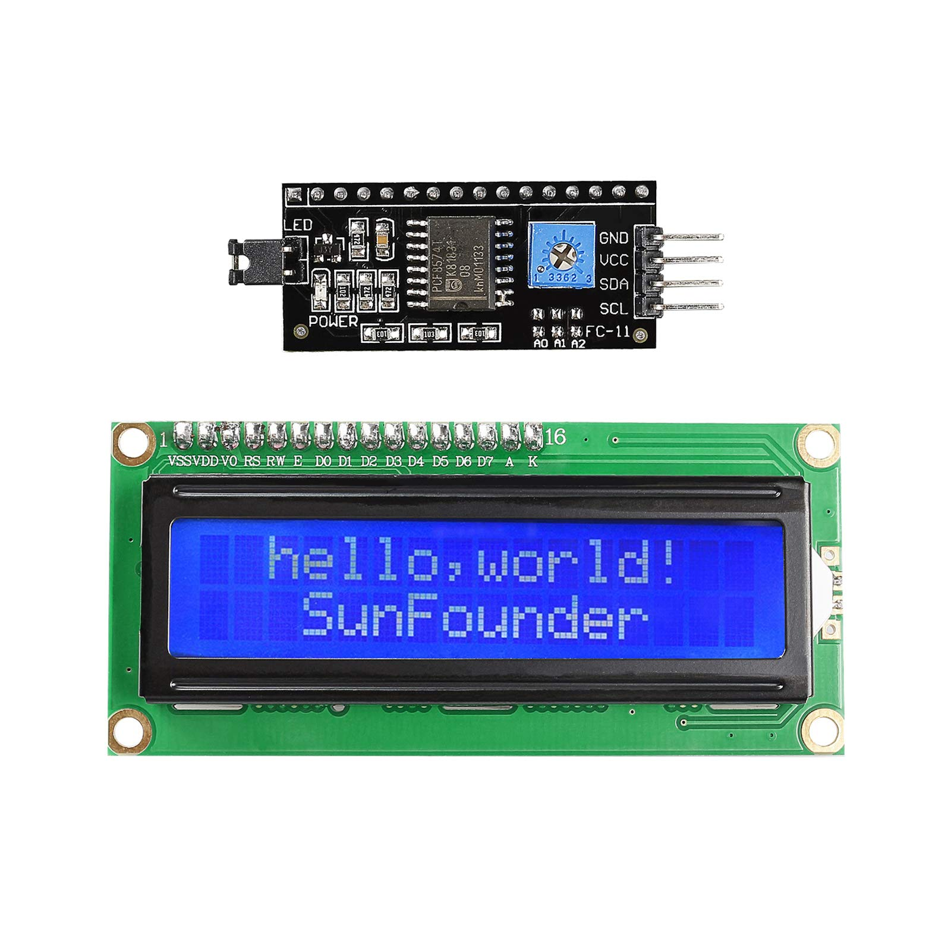
2. I2C Module With LCD Display
This controller takes care of converting the signals received from the sensor via I2C into commands and data that the LCD can understand.
__________________________________________
__________________________________________
__________________________________________

Slide 8
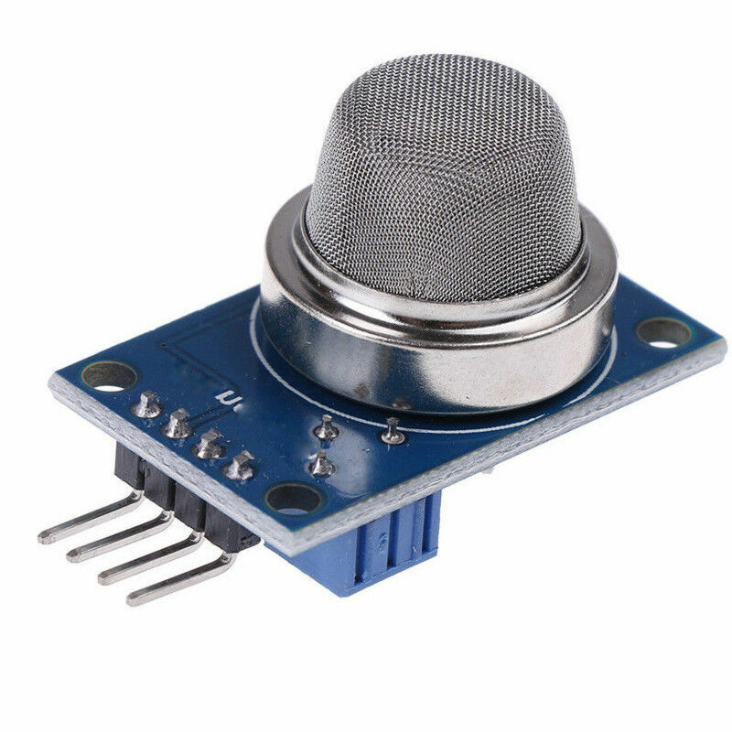
3. MQ2 Sensor:
The MQ-2 sensor is a type of gas sensor that is commonly used to detect a variety of gases in the air.

Slide 9
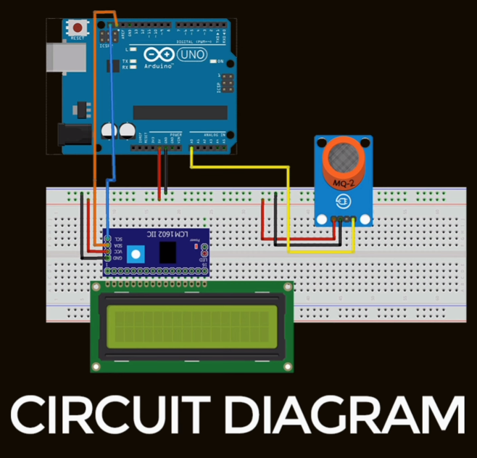
CIRCUIT DIAGRAM

Slide 10
What is the workflow?
Change in
Electrical
Conductivity
Gas Absorption
Heating
Element
Signal Processing
Calibration

Slide 11
Prevention Is Better Than Cure

Slide 12
What are its Real Life Applications?
PREVENTION OF
Domestic LPG Cylinder explosions
CO poisoning fatalities amongst workers and labours
Oil Refinery accidents
Gas Leaks in manufacturing plants

Slide 13
What can be the Future Enhancements?
Heat Sensor :
It can detect and alert about rising temperatures which can predict possible forest fires and fires in textile factories.
Humidity sensor :
It can warn about rising humidity levels in domestic and factory environments with the help of which we can know about possible dampness(सीलन) or leakages in the surroundings.
Software integration:
We plan to learn and integrate a cloud based application so that the real time data can be stored and monitored from remote locations.

Slide 14
Where do we lack?
Prototype:
It is just a prototype for the idea and the concept we aim to implement. The readings we observe here might not be totally accurate due to calibration and sensor issues.
Software Implementation:
We lack proficiency in integrating software with our module.
`

Slide 15
As Future Engineers, we aim to improve everyday to be better innovators and problem Solvers.

Slide 16
THANK YOU

