Slide 1


Capstone Project Bike Sharing Demand Prediction
Presented By
Student Name: Harshal Khemnar
College Name: Sanjivani College of Engineering, Kopargaon
Department: Computer Engineering
Email ID: shashikhemnar3@gmail.com
AICTE Student ID:

Slide 2
OUTLINE
Problem Statement
Data Description
Exploratory Data Analysis
Proposed System/Solution
System Development Approach
Algorithm & Deployment
Result (Output Image)
Conclusion
Future Scope
References

Slide 3
Problem Statement
Rental bikes are widely used in urban cities to improve mobility comfort. Ensuring bikes are available at the right time and place is a major challenge.
The key issue is accurately predicting the number of bikes required each hour to maintain a stable and efficient rental system, reduce wait times, and improve user satisfaction.

Slide 4
Data Description
The Seoul Bike Sharing Demand Dataset contains information about bike rentals in Seoul from Dec 2017 to Nov 2018.
It includes hourly observations of bike rentals, such as the date, time, number of rented bikes, weather conditions, and other factors that may influence bike rental demand.
This dataset contains more than 8700 rows and 14 columns of data.

Slide 5
Data Description
Date: The date of the observation.
• Rented Bike Count: The number of bikes rented during the observation period.
• Hour: The hour of the day when the observation was taken.
• Temperature(°C): The temperature in Celsius at the time of observation.
• Humidity(%): The percentage of humidity at the time of observation.
• Wind speed (m/s): The wind speed in meters per second at the time of observation.
• Visibility (10m): The visibility in meters at the time of observation.
• Dew point temperature(°C): The dew point temperature in Celsius at the time of observation.
• Solar Radiation (MJ/m2): The amount of solar radiation in mega-joules per square meter at the time of observation.
• Rainfall(mm): The amount of rainfall in millimeters during the observation period.
• Snowfall(cm): The amount of snowfall in centimeters during the observation period.
• Seasons: The season of the year when the observation was taken.

Slide 6
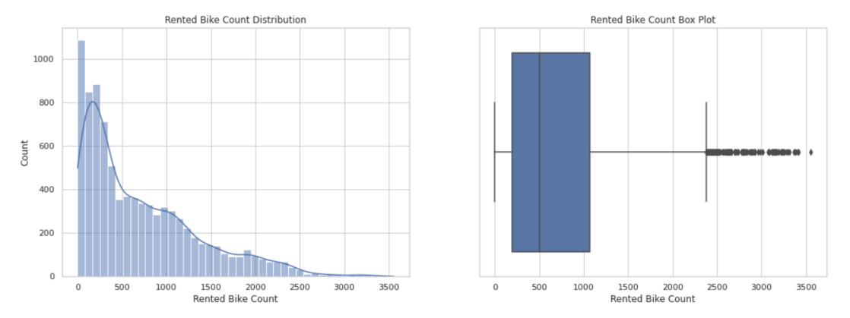
Exploratory Data Analysis
Rented Bike Count Distribution

Slide 7
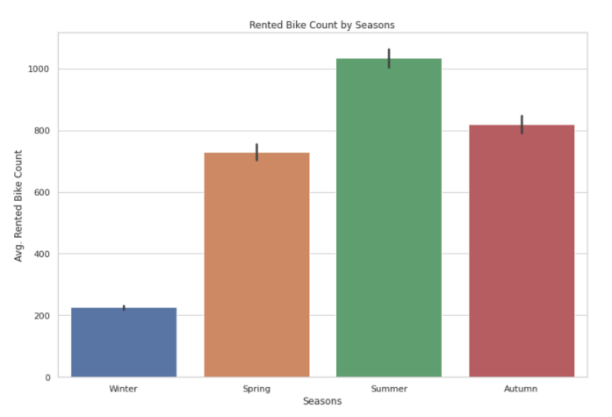
Exploratory Data Analysis
Rented Bike Count by Seasons
Rental Bike demand in winter season is significantly lower than other months.
Demand is highest in Summer

Slide 8
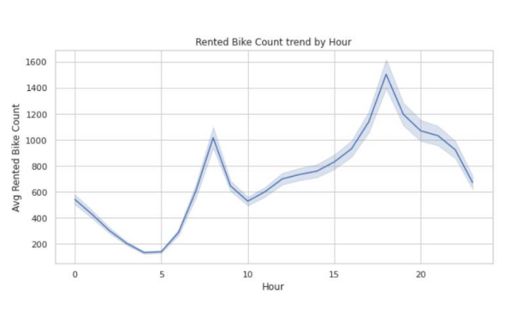
Exploratory Data Analysis
Rented Bike Count by Hour
We can see demand peaks during rush hours of the day.
Rush hour is generally around 8AM in the morning and 6PM in the evening.

Slide 9
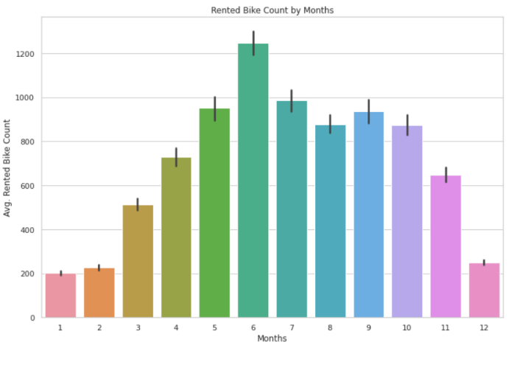
Exploratory Data Analysis
Rented Bike Count by Months
Similar to what we saw with seasons, demand decreases significantly during winter months like Dec, Jan, Feb etc.
Demand peaks at summer months like May, June July etc.

Slide 10
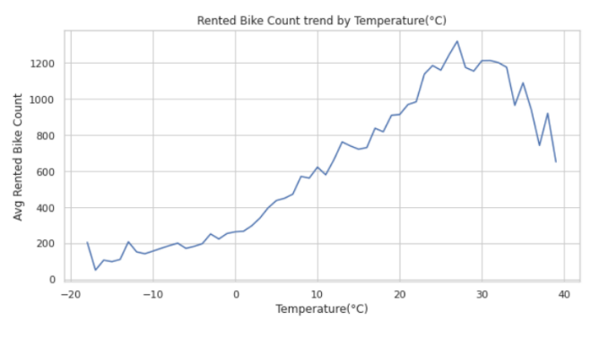
Exploratory Data Analysis
Rented Bike Count by Temperature
The Bike rental demand increases as the temperature increases.
Although too high temperature leads to decrease in demand again.

Slide 11
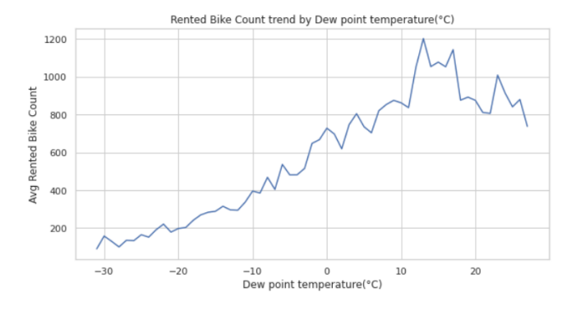
Exploratory Data Analysis
Rented Bike Count by Dew Point
Temperature
Similar trend for dew point temperature as well i.e., The Bike rental demand increases as the temperature increases.
Although too high dew point temperature leads to decrease in demand again.

Slide 12
Proposed Solution
The system aims to predict hourly bike demand using machine learning to ensure a stable supply of rental bikes.
Key Components:
Data Collection: Gather historical bike rental data and real-time inputs like weather and holidays.
Data Preprocessing: Clean data, handle outliers, and apply feature engineering for better model accuracy.
Machine Learning: Use models like XGBoost or LSTM, trained on time and weather-based features.
Deployment: Build a simple app or dashboard for real-time predictions on a reliable platform.
Evaluation: Measure model accuracy using MAE, RMSE, and fine-tune based on results.

Slide 13
System Approach
System Requirements:
Operating System: Windows/Linux
Processor: Intel i5 or higher
RAM: Minimum 8 GB
Software: Jupyter Notebook / VS Code
Python Version: 3.8 or above
Libraries Required:
pandas – for data manipulation
numpy – for numerical operations
matplotlib, seaborn – for data visualization
scikit-learn – for preprocessing and model training
xgboost – for implementing the XGBoost Regressor
statsmodels – for hypothesis testing
joblib – for model saving and deployment

Slide 14
Algorithm & Deployment
Algorithm Used: XGBoost Regressor was chosen for its high accuracy and ability to handle complex, non-linear patterns in the data.
Data Input: Features included hour, temperature, humidity, wind speed, visibility, season, holiday, and functioning day.
Training Process: Used 75% of data for training with cross-validation and hyperparameter tuning to improve performance and avoid overfitting.
Prediction Process: The model predicts hourly bike demand based on input features. It can be deployed with real-time weather and time data for live predictions.

Slide 15
Result
The XGBoost model achieved the best performance with an R² score of 0.94, accurately predicting hourly bike rental demand. It outperformed other models like Linear Regression and Random Forest. Visual comparisons between actual and predicted counts show high alignment, proving the model’s effectiveness. This ensures reliable and efficient bike availability for users.

Slide 16
Conclusion
The XGBoost model provided the best performance with an R² score of 0.94, accurately predicting hourly bike rental demand. This helps ensure stable supply, improves service efficiency, and enhances user satisfaction.
The model effectively handles multiple variables like weather, time, and season. It supports smart city planning and optimizes bike distribution in real-time. This project showcases the power of machine learning in solving real-world mobility problems.

Slide 17
Future scope
Real-time Prediction Integration: Implement real-time data pipelines to dynamically update bike demand forecasts using live weather, traffic, and event data.
Geo-Spatial Demand Forecasting: Expand the model to predict demand at specific stations or zones using GPS data, enabling better resource allocation across the city.
Integration with Smart Cities and IoT: Combine the prediction system with IoT sensors and smart docking stations to enable automatic bike redistribution and user alerts.
Mobile App Suggestion System: Provide users with real-time suggestions for bike availability or nearest stations based on demand forecasts.
Sustainable Urban Planning: Help city planners design more efficient bike lanes and infrastructure using long-term demand insights for sustainability and reduced traffic congestion.
Model Enhancement with Deep Learning: Explore advanced models like LSTM, XGBoost, or Graph Neural Networks (GNNs) to improve prediction accuracy.

Slide 18
References
UCI Machine Learning Repository – Bike Sharing Dataset Fanaee-T, Hadi, and Gama, Joao.
Source: https://archive.ics.uci.edu/ml/datasets/Bike+Sharing+Dataset This dataset is widely used for time-series and regression analysis in bike demand prediction.
Kaggle – Bike Sharing Demand Competition
Source: https://www.kaggle.com/competitions/bike-sharing-demand A popular machine learning challenge for predicting the number of bike rentals in an hour using historical data.
Zhao, Yi, et al. (2018). "Predicting bike sharing demand using LSTM neural network." In International Journal of Advanced Computer Science and Applications.
DOI: 10.14569/IJACSA.2018.090765

Slide 19
Thank you

