Slide 1
CS60075 Natural Language Processing Autumn 2020
Indian Institute of Technology Kharagpur
Department of Computer Science & Engineering
Module 11:
Summarization
10 November 2020

Slide 2
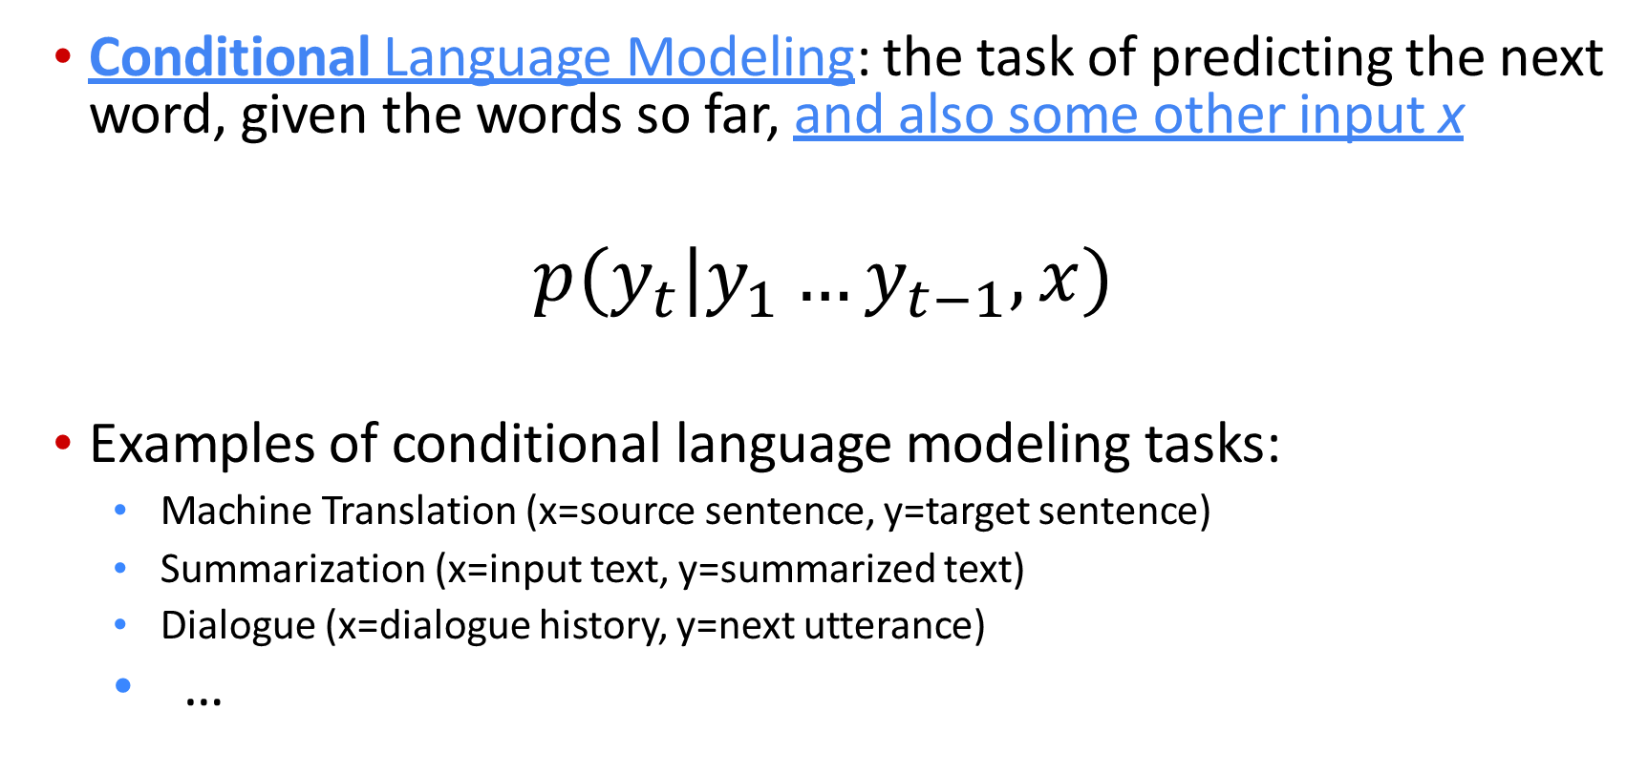
Recap
Conditional Language Modeling: the task of predicting the next word, given the words so far, and also some other input x
$$p(y_{t}|y_{1}…y_{t−1},x)$$
Examples of conditional language modeling tasks:
Machine Translation (x=source sentence, y=target sentence)
Summarization (x=input text, y=summarized text)
Dialogue (x=dialogue history, y=next utterance)
…

Slide 3
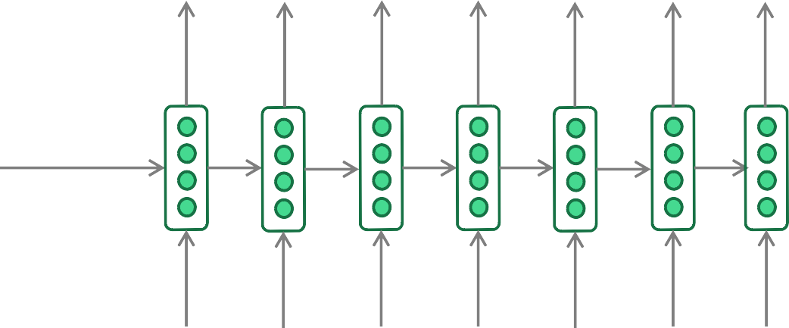
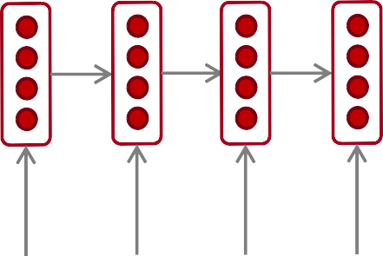
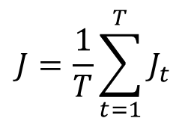
Recap: training a (conditional) RNN-LM
This example: Neural Machine Translation
= negative log prob of “he”
= negative log prob of “with”
= negative log prob of <END>
$$J=\frac{1}{T}\sum_{t=1}^{T}{J_{t}}$$
=
J1
+
J2
+
J3
J4 J5
J6
J7
+
+
+
Probability dist of next word
"!# "!$
"!% "!&
"!' "!₍ "!₎
Encoder RNN
Decoder RNN
il
m’
a entarté
<START> he
hit
me with
a
pie
Source sentence (from corpus)
Target sentence (from corpus)
During training, we feed the gold (aka reference) target sentence into the decoder, regardless of
what the decoder predicts. This training method is called Teacher Forcing.

Slide 4
Summarization: task definition
Task: given input text x, write a summary y which is shorter and contains the main information of x.
Summarization can be single-document or multi-document.

Slide 5
Summarization: task definition
Within single-document summarization, there are datasets with source documents of different lengths and styles:
Gigaword: first one or two sentences of a news article → headline (aka sentence compression)
LCSTS (Chinese microblogging): paragraph → sentence summary
NYT, CNN/DailyMail: news article → (multi)sentence summary
Wikihow (new!): full how-to article → summary sentences
Sentence simplification is a different but related task: rewrite the source text in a simpler (sometimes shorter) way
Simple Wikipedia: standard Wikipedia sentence → simple version
Newsela: news article → version written for children
List of summarization datasets, papers, and codebases: https://github.com/mathsyouth/awesome-text-summarization

Slide 6
Summarization
Indian Express — A massive earthquake of magnitude 7.3 struck Iraq on Sunday, 103 kms (64 miles) southeast of the city of As-Sulaymaniyah, the US Geological Survey said, reports Reuters. US Geological Survey ini:ally said the quake was of a magnitude 7.2, before revising it to 7.3.
The quake has been felt in several Iranian cities and eight villages have been damaged. Electricity has also been disrupted at many places, suggest few TV reports.
Summary A massive earthquake of magnitude 7.3 struck Iraq on Sunday. The epicenter was close to the Iranian border. Eight villages were damaged and six people were killed in Iran.

Slide 7
What makes a good summary?
Summary
A strong earthquake of magnitude 7.3 struck Iraq and Iran on Sunday. The epicenter was close to the Iranian border. Eight villages were damaged and six people were killed in Iran.
Content selection: pick the right content
Right content was repeated within and across documents
Domain-speciﬁc (magnitude + epicenter of earthquakes are important)
Generation: write the summary
Extraction: pick whole sentences from the summary
Compression: compress those sentences but basically just do deletion
Abstraction: rewrite + re-express content freely

Slide 8
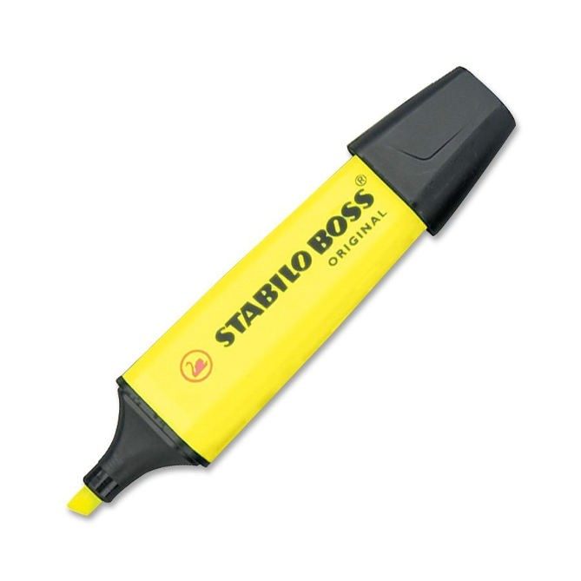

Summarization: two main strategies
Extractive summarization Abstractive summarization
Select parts (typically sentences) of the original text to form a summary.
Generate new text using natural language generation techniques.
Easier
Restrictive (no paraphrasing)
More difficult
More flexible (more human)
22

Slide 9


Overview
Abstractive Summarization
Select phrases or sentences from the source document
Encoder
Article
Representations
Decoder
Alexander M Rush, Sumit Chopra, and Jason Weston. A neural attention model for abstractive sentence summarization. EMNLP 2015.
Ramesh Nallapati, Bowen Zhou, Cicero dos Santos, Caglar Gulcehre, and Bing Xiang. Abstractive text summarization using sequence-tosequence rnns and beyond. CoNLL 2016.
Abigail See, Peter J Liu, and Christopher D Manning. Get to the point: Summarization with pointergenerator networks. ACL 2017.
Romain Paulus, Caiming Xiong, and Richard Socher. A deep reinforced model for abstractive summarization. ICLR 2018.
Fan, Angela, David Grangier, and Michael Auli. Controllable abstractive summarization. arXiv preprint arXiv:1711.05217 (2017).
Notes:
With the advance of deep learning techiques, more and more research aims to generate abstractive summaries.
They use large paired data to train an encoder-decoder network.
This is a more challenging problem compared with extractive method.
But abstractive method provides a more flexible solution for summarization.
We can not only control the length but also style and content of the generated summaries.

Slide 10
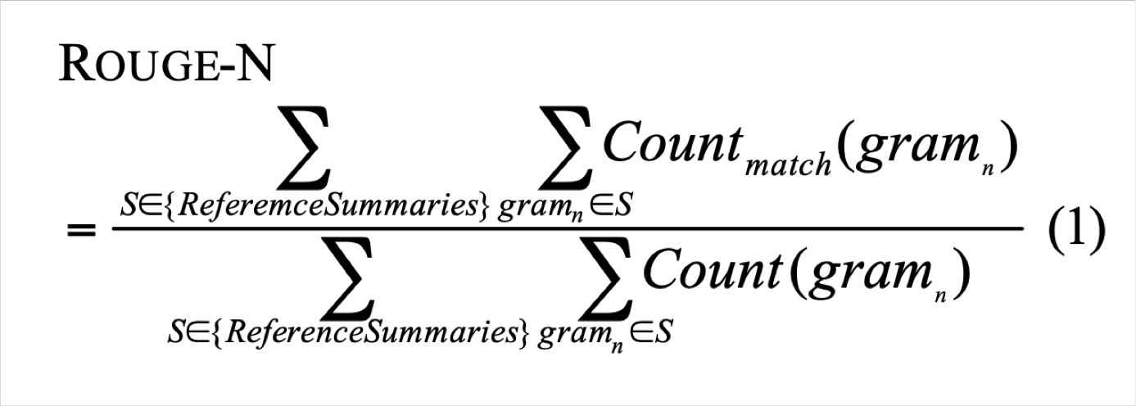
Summarization evaluation: ROUGE
ROUGE (Recall-Oriented Understudy for Gisting Evaluation)
Like BLEU, it’s based on n-gram overlap. Differences:
ROUGE has no brevity penalty
ROUGE is based on recall, while BLEU is based on precision
Arguably, precision is more important for MT (then add brevity penalty to fix under-translation), and recall is more important for summarization (assuming you have a max length constraint)
However, often a F1 (combination of precision and recall) version of ROUGE is reported anyway.
ROUGE: A Package for Automatic Evaluation of Summaries, Lin, 2004 http://www.aclweb.org/anthology/W04-1013

Slide 11
Summarization evaluation: ROUGE
BLEU is reported as a single number, which is combination of the precisions for n=1,2,3,4 n-grams
ROUGE scores are reported separately for each n-gram
The most commonly-reported ROUGE scores are:
ROUGE-1:* unigram overlap
ROUGE-2: bigram overlap
ROUGE-L: longest common subsequence overlap
There is now a convenient Python implementation of ROUGE!
Python implementation of ROUGE: https://github.com/google-research/google-research/tree/master/rouge

Slide 12
Evaluation Metric
METEOR
Sentence-level similarity scores. Search all possible alignments.
Exact
Match words if they are identical.
Stem
Match stem words using a language appropriate Snowball Stemmer (Porter, 2001).
Synonym
Match words that share membership in any synonym set based on WordNet database.
Paraphrase
Match phrases if they are listed as paraphrases in a defined paraphrase table.

Slide 13
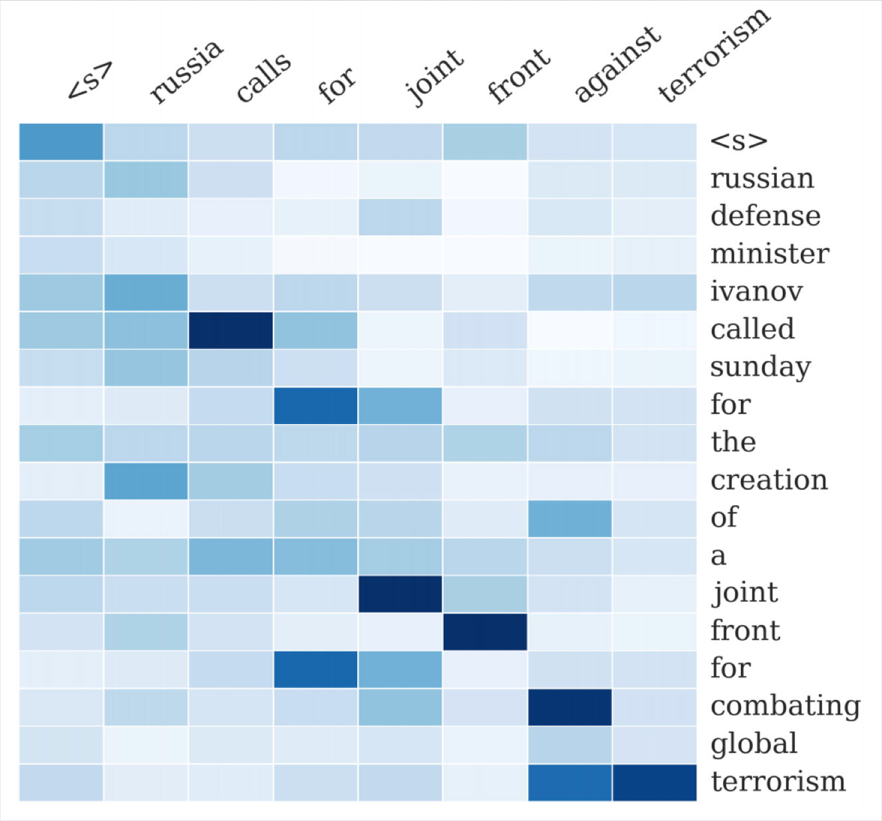
Neural summarization (2015 - present)
2015: Rush et al. publish the first seq2seq summarization paper
Single-document abstractive summarization is a translation task!
Thus we can apply standard seq2seq + attention NMT methods
A Neural Attention Model for Abstractive Sentence Summarization, Rush et al, 2015 https://arxiv.org/pdf/1509.00685.pdf

Slide 14
Neural summarization (2015 - present)
Since 2015, there have been lots more developments!
Making it easier to copy
But also preventing too much copying!
Hierarchical / multi-level attention
More global / high-level content selection
Using Reinforcement Learning to directly maximize ROUGE, or other discrete goals (e.g. length)
Resurrecting pre-neural ideas (e.g. graph algorithms for content selection) and working them into neural systems
• …
List of summarization datasets, papers, and codebases: https://github.com/mathsyouth/awesome-text-summarization
A Survey on Neural Network-Based Summarization Methods, Dong, 2018 https://arxiv.org/pdf/1804.04589.pdf

Slide 15
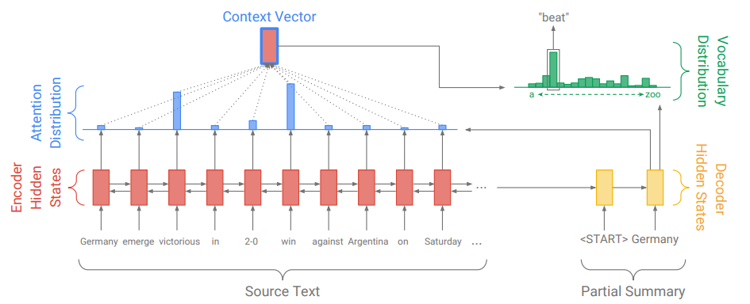
Abstractive Summarization: Sequence-to-sequence attentional model
Problems?
Out Of Vocabulary words

Slide 16
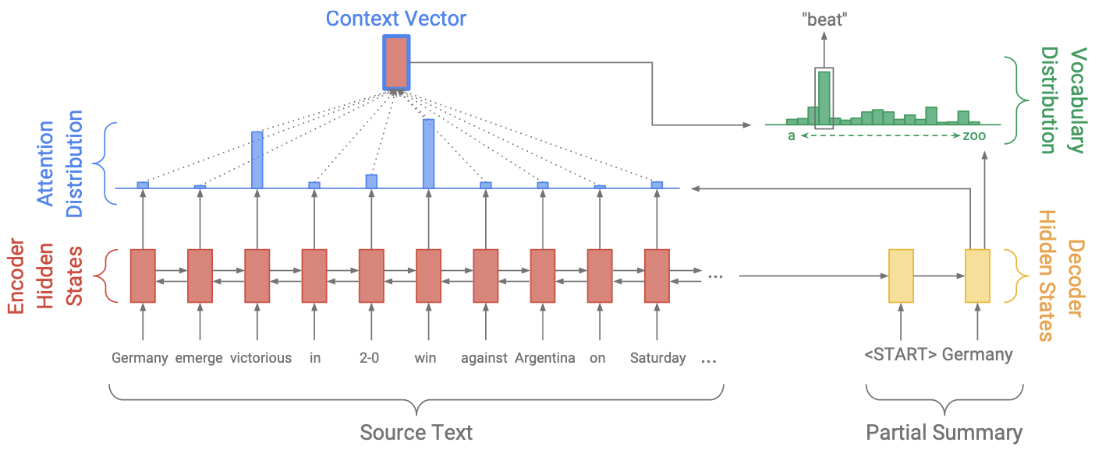





Slide 17
Neural summarization: copy mechanisms
Seq2seq+attention systems are good at writing fluent output, but bad at copying over details (like rare words) correctly
Copy mechanisms use attention to enable a seq2seq system to easily copy words and phrases from the input to the output
Clearly this is very useful for summarization
Allowing both copying and generating gives us a hybrid extractive/abstractive approach
There are several papers proposing copy mechanism variants:
Language as a Latent Variable: Discrete Generative Models for Sentence Compression, Miao et al, 2016 https://arxiv.org/pdf/1609.07317.pdf
Abstractive Text Summarization using Sequence-to-sequence RNNs and Beyond, Nallapati et al, 2016 https://arxiv.org/pdf/1602.06023.pdf
Incorporating Copying Mechanism in Sequence-to-Sequence Learning, Gu et al, 2016 https://arxiv.org/pdf/1603.06393.pdf
etc

Slide 18
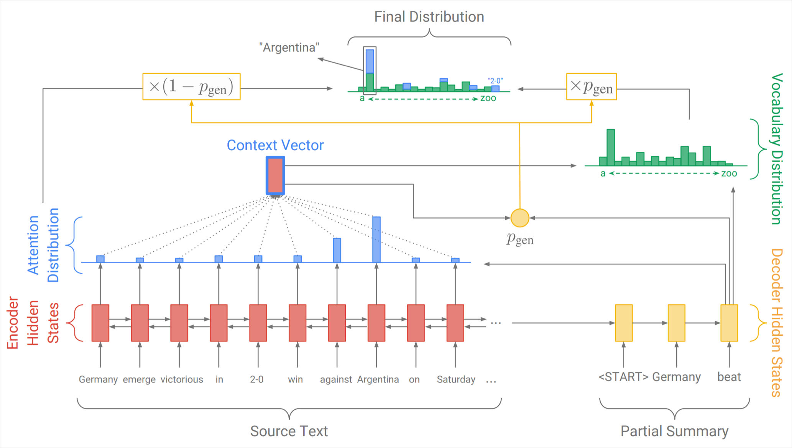
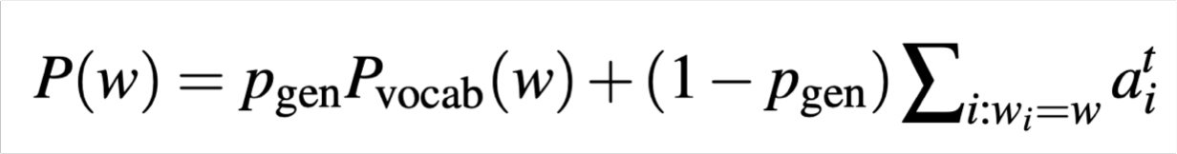
Neural summarization: copy mechanisms
One example of how to do a copying mechanism:
On each decoder step, calculate p_{gen}, the probability of generating the next word (rather than copying it). The final distribution is a mixture of the generation (aka “vocabulary”) distribution, and the copying (i.e. attention) distribution:
Get To The Point: Summarization with Pointer-Generator Networks, See et al, 2017 https://arxiv.org/pdf/1704.04368.pdf

Slide 19
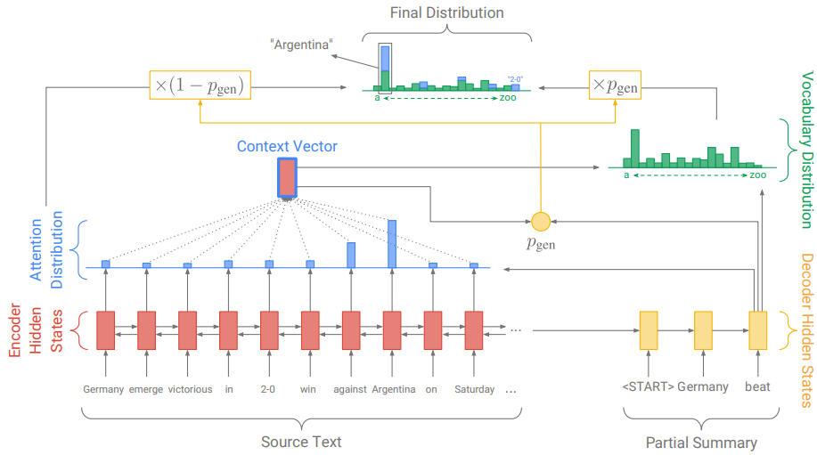

Slide 20




Coverage mechanism
To address the repetition issue.
Coverage vector c’
(sum of attention)
Additional input to attention
Inform attention network a reminder of its previous decisions.
Coverage loss
Final loss

Slide 21
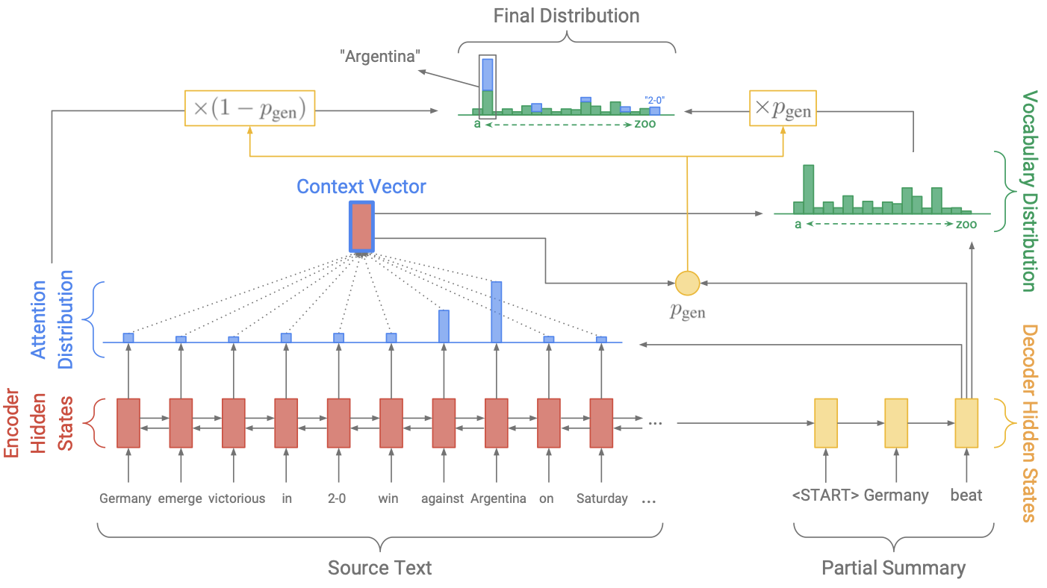



Coverage Mechanism
Notes:
Explain that they already had this in Machine Translation covloss: When the coverage vector is 0, no penalty when things are being attended to.

Slide 22
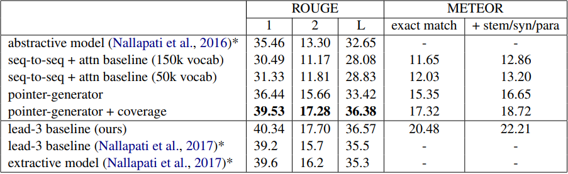
Results
* were trained and evaluated on the anonymized dataset
lead-3 baseline uses the first three sentences of the article as a summary.

Slide 23
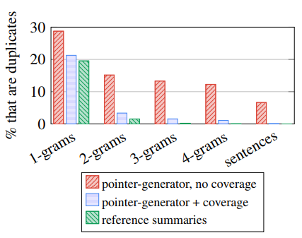
Results - Coverage
Coverage eliminates undesirable repetition.

Slide 24
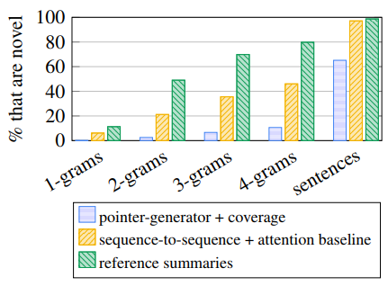
Results - Abstraction
The baseline mode produces more novel n-grams but mostly incorrect.

Slide 25
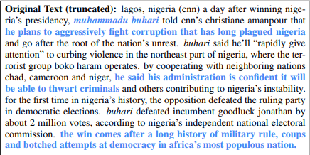
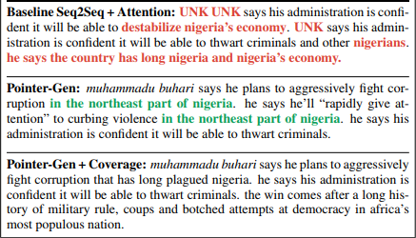
Results - Example
Baseline
Cannot generate OOV words (name).
Thwart -> destabilize
Repetition and eventually non-sense.

Slide 26
Neural summarization: copy mechanisms
Big problem with copying mechanisms:
They copy too much!
Mostly long phrases, sometimes even whole sentences
What should be an abstractive system collapses to a mostly extractive system.
Another problem:
They’re bad at overall content selection, especially if the input document is long
No overall strategy for selecting content

Slide 27
Neural summarization: better content selection
Recall: pre-neural summarization had separate stages for content selection and surface realization (i.e. text generation)
In a standard seq2seq+attention summarization system, these two stages are mixed in together
On each step of the decoder (i.e. surface realization), we do word-level content selection (attention)
This is bad: no global content selection strategy
One solution: bottom-up summarization

