Slide 1
CS60075 Natural Language Processing Autumn 2020
Indian Institute of Technology Kharagpur
Department of Computer Science & Engineering
Lecture 2B : Smoothing
Sep 10 2020
Sudeshna Sarkar

Slide 2
Readings
Chapter 3 of Jurafsky & Martin (3rd Ed)
https://web.stanford.edu/~jurafsky/slp3/3.pdf
Chapter 6 of Eisenstein
https://github.com/jacobeisenstein/gt-nlp-class/blob/master/notes/eisenstein-nlp-notes.pdf

Slide 3
Unknown Words
How to handle out of vocabulary (OOV) words?
Train a model that includes an explicit symbol for an unknown word ( <UNK> )
Choose a vocabulary in advance and replace other words in the training corpus with <UNK>.
Replace the first occurrence of each word in the training data with <UNK>.
Character based models

Slide 4
Sample Perplexity Evaluation
Models trained on 38 million words from the Wall Street Journal (WSJ) using a 19,979 word vocabulary.
Evaluate on a disjoint set of 1.5 million WSJ words.
 | Unigram | Bigram | Trigram
Perplexity | 962 | 170 | 109

Slide 5
Empirical Observations
A small number of events occur with high frequency
A large number of events occur with low frequency
Some of the zeroes in the table are low frequency events you haven't seen yet.
Words follow a Zipfian distribution
Small number of words occur very frequently
A large number are seen only once
Zipf’s law: a word’s frequency is approximately inversely proportional to its rank in the word distribution list

Slide 6
Smoothing
Many rare (but not impossible) combinations never occur in training, so MLE incorrectly assigns zero to many parameters (sparse data).
If a new combination occurs during testing, it is given a probability of zero and the entire sequence gets a probability of zero (i.e. infinite perplexity).
In practice, parameters are smoothed (or regularized) to reassign some probability mass to unseen events.
Adding probability mass to unseen events requires removing it from seen ones (discounting) in order to maintain a joint distribution that sums to 1.

Slide 7
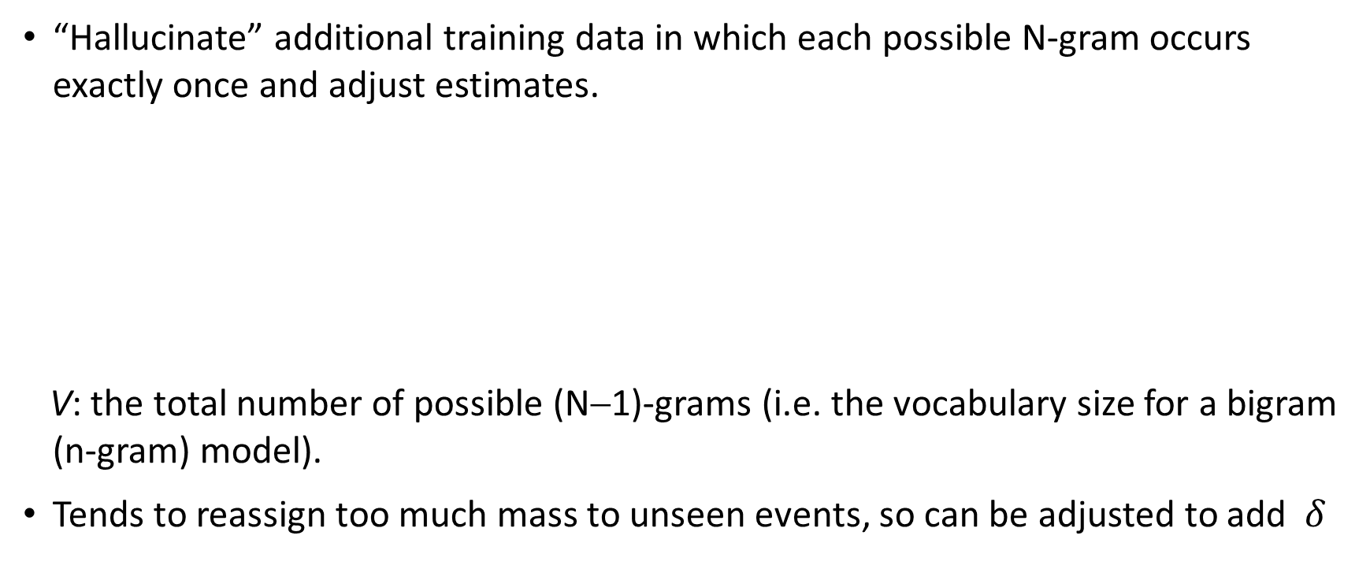
Laplace (Add-One) Smoothing
“Hallucinate” additional training data in which each possible N-gram occurs exactly once and adjust estimates.
V: the total number of possible (N−1)-grams (i.e. the vocabulary size for a bigram (n-gram) model).
Tends to reassign too much mass to unseen events, so can be adjusted to add $δ$
Bigram:
N-gram:

Slide 8
Advanced Smoothing
Improved smoothing for language models.
Interpolation
Backoff
Kneser-Ney
Class-based (cluster) N-grams

Slide 9
Model Combination
As N increases, the power (expressiveness) of an N-gram model increases
but the ability to estimate accurate parameters from sparse data decreases
A general approach is to combine the results of multiple N-gram models of increasing complexity (i.e. increasing N).

Slide 10
Interpolation
Linearly combine estimates of N-gram models of increasing order.
Learn proper values for λ_{i} by training to (approximately) maximize the likelihood of an independent development corpus.

Slide 11
Backoff
Only use lower-order model when data for higher-order model is unavailable.
Recursively back-off to weaker models until data is available.
P* is a discounted probability estimate to reserve mass for unseen events and α’s are back-off weights.

Slide 12
A Problem for N-Grams: Long Distance Dependencies
Syntactic dependencies
“The man next to the large oak tree near the grocery store on the corner is tall.”
“The men next to the large oak tree near the grocery store on the corner are tall.”
Semantic dependencies
“The bird next to the large oak tree near the grocery store on the corner flies rapidly.”
“The man next to the large oak tree near the grocery store on the corner talks rapidly.”

Slide 13
Neural language model
$$P\left(w_{t} | w_{t−n}, …,w_{t−1}\right)=\frac{C(w_{t−n}, …,w_{t})}{C(w_{t−n}, …,w_{t−1})}=f_{θ}(w_{t−n}, …,w_{t−1})$$
Parametric estimator
We need numerical representation of words

