Slide 1

Multi-Objective Optimization Problems
With Well-Conditioned Solutions
Harshal Bharat Dupare
18MA20015
Under the guidance of
Dr. Swanand Ravindra Khare & Dr. Geetanjali Panda
Department of Mathematics
Indian Institute of Technology Kharagpur
November, 2022
Harshal Bharat Dupare, 18MA20015 Department of Mathematics, Indian Institute of Technology Kharagpur

Slide 2
Agenda
Preliminaries
Problem Definition
Motivation and Applications
Related Works
Analysis
Questions
Conclusion and Future Work
Harshal Bharat Dupare, 18MA20015 Department of Mathematics, Indian Institute of Technology Kharagpur

Slide 3
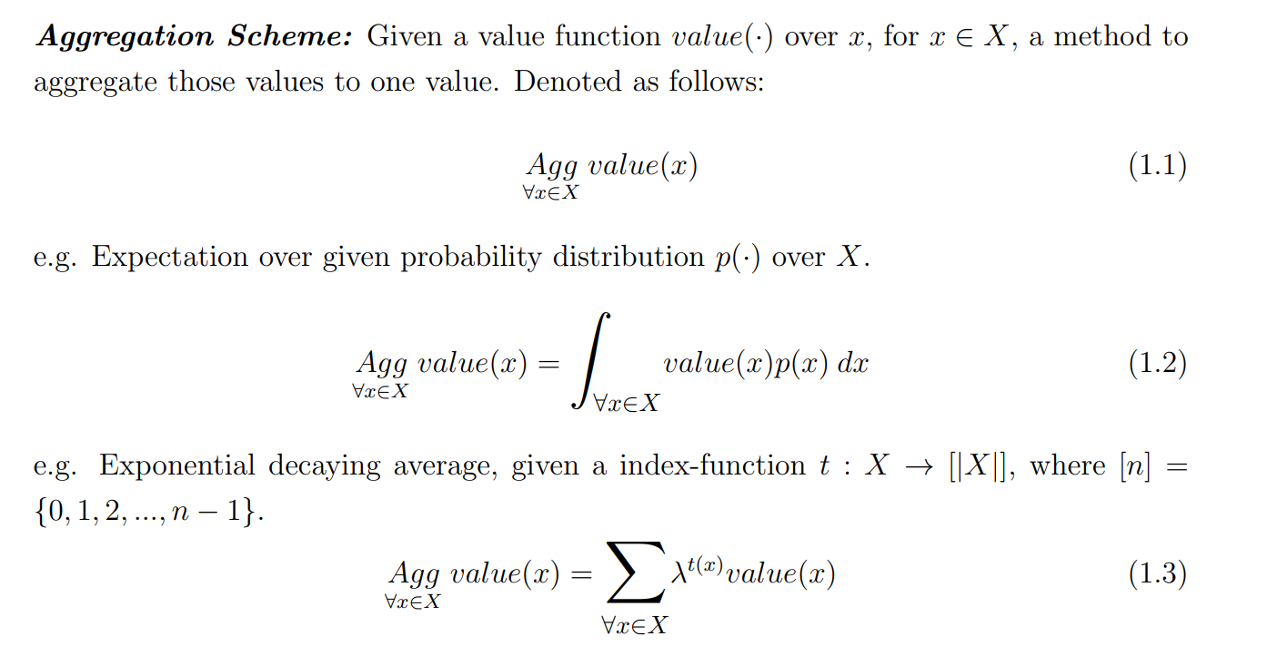
Preliminaries
Harshal Bharat Dupare, 18MA20015 Department of Mathematics, Indian Institute of Technology Kharagpur

Slide 4
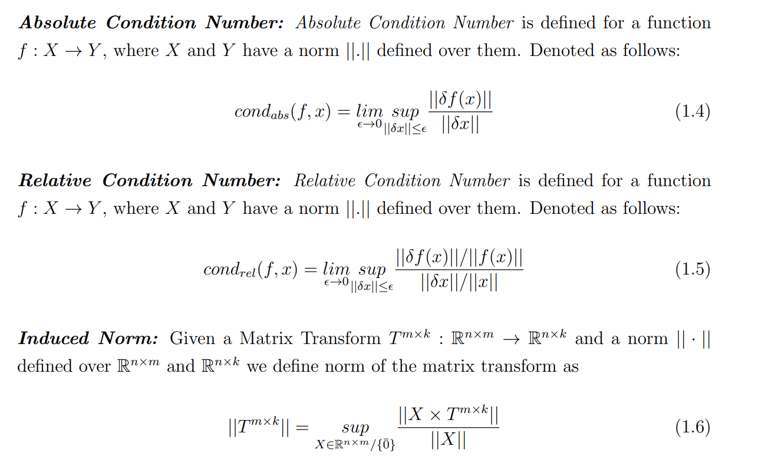
Harshal Bharat Dupare, 18MA20015 Department of Mathematics, Indian Institute of Technology Kharagpur

Slide 5
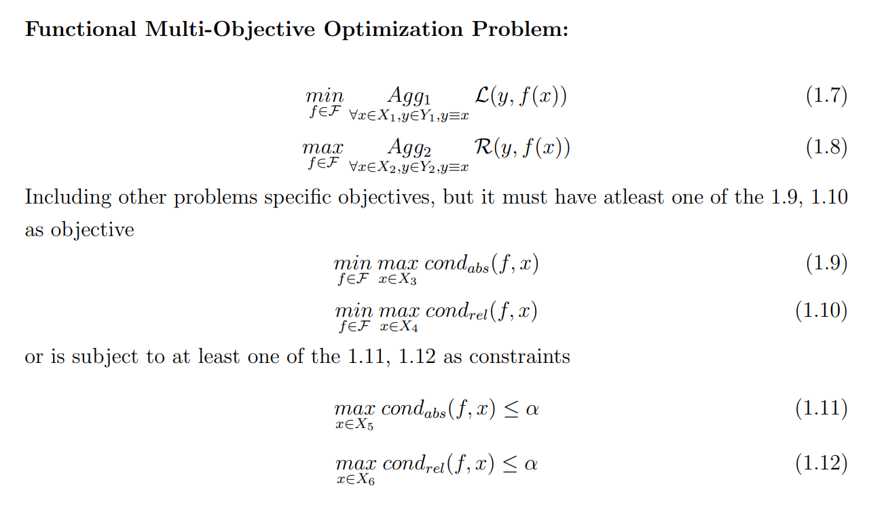
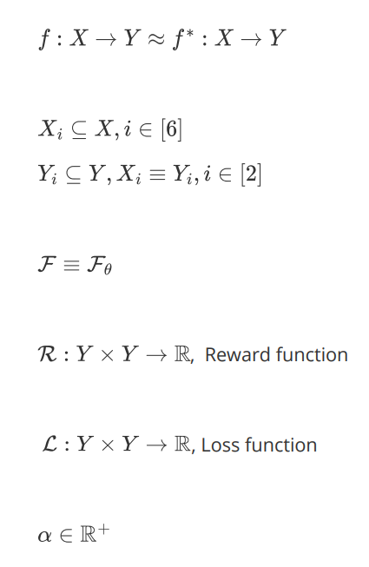
Problem Definition
Harshal Bharat Dupare, 18MA20015 Department of Mathematics, Indian Institute of Technology Kharagpur

Slide 6
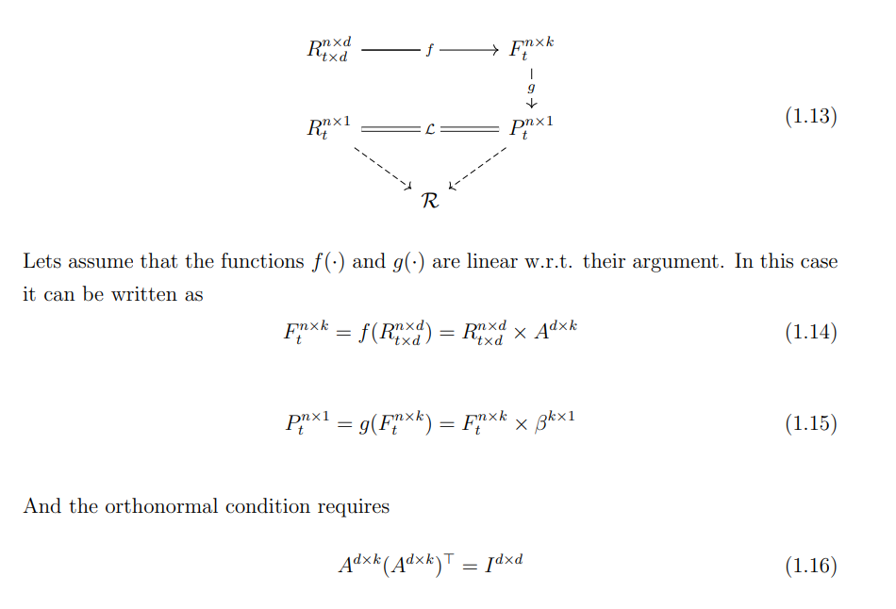
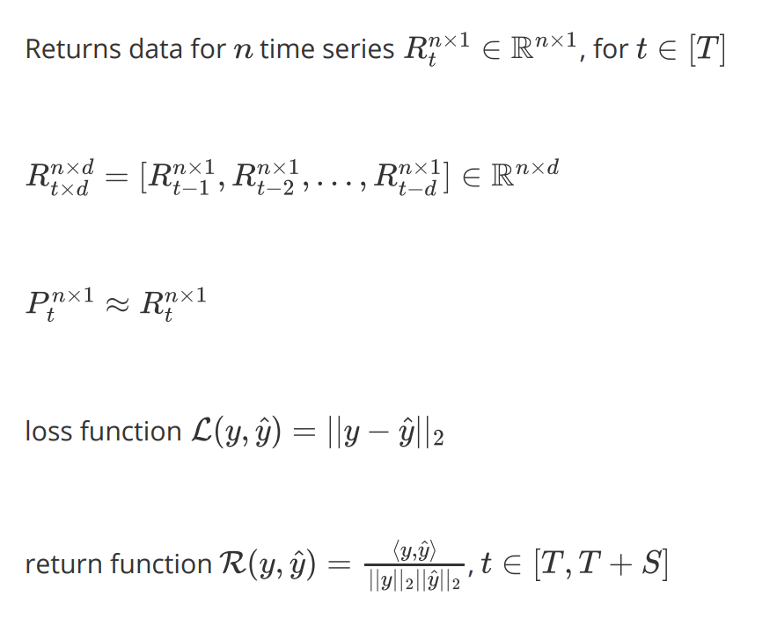
Motivation and Applications
Linear Factor Model
Harshal Bharat Dupare, 18MA20015 Department of Mathematics, Indian Institute of Technology Kharagpur

Slide 7
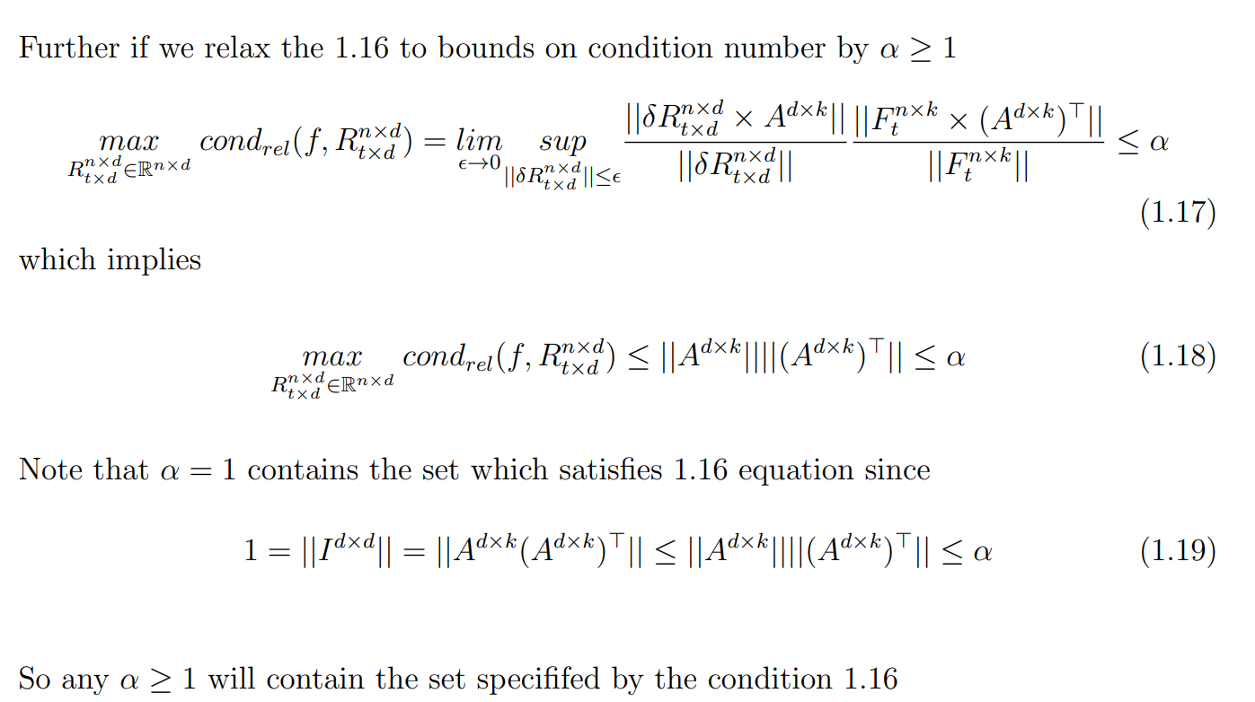
Harshal Bharat Dupare, 18MA20015 Department of Mathematics, Indian Institute of Technology Kharagpur

Slide 8
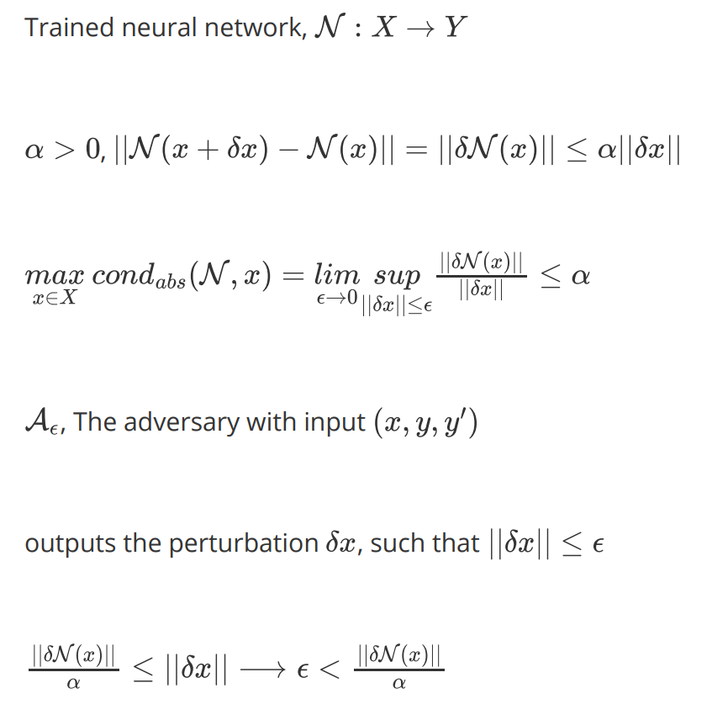
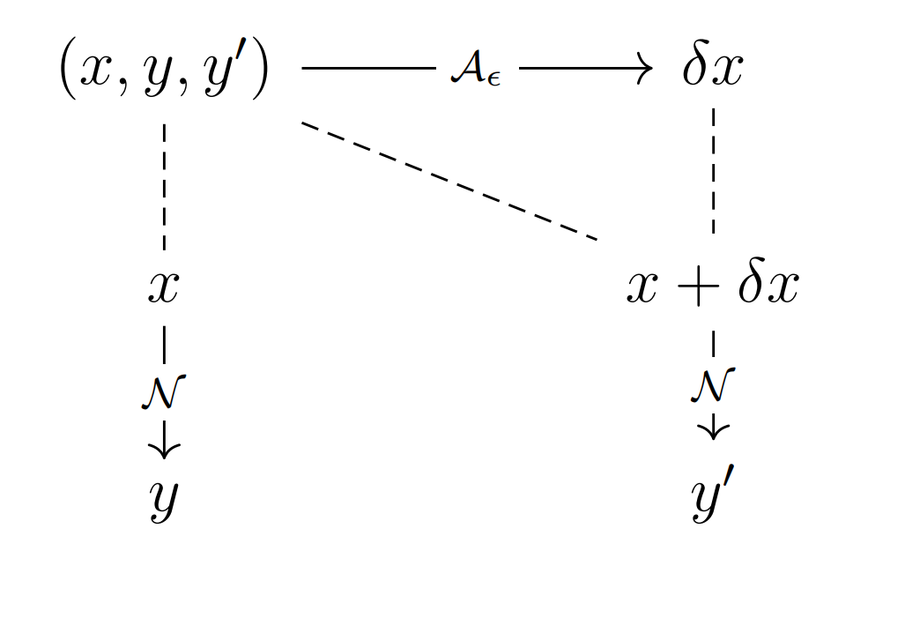
Defense Against Adversarial Attacks on Neural Networks
Harshal Bharat Dupare, 18MA20015 Department of Mathematics, Indian Institute of Technology Kharagpur

Slide 9
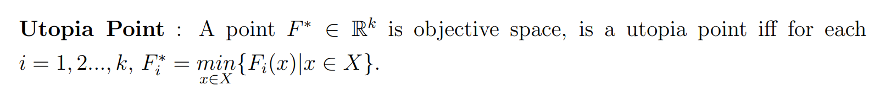
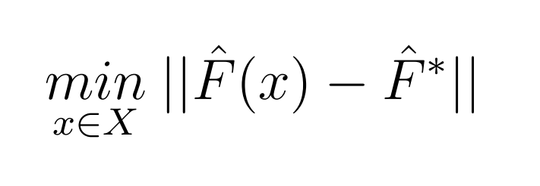
Related Works
Multi-Objective Optimization
No Preference Methods
No DM is available and a neutral compromise solution is identified without any specification of the preference information.
Vincent, Thomas L / Grantham, Walter Jervis(1981): Optimality in parametric systems(Book)
Zeleny, Milan(1973): Compromise programming
Miettinen, Kaisa (1998): No-Preference Methods. Boston, MA, Springer US: 67–76
Harshal Bharat Dupare, 18MA20015 Department of Mathematics, Indian Institute of Technology Kharagpur

Slide 10
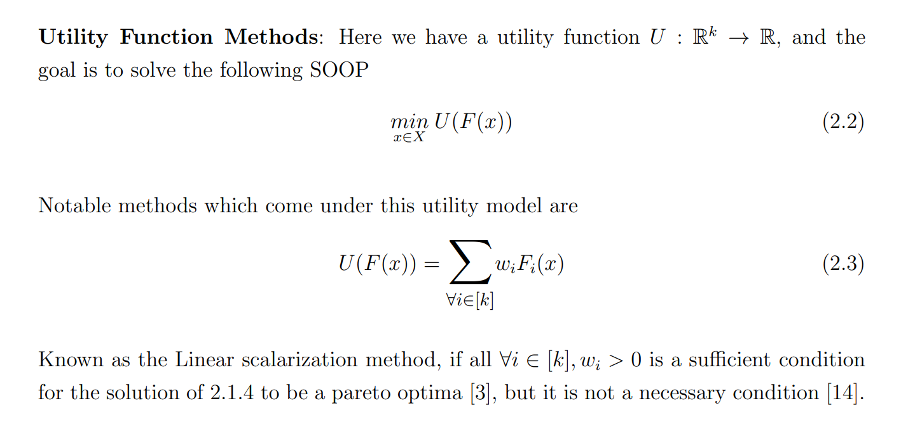
A Priori Methods
Based on the preference information given by the DM the optimal solution is found.
[3] Zadeh, Lofti(1963): Optimality and non-scalar-valued performance criteria
[14] Zionts, Stanley(1989): Multiple criteria mathematical programming: an updated overview and several approaches
Harshal Bharat Dupare, 18MA20015 Department of Mathematics, Indian Institute of Technology Kharagpur

Slide 11
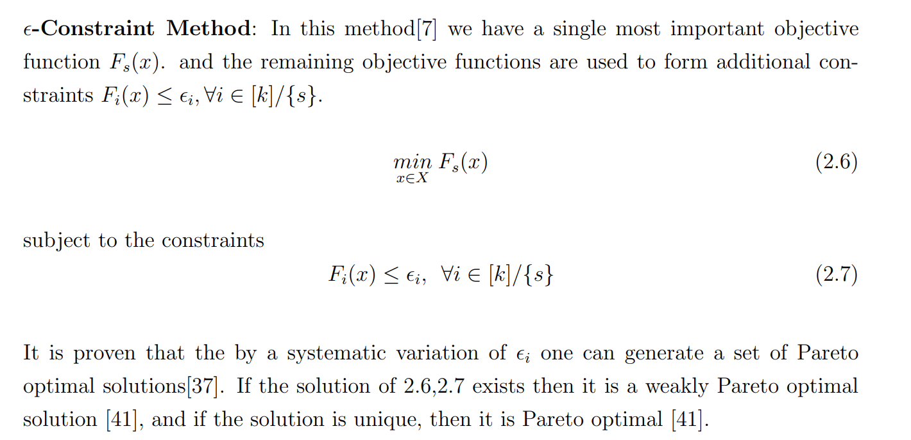
[7] Haimes, Yacov(1971): On a bicriterion formulation of the problems of integrated system identification and system optimization
[37] Hwang, Ching Lai / Masud, Abu Syed Md (1979): Methods for multiple objective decision making. Multiple objective decision making—methods and applications
[41] Miettinen, Kaisa (2012): Nonlinear multiobjective optimization. , Springer Science & Business Media.
Harshal Bharat Dupare, 18MA20015 Department of Mathematics, Indian Institute of Technology Kharagpur

Slide 12
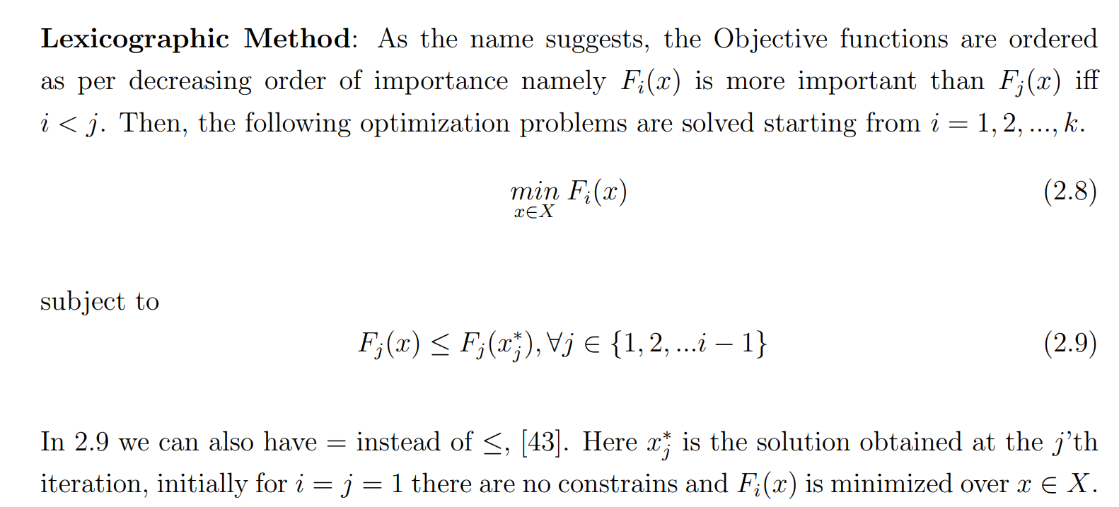
[43] Stadler, Wolfram (1988): Multicriteria Optimization in Engineering and in the Sciences. , Springer Science & Business Media.
Harshal Bharat Dupare, 18MA20015 Department of Mathematics, Indian Institute of Technology Kharagpur

Slide 13
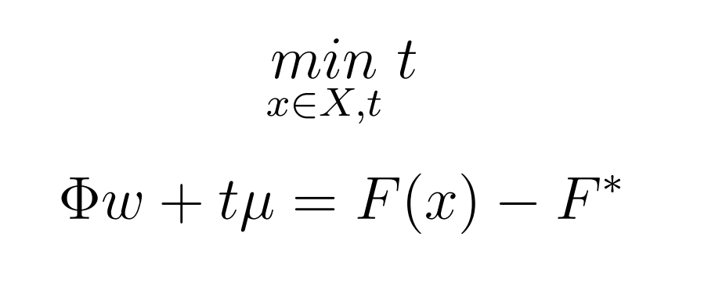

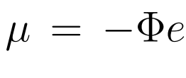
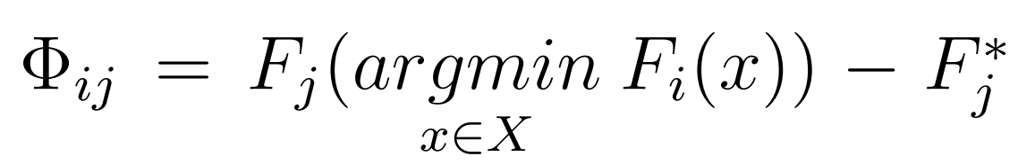

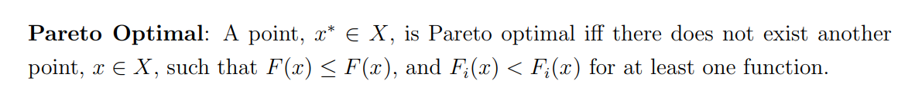
A Posteriori Methods
A good representative set of Pareto optimal solutions is found, and from among them the DM must choose the best solution.
Mathematical programming methods
Normal Boundary Intersection Method: Weighted sum method does provide a pareto optimal solution but its is very difficult to find evenly spread solution by varying the weights
NBI method doesn’t provide sufficient nor necessary condition for pareto optimality of the solutions
Das, Indraneel / Dennis, John E(1998): Normal-boundary intersection: A new method for generating the Pareto surface in nonlinear multicriteria optimization problems
Das, Indraneel / Dennis, JE (1999): An improved technique for choosing parameters for Pareto surface generation using normal-boundary intersection.
Messac, Achille / Ismail Yahaya, Amir / Mattson, Christopher A(2003): The normalized normal constraint method for generating the Pareto frontier
Harshal Bharat Dupare, 18MA20015 Department of Mathematics, Indian Institute of Technology Kharagpur

Slide 14
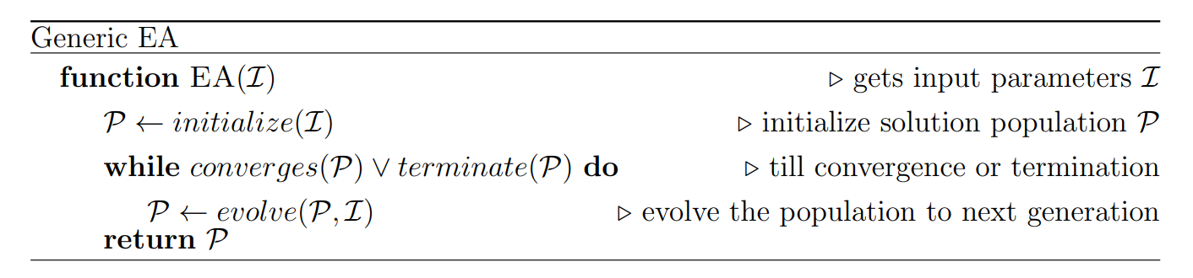
Evolutionary algorithms
Evolutionary algorithms are subset of the paradigm which is inspired by nature and evolution in designing algorithms for various purposes including solving optimization problems.
Non-dominated Sorting Genetic Algorithm-II (NSGA-II): Elitist principle based partial-order sorting of the population
Ant Colony Optimization (ACO): Ant pheromone to communicate to explore more of the promising regions
Particle Swarm Optimization (PSO): Flocking behaviour of the birds
Vikhar, Pradnya A (2016): Evolutionary algorithms: A critical review and its future prospects. 2016 International conference on global trends in signal processing
Deb, Kalyanmoy / Pratap, Amrit / Agarwal, Sameer / Meyarivan, TAMT(2002): A fast and elitist multiobjective genetic algorithm: NSGA-II
Slowik, Adam / Kwasnicka, Halina(2017): Nature inspired methods and their industry applications—Swarm intelligence algorithms
Poli, Riccardo / Kennedy, James / Blackwell, Tim(2007): Particle swarm optimization
Harshal Bharat Dupare, 18MA20015 Department of Mathematics, Indian Institute of Technology Kharagpur

Slide 15
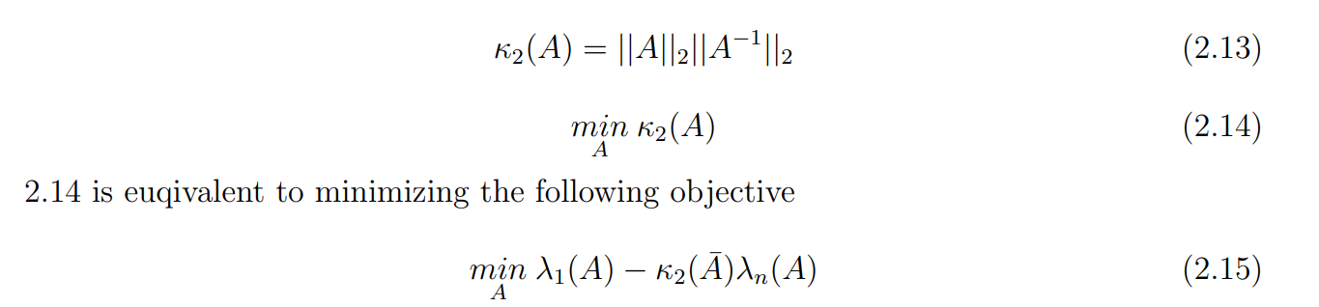
Condition Number
Condition Number of Matrices
Pierre Maréchal and Jane J. Ye in their paper Optimizing Condition Numbers[26] showed that for a symmetric positive semi-definite n × n matrix A minimizing the condition number 𝜅(A).
[26] Maréchal, Pierre / Ye, Jane J(2009): Optimizing condition numbers, 2: 935–947.
Chen, Xiaojun / Womersley, Robert S / Ye, Jane J(2011): Minimizing the condition number of a Gram matrix, 1: 127–148.
Harshal Bharat Dupare, 18MA20015 Department of Mathematics, Indian Institute of Technology Kharagpur

Slide 16
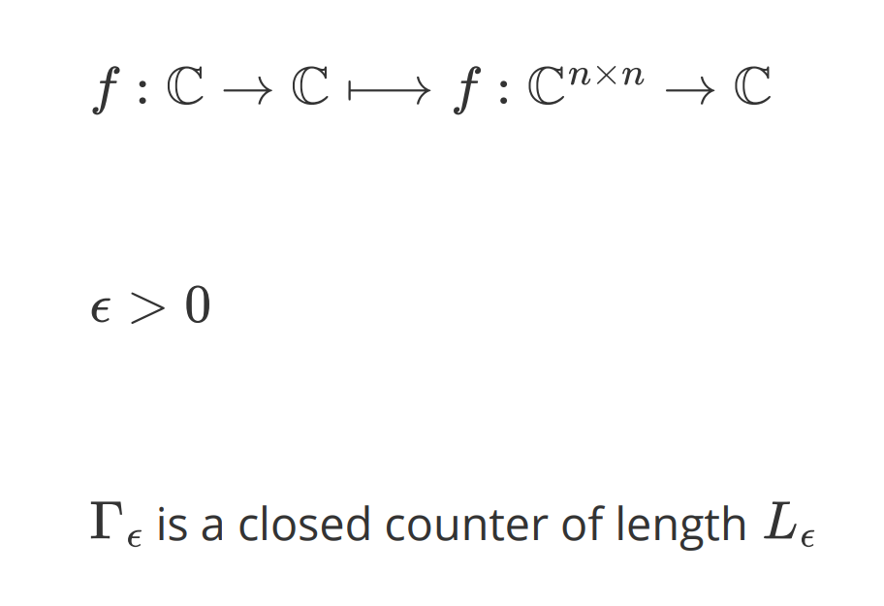
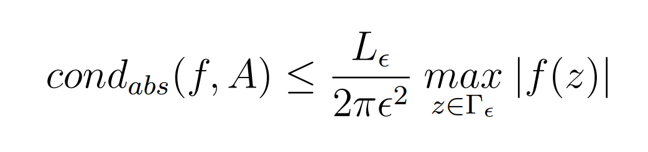
Condition Number of Functions
Edvin Deadman and Samuel D. Relton in their paper [31] extended the taylor’s theorem for a complex function of matrices
A more extensive treatment and analysis of conditioning of such function is also done in the book by Nicholas J. Higham [36], based on the book a Matlab toolbox has also been made available by the name of Matrix Function Toolbox [34].
[31] Deadman, Edvin / Relton, Samuel D(2016): Taylor’s theorem for matrix functions with applications to condition number estimation
[36] Higham, Nicholas J (2008): Functions of matrices: theory and computation. , SIAM.
[34] Higham, Nicholas J(2022): The Matrix Function Toolbox (https://www.mathworks.com/matlabcentral/fileexchange/20820-the-matrixfunction-toolbox).
Harshal Bharat Dupare, 18MA20015 Department of Mathematics, Indian Institute of Technology Kharagpur

Slide 17
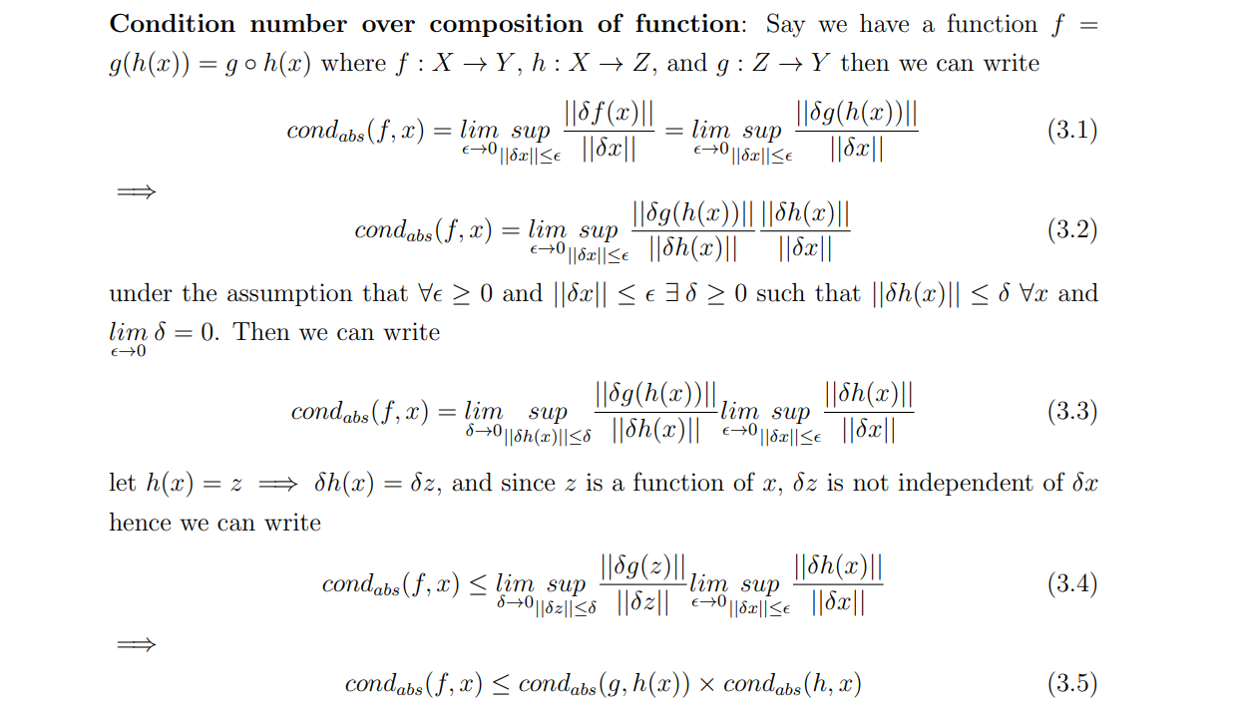
Analysis
Harshal Bharat Dupare, 18MA20015 Department of Mathematics, Indian Institute of Technology Kharagpur

Slide 18
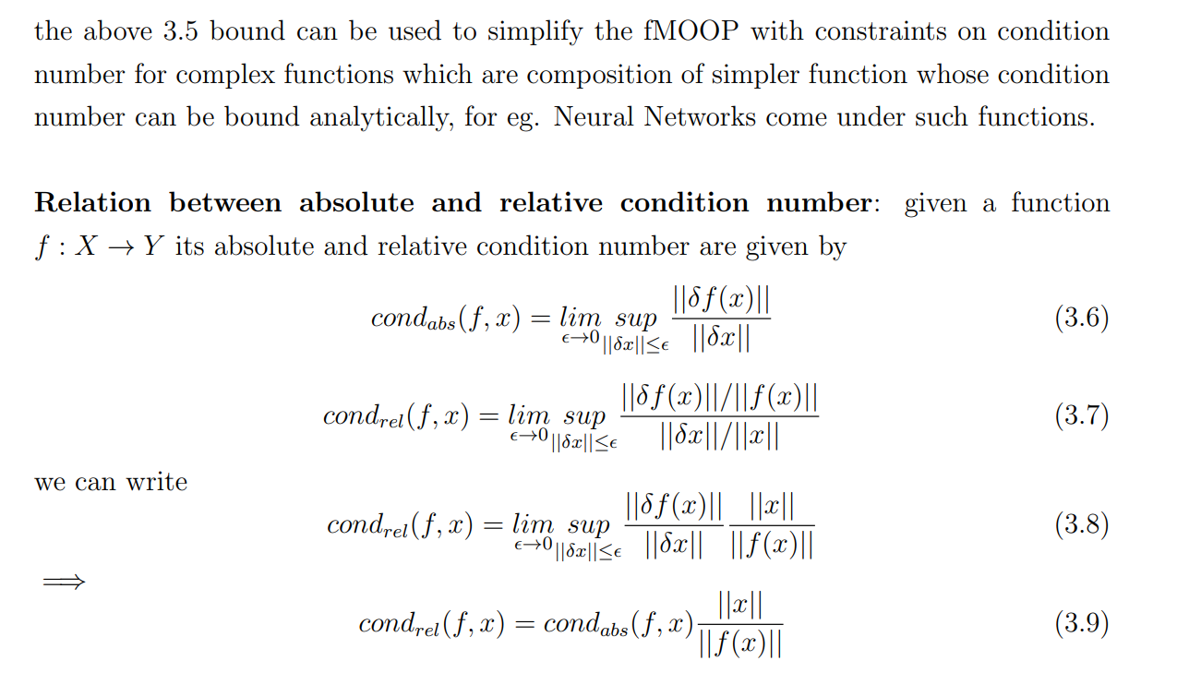
Harshal Bharat Dupare, 18MA20015 Department of Mathematics, Indian Institute of Technology Kharagpur

Slide 19
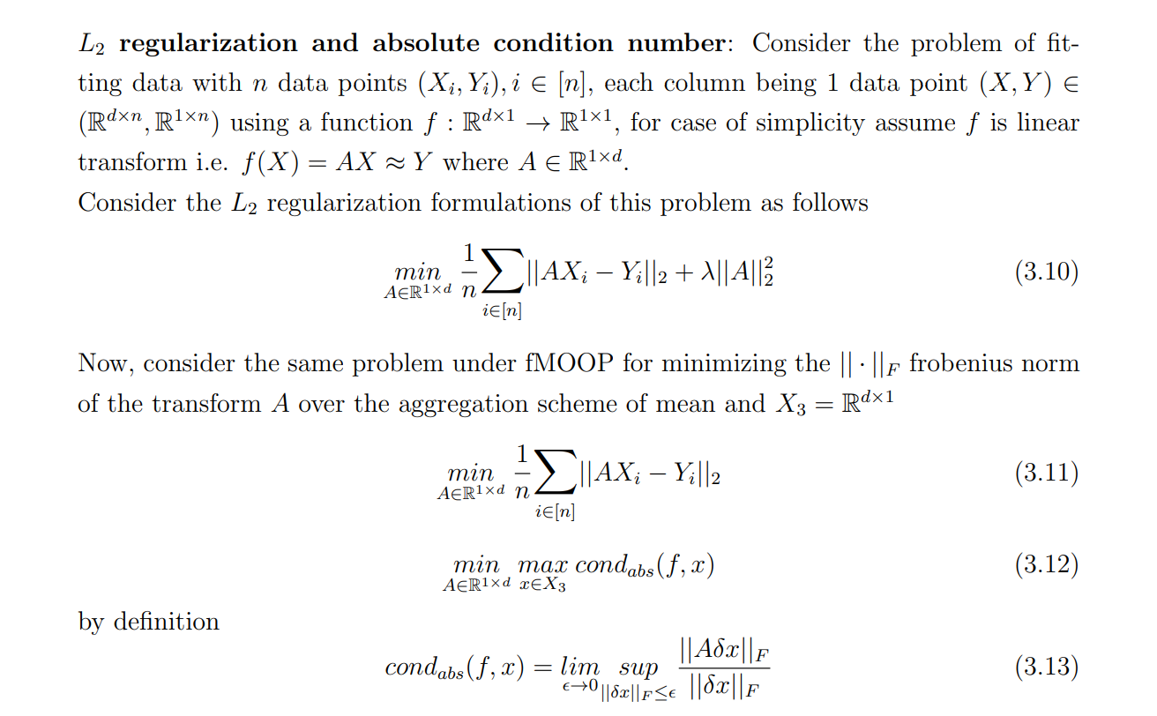
Harshal Bharat Dupare, 18MA20015 Department of Mathematics, Indian Institute of Technology Kharagpur

Slide 20
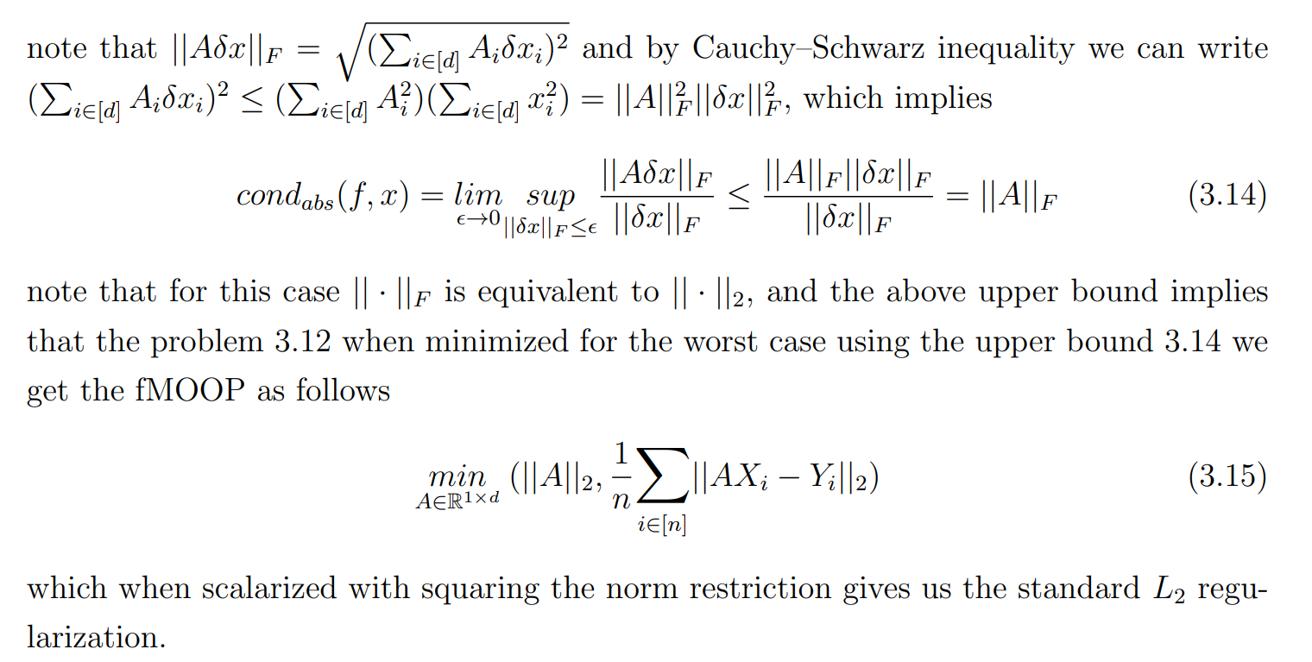
Harshal Bharat Dupare, 18MA20015 Department of Mathematics, Indian Institute of Technology Kharagpur

Slide 21
Questions
What types of fMOOPs confirm to restrictions on condition number of 𝑓?
How to determine minimum feasible value of α for a given problem and subsets X₁, X₂, X₅, X₆ ⊆ X?
For the fMOOPs which confirm such condition number restrictions how does the condition number behave over the domain X₅, X₆?
For the fMOOPs which confirm such condition number restrictions how does the condition number behave over the domain X₅, X₆?
What all computation methods/algorithms are available for condition number w.r.t. specific fMOOP?
How the transformed problems with bounds on condition number behave and how close are their solutions to the original problems solutions?
Harshal Bharat Dupare, 18MA20015 Department of Mathematics, Indian Institute of Technology Kharagpur

Slide 22
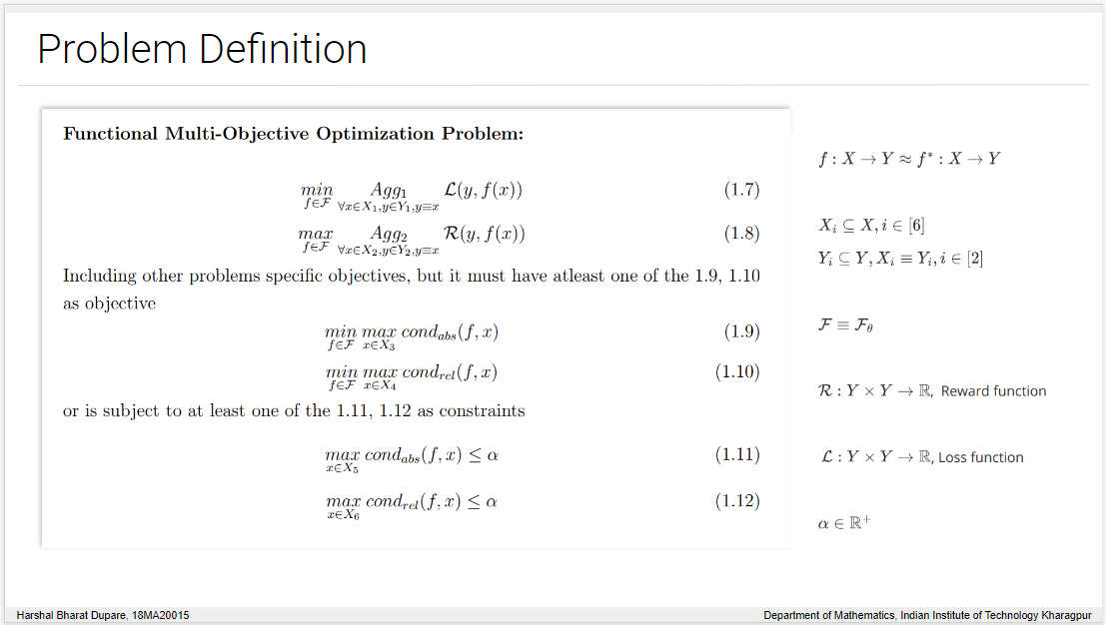
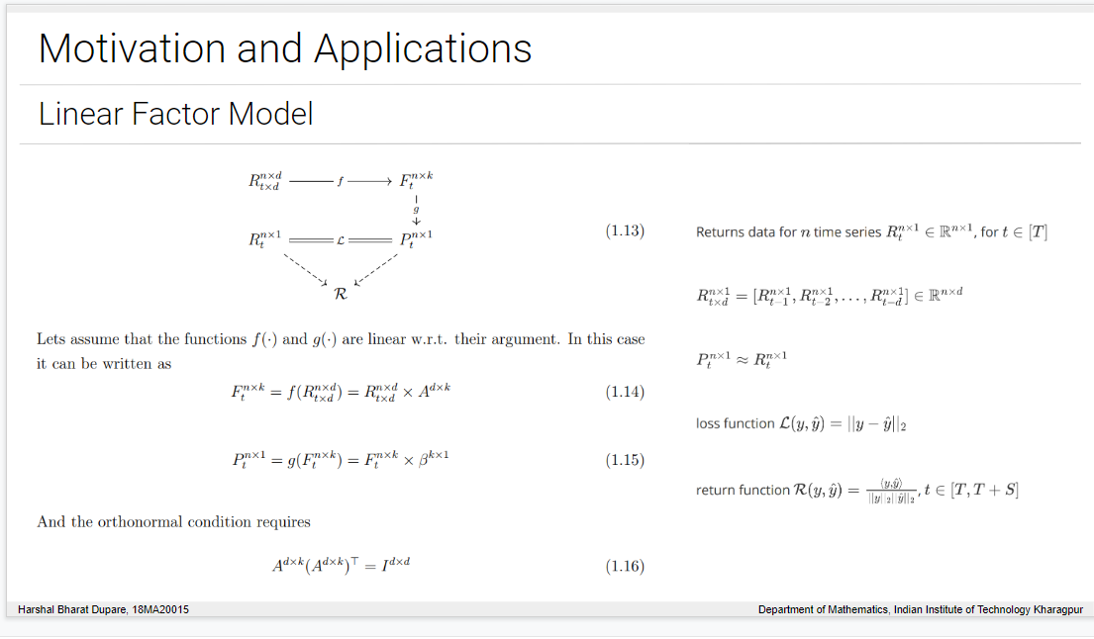
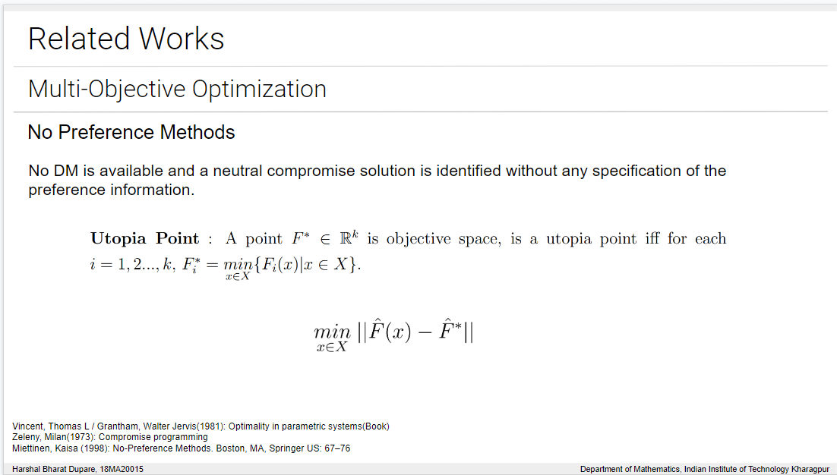
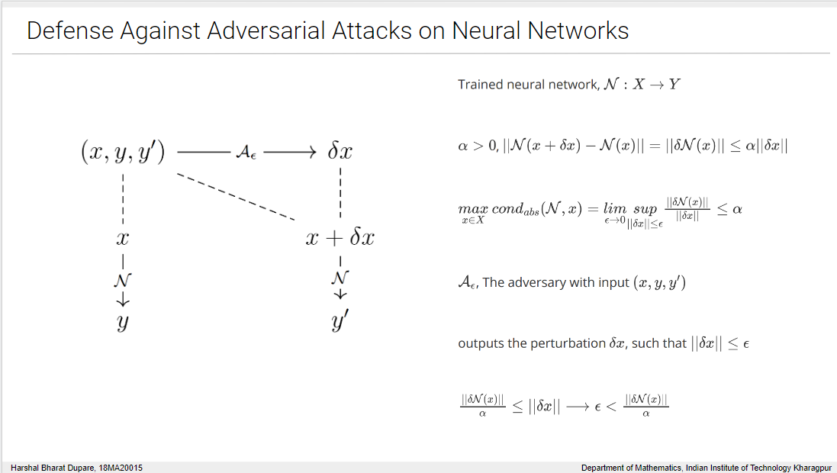
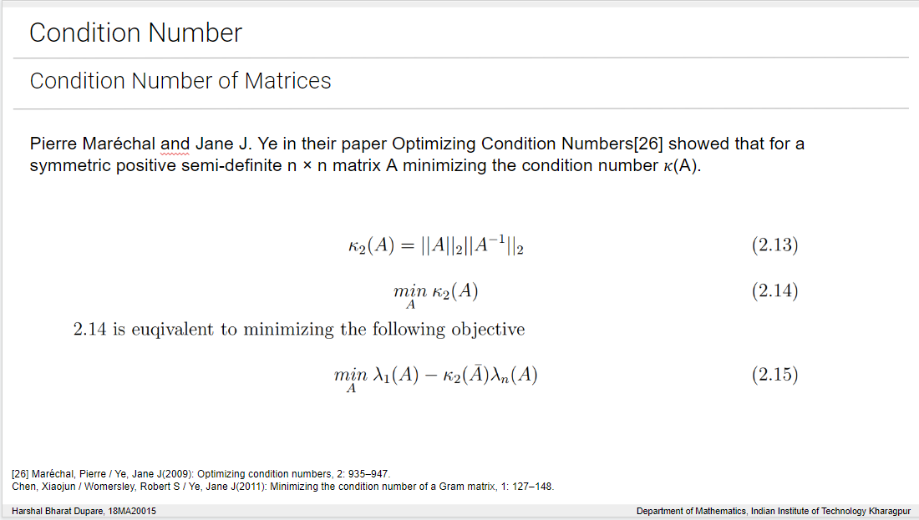
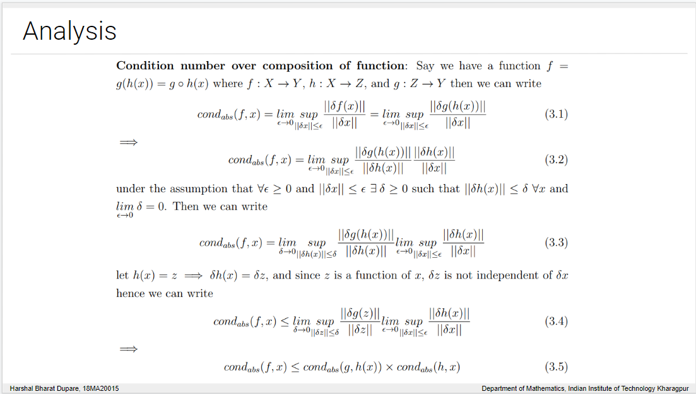
Conclusion and Future Work
🗸 Problem Definition
🗸 Motivations & Applications
🗸 Relevant Literature
🗸 Preliminary Analysis
Analysis & Address Questions
Experimentations & Results
Harshal Bharat Dupare, 18MA20015 Department of Mathematics, Indian Institute of Technology Kharagpur

Slide 23
Thank You
Open For Questions
Harshal Bharat Dupare, 18MA20015 Department of Mathematics, Indian Institute of Technology Kharagpur

Slide 24
Harshal Bharat Dupare, 18MA20015 Department of Mathematics, Indian Institute of Technology Kharagpur

Slide 25
Harshal Bharat Dupare, 18MA20015 Department of Mathematics, Indian Institute of Technology Kharagpur

