Slide 1
Scaling in Kubernetes
TechMeetup Ostrava 01-Nov-2018

Slide 2
Initialization
Slides and code examples are available on :
https://github.com/harshal-shah/techmeetup-ostrava
We are using following tools for a quick setup:
Helm
Helmfile
Prometheus
Nginx ingress

Slide 3
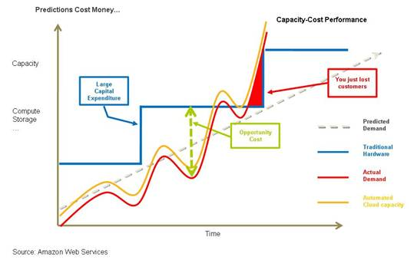
Why scaling and elasticity matter?

Slide 4
Types of scaling in Kubernetes
Cluster Autoscaling
Horizontal Pod Autoscaling
Vertical Pod Autoscaling
Proportional Autoscaling
Virtual Kubelet

Slide 5
Cluster Autoscaler

Slide 6
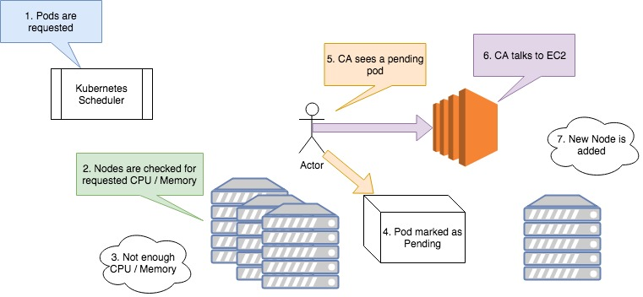
Cluster Autoscaler Scale Up

Slide 7
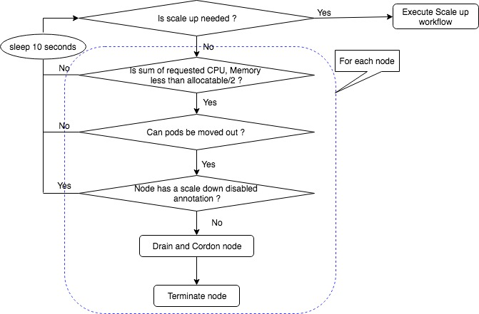
Cluster Autoscaler Scale Down

Slide 8
Demo - Cluster Autoscaler

Slide 9
Horizontal Pod Autoscaling
Requires metrics server to be running on cluster
Resource with dedicated controller
Supports scaling based on CPU, Memory, Custom Metrics*.
Supports raw values as well as percentages
Scale up can be tuned at resource level
Intervals for scaledown and scale up are configurable.
Formula : desiredReplicas = ceil[currentReplicas * ( currentMetricValue / desiredMetricValue )]

Slide 10
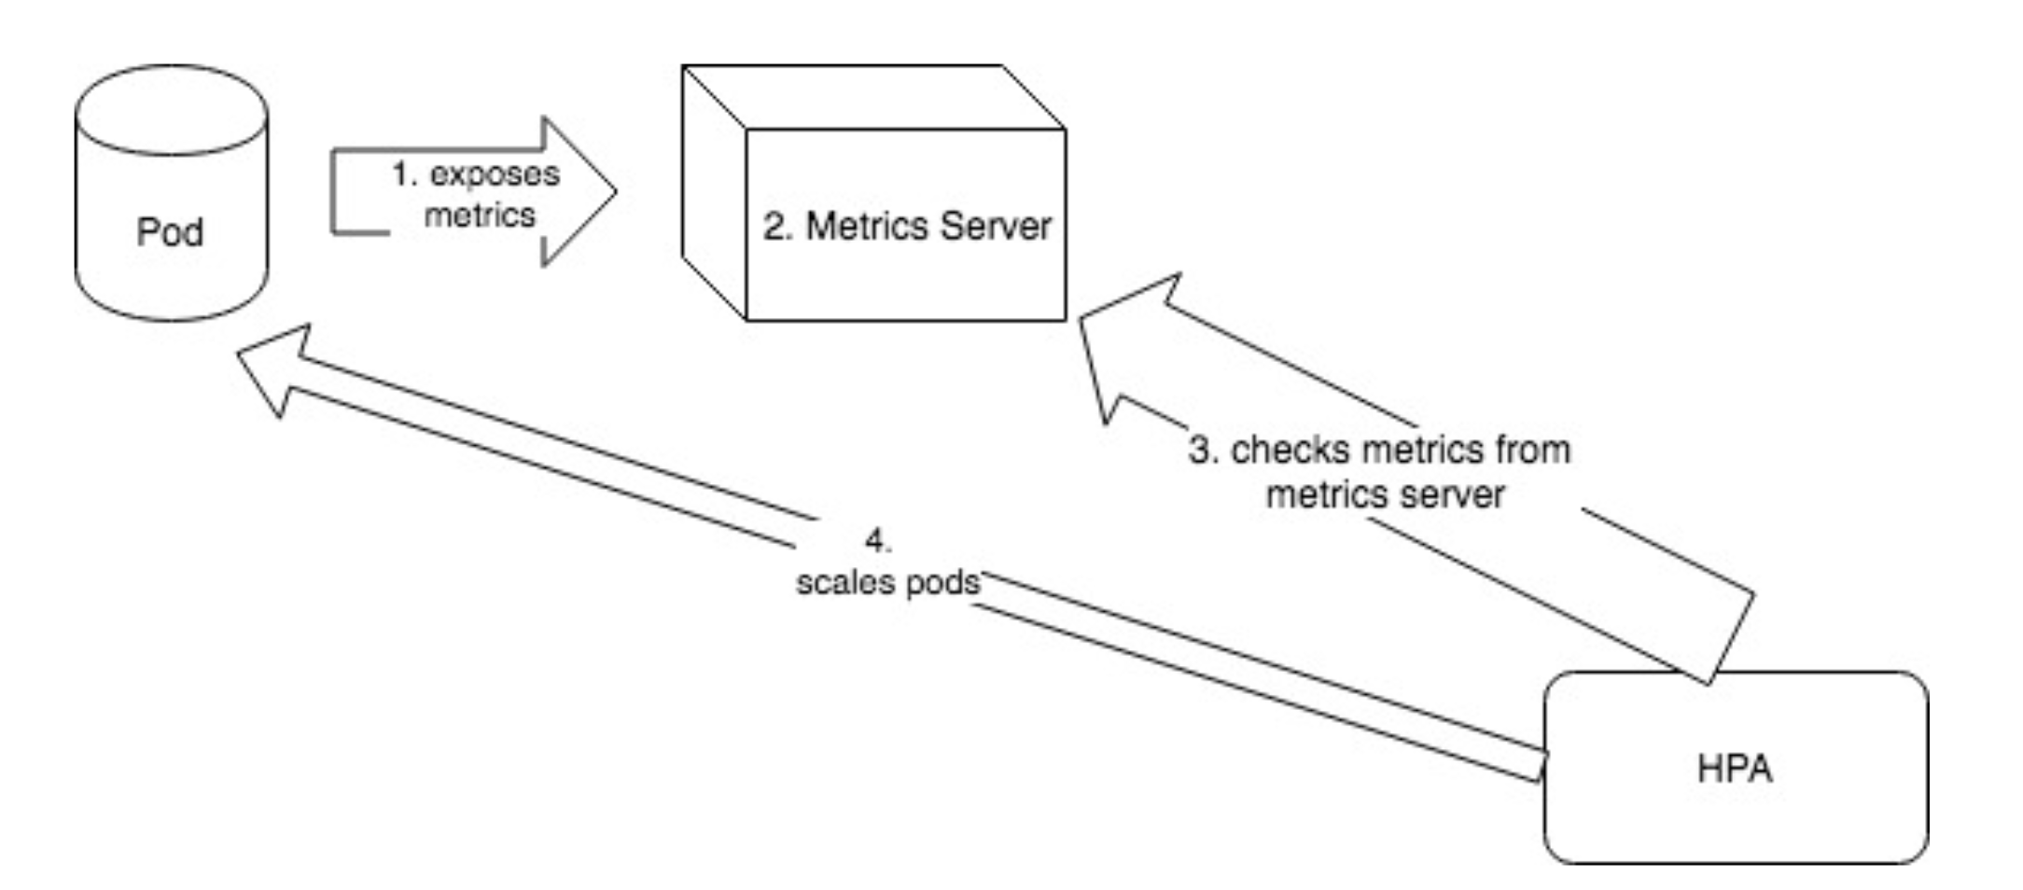
Resource Based HPA

Slide 11
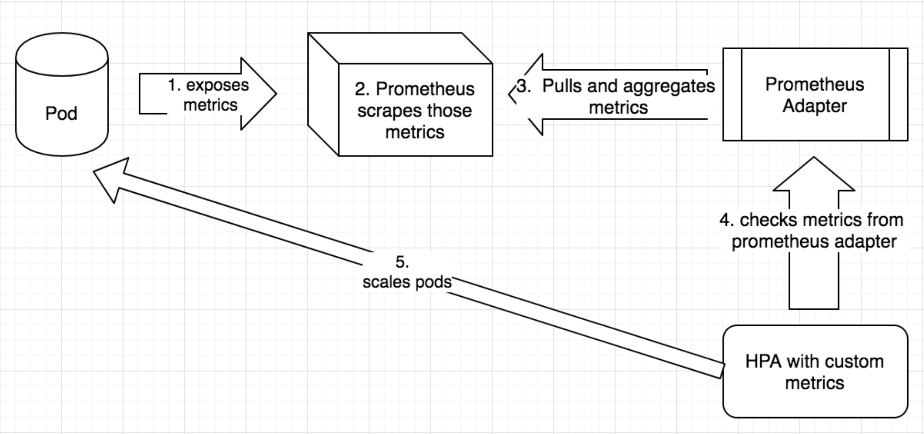
HPA with custom metrics

Slide 12
Examples of HPA metrics
CPU with percent values
Memory with raw values
- type: Resource
resource:
name: cpu
targetAverageUtilization: 50
- type: Resource
resource:
name: memory
targetAverageValue: 500Mi
Custom metric exposed by the pod
Metrics of another object in the namespace
- type: Pods
pods:
metric:
name: packets-per-second
targetAverageValue: 1k
- type: Object
object:
metric:
name: requests-per-second
describedObject:
apiVersion: extensions/v1beta1
kind: Ingress
name: main-route
targetValue: 10k

Slide 13
Demo - HPA

Slide 14
Cluster Proportional Autoscaler
Adjusts pod count of a deployment based on number of nodes and cores in a cluster
Incubator project
Main use cases: DNS Pods, Admission controller servers, tiller, ingress controller pods etc

Slide 15
Vertical Pod Autoscaler
Can be used to “right size” the CPU and memory allocation for pods
CPU / Memory changes are activated only upon pod restart
More useful for stateful sets
Respects Pod Disruption Budget
HPA XOR VPA
Still in very early stages of development.

Slide 16
Virtual Kubelet
Interfaces with container services like ACS / Fargate.
Runs as a pod in a Kubernetes cluster.
Good for handling short lived spikes.
Good for autonomous workloads as networking is still not very mature.

Slide 17
Thank you!
harshal2623@gmail.com
@harshal2623

