Slide 1
POWER AND PROPULSION SYSTEMS FOR UV
Exercises 1 & 2
GT-Power IC Engine Simulation • P1 Hybrid Vehicle Simulation with ECMS
Prof. ALFREDO GIMELLI
Prof. VINCENZO DE BELLIS
Harshal Rajesh Kokitkar
• Autonomous Vehicle Engineering
Università degli Studi di Napoli Federico II — July 2026

Slide 2
What This Deck Covers
01
02
03
Exercise 1 — IC Engine
Exercise 2 — Vehicle Simulation
Conclusions
GT-Power 1D simulation: speed sweep, AFR sweep, spark-advance sweep, throttle/load sweep.
P1 hybrid EV, ECMS energy management, WLTC + Artemis cycles, emissions, mass sensitivity.
Cross-cutting takeaways linking engine-level and vehicle-level results.
Agenda
Harshal Rajesh Kokitkar | AVE, Federico II

Slide 3
PART ONE
Exercise 1: IC Engine
GT-Power Simulation
Four sub-cases on a 4-cylinder SI port-fuel-injected engine — speed, AFR, spark advance, and throttle/load sweeps.

Slide 4
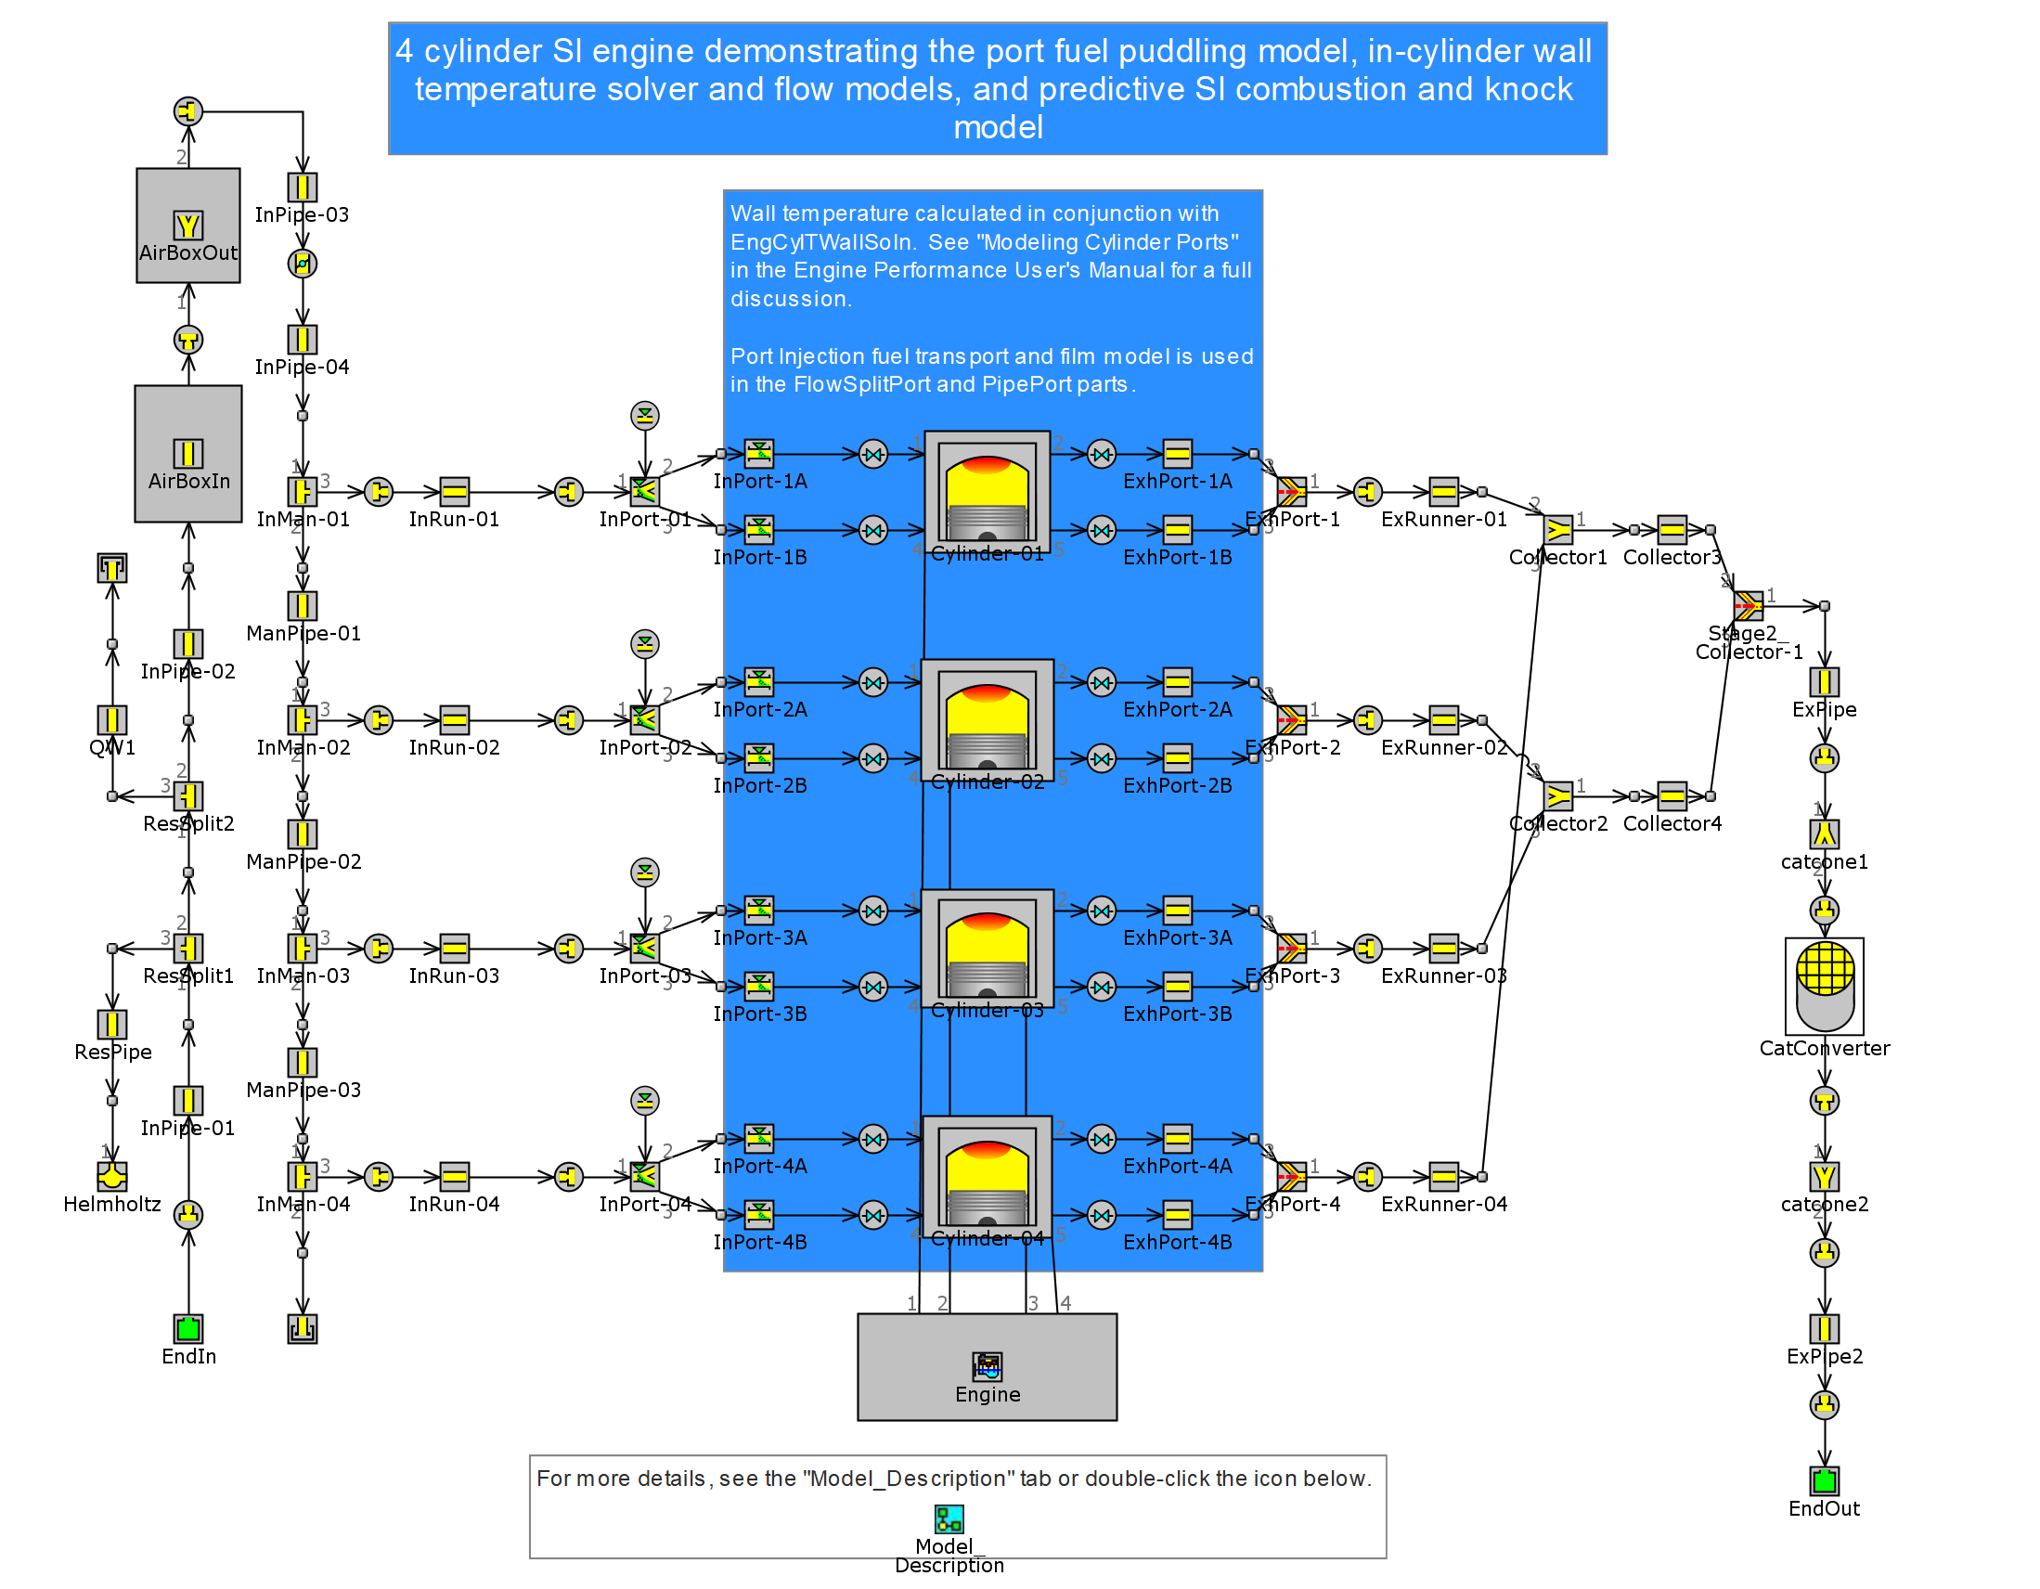
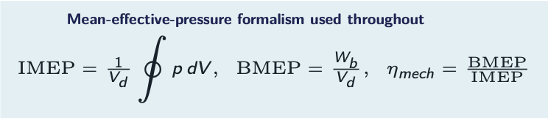
EXERCISE 1 · SETUP
Model & Scaling Parameters
Assigned parameters
Bore multiplier
× 0.97
Stroke multiplier
× 1.04
ICE torque multiplier (Ex.2)
× 1.02
Base template
SI_4cyl_SITurb_PortFuelFilm_TWallSoln
Four cylinders, predictive SI combustion, knock model, port fuel-film dynamics, in-cylinder wall-temperature solver. AFR held stoichiometric (14.7) for the baseline.
Exercise 1 — Model Setup
Harshal Rajesh Kokitkar | AVE, Federico II

Slide 5
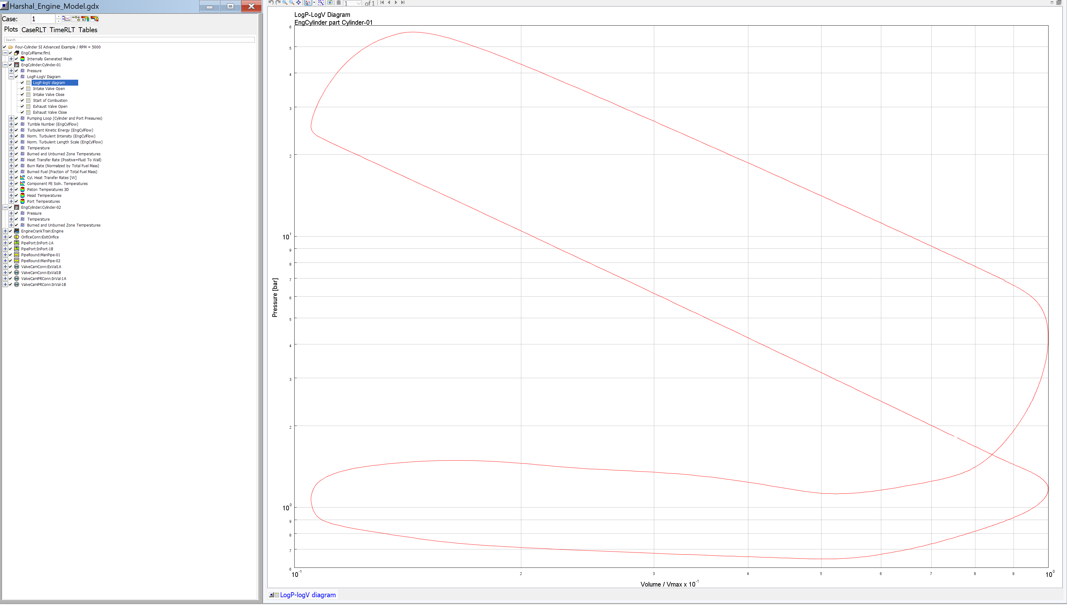
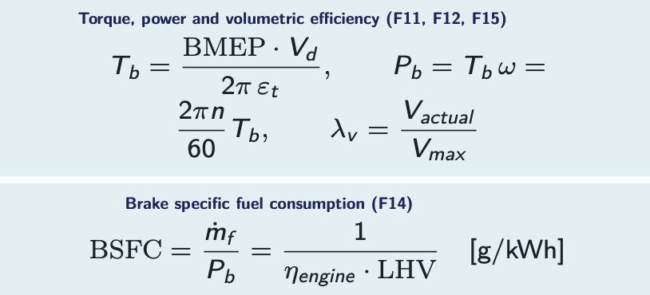
EXERCISE 1 · CASE 1
Engine Speed Sweep (1000–5000 rpm, WOT)
Torque/BMEP rise with volumetric efficiency (≈69% → 100%), peak near 3500–4000 rpm as friction/pumping losses overtake breathing gains. Brake power keeps climbing to 5000 rpm since P_b = T_b·ω. BSFC is minimized (≈240 g/kWh) near 3000 rpm where indicated efficiency peaks (≈39%).
p–V loop, 5000 rpm: classic figure-eight (high-pressure loop + gas-exchange loop).
Exercise 1 — Case 1: Speed Sweep
Harshal Rajesh Kokitkar | AVE, Federico II

Slide 6
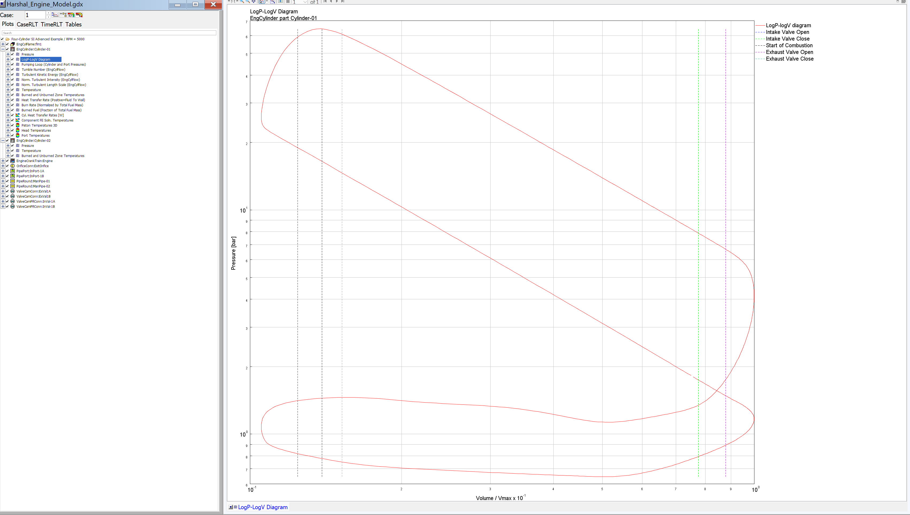
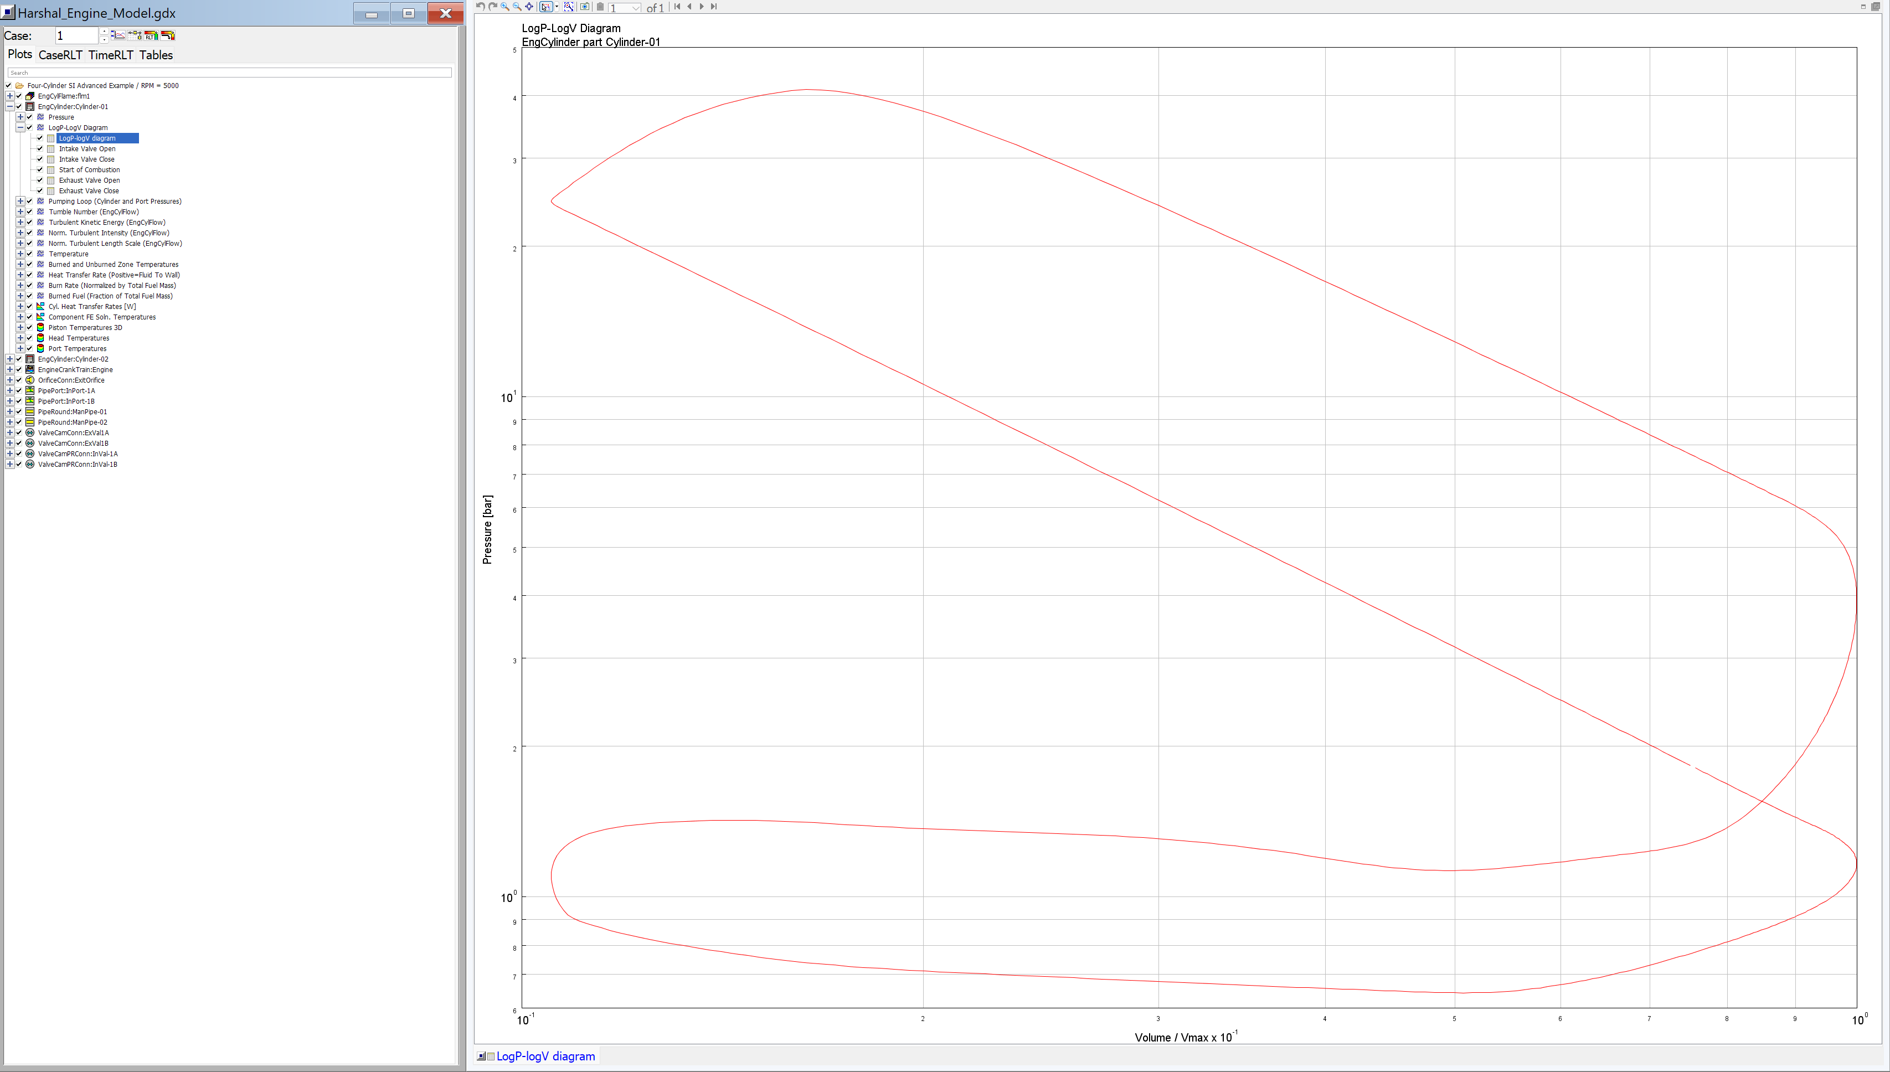
EXERCISE 1 · CASE 2
Air–Fuel Ratio Sweep: Rich vs. Lean
RPM | 1000 | 3000 | 5000
BMEP rich [bar] | 7.50 | 11.05 | 10.65
BMEP lean [bar] | 6.50 | 9.35 | 8.35
BSFC rich [g/kWh] | 342 | 297 | 316
BSFC lean [g/kWh] | 259 | 236 | 267
Rich (AFR 11.76)
Lean (AFR 17.64)
Rich mixtures inject ~25% more fuel per cycle → higher BMEP/torque/power, but higher BSFC.
Lean mixtures combust closer to the SI efficiency optimum (λ≈1.1–1.2) → BSFC 20–25% lower, at the cost of 15–25% less output. Classic rich-power / lean-economy trade-off.
Exercise 1 — Case 2: AFR Sweep
Harshal Rajesh Kokitkar | AVE, Federico II

Slide 7
EXERCISE 1 · CASE 3
Spark-Advance Sweep (3000 rpm)
Advancing the spark (−10° → −30° CA) fires earlier, concentrating combustion near TDC: peak pressure rises monotonically from ≈40 to ≈76 bar, and its location moves from ≈29° to ≈7–8° ATDC.
Exercise 1 — Case 3: Spark-Advance Sweep
Harshal Rajesh Kokitkar | AVE, Federico II

Slide 8
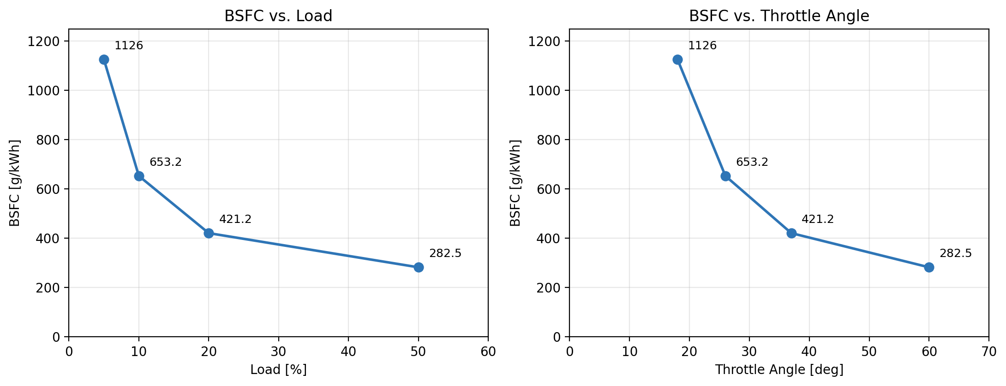
EXERCISE 1 · CASE 4
Throttle Position / Load Sweep
Closing the throttle at light load creates a large pumping loop (negative work, high PMEP) and starves the cylinder of trapped air. BSFC falls steeply and non-linearly — more than half the total improvement is realised by the second point alone (5%→10% load). This directly motivates ECMS avoiding light-load ICE operation in Exercise 2.
Load | 5% | 10% | 20% | 50%
Throttle [°] | 18 | 26 | 37 | 60
BSFC [g/kWh] | 1126.0 | 653.2 | 421.2 | 282.5
Exercise 1 — Case 4: Throttle/Load Sweep
Harshal Rajesh Kokitkar | AVE, Federico II

Slide 9
EXERCISE 1 · WRAP-UP
Exercise 1 — Key Takeaways
Speed sweep
Torque/BMEP peak ~3500–4000 rpm; power rises to 5000 rpm (P=T·ω); BSFC minimized ~3000 rpm.
AFR sweep
Rich buys peak torque at the cost of BSFC; lean buys economy at the cost of output.
Spark advance
Advancing spark moves combustion toward TDC, raising peak pressure and indicated work up to MBT.
Throttle/load
Pumping losses dominate at light load; BSFC improves sharply and non-linearly as throttle opens.
Exercise 1 — Conclusions
Harshal Rajesh Kokitkar | AVE, Federico II

Slide 10
PART TWO
Exercise 2: P1 Hybrid Vehicle
Simulation with ECMS
WLTC Class 3 and Artemis cycles, emission assessment against Euro 6e / EU CO₂ target, and vehicle-mass sensitivity analysis.

Slide 11
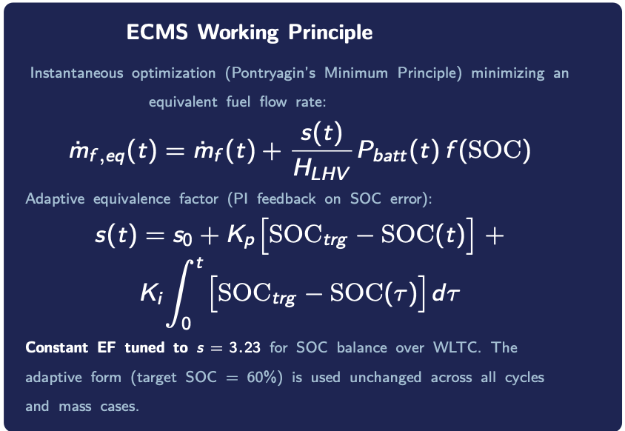
EXERCISE 2 · ARCHITECTURE & STRATEGY
P1 Architecture & ECMS Energy Management
P1 Hybrid Architecture
●
EM rigidly coupled to the crankshaft, upstream of clutch/transmission
●
No pure-EV propulsion — EM always rotates with the ICE
●
Torque assist, generation (load-point shifting), partial regen braking
●
Efficient start/stop via integrated starter-generator
ICE torque map multiplier (assigned): × 1.02
Exercise 2 — Architecture & ECMS
Harshal Rajesh Kokitkar | AVE, Federico II

Slide 12
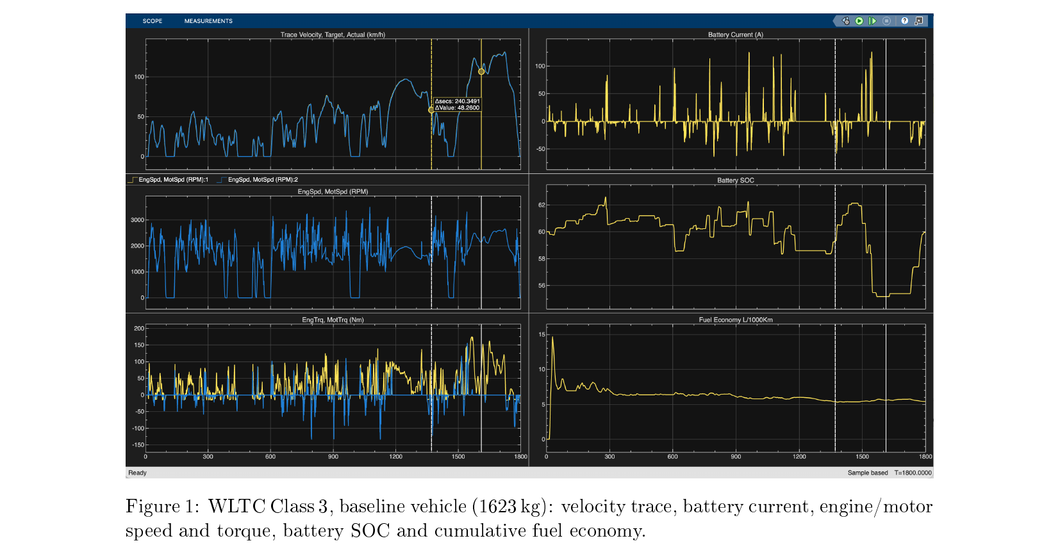
EXERCISE 2 · WLTC BASELINE
WLTC Class 3 — Cycle Following & SOC
60% → 57.5–58.5%
SOC start → end (charge-sustaining)
≈ 5.5 l/100km
Cumulative fuel economy
1800 s / 23.27 km
Cycle duration / distance
SOC dips to ~55% in the extra-high-speed phase (peak demand); the adaptive EF restores it toward the 60% target.
Exercise 2 — WLTC Baseline
Harshal Rajesh Kokitkar | AVE, Federico II

Slide 13
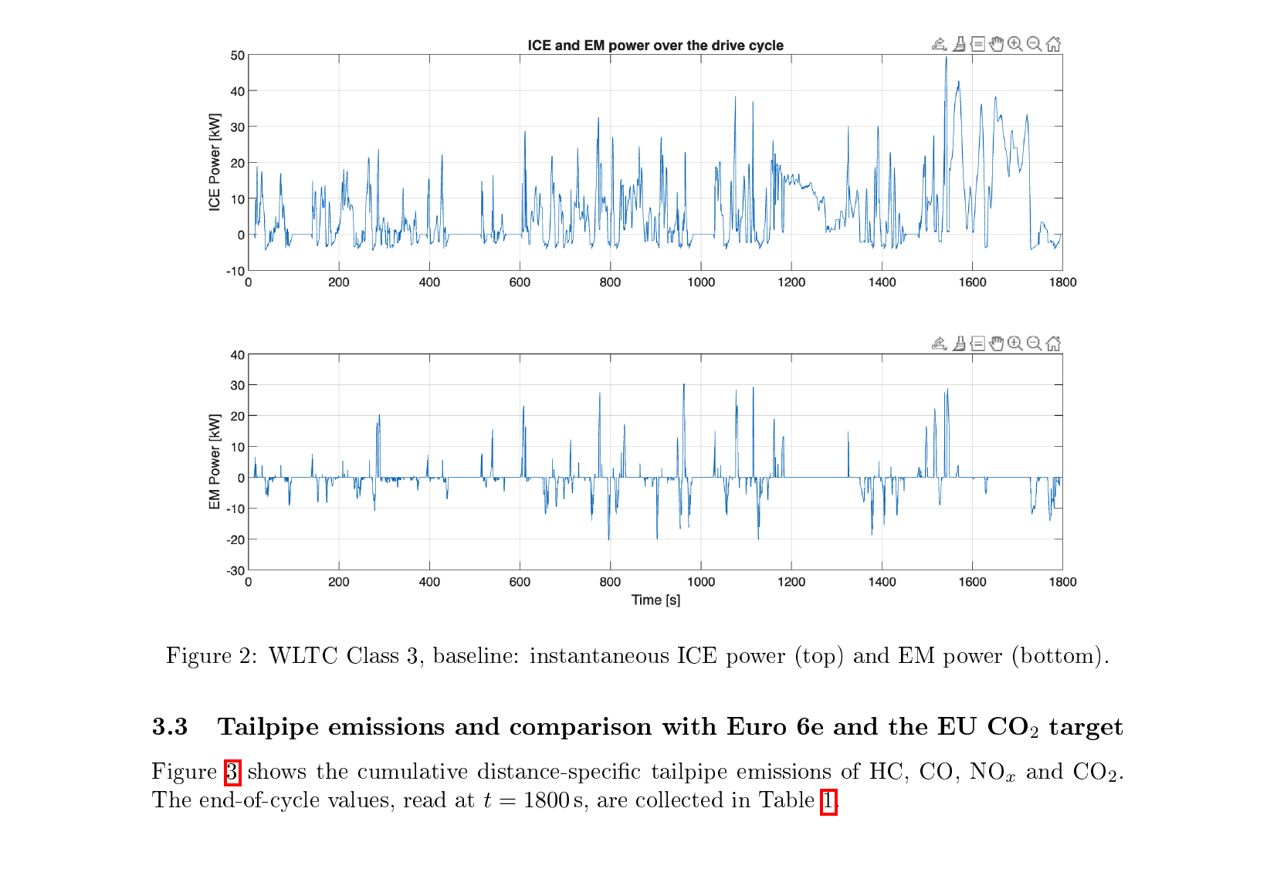
EXERCISE 2 · WLTC BASELINE
ICE/EM Power Split & Tailpipe Emissions
Pollutant | Simulated | Limit/Target | Status
CO [g/km] | ≈ 0.70 | 1.0 (Euro 6e) | Compliant
THC [g/km] | ≈ 0.014 | 0.10 (Euro 6e) | Compliant
NOx [g/km] | ≈ 8×10⁻⁴ | 0.06 (Euro 6e) | Compliant
CO₂ [g/km] | ≈ 125 | 93.6 (EU 2025 fleet) | Above target
HC, CO and NOx are comfortably compliant with Euro 6e. CO₂ (≈125 g/km) exceeds the 2025 EU fleet-average target of 93.6 g/km — a mild P1 hybrid alone is not sufficient at this vehicle mass; stronger electrification or downsizing would be needed.
ICE provides essentially all traction power (peaks ≈50 kW); EM exchanges only ±3 kW — typical P1 mild-hybrid behaviour.
Exercise 2 — Emissions vs. Euro 6e / EU CO₂
Harshal Rajesh Kokitkar | AVE, Federico II

Slide 14
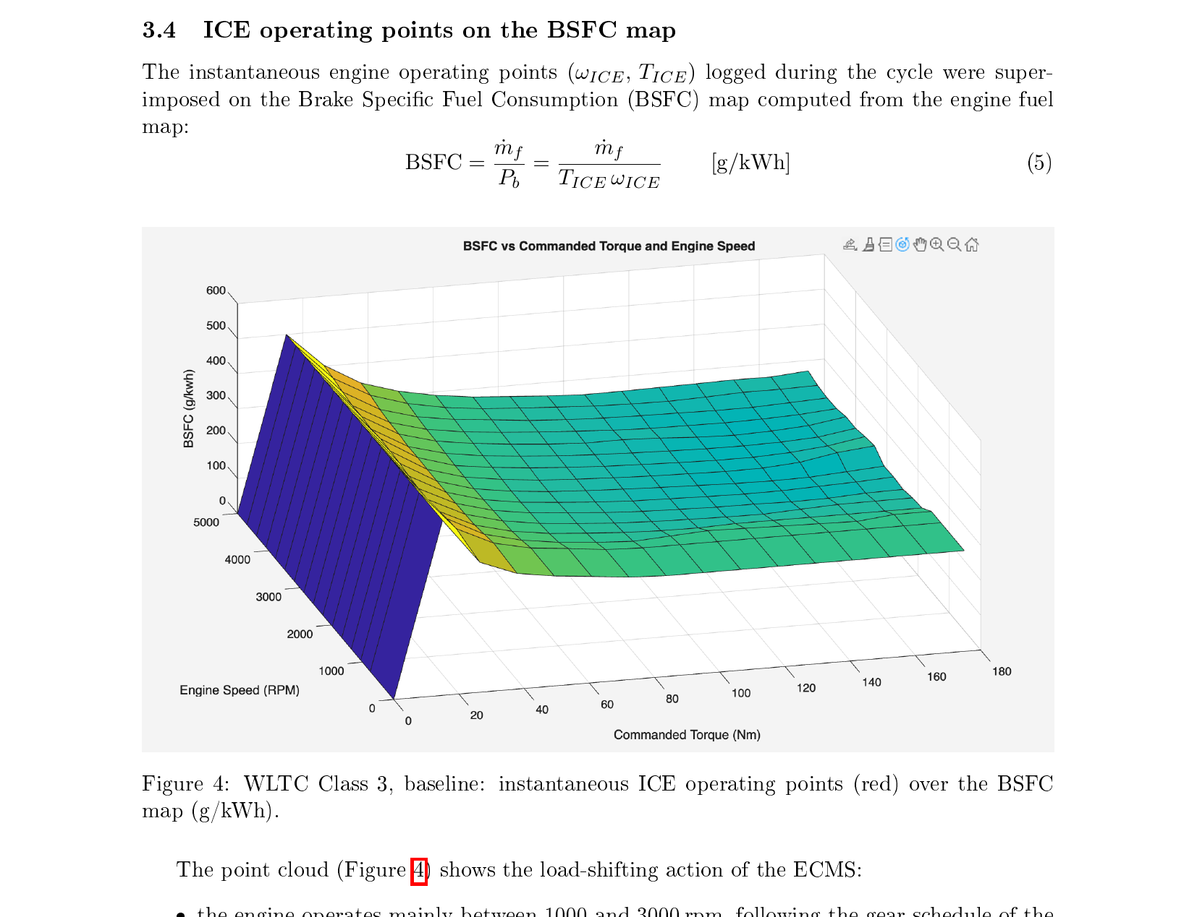
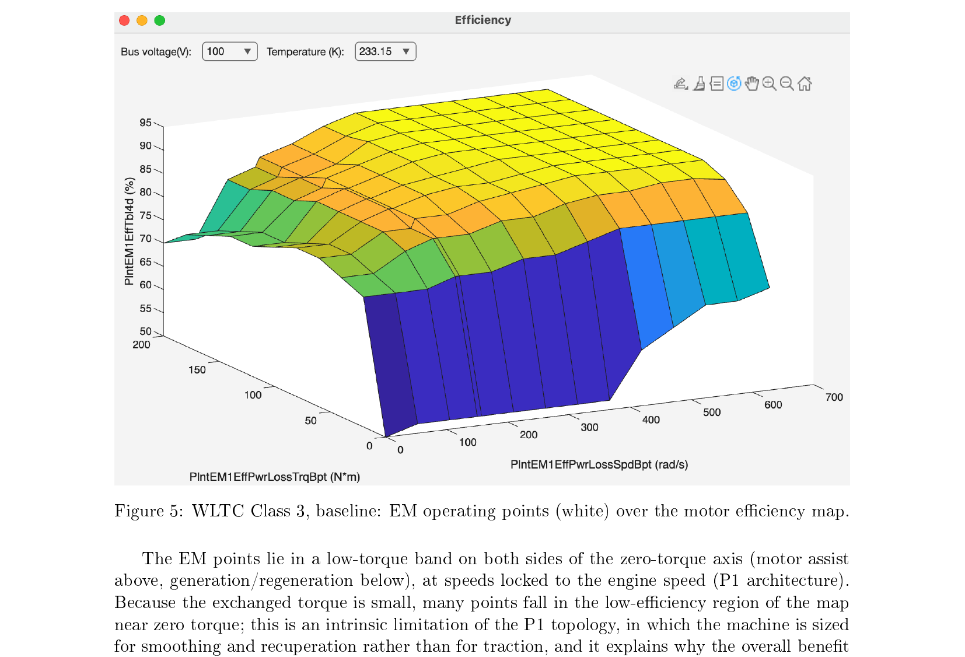
EXERCISE 2 · OPERATING POINTS
Engine BSFC Map & Motor Efficiency Map
ICE points cluster 1000–3000 rpm, pushed toward medium–high load where BSFC nears its minimum (≈240–260 g/kWh); ECMS avoids sustained light-load operation. EM points sit in a low-torque band on both sides of zero — an intrinsic P1 limitation, since the machine is sized for smoothing/recuperation, not traction.
Exercise 2 — BSFC & Efficiency Maps
Harshal Rajesh Kokitkar | AVE, Federico II

Slide 15
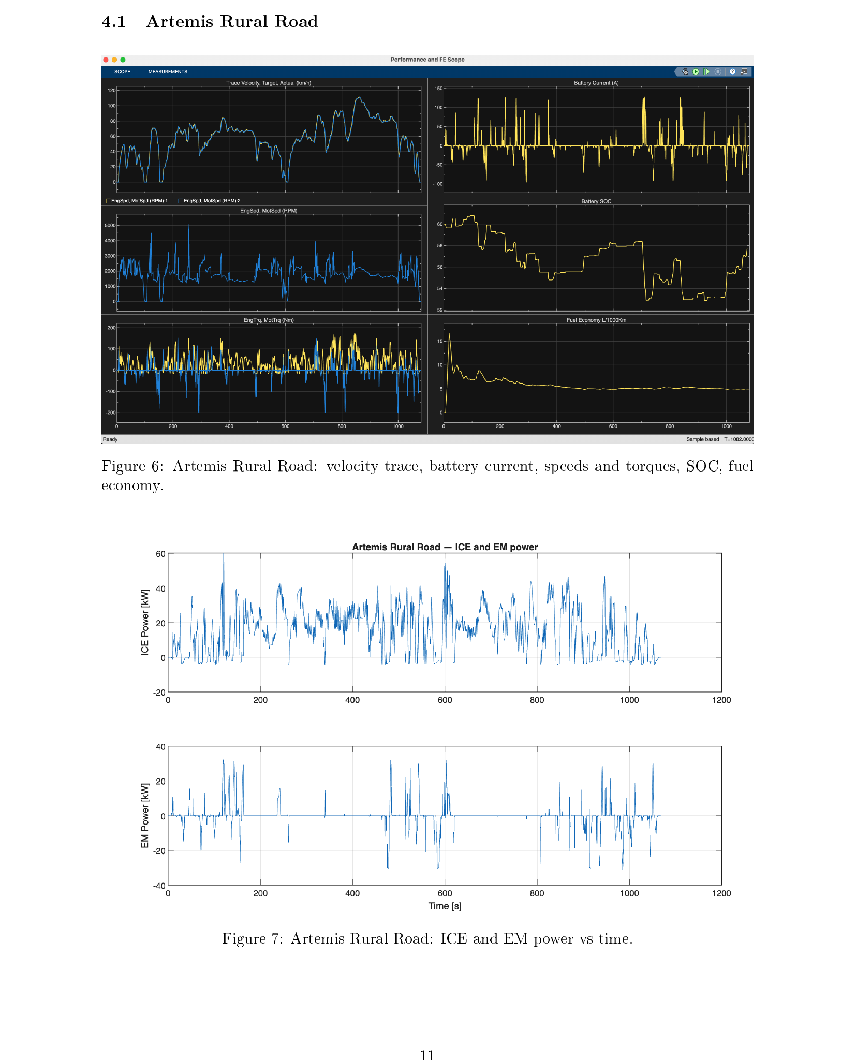
EXERCISE 2 · CYCLE COMPARISON
Artemis Rural & Motorway (Same ECMS, No Retuning)
 | WLTC | Artemis Rural | Artemis Motorway
Duration [s] | 1800 | 1082 | 1068
Final SOC [%] | ≈ 57.5 | ≈ 57.7 | ≈ 58.5
Fuel econ. [l/100km] | ≈ 5.5 | ≈ 5.0 | ≈ 6.0
CO₂ [g/km] | ≈ 125 | ≈ 115 | ≈ 135
CO [g/km] | ≈ 0.70 | ≈ 0.38 | ≈ 1.1
Ranking follows mean traction power: motorway > WLTC > rural. On the motorway cycle, hybrid benefit almost vanishes and CO (≈1.1 g/km) exceeds the Euro 6e number — acceptable since Euro 6e is legally defined on WLTC, but it flags sensitivity to high-load enrichment. The adaptive ECMS keeps charge-sustaining operation on every cycle with no retuning.
Artemis Rural Road: ICE/EM power — frequent moderate accel/decel, best fuel economy of the three cycles.
Exercise 2 — Cycle Comparison
Harshal Rajesh Kokitkar | AVE, Federico II

Slide 16
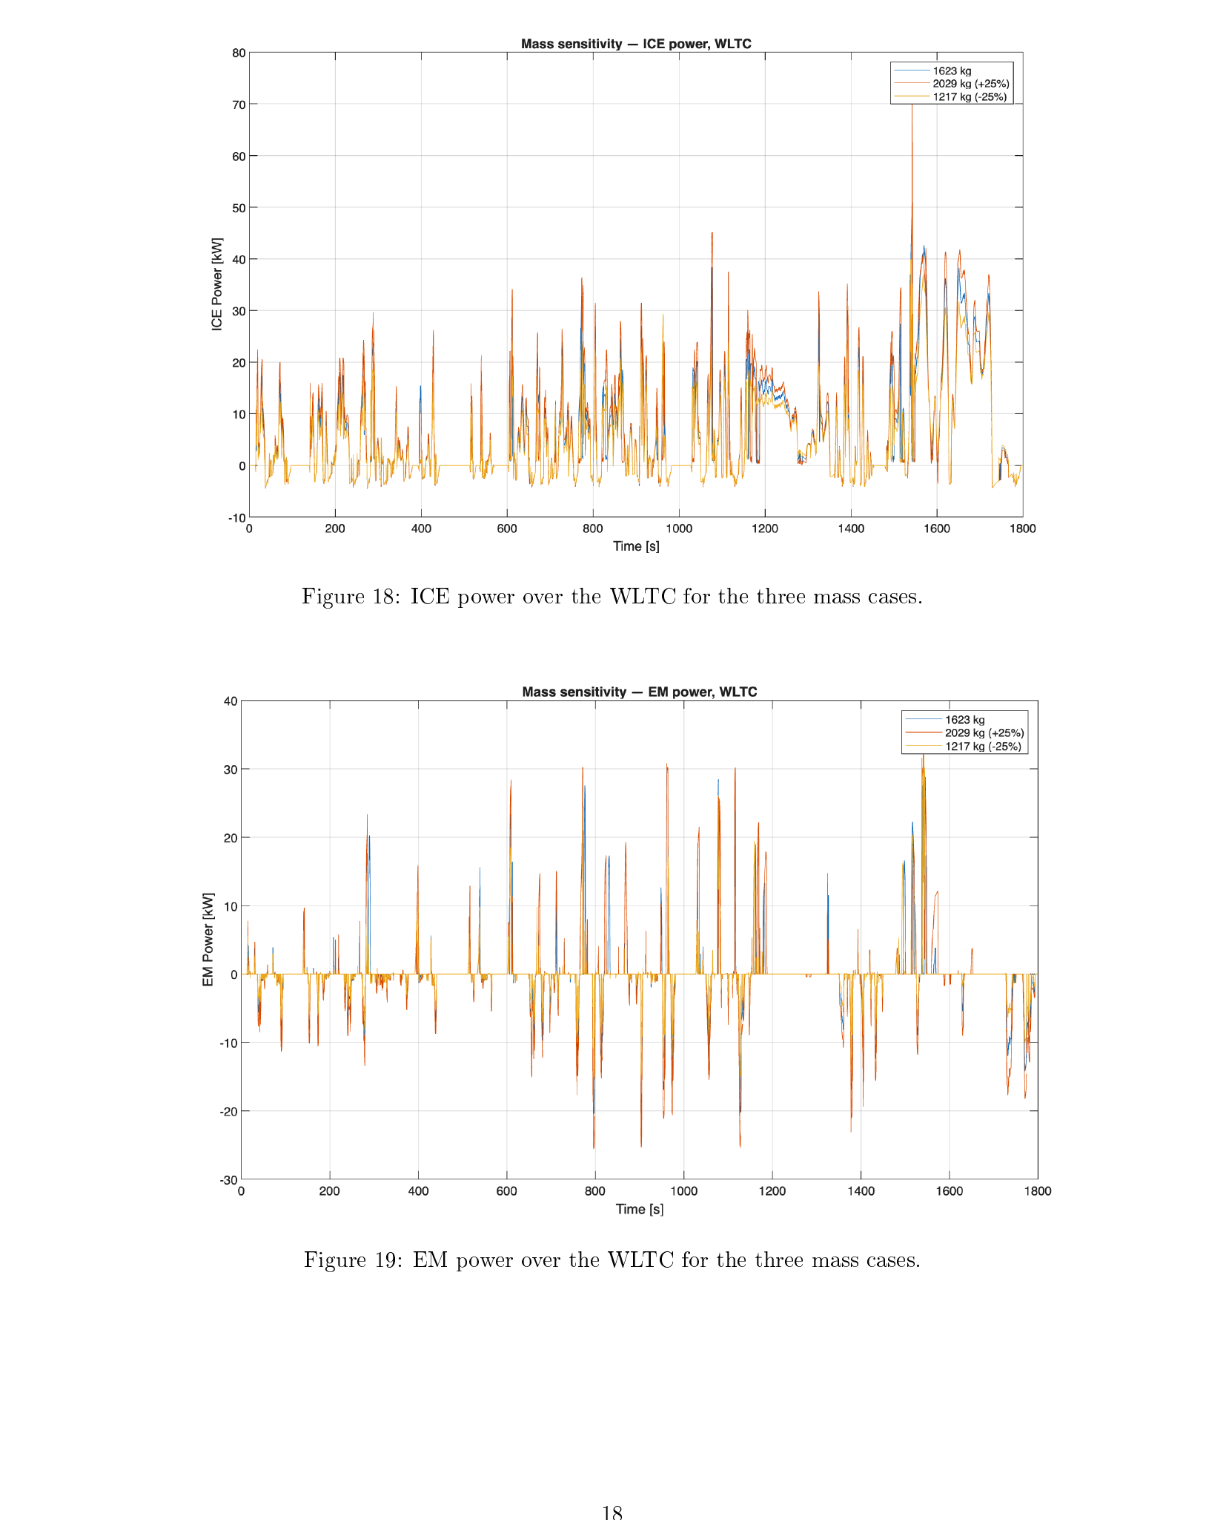
EXERCISE 2 · SENSITIVITY ANALYSIS
Vehicle Mass Sensitivity (±25%, WLTC)
 | 1217 kg (−25%) | 1623 kg | 2029 kg (+25%)
Final SOC [%] | ≈ 57.5 | ≈ 57.5 | ≈ 58
Fuel econ. [l/100km] | ≈ 5.0 | ≈ 5.5 | ≈ 6.5
CO₂ [g/km] | ≈ 110 | ≈ 125 | ≈ 140
Theoretical justification
Ft = m·a + m·g·cr·cosα + ½·ρ·cx·A·v² + m·g·sinα
Inertia and rolling-resistance terms scale directly with mass — on a transient cycle like WLTC these dominate. Simulated ±25% mass gave ≈−9% / +18% changes in fuel consumption, consistent with only 2 of 4 force terms scaling with m. The adaptive ECMS keeps SOC balanced in all three cases without retuning.
ICE & EM power vs. time, three mass cases (1217 / 1623 / 2029 kg).
Exercise 2 — Mass Sensitivity
Harshal Rajesh Kokitkar | AVE, Federico II

Slide 17
EXERCISE 2 · WRAP-UP
Exercise 2 — Key Findings
ECMS tuning
Constant EF s=3.23 gives SOC balance on WLTC; adaptive form is charge-sustaining on every cycle/mass tested without retuning.
Fuel economy & emissions
≈5.5 l/100km, ≈125 g/km CO₂ on WLTC. HC/CO/NOx well within Euro 6e; CO₂ remains above the 93.6 g/km EU 2025 target.
Operating points
ECMS shifts ICE points to low-BSFC region; P1 EM confined to a narrow low-torque assist/regen band.
Cycle & mass sensitivity
Fuel use and emissions scale with mean power demand and roughly linearly with mass (inertia + rolling dominated).
Exercise 2 — Conclusions
Harshal Rajesh Kokitkar | AVE, Federico II

Slide 18
CLOSING SUMMARY
From Cylinder to Cycle
Exercise 1 showed that engine efficiency is governed by breathing (λv), mixture (AFR) and combustion phasing (spark advance) — and that light-load throttling is the single largest efficiency penalty (BSFC 1126 → 282 g/kWh, 5%→50% load).
Exercise 2 showed that a P1 ECMS-controlled hybrid exploits exactly this insight — shifting the engine into its efficient mid–high-load region and avoiding light-load operation — achieving Euro 6e-compliant pollutant emissions, though CO₂ remains above the 2025 EU fleet target for this vehicle class, and both fuel use and emissions scale predictably with driving-cycle severity and vehicle mass.

