Slide 2
ONOS
GNS3 Server
(GNS3 VM)
GNS3 Client
OpenDaylight
Ryu
Bridge
Adapter
ONOS Docker
NIC
VirtualBox
Adapter
Mininet
VirtualBox
Host machine

Slide 3
Version 1.0 | Version 1.1 | Version 1.2 | Version 1.3 | Version 1.4 | Version 1.5
Single flow table entry | Multiple flow table | Support for IPv6 | Support for IPv6 extension header | Add in bundle mechanism | Egress table
Single Controller | Pipeline Processing | Extensible TLV support | Flow meter | Support for Table synchronization | Packet type aware Pipeline
Support for IPv4 | Support for VLAN and MPLS |  | Support for Table miss |  | Extensible flow entry statistics
 | Group table
 | Virtual ports

Slide 4
SDN Control Architecture

Slide 5
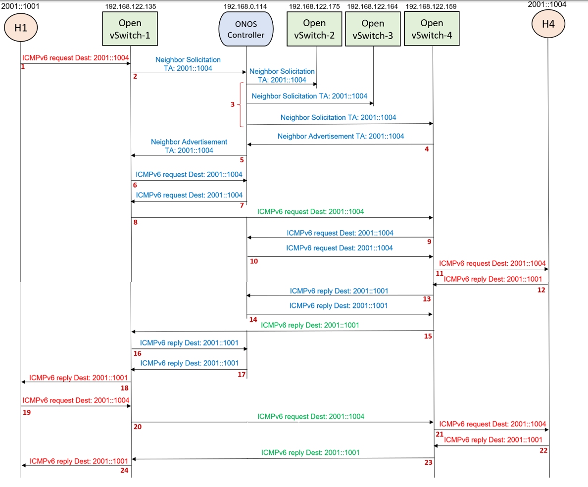

Slide 6
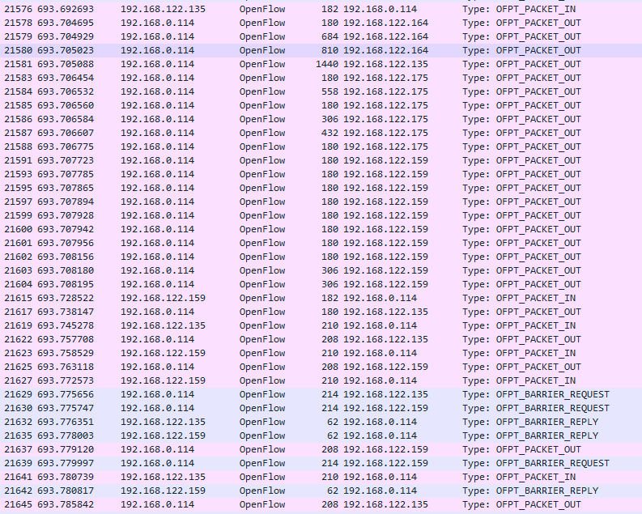
2
3
4
5
6
7
9
10
13
14
16
17

Slide 7
2001::1001
192.168.122.135
192.168.0.114
192.168.122.175
192.168.122.164
192.168.122.159
2001::1004
H1
Open vSwitch-1
ONOS Controller
Open vSwitch-2
Open vSwitch-3
Open vSwitch-4
H4
ICMPv6 request Dest: 2001::1004
Neighbor Solicitation
TA: 2001::1004
1
Neighbor Solicitation
TA: 2001::1004
2
Neighbor Solicitation TA: 2001::1004
3
Neighbor Solicitation TA: 2001::1004
Neighbor Advertisement
TA: 2001::1004
Neighbor Advertisement TA: 2001::1004
4
5
ICMPv6 request Dest: 2001::1004
6
ICMPv6 request Dest: 2001::1004
7
ICMPv6 request Dest: 2001::1004
8
ICMPv6 request Dest: 2001::1004
9
ICMPv6 request Dest: 2001::1004
10
ICMPv6 request Dest: 2001::1004
11
ICMPv6 reply Dest: 2001::1001
ICMPv6 reply Dest: 2001::1001
12
ICMPv6 reply Dest: 2001::1001
13
14

Slide 8
2001::1001
192.168.122.135
192.168.0.114
192.168.122.175
192.168.122.164
192.168.122.159
2001::1004
H1
Open vSwitch-1
ONOS Controller
Open vSwitch-2
Open vSwitch-3
Open vSwitch-4
H4
ICMPv6 request Dest: 2001::1004
11
ICMPv6 reply Dest: 2001::1001
ICMPv6 reply Dest: 2001::1001
12
13
ICMPv6 reply Dest: 2001::1001
14
ICMPv6 reply Dest: 2001::1001
15
ICMPv6 reply Dest: 2001::1001
16
ICMPv6 reply Dest: 2001::1001
ICMPv6 reply Dest: 2001::1001
17
18
ICMPv6 request Dest: 2001::1004
19
ICMPv6 request Dest: 2001::1004
20
ICMPv6 request Dest: 2001::1004
21
ICMPv6 reply Dest: 2001::1001
ICMPv6 reply Dest: 2001::1001
22
ICMPv6 reply Dest: 2001::1001
23
24

Slide 9
2001::1001
2001::1004
H1
Open vSwitch-1
Open vSwitch-4
H4
ICMPv6 request Dest: 2001::1004
1
ICMPv6 request Dest: 2001::1004
2
ICMPv6 request Dest: 2001::1004
3
ICMPv6 reply Dest: 2001::1001
4
ICMPv6 reply Dest: 2001::1001
6
ICMPv6 reply Dest: 2001::1001
7

Slide 10
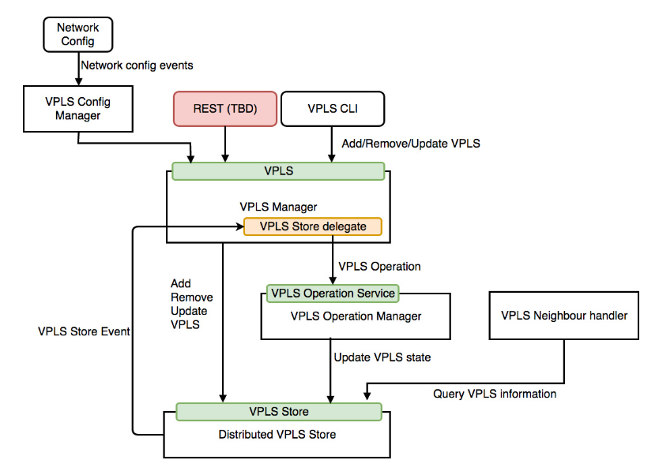

Slide 11
ONOS CLI
REST API
VPLS Config Manager
VPLS Config Events
VPLS
VPLS Manager
VPLS Store delegate
VPLS Operation
Add
Remove
Update
VPLS
VPLS Operation Service
VPLS Neighbour Handler
VPLS Operation Manager
VPLS
Store
Event
Update VPLS state
Query VPLS information
VPLS Store
Distributed VPLS Store

Slide 12
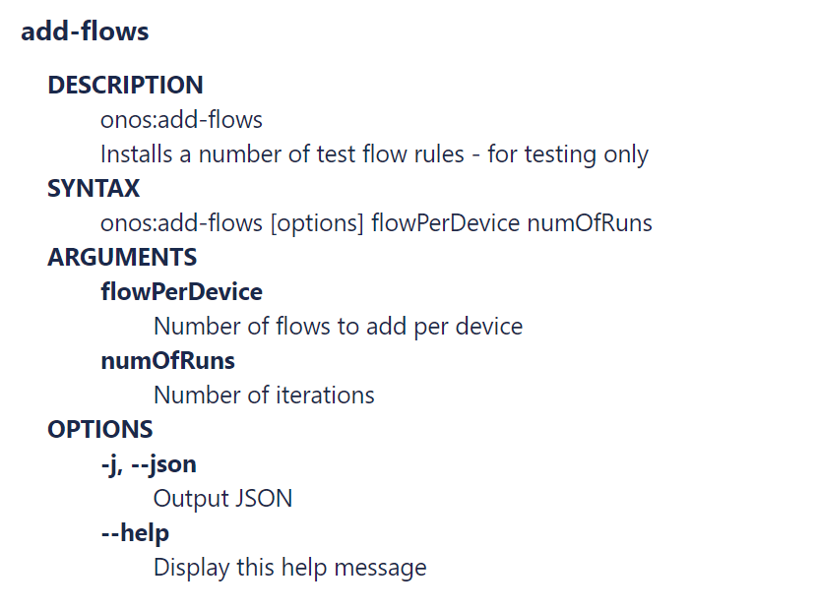
add-test-flows
onos:add-test-flows
onos:add-test-flows [options] flowPerDevice numOfRuns

Slide 13
Open vSwitch
Match Fields:
Ingress port +
Packet header +
metadata
Flow
Table
0
Flow
Table
1
Flow
Table
n
Execute Action Set
Packet
Out
Packet
In
Action Set
Action Set
Action Set
Action Set
. . .
Ingress Port
Egress Port

Slide 14
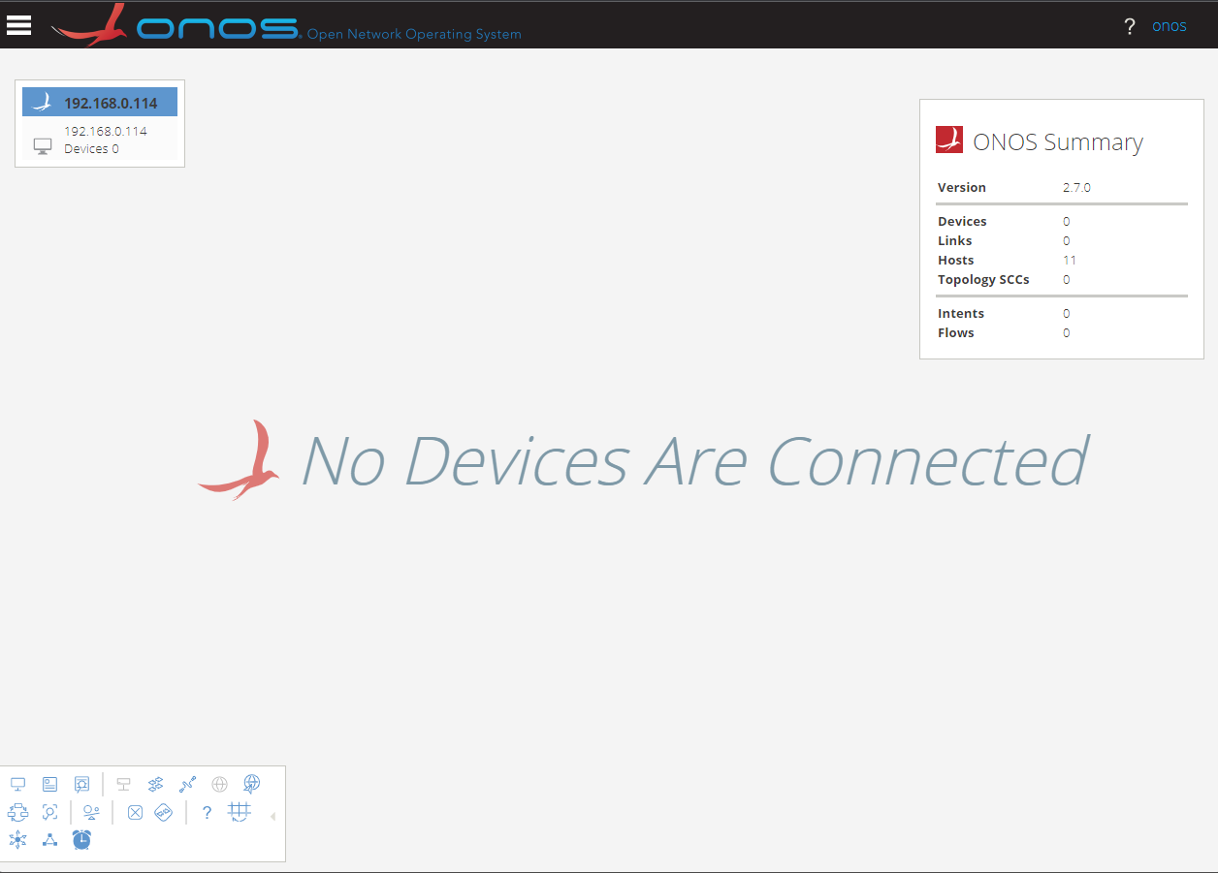
Masthead
ONOS Cluster Node Panel
Navigation Menu Button
Summary Panel
Username/
Logout link
Topology Toolbar

Slide 15
Application & Service Layer
Application Plane
SDN
Applications
Northbound Interface (NBI)
REST API
Control Layer
Controller Plane
SDN
Controller
Southbound Interface (SBI)
OpenFlow, BGP, NetConf
Infrastructure Layer
Data Plane
Network
Elements

