Slide 2
Version 1.0 | Version 1.1 | Version 1.2 | Version 1.3 | Version 1.4 | Version 1.5
Single flow table entry | Multiple flow table | Support for IPv6 | Support for IPv6 extension header | Add in bundle mechanism | Egress table
Single Controller | Pipeline Processing | Extensible TLV support | Flow meter | Support for Table synchronization | Packet type aware Pipeline
Support for IPv4 | Support for VLAN and MPLS |  | Support for Table miss |  | Extensible flow entry statistics
 | Group table
 | Virtual ports

Slide 3
SDN Control Architecture

Slide 4
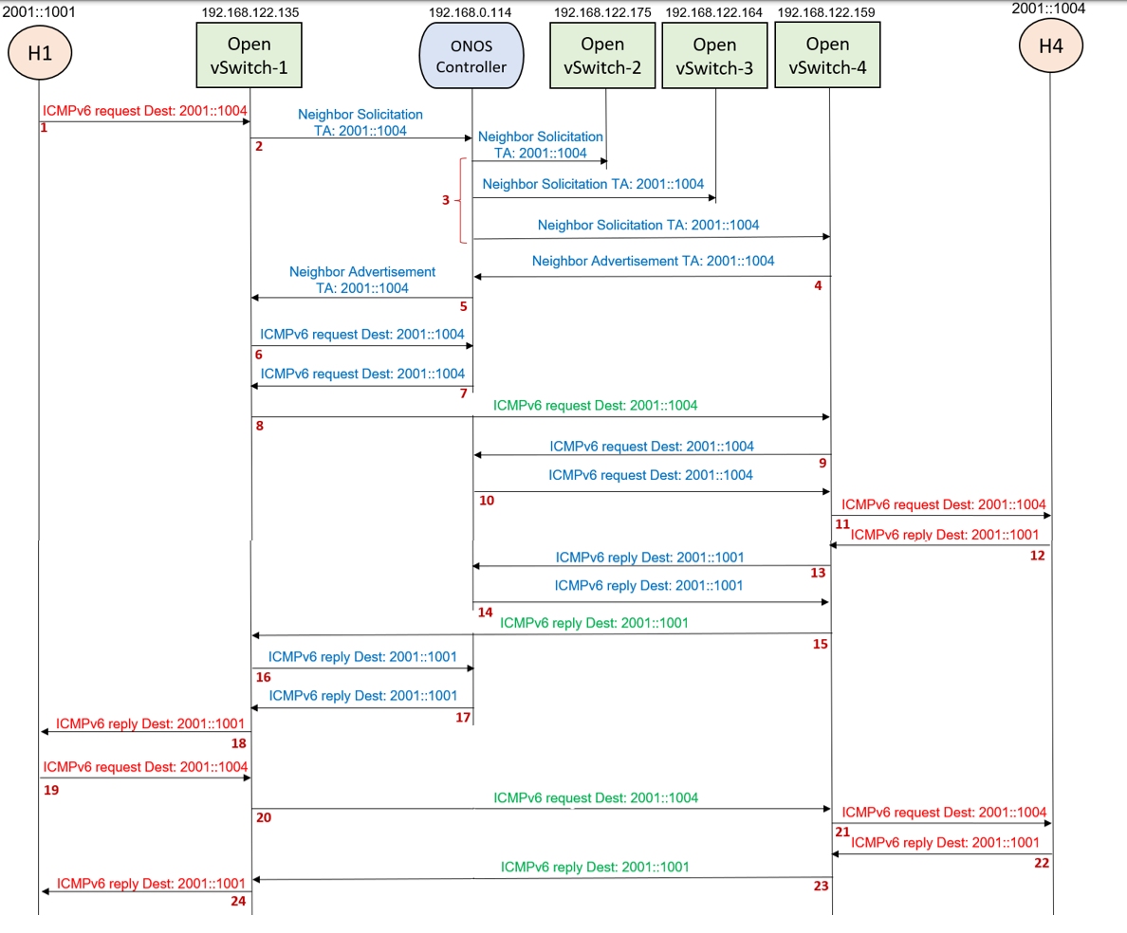

Slide 5
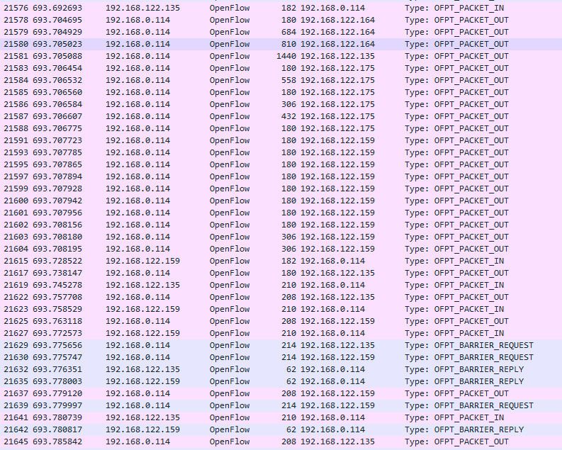
2
3
4
5
6
7
9
10
13
14
16
17

Slide 6
2001::1001
192.168.122.135
192.168.0.114
192.168.122.175
192.168.122.164
192.168.122.159
2001::1004
H1
Open vSwitch-1
ONOS Controller
Open vSwitch-2
Open vSwitch-3
Open vSwitch-4
H4
ICMPv6 request Dest: 2001::1004
Neighbor Solicitation
TA: 2001::1004
1
Neighbor Solicitation
TA: 2001::1004
2
Neighbor Solicitation TA: 2001::1004
3
Neighbor Solicitation TA: 2001::1004
Neighbor Advertisement
TA: 2001::1004
Neighbor Advertisement TA: 2001::1004
4
5
ICMPv6 request Dest: 2001::1004
6
ICMPv6 request Dest: 2001::1004
7
ICMPv6 request Dest: 2001::1004
8
ICMPv6 request Dest: 2001::1004
9
ICMPv6 request Dest: 2001::1004
10
ICMPv6 request Dest: 2001::1004
11
ICMPv6 reply Dest: 2001::1001
ICMPv6 reply Dest: 2001::1001
12
ICMPv6 reply Dest: 2001::1001
13
14

Slide 7
2001::1001
192.168.122.135
192.168.0.114
192.168.122.175
192.168.122.164
192.168.122.159
2001::1004
H1
Open vSwitch-1
ONOS Controller
Open vSwitch-2
Open vSwitch-3
Open vSwitch-4
H4
ICMPv6 request Dest: 2001::1004
11
ICMPv6 reply Dest: 2001::1001
ICMPv6 reply Dest: 2001::1001
12
13
ICMPv6 reply Dest: 2001::1001
14
ICMPv6 reply Dest: 2001::1001
15
ICMPv6 reply Dest: 2001::1001
16
ICMPv6 reply Dest: 2001::1001
ICMPv6 reply Dest: 2001::1001
17
18
ICMPv6 request Dest: 2001::1004
19
ICMPv6 request Dest: 2001::1004
20
ICMPv6 request Dest: 2001::1004
21
ICMPv6 reply Dest: 2001::1001
ICMPv6 reply Dest: 2001::1001
22
ICMPv6 reply Dest: 2001::1001
23
24

Slide 8
2001::1001
2001::1004
H1
Open vSwitch-1
Open vSwitch-4
H4
ICMPv6 request Dest: 2001::1004
1
ICMPv6 request Dest: 2001::1004
2
ICMPv6 request Dest: 2001::1004
3
ICMPv6 reply Dest: 2001::1001
4
ICMPv6 reply Dest: 2001::1001
6
ICMPv6 reply Dest: 2001::1001
7

Slide 9
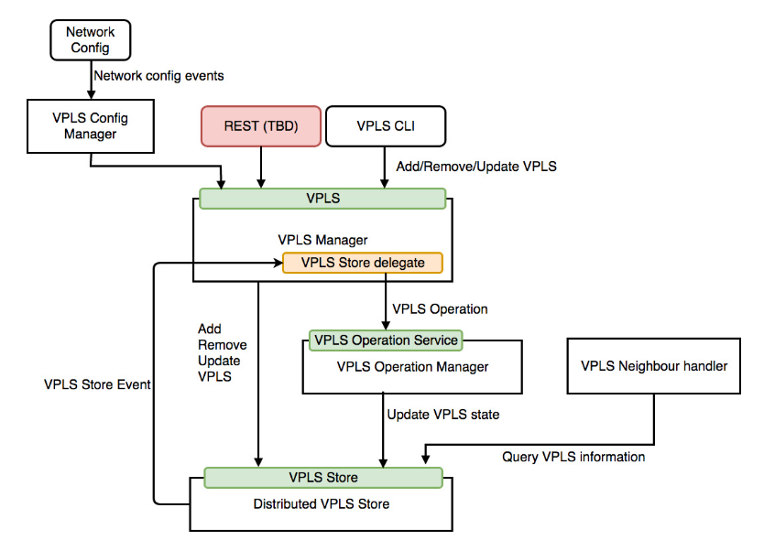

Slide 10
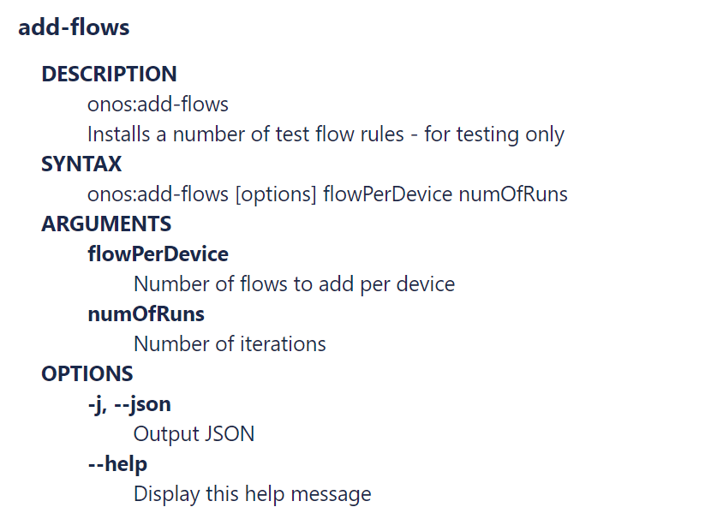
add-test-flows
onos:add-test-flows
onos:add-test-flows [options] flowPerDevice numOfRuns

Slide 11
Open vSwitch
Match Fields:
Ingress port +
Packet header +
metadata
Flow
Table
0
Flow
Table
1
Flow
Table
n
Execute Action Set
Packet
Out
Packet
In
Action Set
Action Set
Action Set
Action Set
. . .
Ingress Port
Egress Port

Slide 12
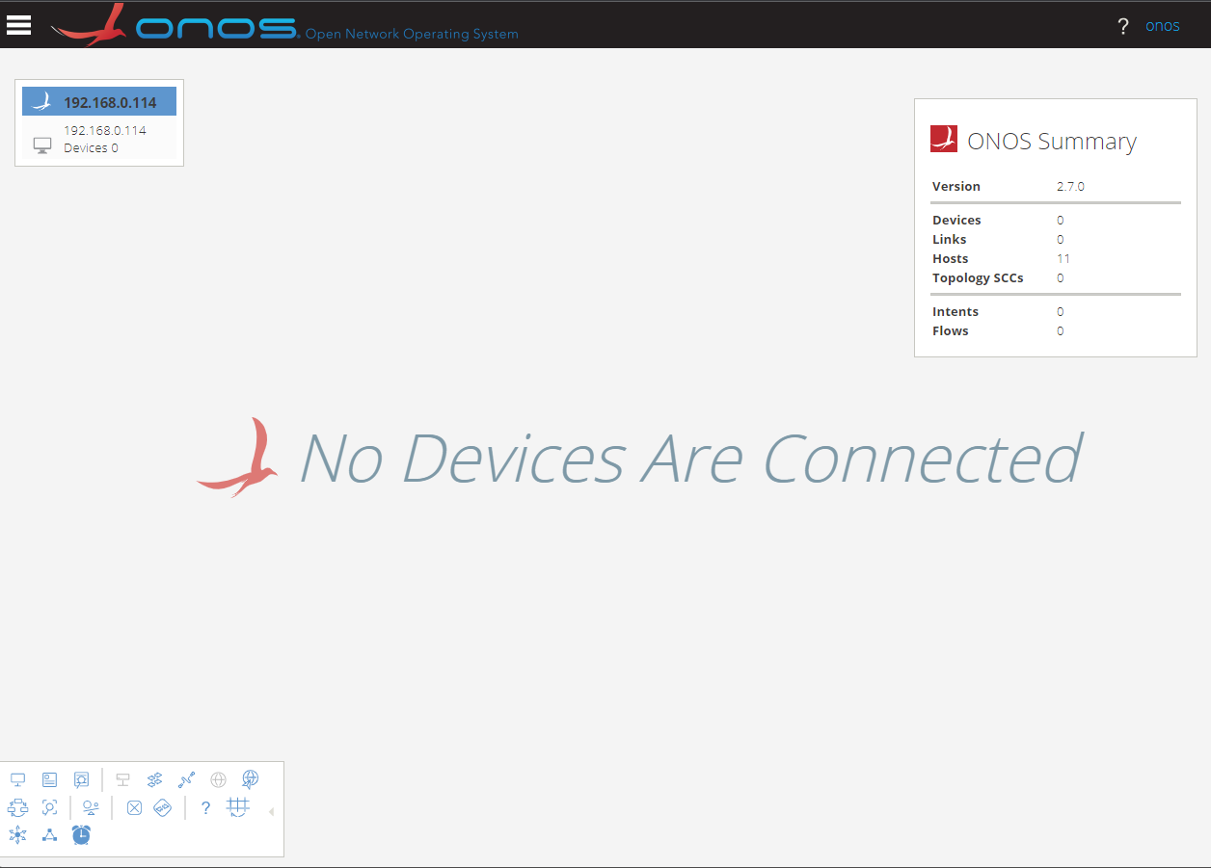
Masthead
ONOS Cluster Node Panel
Navigation Menu Button
Summary Panel
Username/
Logout link
Topology Toolbar

Slide 13
Application & Service Layer
Application Plane
SDN
Applications
Northbound Interface (NBI)
REST API
Control Layer
Controller Plane
SDN
Controller
Southbound Interface (SBI)
OpenFlow, BGP, NetConf
Infrastructure Layer
Data Plane
Network
Elements

