Slide 1

SDN based Network Management in Emulated Environment
Submitted by: Harshal Rajan Vaze
Matriculation no.: 1269879
First examiner: Prof. Dr. Ulrich Trick
Second examiner: Prof. Dr. Armin Lehmann
External supervisor: Dr. Peter Gröschke

Slide 2
Agenda
SDN Architecture
SDN Components
Creation of flow rules
Use-cases

Slide 3
SDN Architecture
Application & Service Layer
Application Plane
SDN
Applications
Northbound Interface
REST API
Control Layer
Controller Plane
Eastbound Interface
SDN
Controller
Westbound Interface
Southbound Interface
OpenFlow, BGP, NetConf
Infrastructure Layer
Data Plane
Network
Elements

Slide 4






SDN Components
SDN Controllers | Network Elements | Network Emulators
Mininet

Slide 5
Flow Rules
Creation of Flow rules
Creation of Intents
Packet forwarding flow rules
Application commands >> Flow rules
Creation & Installation
Open vSwitch CLI
ONOS REST API
ONOS CLI
Policy-based directives
Intent Framework is a subsystem
Application commands >> Flow rules
Creation & Installation
ONOS CLI
ONOS GUI
ONOS REST API

Slide 6

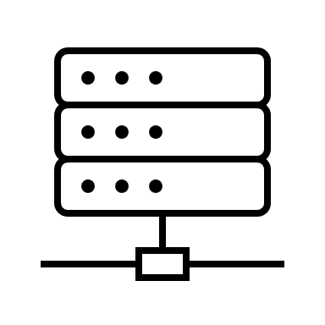
Use Case-1: Testing the ONOS Controller with Isolated Layer 2 Overlay Networks
H1
H1
Server1
OVS-1
OVS-3
OVS-5
OVS-7
Server1
10.0.0.1
10.0.0.10
10.0.0.2
10.0.0.11
H2
OVS-2
OVS-4
OVS-6
OVS-8
H2
Server2
Server2
10.0.0.3
10.0.0.12
H3
H3
Server3
Server3

Slide 7
Use Case-2: Testing the Network with Multiple ONOS Controllers
Atomix-1
Atomix-2
Atomix-3
Raft
protocol
ONOS-1
ONOS-2
ONOS-3
Underlying network

Slide 8
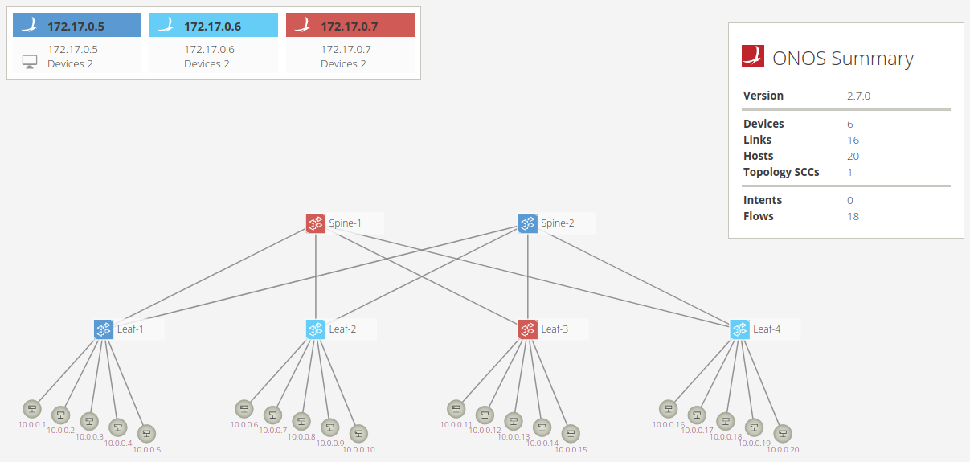
Open vSwitches with their respective Master Controller

Slide 9
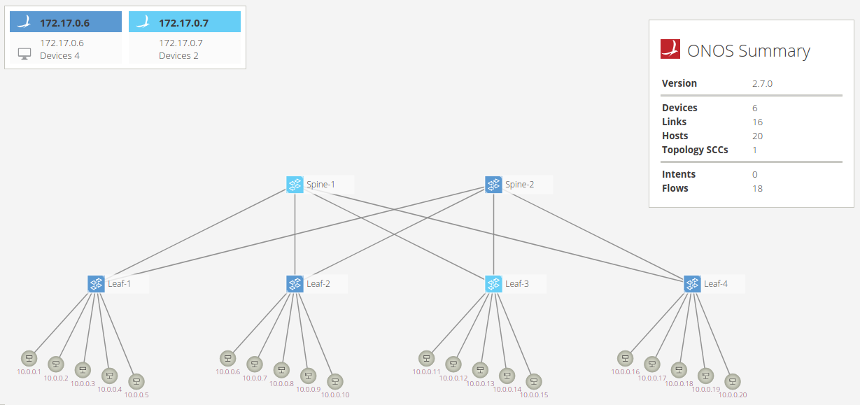
Failure of one ONOS Controller instance from the cluster

Slide 10
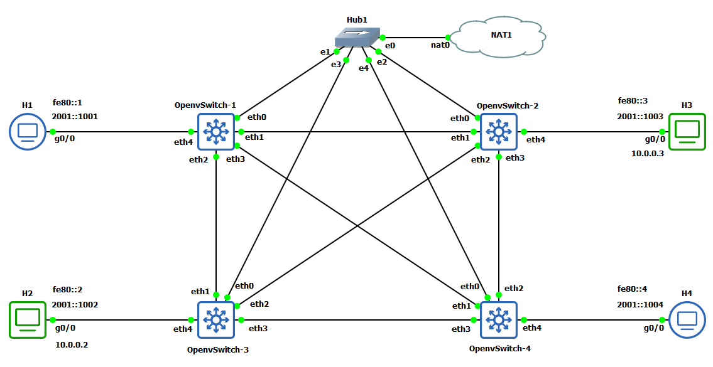
Use Case-3: Testing the ONOS Controller with IPv6 Addressing

Slide 11
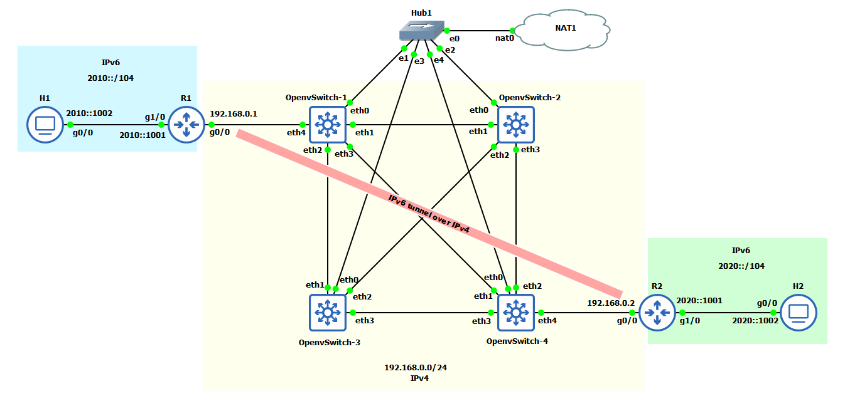
IPv6 tunneling over IPv4 network

Slide 12
Use Case-4: Integrating Software-defined Network with the Legacy Networks
Internal R5
Internal R6
Border R1
OVS-1
OVS-7
Border R3
AS 100
50.0.0.1/24
60.0.0.1/24
AS 300
10.0.0.1/24
30.0.0.1/24
OVS-3
OVS-5
SDN
AS 500
Border R4
40.0.0.1/24
AS 400
Border R2
OVS-4
OVS-8
AS 200
20.0.0.1/24
10.0.0.2/24
20.0.0.2/24
30.0.0.2/24
40.0.0.2/24
50.0.0.2/24
60.0.0.2/24
Controller
OVS-2
.2
192.168.100.0/24
.1
BGP Speaker

Slide 13
Questions?

Slide 14
Thank you!

