Slide 1
SDN based Network Management in Emulated Environment
Submitted by: Harshal Rajan Vaze
Matriculation no.: 1269879
First examiner: Prof. Dr. Ulrich Trick
Second examiner: Prof. Dr. Armin Lehmann
External supervisor: Dr. Peter Gröschke

Slide 2
Agenda

Slide 3
Application Layer
Northbound Interface
Embedded controlling and forwarding device
Control Layer
Southbound Interface
Infrastructure Layer
Traditional Network (distributed control)
Software-defined Network (centralised control)

Slide 4
Application & Service Layer
Application Plane
SDN
Applications
Northbound Interface
REST API
Control Layer
Controller Plane
Eastbound Interface
SDN
Controller
Westbound Interface
Southbound Interface
OpenFlow, BGP, NetConf
Infrastructure Layer
Data Plane
Network
Elements

Slide 5
a. Physically-centralised architecture
b. Physically-distributed architecture
Act like a single controller for network
c. Physically-distributed & Logically-centralised architecture
d. Physically-distributed & Logically-distributed architecture

Slide 6
Root controller
e. Flat architecture
f. Hierarchical architecture
- SDN controller
- Network device

Slide 7
Popular SDN Controllers
ONOS
ODL
Ryu

Slide 8
SDN network emulators
GNS3
Mininet

Slide 9
SDN network components
OVS
OpenFlow

Slide 10
Flow Rules

Slide 11
Intent

Slide 12
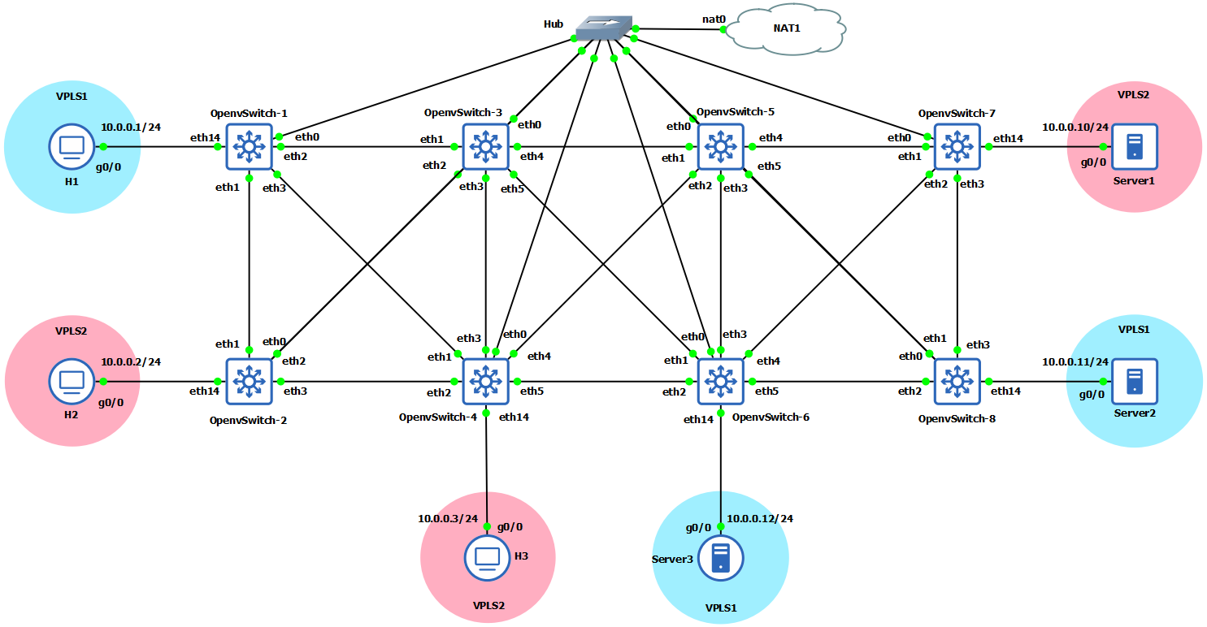
Demo

Slide 13

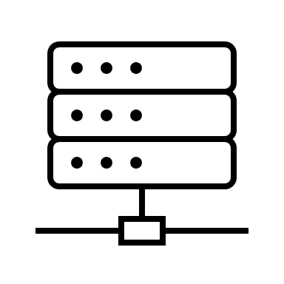
H1
OVS-1
OVS-3
OVS-5
OVS-7
Server1
eth14
eth2
eth1
eth4
eth1
eth4
eth1
eth14
10.0.0.1/24
eth3
eth2
eth5
eth2
eth5
eth2
10.0.0.10/24
eth1
eth3
eth3
eth3
eth1
eth2
eth1
eth3
eth4
eth1
eth3
eth4
eth1
eth3
10.0.0.11/24
10.0.0.2/24
eth14
eth3
eth2
eth5
eth2
eth5
eth2
eth14
H2
OVS-2
eth14
OVS-4
eth14
OVS-6
OVS-8
Server2
10.0.0.3/24
10.0.0.12/24
H3
Server3

Slide 14
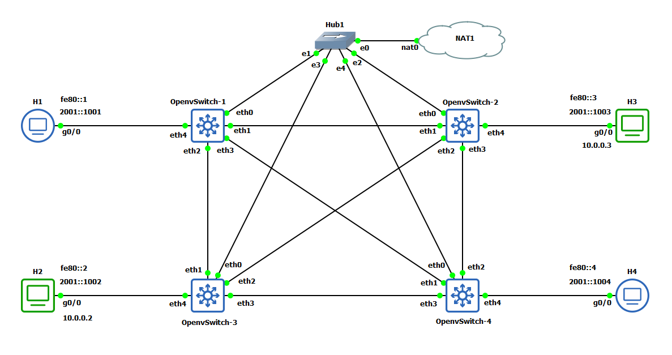


Slide 15
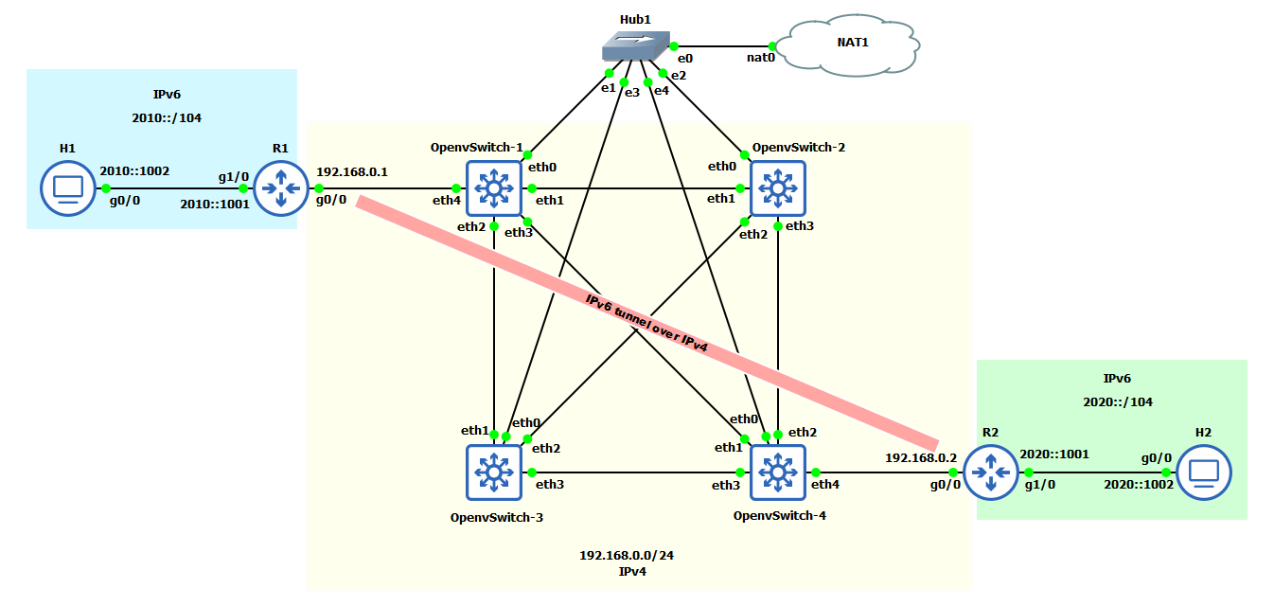

Slide 16
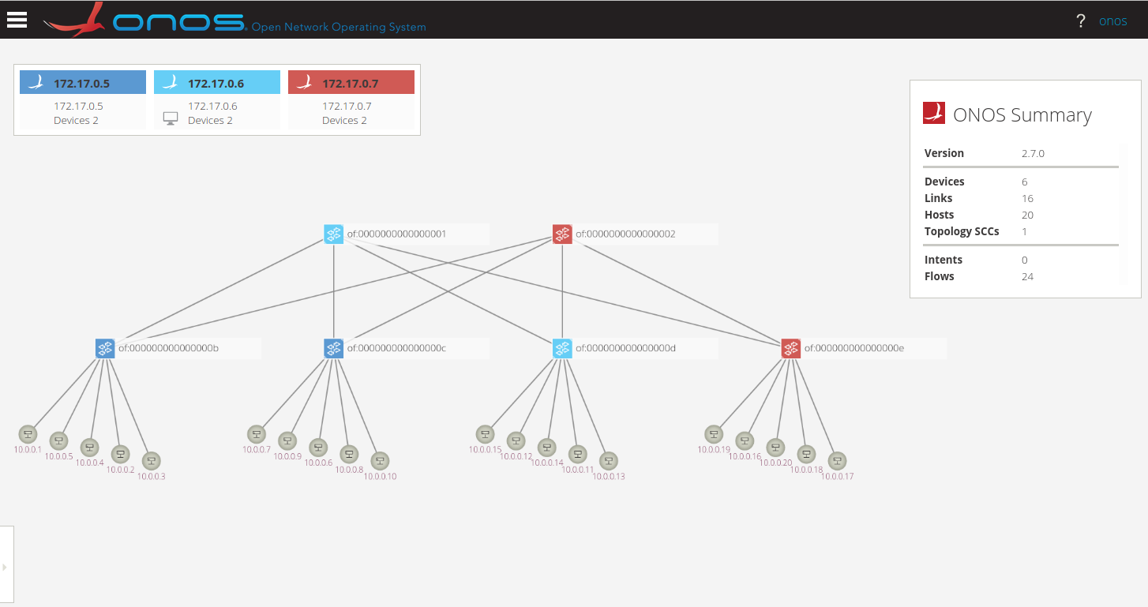

Slide 17
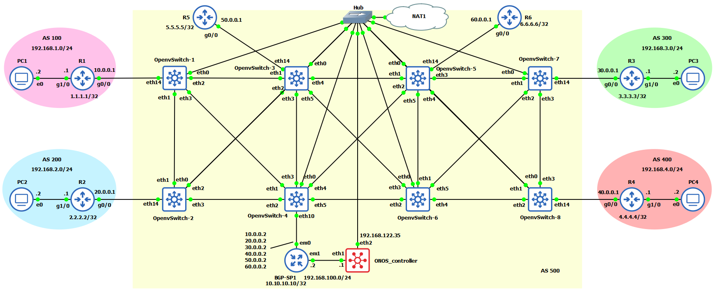

Slide 18
Single-point to single-point intents
These are uni-directional intents used to establish the BGP peering session between the external routers and the SDN BGP speakers. Each Intent connects two single attachment points in the SDN network. Each attachment point contains the following information: SDN switch DPID and switch port, and the MAC address of the attached BGP speaker/router.
Multi-point to single-point intents
These are uni-directional intents used to connect the hosts of the external networks together. Each intent is associated with an IP prefix (the IP destination), and connects the ingress attachment points of the SDN network with a single egress attachment point - the best next-hop router toward the destination IP prefix. At the ingress edge of the SDN network, an IP packet is matched on the IP destination address. The forwarding entry for the best (longest network prefix) match is selected to forward the packet toward the corresponding egress attachment point. In addition, right before the packet is forwarded, the “change destination MAC address” action is applied such that the data packet will contain the MAC address of the egress IP router toward the destination.

Slide 22
50.0.0.1/24
60.0.0.1/24
OVS-3
OVS-5
PC1
OVS-1
OVS-7
eth14
eth14
10.0.0.1/24
30.0.0.1/24
40.0.0.1/24
20.0.0.1/24
eth14
eth14
OVS-8
PC2
OVS-2
10.0.0.2/24
20.0.0.2/24
30.0.0.2/24
40.0.0.2/24
50.0.0.2/24
60.0.0.2/24
eth14
OVS-4
.2
192.168.100.0/24
.1

Slide 23
Switchport
VLAN ID
Src MAC
Dest MAC
Src IP
Dest IP
OF: Match-fields
OF: Action
1
10
*
FF:FF:FF:FF:FF:FF
*
*
Ingress port
Dest MAC
VLAN ID
Egress port 2,3

Slide 24
172.17.0.2
172.17.0.3
172.17.0.4
Atomix-1
Atomix-2
Atomix-3
Raft protocol
ONOS-1
ONOS-2
ONOS-3
172.17.0.5
172.17.0.6
172.17.0.7

Slide 25
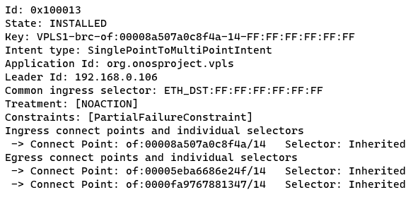
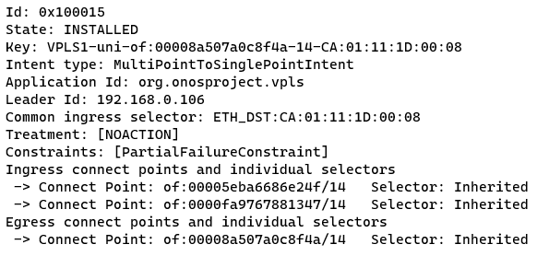

Slide 26
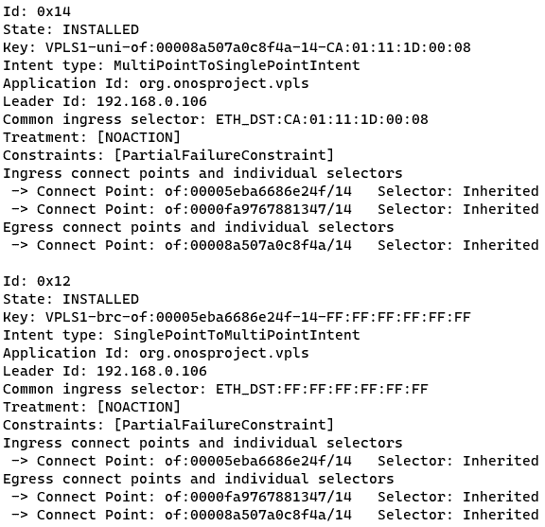

Slide 27
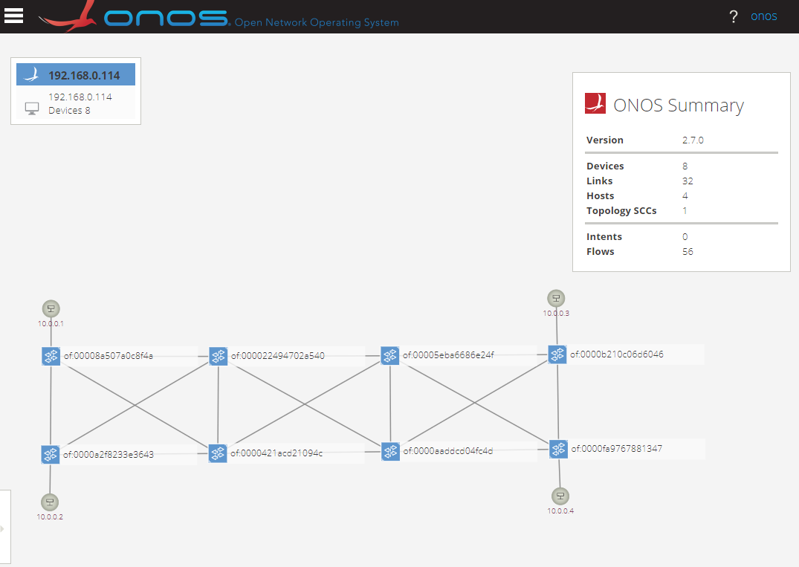
VPLS1
VPLS2
H1
S1
OVS-3
OVS-5
OVS-1
OVS-7
OVS-2
OVS-8
OVS-4
OVS-6
H2
S2
VPLS2
VPLS1

Slide 28
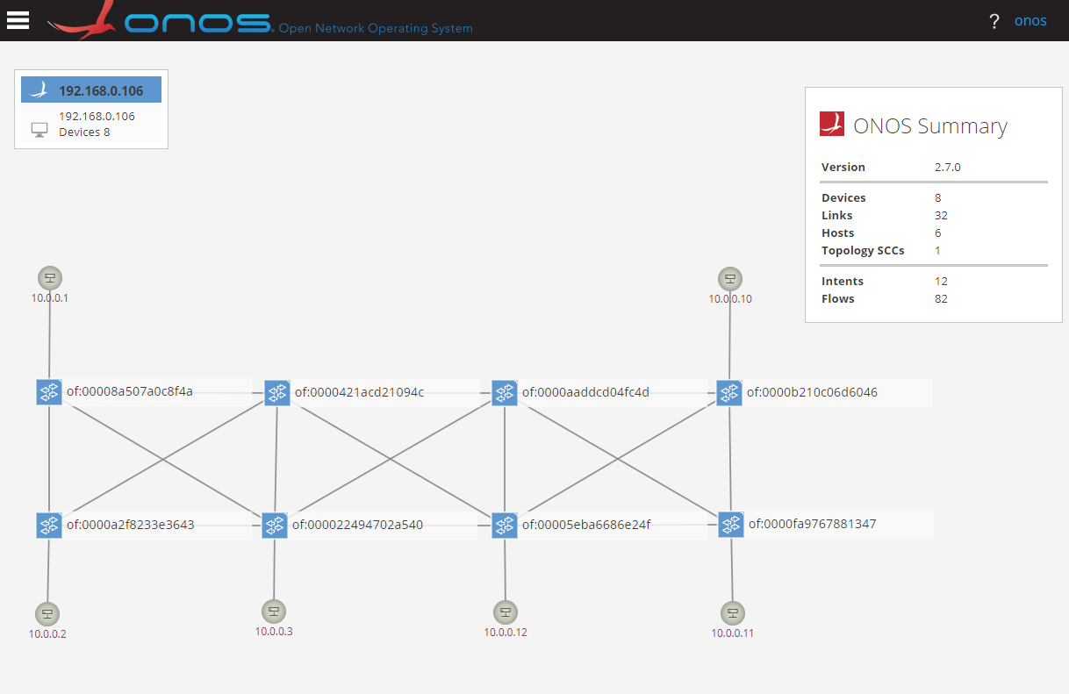
VPLS1
VPLS2
H1
S1
OVS-3
OVS-5
OVS-1
OVS-7
OVS-2
OVS-8
OVS-4
OVS-6
H2
H3
S3
S2
VPLS2
VPLS2
VPLS1
VPLS1

Slide 29
Atomix Cluster
{
Set the cluster ID : { onos }
Set the node ID : { atomix-number }
Set the IP address of atomix container : { x.x.y.y }
Set the port number to lister to onos : { 5679 }
# List of atomix containers part of the cluster
Discovery:
{ node ID and IP address of atomix container }
# Specify the management group information for configuration of managing primitives
type : { raft }
partitions : { number of partitions }
members : { node IDs of atomix container }
# Specify the partition group information for configuration of primitive storage and replication
type : { raft }
partitions : { number of partitions }
members : { node IDs of atomix container }
}

Slide 30
ONOS Cluster
{
Set the name : { onos }
Set the node ID : { onos-number }
Set the IP address of onos container : { x.x.y.y }
Set the port number : { 9876 }
# Specify the information about atomix cluster
Storage:
{
IP address of atomix container : { raft }
node ID of atomix container : { raft }
port number of atomix container : { 5679 }
}
}

Slide 31
VPLS configuration
{
# Specify the list of Open vSwitch ports where hosts are connected
Device ID : { MAC address of logical management interface (Bridge br0) of Open vSwitch }
Interfaces : { name, MAC address and VLAN ID of the host device }
Set the application ID of VPLS : { org.onosproject.vpls }
# Create the list of VPLS overlay network
Set VPLS ID : { name for VPLS }
Add the interfaces to the created VPLS ID : { name of the host device participating in the same VPLS ID }
Set encapsulation method for VLAN: { VLAN, MPLS or none }
}

Slide 32
Flows
{
Declare priority value of flow : { 0 and 65535 }
Set the flow entry state : { permanent=true, timeout-0 }
Set Device ID : { MAC address of logical management interface (Bridge br0) of Open vSwitch }
# Action to be taken by open vSwitch after the match-fields are matched
Treatment:
instructions: { send out the packet from port number,
send packet to flow table number, etc. }
# Specifying the match-fields for flow
Selector:
criteria: { source and destination MAC address,
source and destination IP address,
ingress port, VLAN ID, etc. }
}

Slide 33
Intents
{
Declare the type of intent : { Host-to-Host, SinglePoint-to-MultiPoint, MultiPoint-to-SinglePoint }
Set the application ID : { org.onosproject.ovsdb }
Declare priority value of intent : { 0 and 65535 }
# Specify the information of devices
For Host-to-Host intent: { MAC address of the first and second host }
For SinglePoint-to-MultiPoint intent: { Device ID with ingress port number & Device IDs with egress port numbers }
For MultiPoint-to-SinglePoint intent: { Device IDs with ingress port numbers & Device ID with egress port number }
}

Slide 34
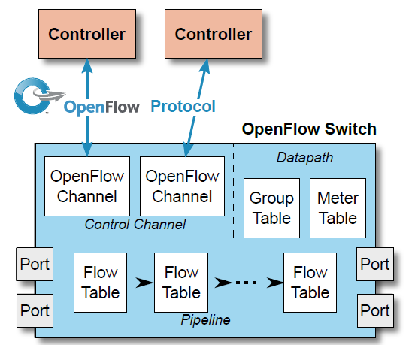
Controller 1
Controller 1
OpenFlow
OpenFlow Switch
OpenFlow
Channel
OpenFlow
Channel
Datapath
Group Table
Meter Table
Control Channel
Port
Flow Table 0
Flow Table 1
. . .
Flow Table n
Port
Pipeline

Slide 35
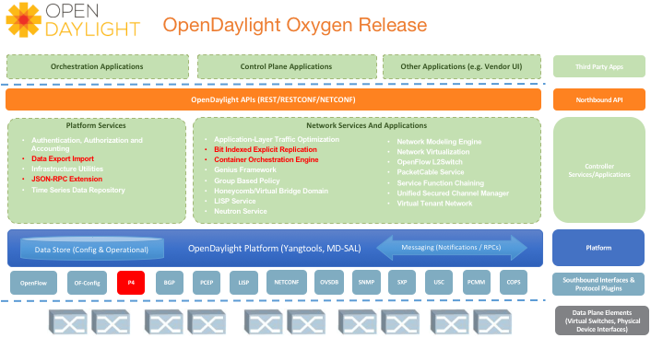
Applications, Orchestration
North-bound API
OpenDaylight
Platform Services
AAA
Data Exchange
Infrastructure utilities
Network Services
LISP service
Group-based policy
Application layer traffic optimization
Built-in Applications
Layer 2 Switch
Virtual Tenant Network
Platform (MD-SAL, YANG tools)
South-bound API
Network Elements

Slide 36
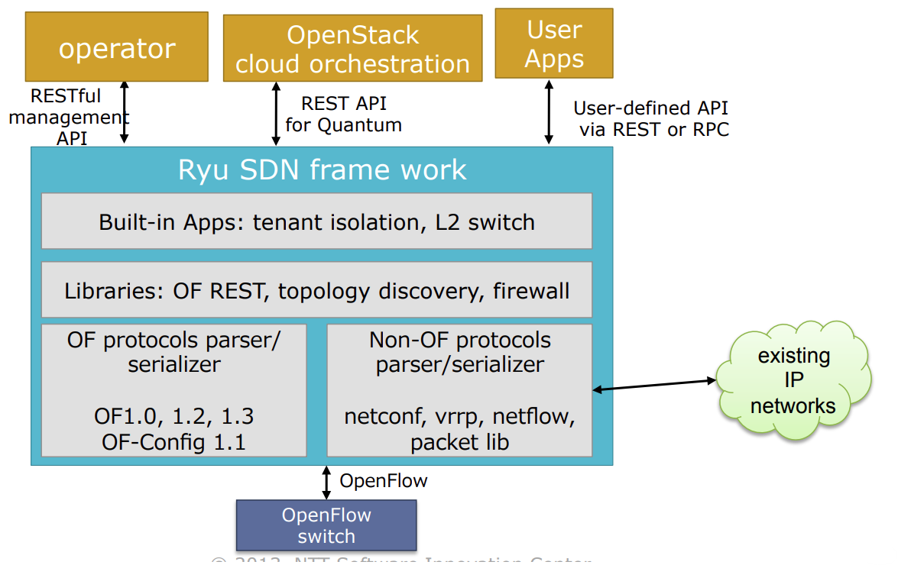
Applications, Operator, OpenStack cloud orchestration
North-bound API
Ryu Framework
Built-in Applications: tenant isolation, layer2 switch
Libraries: topology discovery, OpenFlow REST
OpenFlow protocols parser/ serializer
OpenFlow, OF-config
Non-OpenFlow protocols parser/ serializer
NetConf, NetFlow, VRRP
South-bound API
Network Elements

Slide 37
Applications
North-bound (Consumer) API
Core
(Modules, Subsystems)
South-bound (Provider) API
Providers
(Link, Flow, Device, Host)
Protocols
Network Elements

Slide 38
ONOS
GNS3 Server
(GNS3 VM)
GNS3 Client
OpenDaylight
Ryu
Bridge
Adapter
ONOS Docker
NIC
VirtualBox
Adapter
Mininet
VirtualBox
Host machine

Slide 39
Version 1.0 | Version 1.1 | Version 1.2 | Version 1.3 | Version 1.4 | Version 1.5
Single flow table entry | Multiple flow table | Support for IPv6 | Support for IPv6 extension header | Add in bundle mechanism | Egress table
Single Controller | Pipeline Processing | Extensible TLV support | Flow meter | Support for Table synchronization | Packet type aware Pipeline
Support for IPv4 | Support for VLAN and MPLS |  | Support for Table miss |  | Extensible flow entry statistics
 | Group table
 | Virtual ports

Slide 40
SDN Control Architecture

Slide 41
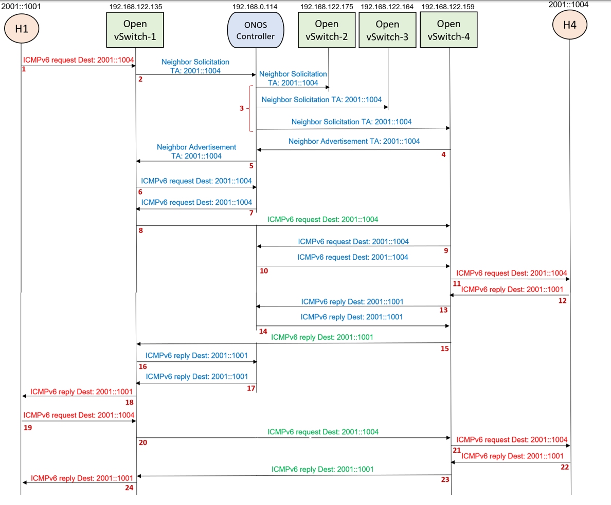
OF:

Slide 42
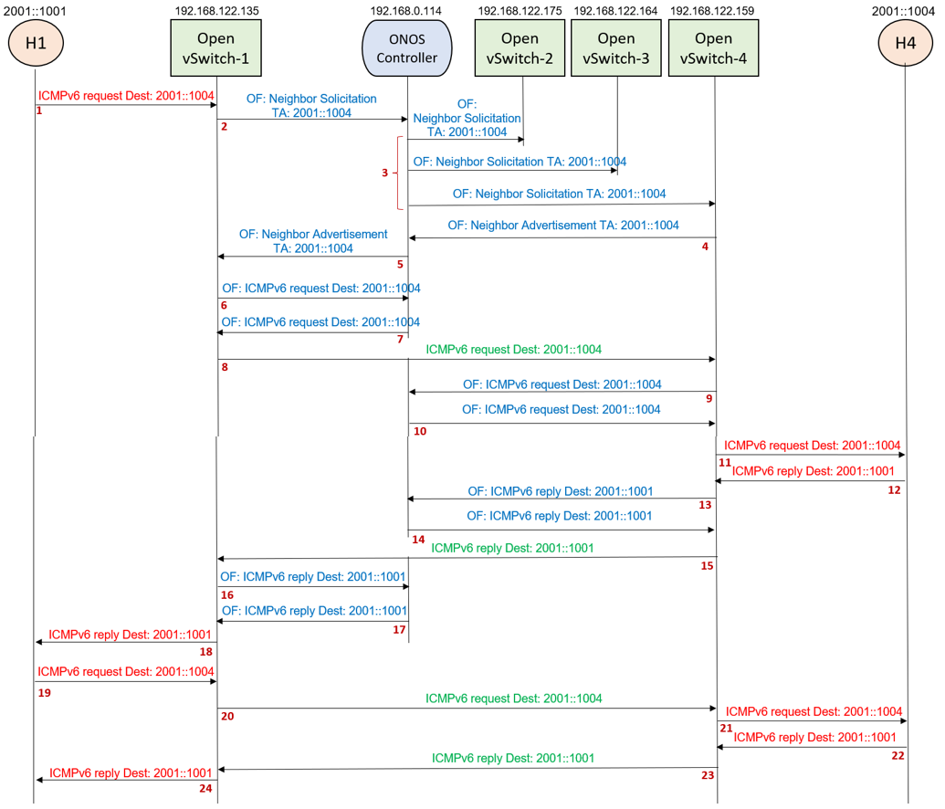
OF:

Slide 43
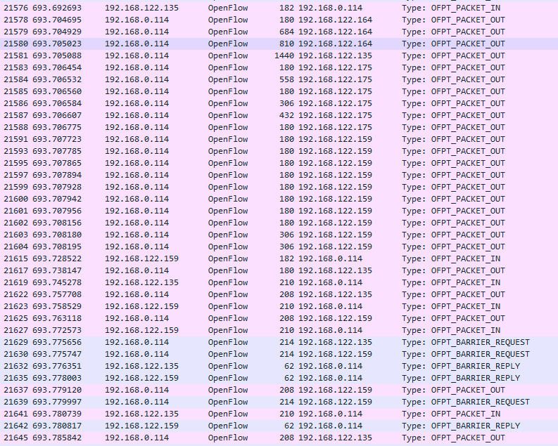
2
3
4
5
6
7
9
10
13
14
16
17

Slide 44
2001::1001
192.168.122.135
192.168.0.114
192.168.122.175
192.168.122.164
192.168.122.159
2001::1004
H1
Open vSwitch-1
ONOS Controller
Open vSwitch-2
Open vSwitch-3
Open vSwitch-4
H4
ICMPv6 request Dest: 2001::1004
OF: Neighbor Solicitation
TA: 2001::1004
OF:
Neighbor Solicitation
TA: 2001::1004
1
2
3
OF: Neighbor Solicitation TA: 2001::1004
OF: Neighbor Solicitation TA: 2001::1004
OF: Neighbor Advertisement
TA: 2001::1004
OF: Neighbor Advertisement TA: 2001::1004
4
5
OF: ICMPv6 request Dest: 2001::1004
6
OF: ICMPv6 request Dest: 2001::1004
7
ICMPv6 request Dest: 2001::1004
8
OF: ICMPv6 request Dest: 2001::1004
9
OF: ICMPv6 request Dest: 2001::1004
10

Slide 45
2001::1001
192.168.122.135
192.168.0.114
192.168.122.175
192.168.122.164
192.168.122.159
2001::1004
H1
Open vSwitch-1
ONOS Controller
Open vSwitch-2
Open vSwitch-3
Open vSwitch-4
H4
ICMPv6 request Dest: 2001::1004
11
ICMPv6 reply Dest: 2001::1001
OF: ICMPv6 reply Dest: 2001::1001
12
13
OF: ICMPv6 reply Dest: 2001::1001
14
ICMPv6 reply Dest: 2001::1001
15
OF: ICMPv6 reply Dest: 2001::1001
16
OF: ICMPv6 reply Dest: 2001::1001
ICMPv6 reply Dest: 2001::1001
17
18
ICMPv6 request Dest: 2001::1004
19
ICMPv6 request Dest: 2001::1004
20
ICMPv6 request Dest: 2001::1004
21
ICMPv6 reply Dest: 2001::1001
ICMPv6 reply Dest: 2001::1001
22
ICMPv6 reply Dest: 2001::1001
23
24

Slide 46
2001::1001
2001::1004
H1
Open vSwitch-1
Open vSwitch-4
H4
ICMPv6 request Dest: 2001::1004
1
ICMPv6 request Dest: 2001::1004
2
ICMPv6 request Dest: 2001::1004
3
ICMPv6 reply Dest: 2001::1001
4
ICMPv6 reply Dest: 2001::1001
6
ICMPv6 reply Dest: 2001::1001
7

Slide 47
ONOS CLI
REST API
VPLS Config Manager
VPLS Config Events
VPLS
VPLS Manager
VPLS Store delegate
VPLS Operation
Add
Remove
Update
VPLS
VPLS Operation Service
VPLS Neighbour Handler
VPLS Operation Manager
VPLS
Store
Event
Update VPLS state
Query VPLS information
VPLS Store
Distributed VPLS Store

Slide 48
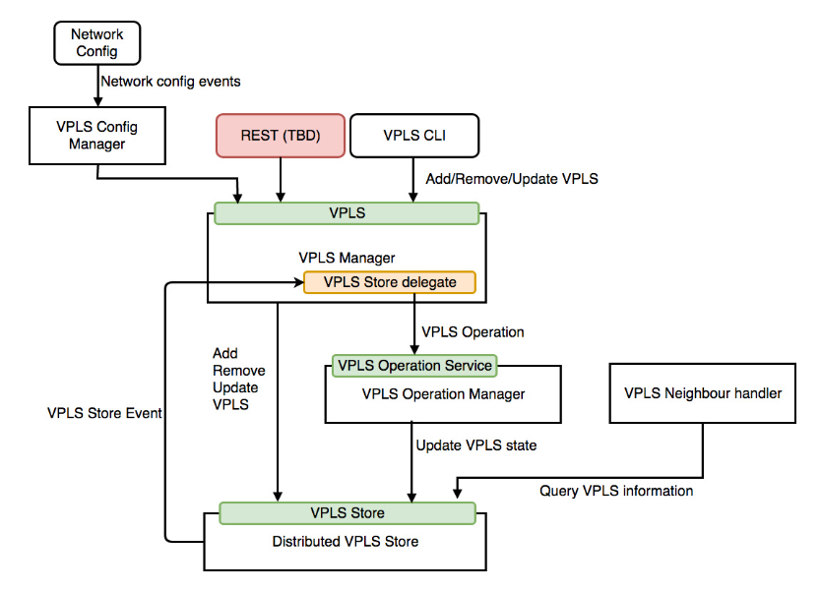

Slide 49
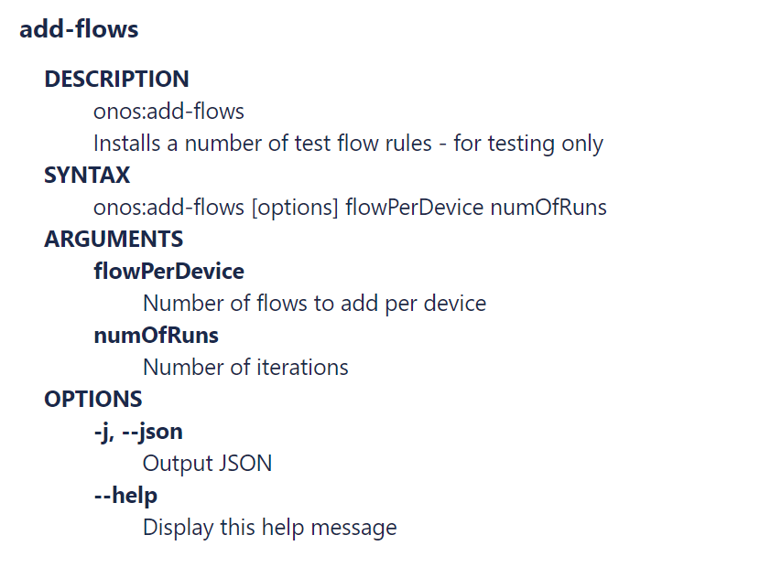
add-test-flows
onos:add-test-flows
onos:add-test-flows [options] flowPerDevice numOfRuns

Slide 50
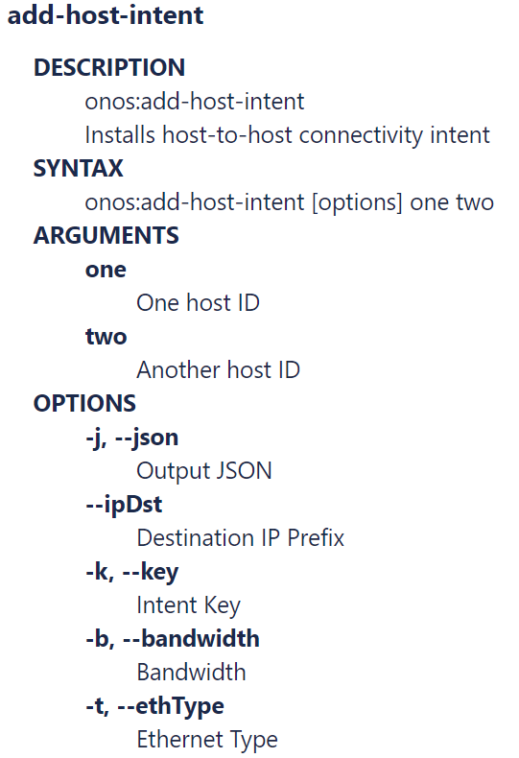
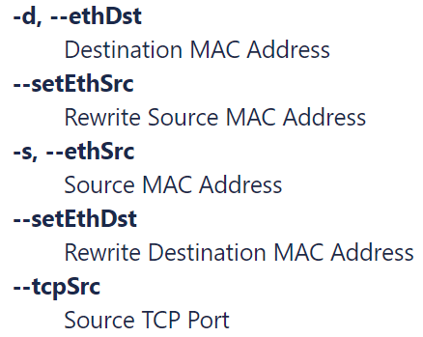
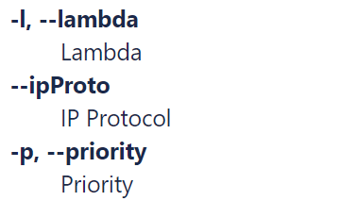

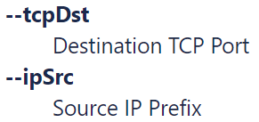

Slide 51
Open vSwitch
Match Fields:
Ingress port +
Packet header +
metadata
Flow
Table
0
Flow
Table
1
Flow
Table
n
Execute Action Set
Packet
Out
Packet
In
Action Set
Action Set
Action Set
Action Set
. . .
Ingress Port
Egress Port

Slide 52
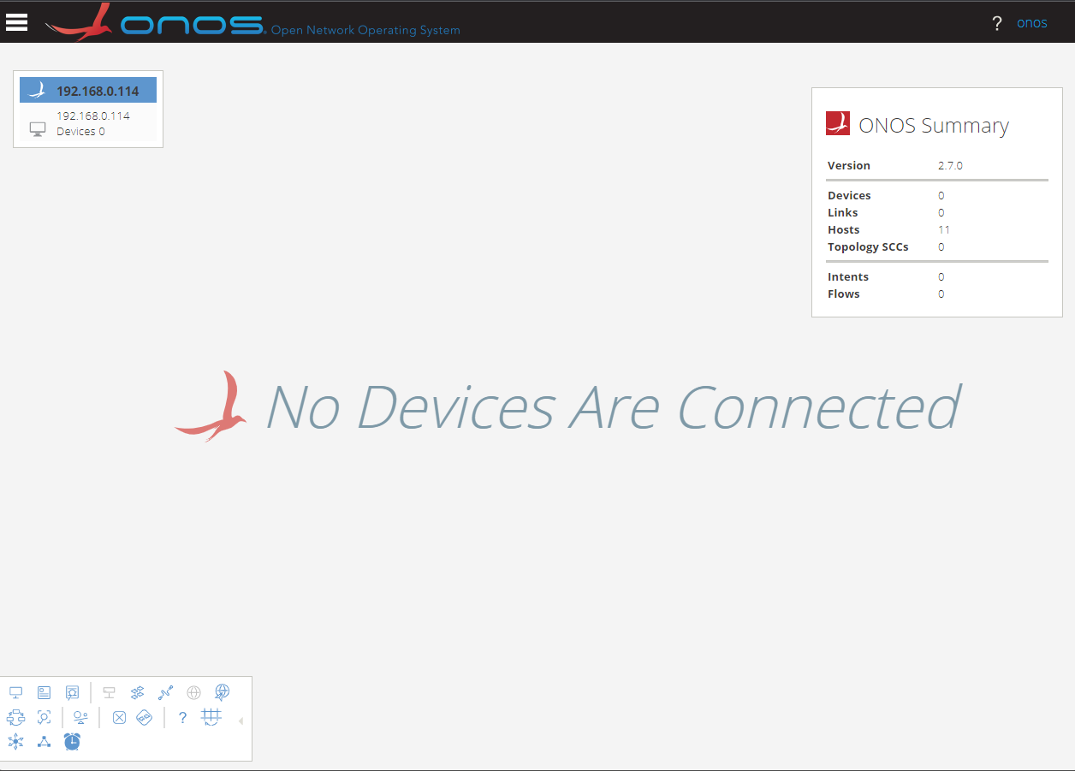
Masthead
ONOS Cluster Node Panel
Navigation Menu Button
Summary Panel
Username/
Logout link
Topology Toolbar

Slide 53
Application & Service Layer
Application Plane
SDN
Applications
Northbound Interface (NBI)
REST API
Control Layer
Controller Plane
SDN
Controller
Southbound Interface (SBI)
OpenFlow, BGP, NetConf
Infrastructure Layer
Data Plane
Network
Elements

Slide 54
Application Layer
Northbound Interface
Embedded controlling and forwarding device
Control Layer
Southbound Interface
Infrastructure Layer
Traditional Network (distributed control)
Software-defined Network (centralised control)

Slide 55
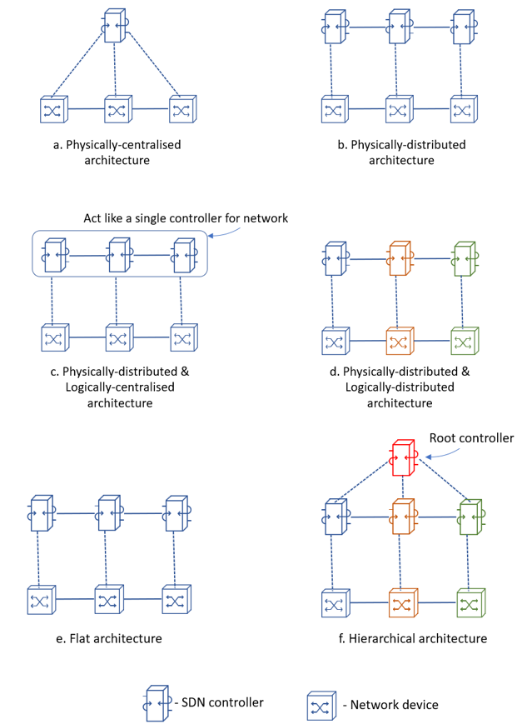

Slide 56
ONOS Controller
NAT
192.168.0.114
Switch
192.168.122.161
192.168.122.162
192.168.122.163
192.168.122.164
eth0
eth0
eth0
eth0
OVS-1
eth3
eth1
eth2
eth1
eth2
eth1
OVS-4
eth1
eth2
OVS-2
OVS-3
eth2
10.0.0.1/24
g0/0
g0/0
10.0.0.2/24
g0/0
10.0.0.3/24
R1
R2
R3

Slide 57
50.0.0.1/24
60.0.0.1/24
PC1
OVS-1
OVS-3
OVS-5
OVS-7
eth14
eth2
eth1
eth4
eth1
eth4
eth1
eth14
10.0.0.1/24
eth3
eth2
eth5
eth2
eth5
eth2
30.0.0.1/24
eth1
eth3
eth3
eth3
eth1
eth2
eth1
eth3
eth4
eth1
eth3
eth4
eth1
eth3
20.0.0.1/24
40.0.0.1/24
eth14
eth3
eth2
eth5
eth2
eth5
eth2
eth14
PC2
OVS-2
eth14
OVS-4
eth14
OVS-6
OVS-8
10.0.0.2/24
20.0.0.2/24
30.0.0.2/24
40.0.0.2/24
50.0.0.2/24
60.0.0.2/24
.2
192.168.100.0/24
.1

Slide 58
Network – technical icons (1)
IP/MPLS Routers
Ethernet/IP Switches
IP/MPLS Complementary - Security
ATM
Converged Service Delivery Platform
Router
Switch
Load Balancer
Router with ATM
Content Engine
Broadband Router
Secure Switch
Load Balancer
ATM Switch
Content Server
Service Router
IP DSL Switch
Load Balancer Star
Switch Router
Video Server
Secure Router
TDM Switch
DSLAM
DSLAM (ATM)
Music Server
Router with TDM
Content Switch
Firewall
Application Control Engine
Content Router
IP/TV Content Manager
IPoDWDM Router
Storage Router
Wavelength Router

Slide 59
Network – technical icons (2)
Voice Platform
Wireless Technology
Wireless Technology - Mobile Service Delivery Platform
Wireline Technology - Signaling
Miscellaneous
Media Gateway
Wireless Transport
Wireless Access Point
Digital Cross-Connect
Database/Storage
Soft Switch
Wireless Router
Wireless Bridge
Fixed Access Point
Gateway
Encoder
Base Station
WLAN Controller
MSAN
Controller
Decoder
NodeB
Cell Phone
SBC
Control Device
Transcoder
WiAN
SGSN
STP
Access Device
Access Gateway
BSC
GGSN
Telephone POTS
RNC
MSC
Miscellaneous
Telephone IP
4G Control
Net Sonar
Netcrypt
Protocol Translator
Call Manager
Guard
Resource Manager
Asic Processor
FC Storage

