Slide 1

SDN based Network Management in Emulated Environment
Submitted by: Harshal Rajan Vaze
Matriculation no.: 1269879
First examiner: Prof. Dr. Ulrich Trick
Second examiner: Prof. Dr. Armin Lehmann
External supervisor: Dr. Peter Gröschke

Slide 2
Agenda
SDN Architecture
Different SDN Architectures
Open-source SDN Controllers
Open vSwitch
OpenFlow
Creation of Flow rules
Creations of Intents
Use-cases

Slide 3
SDN Architecture
Application & Service Layer
Application Plane
SDN
Applications
Northbound Interface
REST API
Control Layer
Controller Plane
Eastbound Interface
SDN
Controller
Westbound Interface
Southbound Interface
OpenFlow, BGP, NetConf
Infrastructure Layer
Data Plane
Network
Elements

Slide 4
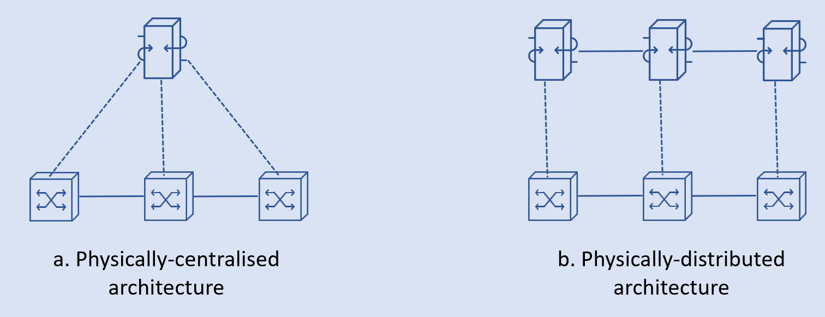
Different SDN Architectures (1/3)
a. Physically-centralised architecture
b. Physically-distributed architecture

Slide 5
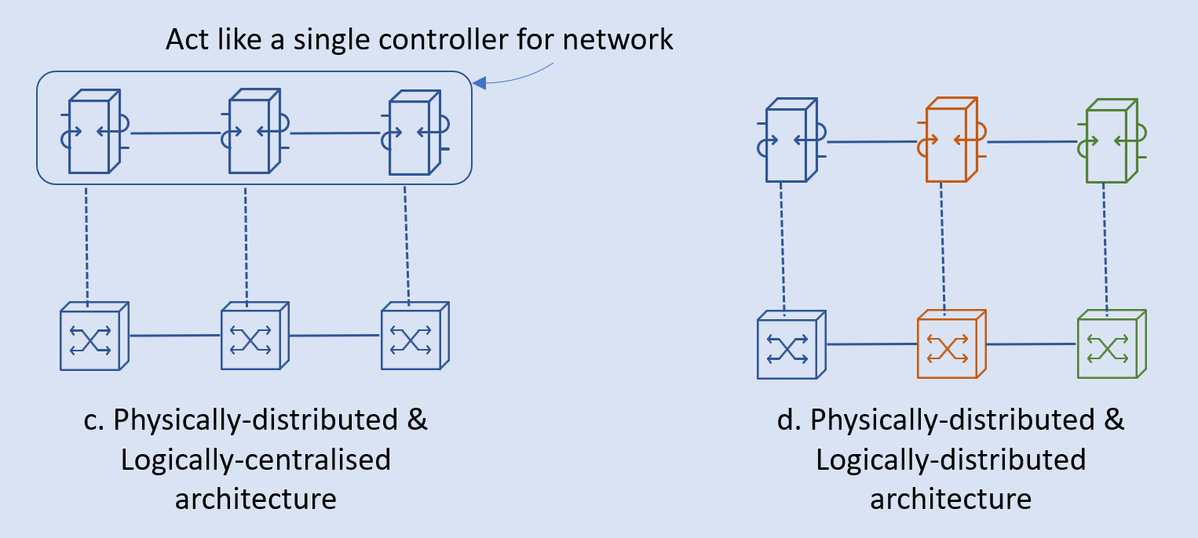
Different SDN Architectures (2/3)
Act like a single controller for network
c. Physically-distributed & Logically-centralised architecture
d. Physically-distributed & Logically-distributed architecture

Slide 6
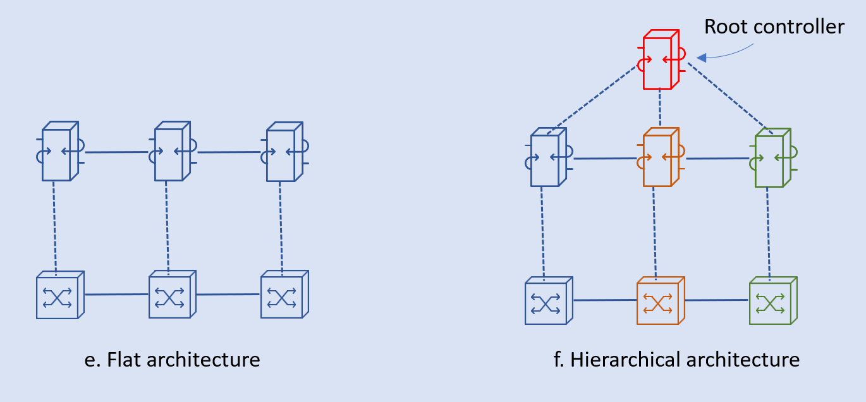
Different SDN Architectures (3/3)
Root controller
e. Flat architecture
f. Hierarchical architecture

Slide 7
SDN Network Components
Different components by different communities
SDN Controllers
ONOS
OpenDaylight
Ryu
Open vSwitch
OpenFlow protocol
Emulated environments

Slide 8

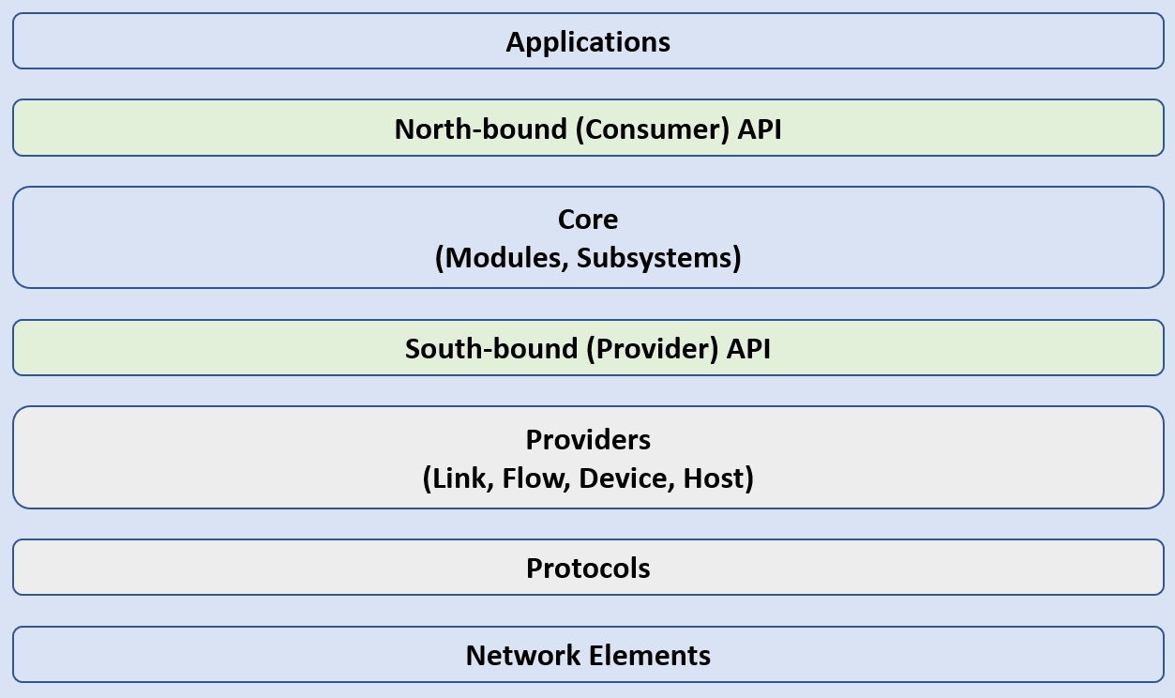
ONOS Controller
Applications
North-bound (Consumer) API
Core
(Modules, Subsystems)
South-bound (Provider) API
Providers
(Link, Flow, Device, Host)
Protocols
Network Elements

Slide 9

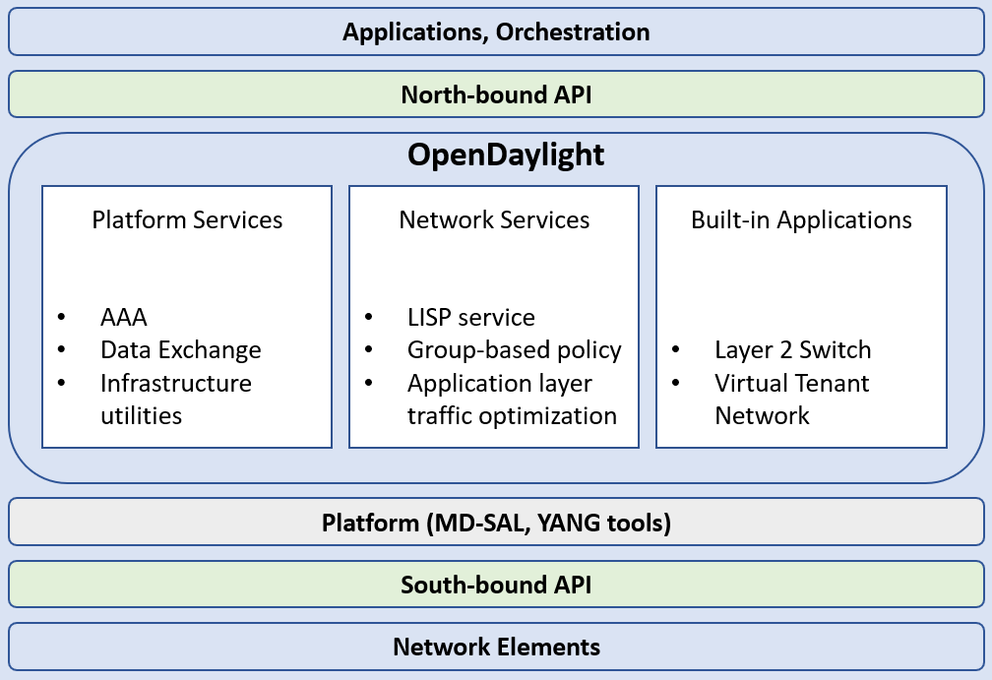
OpenDaylight Controller
Applications, Orchestration
North-bound API
OpenDaylight
Platform Services
AAA
Data Exchange
Infrastructure utilities
Network Services
LISP service
Group-based policy
Application layer traffic optimization
Built-in Applications
Layer 2 Switch
Virtual Tenant Network
Platform (MD-SAL, YANG tools)
South-bound API
Network Elements

Slide 10

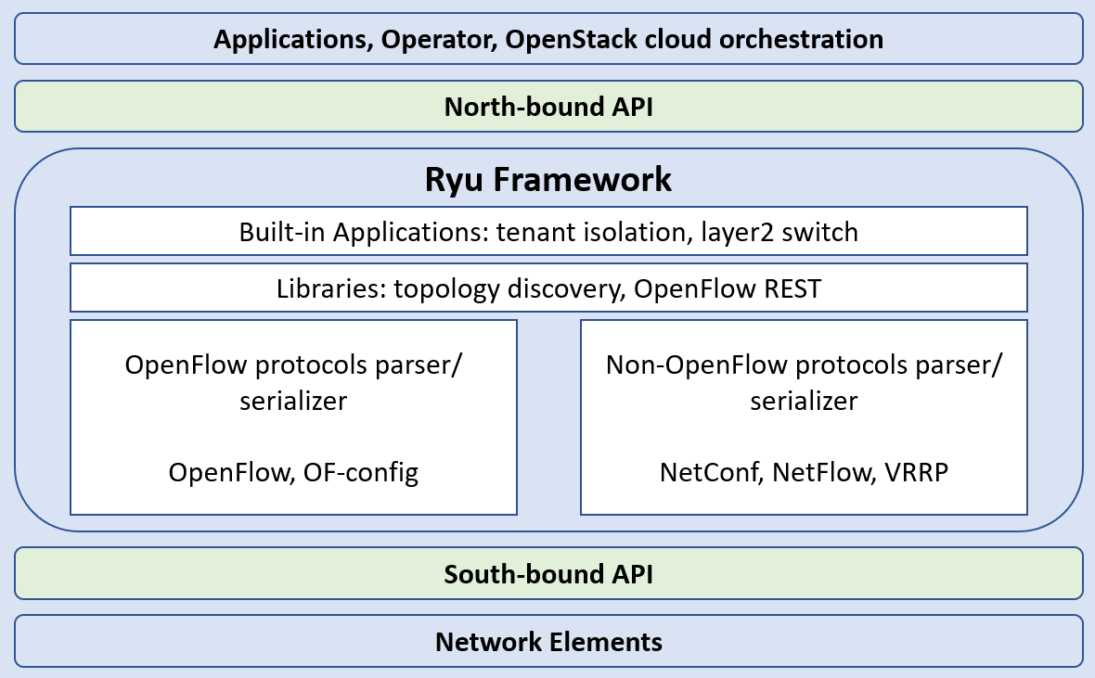
Ryu Controller
Applications, Operator, OpenStack cloud orchestration
North-bound API
Ryu Framework
Built-in Applications: tenant isolation, layer2 switch
Libraries: topology discovery, OpenFlow REST
OpenFlow protocols parser/ serializer
OpenFlow, OF-config
Non-OpenFlow protocols parser/ serializer
NetConf, NetFlow, VRRP
South-bound API
Network Elements

Slide 11
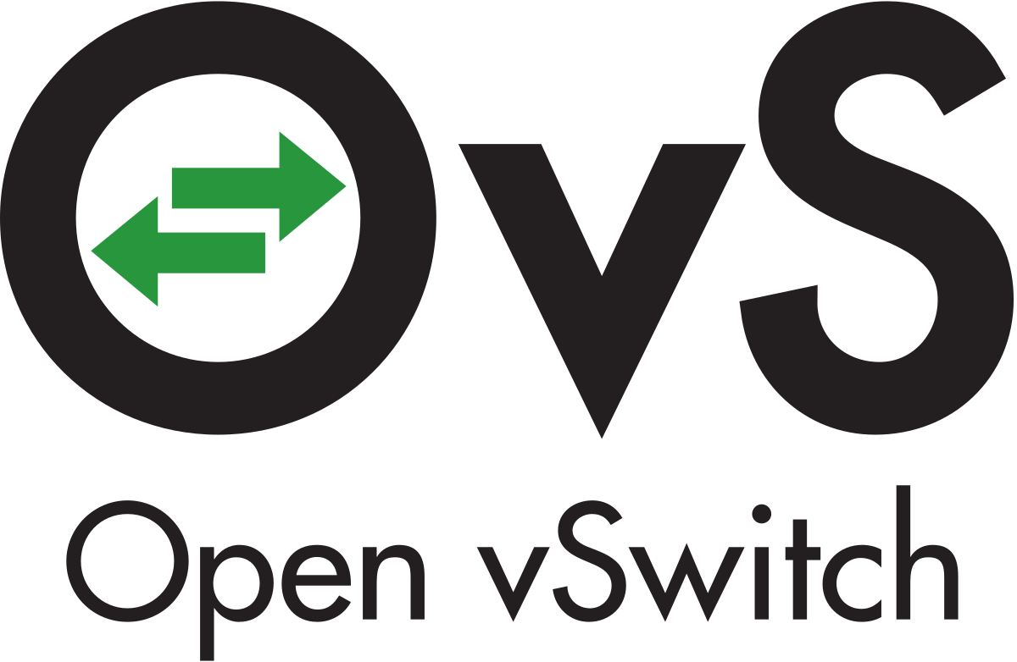
Open vSwitch
Controller
OVSDB Management
Protocol
OpenFlow
Protocol
Management
User Space
ovs-vswitchd
ovsdb-server
OVSDB Management
Protocol
Kernel
Netlink
Kernel module
Flow Tables
In-Port
Out-Port

Slide 12

OpenFlow Protocol
Controller 1
Controller 2
OpenFlow
OpenFlow Switch
OpenFlow
Channel
OpenFlow
Channel
Datapath
Group Table
Meter Table
Control Channel
Port
Flow Table 0
Flow Table 1
. . .
Flow Table n
Port
Pipeline

Slide 13

SDN network emulators
GNS3
Client part: The GNS3-all-in-one software (GUI)
Server part: The GNS3 virtual machine (GNS3 VM)
Advantages of GNS3:
Implements easy to access network topology.
No limitation on number of devices or complexity of topology.
Supports multiple vendors network devices.
Supports multiple deployment options: local machine, hypervisor, or remote server.
Pre-configured and optimised appliances available to simplify deployment.
Availability of in-built software packages such as Wireshark and Putty.
Supports sharing of implemented network including the device configuration.
Large and active community
Disadvantages of GNS3:
Limitation of CPU and memory resources provided by the host machine.
The software images of the network devices such as Cisco routers are required to be purchased and downloaded by the user.
Mininet
Advantages of Mininet:
It is very fast and takes very little time for booting.
It is easy to install and use.
It saves money because the emulators are cost-effective instead of testing with hardware devices.
It is also very easy to connect with other network devices.
Disadvantages of Mininet:
Deployed network elements cannot exceed the CPU and bandwidth available on host machine.
Single server implementation gave rise to the performance problems.
All Mininet hosts share the host file system and PID space, a careful assessment of running daemons is required for process of debugging.

Slide 14
Flow Rules
Forwarding flow rules
Application commands >> Flow rules
Creation & Installation
Open vSwitch CLI
ONOS REST API
ONOS CLI
Demo

Slide 15
Packet transmission through flow tables within an Open vSwitch
Open vSwitch
Match Fields:
Ingress port +
Packet header +
metadata
Flow
Table
0
Flow
Table
1
Flow
Table
n
Execute Action Set
Packet
Out
Packet
In
Action Set
Action Set
Action Set
Action Set
. . .
Ingress Port
Egress Port

Slide 16
Creation of Intents
Policy-based directives
Intent Framework is a subsystem
Application commands >> Flow rules
Creation & Installation
ONOS CLI
ONOS GUI
ONOS REST API
Demo

Slide 17
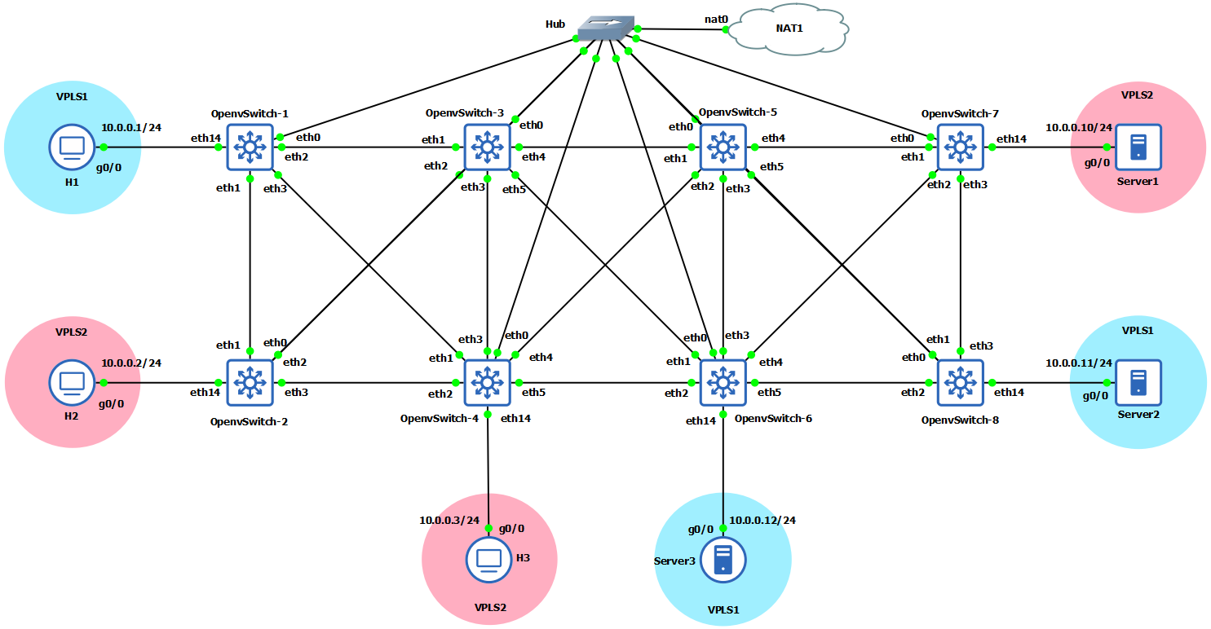
Use Case-1: Testing the ONOS Controller with Isolated Layer 2 Overlay Networks
Demo

Slide 18
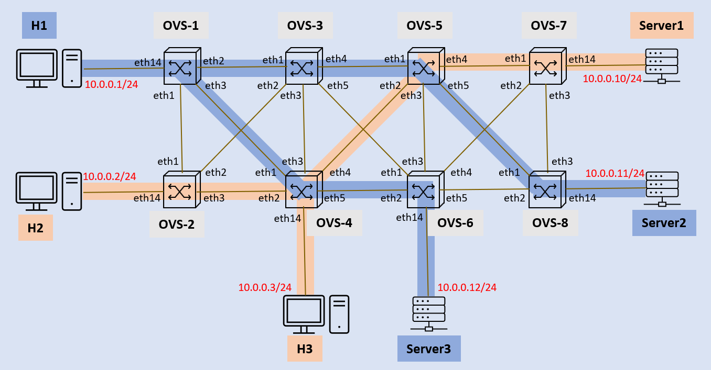

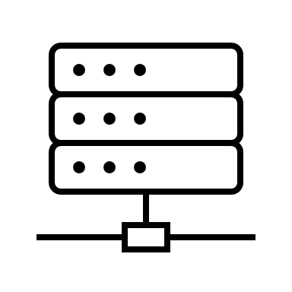
Created Layer 2 Overlay Networks
H1
OVS-1
OVS-3
OVS-5
OVS-7
Server1
eth14
eth2
eth1
eth4
eth1
eth4
eth1
eth14
10.0.0.1/24
eth3
eth2
eth5
eth2
eth5
eth2
10.0.0.10/24
eth1
eth3
eth3
eth3
eth1
eth2
eth1
eth3
eth4
eth1
eth3
eth4
eth1
eth3
10.0.0.11/24
10.0.0.2/24
eth14
eth3
eth2
eth5
eth2
eth5
eth2
eth14
H2
OVS-2
eth14
OVS-4
eth14
OVS-6
OVS-8
Server2
10.0.0.3/24
10.0.0.12/24
H3
Server3

Slide 19
Use Case-2: Testing the Network with Multiple ONOS Controllers
172.17.0.2
172.17.0.3
172.17.0.4
Atomix-1
Atomix-2
Atomix-3
Raft protocol
ONOS-1
ONOS-2
ONOS-3
172.17.0.5
172.17.0.6
172.17.0.7
Underlying network
Demo

Slide 20
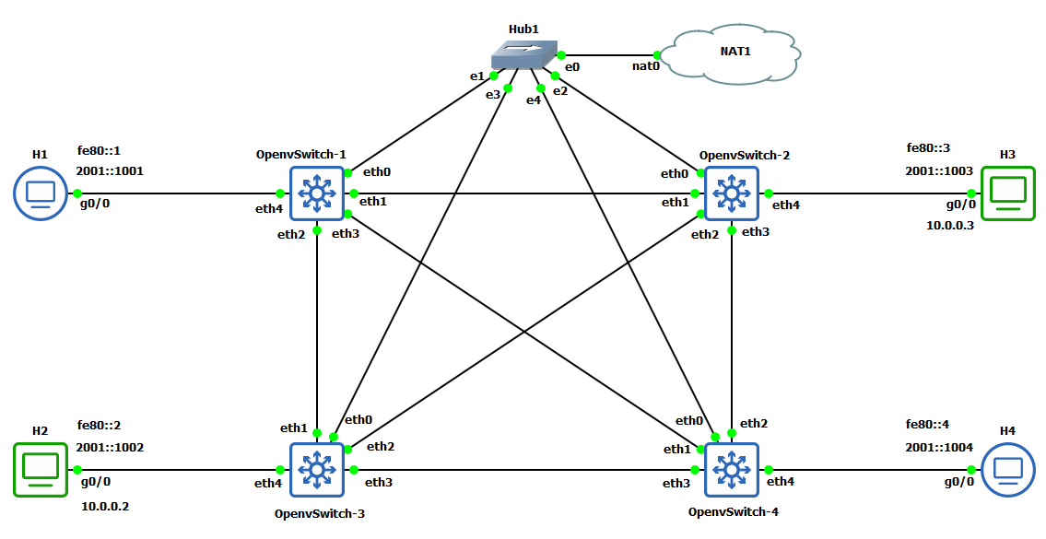

Use Case-3: Testing the ONOS Controller with IPv6 Addressing
Demo

Slide 21
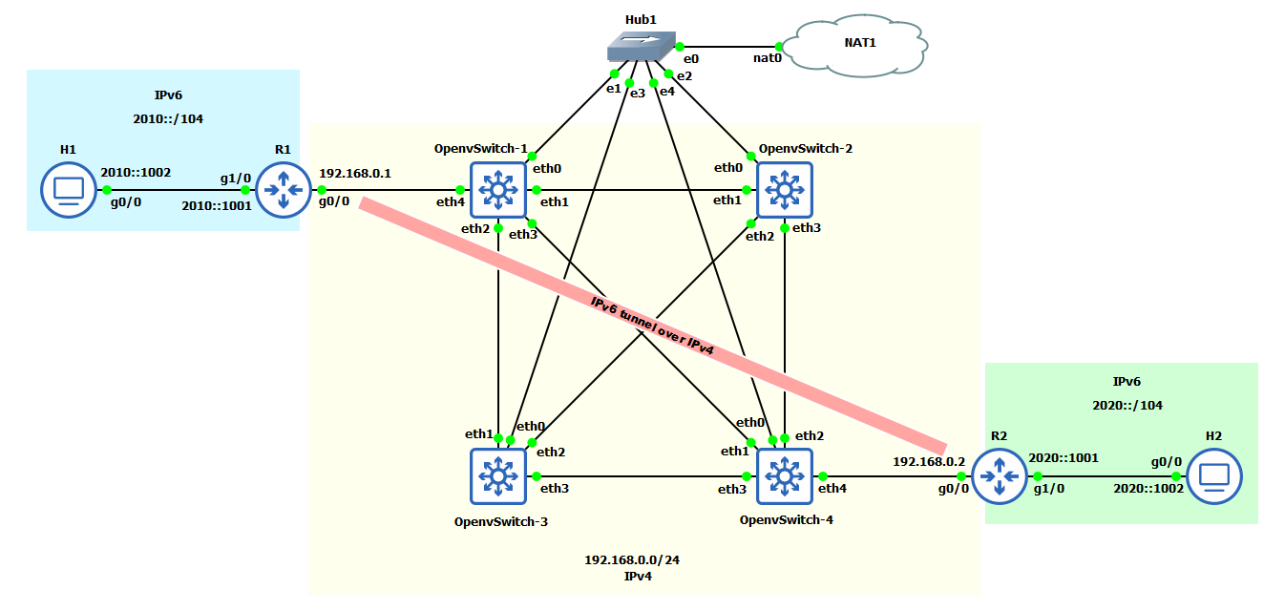
IPv6 tunneling over IPv4 network

Slide 22
Use Case-4: Integrating Software-defined Network with the Legacy Networks
Internal R5
Internal R6
Border R1
OVS-1
OVS-7
Border R3
AS 100
50.0.0.1/24
60.0.0.1/24
AS 300
10.0.0.1/24
30.0.0.1/24
OVS-3
OVS-5
SDN
AS 500
Border R4
40.0.0.1/24
AS 400
Border R2
OVS-4
OVS-8
AS 200
20.0.0.1/24
10.0.0.2/24
20.0.0.2/24
30.0.0.2/24
40.0.0.2/24
50.0.0.2/24
60.0.0.2/24
Controller
OVS-2
.2
192.168.100.0/24
.1
BGP Speaker
Demo

Slide 23
Questions?

Slide 24
Thank you!

Slide 25
Single-point to single-point intents
These are uni-directional intents used to establish the BGP peering session between the external routers and the SDN BGP speakers. Each Intent connects two single attachment points in the SDN network. Each attachment point contains the following information: SDN switch DPID and switch port, and the MAC address of the attached BGP speaker/router.
Multi-point to single-point intents
These are uni-directional intents used to connect the hosts of the external networks together. Each intent is associated with an IP prefix (the IP destination), and connects the ingress attachment points of the SDN network with a single egress attachment point - the best next-hop router toward the destination IP prefix. At the ingress edge of the SDN network, an IP packet is matched on the IP destination address. The forwarding entry for the best (longest network prefix) match is selected to forward the packet toward the corresponding egress attachment point. In addition, right before the packet is forwarded, the “change destination MAC address” action is applied such that the data packet will contain the MAC address of the egress IP router toward the destination.

