Slide 1

SDN based Network Management in Emulated Environment
Submitted by: Harshal Rajan Vaze
Matriculation no.: 1269879
First examiner: Prof. Dr. Ulrich Trick
Second examiner: Prof. Dr. Armin Lehmann
External supervisor: Dr. Peter Gröschke
Notes:
Topic
Aim:
study different aspects of SDN
evaluate performance of SDN components

Slide 2
Agenda
SDN Architecture
SDN Components
Creation of SDN Environment
Use-cases

Slide 3
SDN Architecture
Application & Service Layer
Application Plane
SDN
Applications
Northbound Interface
REST API
Control Layer
Controller Plane
Eastbound Interface
SDN
Controller
Westbound Interface
Southbound Interface
OpenFlow, BGP, NetConf
Infrastructure Layer
Data Plane
Network
Elements
Notes:
Designed to have centralised control point
Control plane and Data plane are separated
Centralised architecture faced some problems
Reliability
Scalability
Single point of failure
Bottleneck situation
Distributed architecture

Slide 4

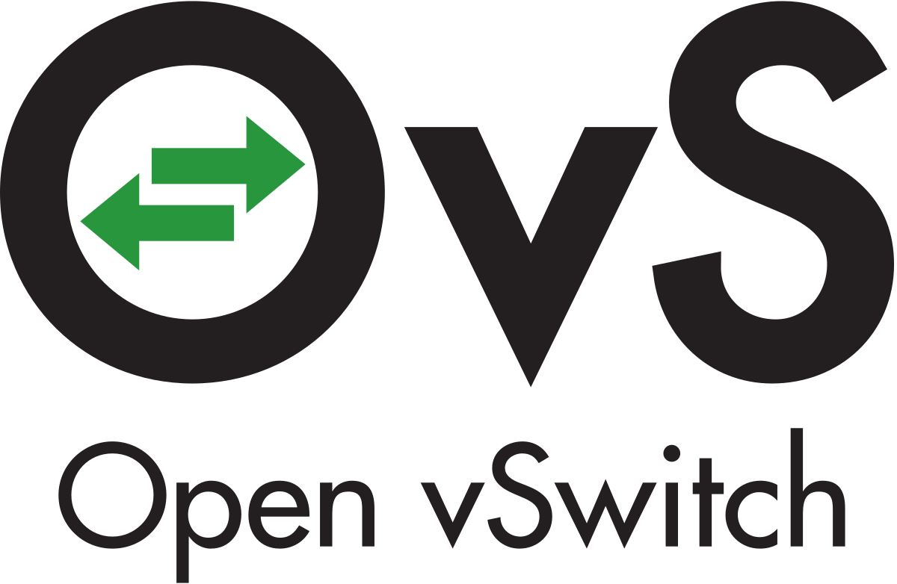




SDN Components
SDN Controllers | Network Elements | Network Emulators
Mininet
Notes:
Study of different SDN controllers
ONOS & ODL > distributed architecture
Ryu > centralised architecture
Some features and Applications not developed for ODL
Use-cases implemented using ONOS, OVS & OpenFlow
GNS3 real images of router and switches
Mininet large SDN networks

Slide 5
Creation of SDN Environment
Evaluation of SDN components
Creation of testbed
Different Configuration methods
Open vSwitch CLI
REST API
Controller CLI
Controller GUI
Implementation of Use-cases

Slide 6

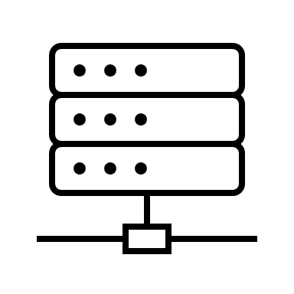
Use Case-1: Testing the ONOS Controller with Isolated Layer 2 Overlay Networks (VPLS)
H1
H1
Server1
OVS-1
OVS-3
OVS-5
OVS-7
Server1
10.0.0.1
10.0.0.10
10.0.0.2
10.0.0.11
H2
OVS-2
OVS-4
OVS-6
OVS-8
H2
Server2
Server2
10.0.0.3
10.0.0.12
H3
H3
Server3
Server3
Notes:
Network of 8 switches in GNS3
VPLS
3 hosts & 3 servers
Before configuration of VPLS networks, all hosts were
Two different methods of configuration
Create the configuration file and forward using RESTful POST method
After successful configuration, two VPLS networks
H1, server2 & server3 in blue VPLS
After successful configuration, end-points were isolated
Second method of VPLS configuration through ONOS CLI
Does not provide option to configure MAC addresses
Performance of ONOS controller was evaluated for layer 2 VPN service

Slide 7
Use Case-2: Testing the Network with Multiple ONOS Controllers
Atomix-1
Atomix-2
Atomix-3
Raft
protocol
ONOS-1
ONOS-2
ONOS-3
Underlying network
Notes:
Single instance of ONOS controller requires large amount of host machine resources
Docker containers of ONOS controller
Underlying network in Mininet using OVS
Cluster formation & management of ONOS is handled by Atomix framework
Atomix framework > scalable networks & fault-tolerant distributed systems
ONOS controller uses Raft protocol

Slide 8
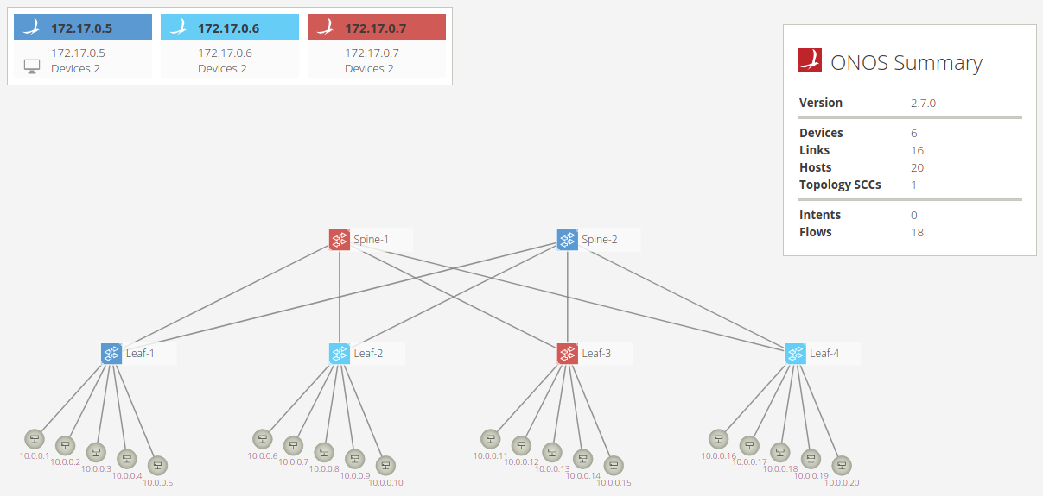
Open vSwitches with their respective Master Controller
Notes:
After successful creation of ONOS cluster, OVS elects master node
Master node is capable to read and write on OVS
6 OVS equally distributed amongst 3 ONOS controllers
Spine-1 has Red ONOS as its Master node & other on Standby mode

Slide 9
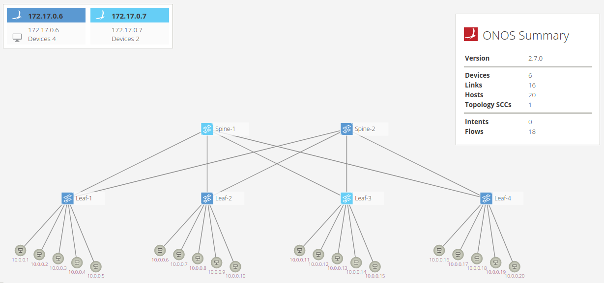
Failure of one ONOS Controller instance from the cluster
Notes:
In case of failure of master node
In this way, functioning failure mechanism of ONOS controller was evaluated

Slide 10
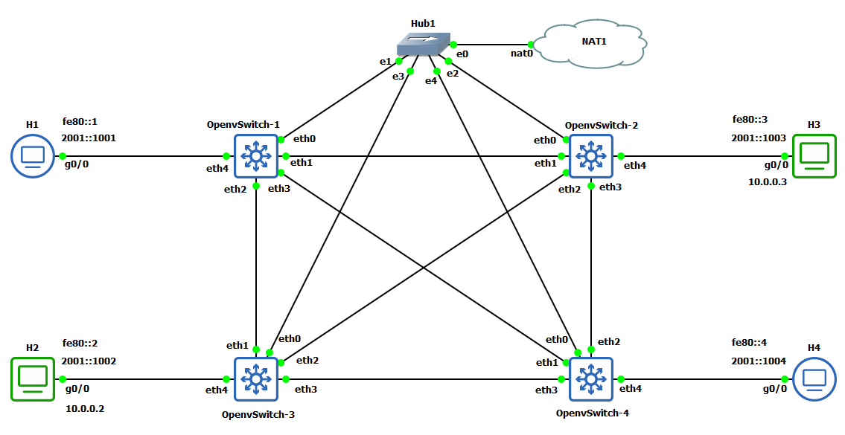
Use Case-3: Testing the ONOS Controller with IPv6 Addressing
Notes:
SDN network of OVS in GNS3
2 hosts with only IPv6 whereas 2 hosts with both IPv4 & IPv6
Before initiating the IPv6 services, ONOS controller was able to detect only IPv4 hosts
After initiating the IPv6 services, IPv6 hosts were detected & network services
During exchange of IPv6 packets, Neighbour discovery through OF was also studied

Slide 11
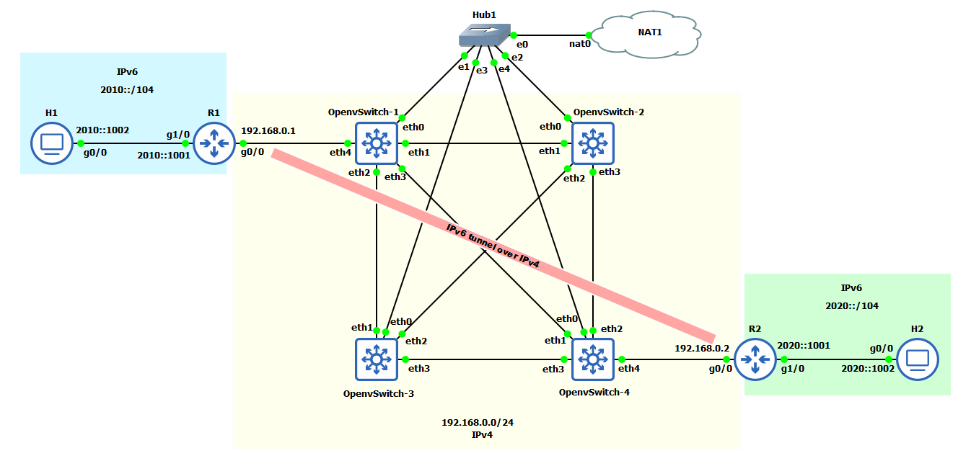
IPv6 tunneling over IPv4 network
Notes:
Another network was implemented consisting of IPv4 subnet between 2 different IPv6 subnets
This network was created to test the functionality of ONOS controller with IPv6 tunneling
After successful configuration of tunnel, routes were advertised over the tunnel
The exchange of IPv6 data packets was captured on wireshark which showed IPv6 packet encapsulated in IPv4 packet which was further encapsulated in OF protocol
In this way, the functionality of ONOS was evaluated with respect to IPv6 addressing

Slide 12
Use Case-4: Integrating Software-defined Network with the Legacy Networks
Internal R5
Internal R6
Border R1
OVS-1
OVS-7
Border R3
AS 100
50.0.0.1/24
60.0.0.1/24
AS 300
10.0.0.1/24
30.0.0.1/24
OVS-3
OVS-5
SDN
AS 500
Border R4
OVS-4
40.0.0.1/24
AS 400
Border R2
10.0.0.2/24
20.0.0.2/24
30.0.0.2/24
40.0.0.2/24
50.0.0.2/24
60.0.0.2/24
Controller
OVS-8
AS 200
20.0.0.1/24
OVS-2
.2
192.168.100.0/24
.1
BGP Speaker
Notes:
4 different legacy networks with AS 100 .. were created with their respective border routers
SDN network with AS 500
Border routers were configured to form BGP peering with BGP speaker
SDN-IP application for BGP peering
Reactive Routing application is used to advertise internal subnets
Internal router R5 subnet for legacy networks whereas internal router R6 subnet for SDN
A detailed configuration file with BGP peering, SDN-IP application, Reactive Routing
After successful configuration, BGP peering was formed
Routes were advertised to legacy networks
End-points exchange data packets
In this way, SDN network was integrated with legacy networks

Slide 13
Summary
Evaluation of different SDN Controllers
Examination of different configuration methods
Implementation of Real-world use-cases
Notes:
To summarize, first the evaluation of different open-source SDN controllers.
Creation of testbed
Examination of configuration methods
Implementation of use-cases to evaluate the functionality of SDN controller for different network services

Slide 14
Thank you! Questions?

