Slide 2
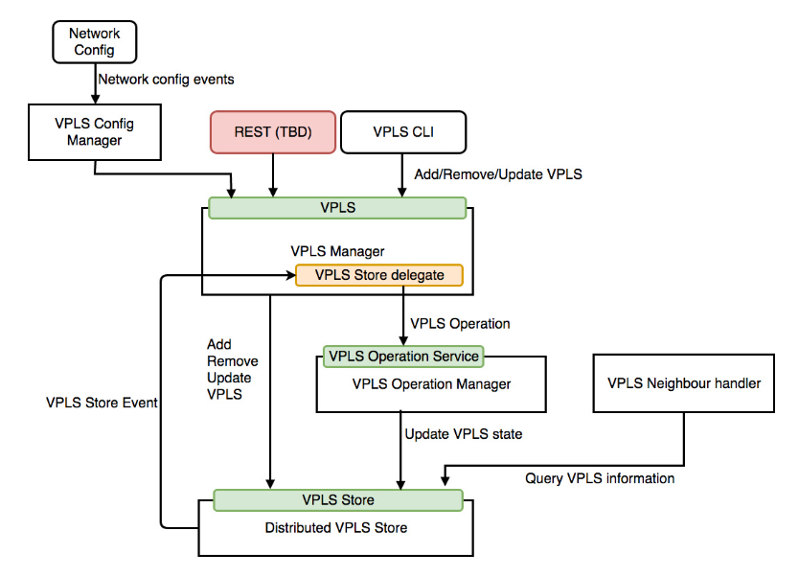

Slide 3
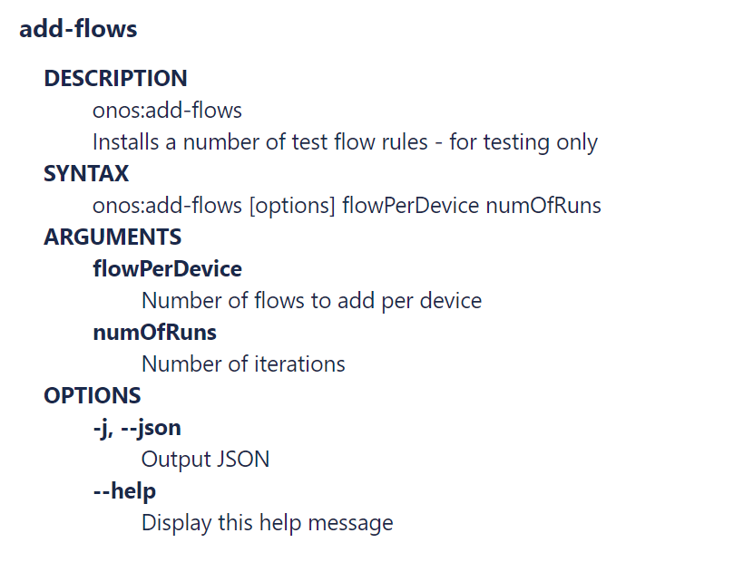
add-test-flows
onos:add-test-flows
onos:add-test-flows [options] flowPerDevice numOfRuns

Slide 4
Open vSwitch
Match Fields:
Ingress port +
Packet header +
metadata
Flow
Table
0
Flow
Table
1
Flow
Table
n
Execute Action Set
Packet
Out
Packet
In
Action Set
Action Set
Action Set
Action Set
. . .
Ingress Port
Egress Port

Slide 5
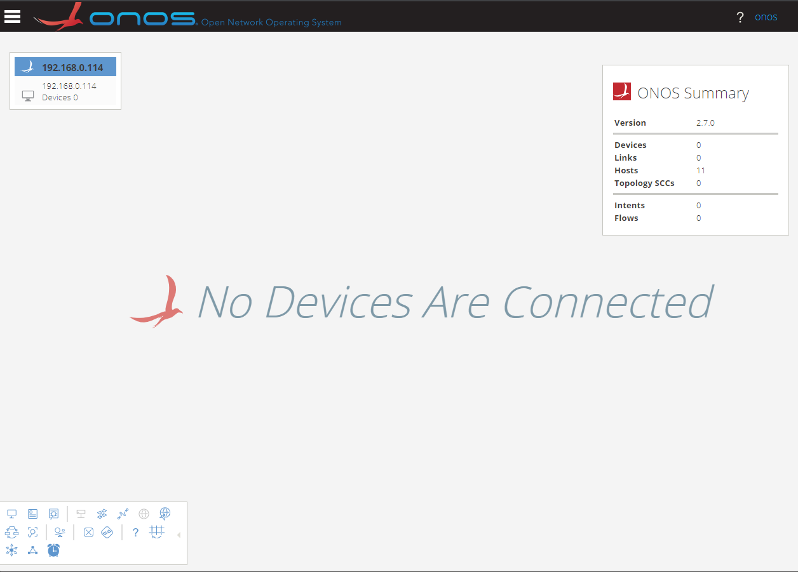
Masthead
ONOS Cluster Node Panel
Navigation Menu Button
Summary Panel
Username/
Logout link
Topology Toolbar

Slide 6
Application & Service Layer
Application Plane
SDN
Applications
Northbound Interface (NBI)
REST API
Control Layer
Controller Plane
SDN
Controller
Southbound Interface (SBI)
OpenFlow, BGP, NetConf
Infrastructure Layer
Data Plane
Network
Elements

