Slide 2
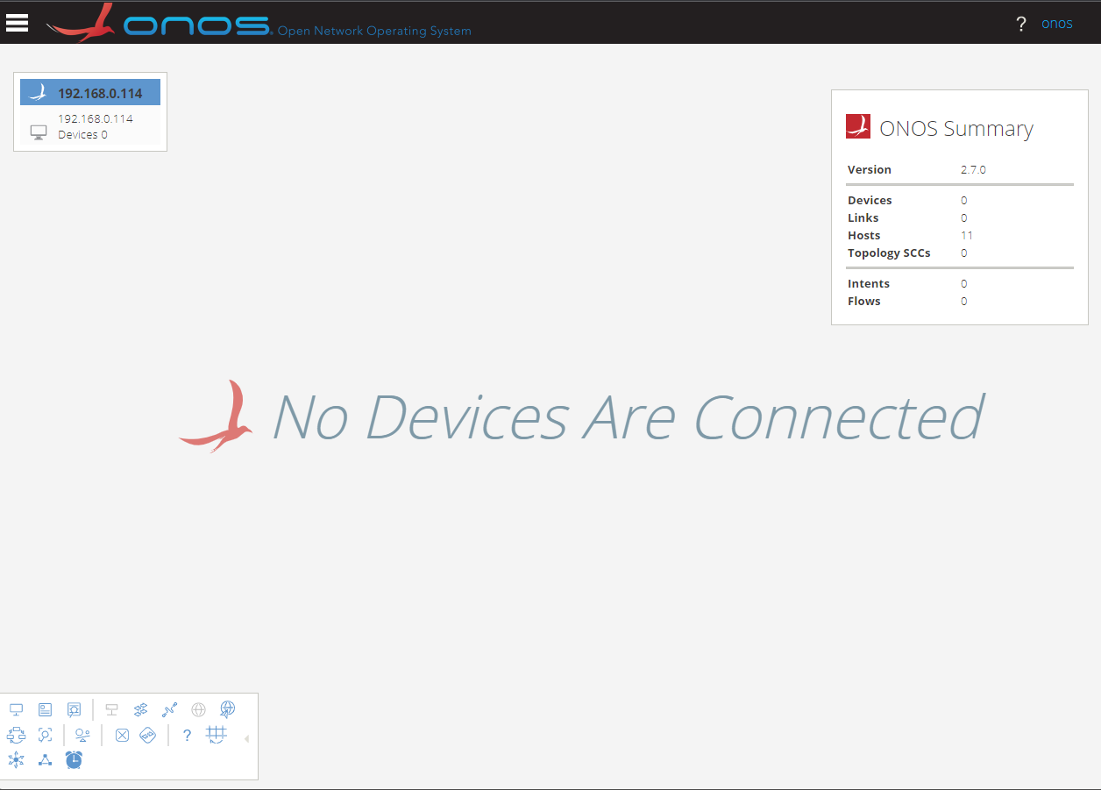
Masthead
ONOS Cluster Head Panel
Navigation Menu Button
Summary Panel
Username/
Logout link
Topology Toolbar

Slide 3
Application & Service Layer
Application Plane
SDN
Applications
Northbound Interface (NBI)
REST API
Control Layer
Controller Plane
SDN
Controller
Southbound Interface (SBI)
OpenFlow, BGP, NetConf
Infrastructure Layer
Data Plane
Network
Elements

