Slide 1
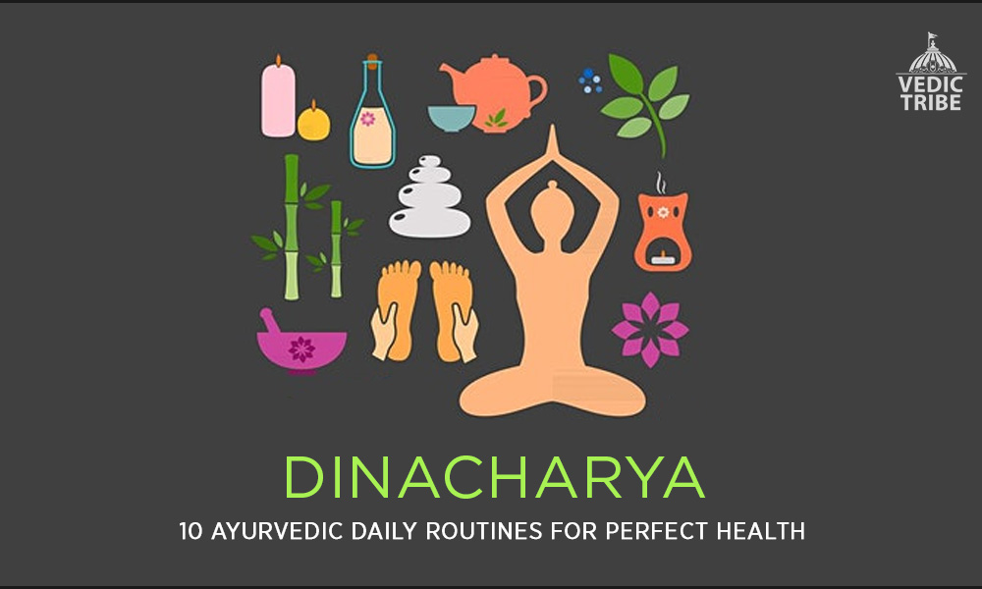
Topic of Presentation
ROLE OF DINACHARYA FOR IMMUNITY
PRESENTED BY:
Dr. NIDHI PATEL
MS 1ST year dept. of PSR
GUIDE
DR. KOLA VIJAYA KUMARI
Professor & HOD
MD(AYU)

Slide 2

DINACHARYA
Dinacharya is defined as "the daily routine".
According to Ayurveda one should follow Dinacharya in order to lead a healthy and disease free life.
Ayurveda gives more emphasis on prevention of diseases than treating a disease.
Dinacharya helps to establish balance in one’s constitution.
It also regularizes a person’s biological clock, aids digestion, absorption and assimilation and generates self esteem, discipline, peace, happiness and longevity.

Slide 3

IMMUNITY
Immunity is the body's natural ability to
resist external infection.
Ayurveda describes it under
Vyadhikshamatwa , Bala, Agni and Ojus.
In simple terms, the immune system is a network of cells and organs in our body, responsible for shielding us from any disease causative organisms.

Slide 4

ब्राह्म मुहूर्त:-
It is the first step of Dinacharya.
The healthy person should wake up from the bed in the ब्राह्म मुहूर्त means around 48 to 96 minutes before the sunrise.
In early morning the atmosphere is very clear as well as fresh and more utility of oxygen is possible.
There will be abundance of nascent of oxygen which easily mixes with haemoglobin forming oxyhaemoglobin reaching to the remote tissues and also boost the immune system as oxygen deficient bodies are highly prone to disease.
Melatonin hormone (mood elevator) is produced much in early morning.
It work as powerful antioxidant, fight against the disease.
During 3 to 6 AM earth vibration is less so mind works effectively throughout the day.

Slide 5

उष् पान:- (भाव प्रकाश)
It means drinking lukewarm water.
Drinks 8 प्रसृति (768 ml) of water at the time of early sunrise shall live for a 100 years and more free from diseases and old age.
If person drinks water in early morning then he/she can not suffer from gastric disorders.
Luke warm water or processed with
dry ginger powder and coriander.
Kindles metabolism and immunity.

Slide 6
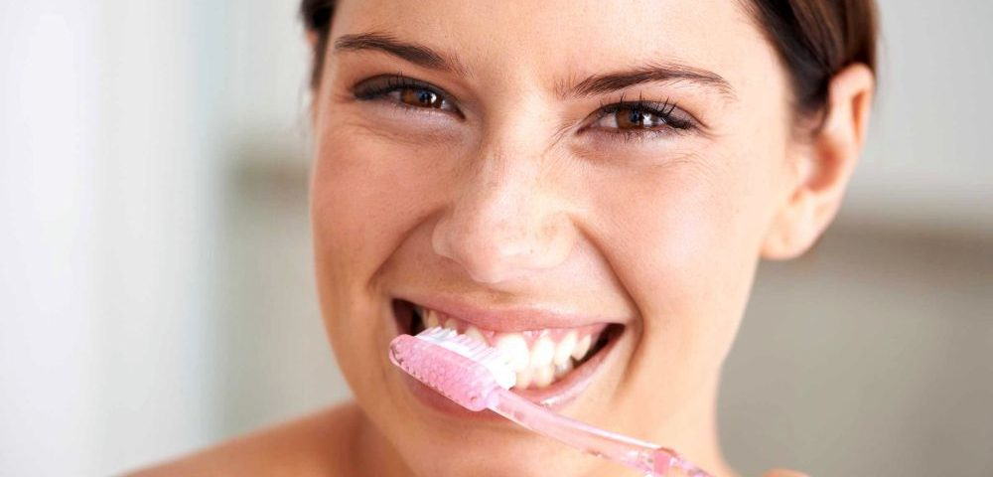
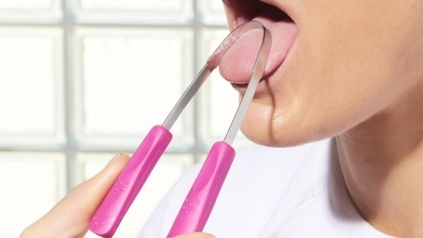
दन्तधावन:-
One should clean one’s teeth two times, one in morning and other at night after intake of food.
दन्तधावन by the twigs of some ayurvedic medicine like अर्क, वट, खदिर, करञ्ज and अर्जुन is very beneficial.
The ayurvedic tooth powder which contains कषाय, मधुर, कटु, तिक्त taste removes the bad smell, removes sliminess from the mouth.
Cleanses and prevent growth of micro organisms.
Enhances local immunity.
जिह्वा निर्लेखन
After brushing tongue cleaning should be done.It prevents Mukha dourgandha (hlitosis), Vairasya (faulty taste), Aruchi (tastelessness).

Slide 7
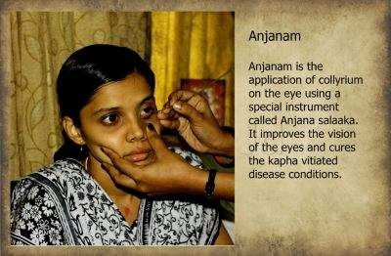
अञ्जन:-
Collyrium to the eyes is good for eyes, so it should be used daily.
By this eyes become beautiful and capable of seeing minute things even.
It prevents & cures Daha (burning), Kandu (itching), Mala (eye debris), Klinnta (watery eye), Vedna (pain) etc.
Not to be done in redness of eyes.
Enhances local immunity.

Slide 8
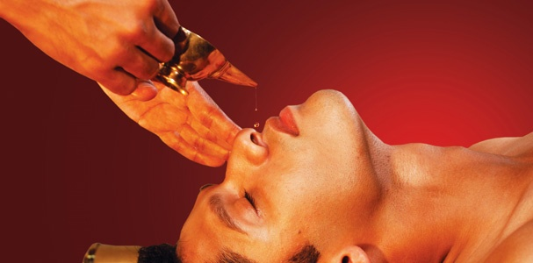
नस्य:-
नस्य is very important procedure and it is beneficial for जत्रूर्ध्व विकार.
The नस्य should be performed daily with अणु तैल.
2 to 3 drops of तैल is administered into each nostrils daily is called प्रतिमर्श नस्य.
The नस्य can be performed with कटु तैल also according to भावप्रकाश.
It prevents- Khalitya (hair fall), Palitya (graying of hair), Manyastambha (stiffness of neck), Hanustambha (stiffness of mendible), Shirah Shool (head ache), Ardita (facial paralysis), Peenasa (chronic rhinitis) and other Vataja disorders.
It Produces a biofilm preventing entry of micro organisms.
To be avoided in acute infection
The physiological action of nasya dravya gets carried through the olfactory nerve endings followed by cilia and cilia stimulate by lipid products.

Slide 9

गण्डूष and कवल:-
These both are different.
Mouth is completely filled with गण्डूष द्रव्य and kept without movement is called गण्डूष.
The liquid should be kept in mouth till the discharge from nasal passage and eyes.
The द्रव्य used moves easily in mouth called as कवल.
Oil can be used for Gandusha. It provides muscular strength and prevents dryness of mouth, throat and other dental problems.
Oil has property of coating. Bacteria, virus and other microbes can’t pass through mucosa. Gandusha is local measure for pathogen entry through mouth.

Slide 10
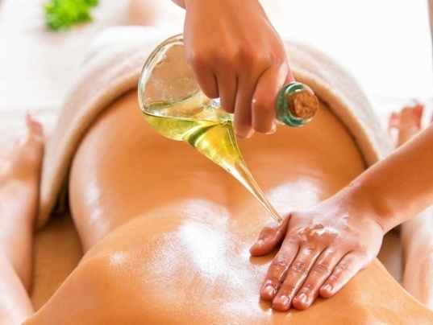
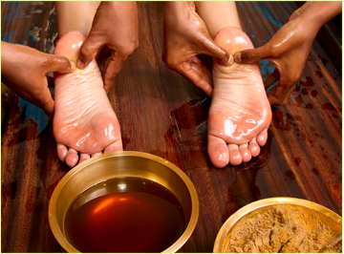
अभ्यङ्ग:-
By taking proper massage it delays aging, cures tiredness and vata disorders, and improves vision,
complexion, nourishment, life, sleep.
And by doing padaabyanga, it provides strength and stability to feet, improves the vision and pacifies the vata.
By doing Shiroabyanga it prevents the balding, graying, hair fall, strengthens the hair root, and makes the hair long and black.
And it also nourishes the sense organs, softens the skin.
It should be practice daily with तिल तैल.
Abhyanga provide anti-inflammatory effect and inhibit the pathogens. It provides strength to skin and act as barrier to pathogen.
Improves blood circulation, excretion of metabolic waste and improves immunity.

Slide 11
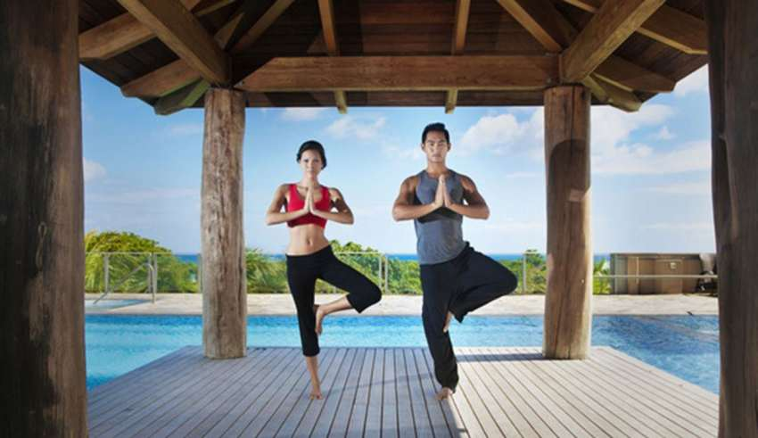
व्यायाम:-
It increases stamina, provide stability to body and increases Agni.
It helps to control obesity.
Regular physical activity controls body weight, reduces stress, maintains blood pressure which helps in acquiring good immunity.
Asana and Pranayama are the best in maintaining physical and mental wellness.
Reduces the incidence of communicable (e.g.,bacterial and viral infections) and non-communicable diseases (e.g., cancer)
Immune competency is enhanced by regular exercise.
Exercise induces release of pro-inflammatory cytokines which lead to cell redistribution and provide anti-inflammatory effects. Neutrophil concentration also increases during exercise.
Blood flow increases during exercise to provide oxygen for metabolic demand of body tissue. Sufficient oxygen supply to tissues help to maintain health in better way.

Slide 12

स्नान:-
Snana increases the life span, it removes dirt (we come in contact with many bacteria, virus and other infectious germs in day to day life).
It removes sweating, itching and provide immunity to fight against diseases.
Snana is a natural immunity booster (Ojasandhanakara).
Snana should be done before taking meal in the morning. Lower body bath should be done with warm water. Head Snana should be done with cold water.
Bathing with warm water leads to hyper thermic action which warms the blood and increase deep body temperature.
Pathogens can’t survive in that particular temperature.
It also increases the blood circulation and strengthens immune system.

Slide 13

आहार:-
Aahar is very important for immunity.
One should start Ahara with Madhura rasa then amla, lavana, tikta, katu, Kashayaa.
Like this one should take Ahara in a chronological order.
And one should take anupana as jala. Because this Ahara rasa gives strength, bala, varna, pushti, dhatu poshana, indriya prasadata etc.
Fruits, roasted cereals like gram, peanuts, pulses etc. Sprouted cereals, Puffed rice, butter milk are considered as healthy food items.
It is needed to change our style of food as: Consume a diet rich in vegetables and fruits , whole fruit is better than fruit juice because it contains fiber.
Vegetables which are green, reduces fat and blood sugar level.
Prepare food by boiling, roasting, steaming, baking and avoid frying.

Slide 14

निद्रा:-
Sleep is a special state of mind in which the mind is not associated with any type of इन्द्रिय.
Proper or improper sleep affects on our health.
If proper sleep is not taken then the person loose his immunity because proper sleep is responsible for attaining immunity.
In ayurveda also आचार्य चरक explained about effects of निद्रा-
निद्रायत्तंसुखं दु:खं पुष्टि: कार्ष्यबलाबलाम |
वृषताक्लिबता ज्ञानामज्ञानंजीवितं न च ||
-च.सू. २१/३६
Sleep provides essential support to the immune system.
Getting sufficient hours of high-quality sleep enables a well-balanced immune defense that features strong innate and adaptive immunity.

Slide 15

CONCLUSION
With the advancement of time, lot of changes has taken place inevitably in the social and religious customs and behavior and also in the mode of lifestyle of people. Boosting the body’s natural immunity plays a significant role in maintenance of health. In busy life everyone needs to understand the importance of dinacharya. The dincharya regimen if followed properly helps to attain physical, mental and spiritual well being of an individual.

Slide 16


