Slide 1
Topic of Presentation
Applied Anatomy of Abdomen
PRESENTED BY:
Dr. NIDHI PATEL
MS 1ST year dept. of PSR
Guided by
DR. KOLA VIJAYA KUMARI DR.R.VIJAYASANTHA KUMARI
Professor & HOD Associate Professor
MD(AYU) MD(AYU)

Slide 2
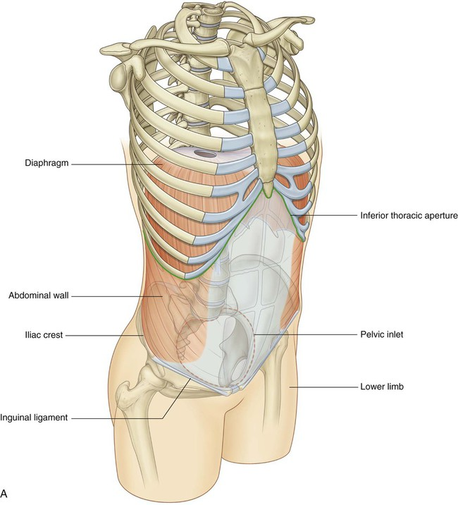
INTRODUCTION
Abdomen is a cylindrical chamber extending from diaphragm to the base of the pelvis, comprising of abdomen proper & the lesser pelvis.
Abdomen proper & lesser pelvis communicate with each other at the plane of inlet into lesser pelvis (upper border of pubic symphysis, pubic crests, arcuate line of innominate bones, sacral promontary).
Contents of Abdomen proper: - Most of the digestive tube, Liver, pancreas, spleen, kidneys, ureters (in part), supra renal gland & various blood &lymph vessels lymph nodes &nerves
Contents of lesser pelvis: - Terminal parts of ureters, urinary bladders, the sigmoid colon, rectum some coils of ileum, internal genitalia, blood & lymph vessels, lymph nodes & nerves.

Slide 3
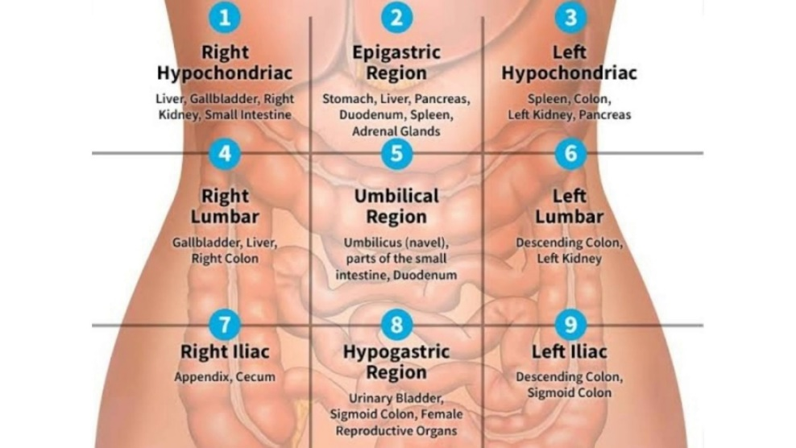
REGIONS OF ABDOMEN
Nine regions of the abdomen can be marked using two horizontal and two vertical dividing lines.
The vertical lines are the mid-clavicular lines taken from the mid-point of each clavicle.
The upper horizontal line is the subcostal line taken from the inferior parts of the lowest costal cartilages.
The lower horizontal line is the intertubercular line connecting the tubercles of the pelvis.
The three main centrally positioned regions are the epigastric region, the umbilical region, and the hypogastric region also known as the pubic region.
On the sides of the abdomen the other six regions are the left and right hypochondriac regions, on either side of the epigastrium; the left and right lumbar flank regions, on either side of the umbilical region, and the left and right iliac or inguinal regions on either side of the hypogastrium.

Slide 4
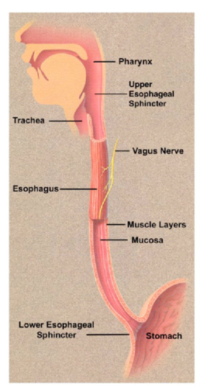
ORGANS OF ABDOMEN
ABDOMEN PART OF ESOPHAGUS:-
The esophagus is a fibromuscular tube, about 25 cm (10 in) long in adults, that travels behind the trachea and heart, passes through the diaphragm, and empties into the uppermost region of the stomach.
The esophagus is surrounded at the top and bottom by two muscular rings, known respectively as the upper esophageal sphincter and the lower esophageal sphincter.
The lower esophageal sphincter, or gastroesophageal sphincter, surrounds the lower part of the esophagus at the junction between the esophagus and the stomach.
It is also called the cardiac sphincter or cardioesophageal sphincter.

Slide 5
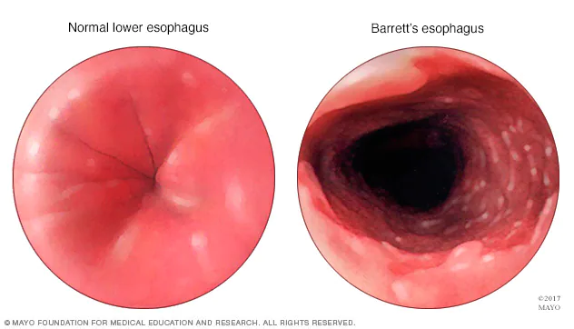
Applied Anatomy:-
Barrett's esophagus:-
Barrett's esophagus is a condition in which there is an abnormal (metaplastic) change in the mucosal cells lining the lower portion of the esophagus, from stratified squamous epithelium to simple columnar epithelium.
The change from normal to premalignant cells indicate Barrett's esophagus does not cause any particular symptoms. Barrett's esophagus, however, is associated with these symptoms:
frequent and longstanding heartburn
trouble swallowing (dysphagia)
vomiting blood (hematemesis)
pain under the sternum where the esophagus meets the stomach
pain when swallowing (odynophagia)
Esophageal cancer

Slide 6
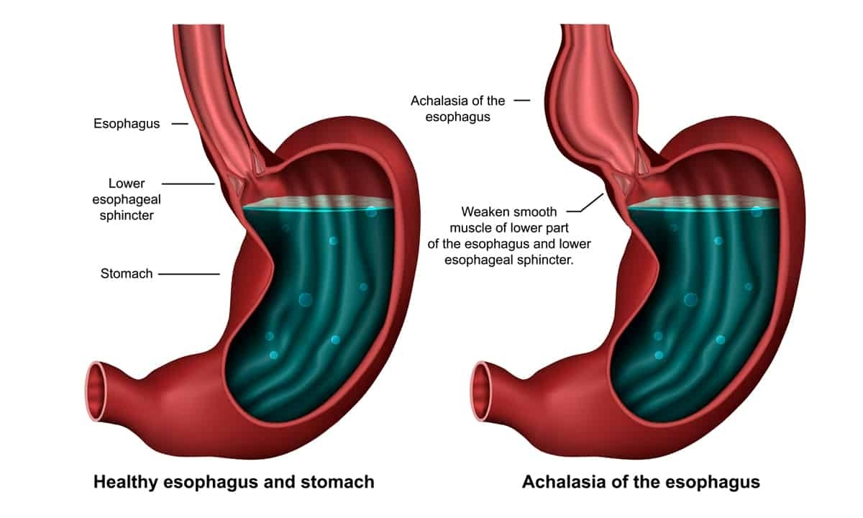
Esophageal achalasia
Esophageal achalasia, often referred to simply as achalasia, is a failure of smooth muscle fibers to relax, which can cause the lower esophageal sphincter to remain closed.
Achalasia is characterized by difficulty in swallowing, regurgitation, and sometimes chest pain.

Slide 7
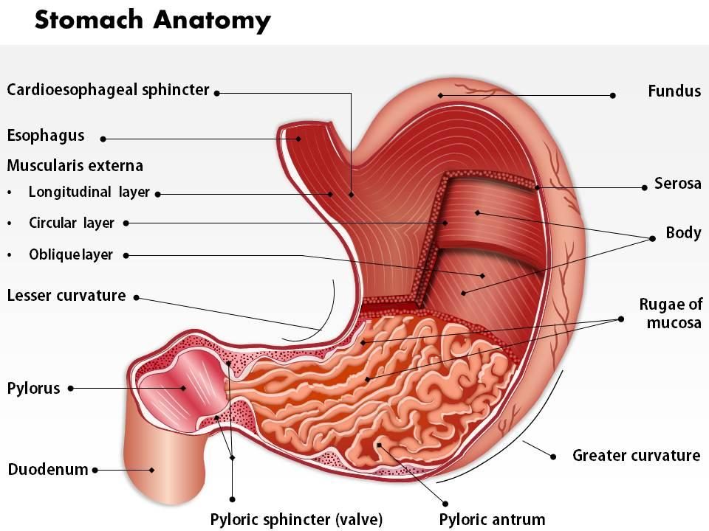
STOMACH: -
The stomach is a muscular organ located on the left upper side of the abdomen.
The stomach is the most dilated part of the digestive system, lying between the esophagus and duodenum.
Shape: - ‘J’ shaped
Capacity: - 30 ml at birth, 1 lit at puberty and 1.5 to 2 liters or more in adults
Location: - 10 Thorasic and 3 lumber
Parts of stomach: -
Cardiac region
Fundus
Body
Pyloric

Slide 8
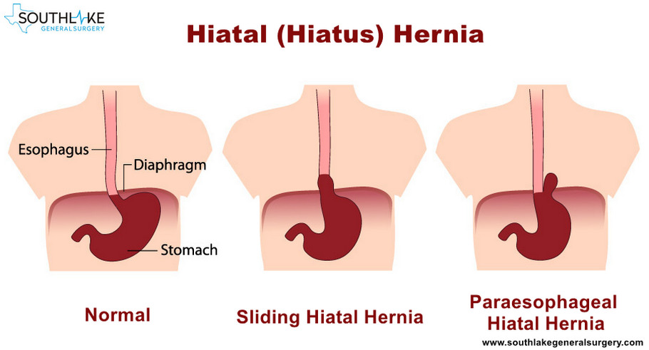
Applied Anatomy:-
HIATAL HERNIA:-
A hiatal hernia is a protrusion of part of the stomach into the mediastinum through the esophageal hiatus of the diaphragm.
Any gastric part can be involved, but the most common situation is a protrusion of the gastroesophageal junction (sliding hiatal hernia), accounting for 95% of cases.
The fundus of the stomach (paraesophageal hiatal hernia), multiple parts, or even the entire organ can herniate into the mediastinum.

Slide 9
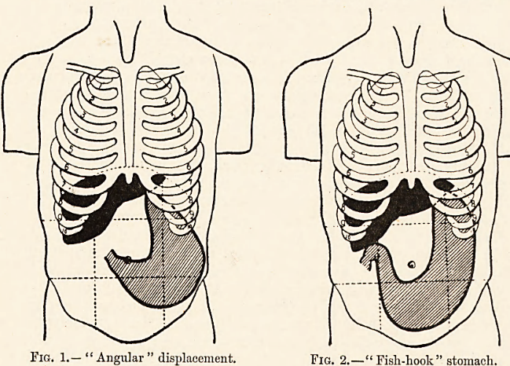
DISPLACEMENT OF STOMACH :-
Pancreatic and pseudo cyst and abcess in the omentum bursa can may push the stomach forword/ anteriorly this displacement is usually visible in lateral radiographic/CT.
The posterior wall of stomach may adhere to the part of the posterior wall of the omentum bursa that covers the pancreas.this occurs due to inflammation of pancrease and it is very close to (posterior wall of stomach) pancreas.

Slide 10
PEPTIC ULCER :-
A sore that develops on the lining of the oesophagus, stomach or small intestine.
Ulcers occur when stomach acid damages the lining of the digestive tract.
Common causes include the bacteria H. Pylori and anti-inflammatory pain relievers including aspirin.
Upper abdominal pain is a common symptom.
CANCER OF STOMACH :-
Stomach cancer, also known as gastric cancer, is cancer developing from the lining of the stomach.
Because the lymphatic vessels of the mucous membrane and submucosa of the stomach are in continuity, it is possible for cancer cells travel to different parts of the stomach.

Slide 11
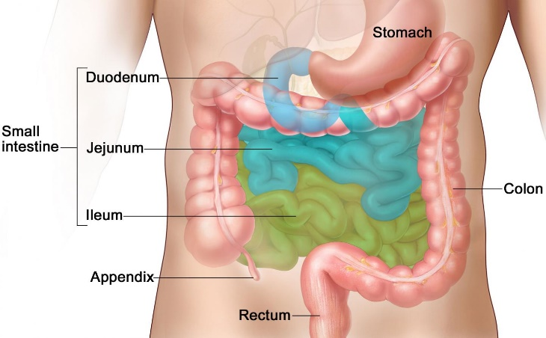
SMALL INTESTINE: -
Small intestine is the part of gastrointestinal tract, extending between the pyloric sphincter of stomach and ileocecal vale, which opens into large intestine. It is called small intestine.
Length: -6 meter
Type: -
Duodenum
Jejunum
Ileum

Slide 12
Applied Anatomy: -
DUODENAL ULCER :-
A duodenal ulcer is a sore that forms in the lining of the duodenum.
It typically occurs after eating or drinking.
Symptoms may include early satiation, uncomfortable fullness, bloating, nausea, vomiting, belching, flatulence, heartburn, regurgitation and diarrhoea.
CONGENITAL STENOSIS AND OBSTRUCTION :-
Stenosis and obstruction of the second part of the duodenum may occur at the site of the opening of the bile duct.
Meckel's diverticulum
It is the most common congenital anomaly of the gastrointestinal tract.
It results from incomplete obliteration of the vitelline duct leading to the formation of a true diverticulum of the small intestine.
Meckel's diverticula are uncommon and often clinically silent, particularly in the adult.
DUODENAL CARCINOMA :-

Slide 13
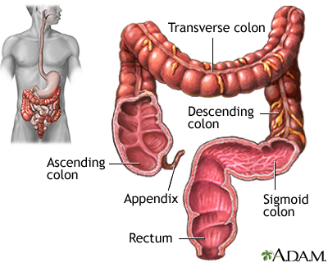
LARGE INTESTINE: -
The large intestine, also known as the large bowel, represents the last part of the gastrointestinal tract.
The large intestine is a 1 to 1.5-meter continuation of the ileum, extending from the ileocecal junction to the anus.
Parts:-
Cecum, appendix, ascending colon, transverse colon, descending colon, sigmoid colon, rectum, anal canal

Slide 14
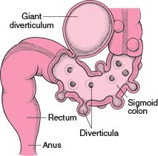
Applied Anatomy: -
DIVERTICULOSIS: -
Also known as “diverticular disease”.
It is the condition of having diverticula in the colon, which are outpocketings of the colonic mucosa and submucosa through weaknesses of muscle layers in the colon wall.
These are more common in the sigmoid colon, which is a common place for increased pressure.
This is uncommon before the age of 40.

Slide 15
PAIN OF APPENDICITIS: -
Visceral pain in the appendix is produced by distention of its lumen or spasm of its muscle.
The afferent pain fibres enter the spinal cord at the level of the tenth thoracic segment and a vague referred pain is felt in the region of the umbilicus.
Later, the pain shifts to where the inflamed appendix irritates the parital peritoneum.

Slide 16
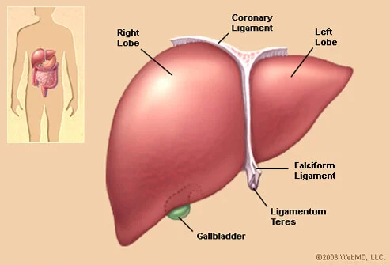
LIVER :-
The liver is a large organ found in the upper right quadrant of the abdomen.
It is a multifunctional accessory organ of the gastrointestinal tract and performs several essential functions such as detoxification, protein synthesis, bile production and nutrient storage to name only a few.
It is the largest gland in the human body, weighing approximately 1.5 kilograms.
Lobes: right, left, caudate, quadrate
Surfaces: diaphragmatic, visceral
Ligaments: coronary, left triangular, falciform, round ligament, venous
Fissures and recesses: porta hepatis (central fissure), subphrenic recess, hepatorenal recess

Slide 17
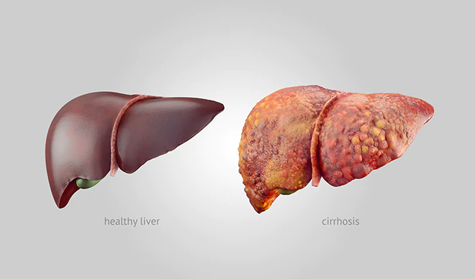
Applied Anatomy: -
LIVER CIRRHOSIS: -
Cirrhosis is a late stage of scarring (fibrosis) of the liver caused by many forms of liver diseases and conditions, such as hepatitis and chronic alcoholism.
Each time your liver is injured — whether by disease, excessive alcohol consumption or another cause — it tries to repair itself.
In the process, scar tissue forms.
As cirrhosis progresses, more and more scar tissue forms, making it difficult for the liver to function (decompensated cirrhosis). Advanced cirrhosis is life-threatening.

Slide 18
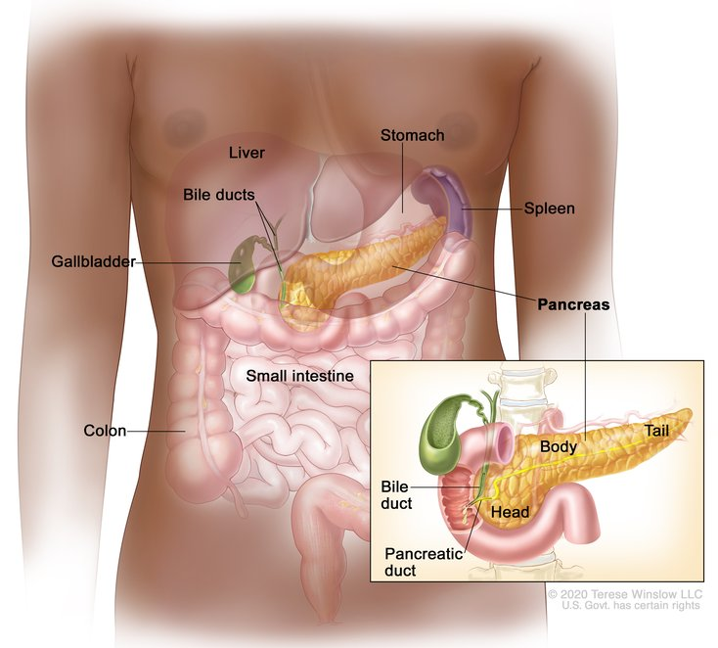
PANCREAS :-
The pancreas is an accessory organ and exocrine gland of the digestive system, as well as a hormone producing endocrine gland.
The pancreas is an elongated organ (approximately 15 cm) which lies obliquely across the posterior abdominal wall, at the level of the L1 and L2 vertebral bodies.
It is a retroperitoneal organ consisting of five parts and an internal system of ducts.
Parts-
External: head, uncinate process, neck, body, tail
Internal: main pancreatic duct (of Wirsung), accessory pancreatic duct

Slide 19
Applied Anatomy: -
PANCREATIC CYST :-
Pancreatic cysts are saclike pockets of fluid on pancreas.
This cyst present as a large fixed tumor in the upper part of abdomen along the median plane.
They are often symptomless.
CARCINOMA OF PANCREAS :-
It is most common in the head of the pancreas.
Pressure over the posteriorly placed bile duct leads to persistent obstructive jaundice.
It may press upon the portal vein causing Ascites.

Slide 20
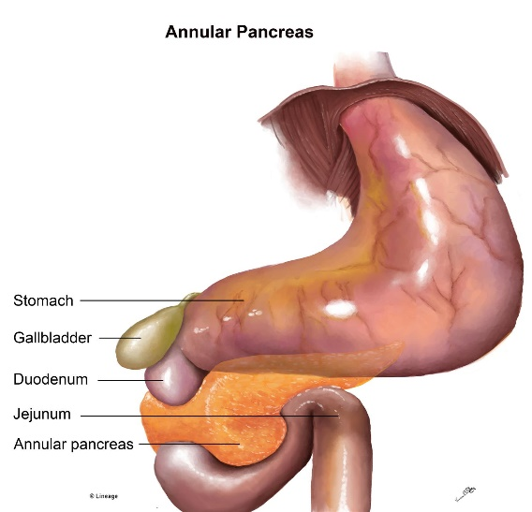
ANNULAR PANCREAS :-
It is a developmental anomaly.
Annular pancreas is a rare condition in which the second part of the duodenum is surrounded by a ring of pancreatic tissue continuous with the head of the pancreas.
This portion of the pancreas can constrict the duodenum and block or impair the flow of food to the rest of the intestines.

Slide 21
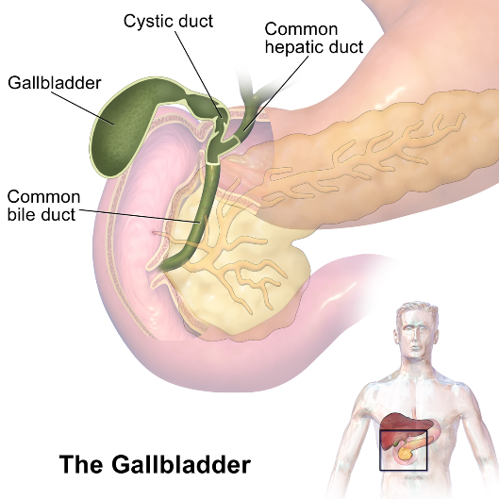
GALL BLADDER :-
The gallbladder is a pear-shaped organ located in the right upper quadrant of the abdomen.
It measures approximately 7 cm to 10 cm in length and 4 cm in width.
The fossa for the gallbladder extends from the right end of the porta hepatis to the inferior border of the liver.

Slide 22
Applied Anatomy: -
OBSTRUCTIVE JAUNDICE :-
Biliary obstruction arises when passage of bile into the duodenum is blocked either completely or partially.
Obstruction may be intrahepatic or extrahepatic.
Causes are – the gall stones which slip down into the bile duct and block it and Cancer of the head of pancreas which compress the bile duct.
Gallbladder carcinoma
Cancer of the gallbladder is uncommon and mostly occurs in later life.
When cancer occurs, it is mostly of the glands lining the surface of the gallbladder (adenocarcinoma).
Gallstones are thought to be linked to the formation of cancer.
Other risk factors include large (>1 cm) gallbladder polyps and having a highly calcified "porcelain" gallbladder.

Slide 23
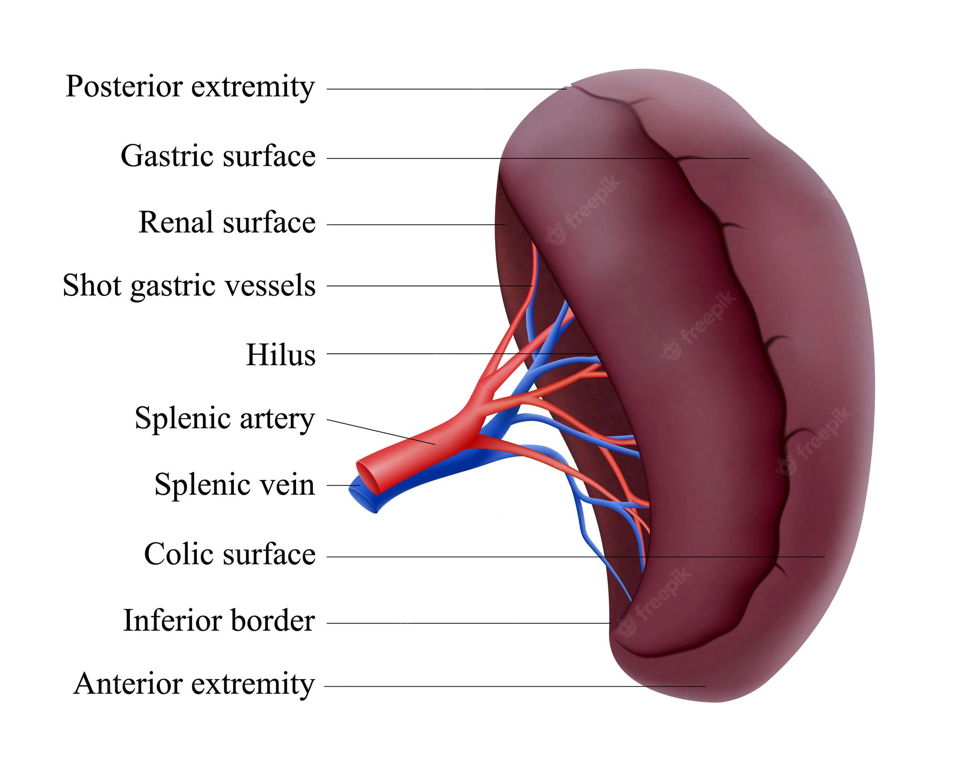
SPLEEN :-
Spleen is a lymphatic organ connected to the blood vascular system.
It acts as a filter for blood and plays an important role in the immune responses of the body.
The spleen is an organ shaped like a shoe that lies relative to the 9th and 11th ribs and is located in the left hypochondrium and partly in the epigastrium.
Thus, the spleen is situated between the fundus of the stomach and the diaphragm.

Slide 24
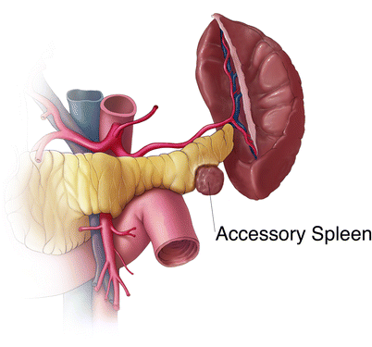
Accessory spleen
An accessory spleen is a small splenic nodule extra to the spleen usually formed in early embryogenesis.
Accessory spleens are found in approximately 10 percent of the population and are typically around 1 centimeter in diameter.
Splenosis is a condition where displaced pieces of splenic tissue (often following trauma or splenectomy) autotransplant in the abdominal cavity as accessory spleens.
Polysplenia is a congenital disease manifested by multiple small accessory spleens, rather than a single, full-sized, normal spleen. Polysplenia sometimes occurs alone, but it is often accompanied by other developmental abnormalities such as intestinal malrotation or biliary atresia, or cardiac abnormalities, such as dextrocardia.
These accessory spleens are non-functional.

Slide 25

REFRENCES: -
B D Chaurasia’s Human Anatomy
Gray’s Anatomy

Slide 26


