Slide 1
CONTROL FLOW
PRINCIPLES OF PROGRAMMING LANGUAGES

Slide 2
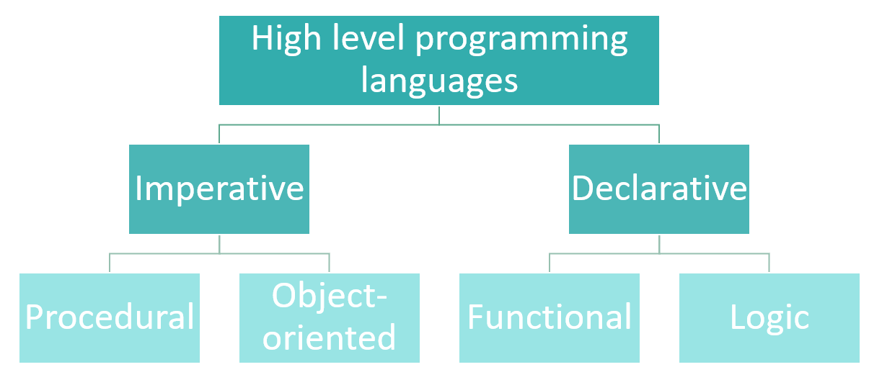

Slide 3
EXPRESSION EVALUATION
Order of evaluation may inﬂuence result of computation.
Purely functional languages:
Computation is expression evaluation.
The only effect of evaluation is the returned value—no side effects.
Order of evaluation of subexpressions is irrelevant.
Imperative languages:
Computation is a series of changes to the values of variables in memory.
This is “computation by side effect”.
The order in which these side effects happen may determine the outcome of the computation.
There is usually a distinction between an expression and a statement.
3/40

Slide 4
ASSIGNMENT
Assignment is the simplest (and most fundamental) type of side effect a computation can have.
Very important in imperative programming languages
Much less important in declarative programming languages
Syntactic differences (Important to know, semantically irrelevant):
A = 3
A :- 3
A <- 3
A =. 3
3 -> A
MOVE 3 TO A (SETQ A 3)
FORTRAN, PL/1, SNOBOL4, C, C++, Java
Pascal, Ada, Icon, ML, Modula-3, ALGOL 68 Smalltalk, Mesa, APL
J BETA COBOL LISP
4/40

Slide 5
REFERENCES AND VALUES
Expressions that denote values are referred to as r-values.
Expressions that denote memory locations are referred to as l-values.
In most languages, the meaning of a variable name differs depending on the side of an assignment statement it appears on:
On the right-hand side, it refers to the variable’s value—it is used as an r-value.
On the left-hand side, it refers to the variable’s location in memory—it is used as an l-value.
a’s value
d = a ;
a = b + c; a’s memory location
5/40

Slide 6
EXPLICIT DEREFERENCING
Some languages explicitly distinguish between l-values and r-values:
BLISS: X := .X + 1
ML: X := !X + 1
In some languages, a function can return an l-value (e.g., ML or C++):
int a[10];
int &f(int i) { return a[i % 10];
}
void main() {
for (int i = 0; i < 100; ++i) f(i) = i;
}
6/40

Slide 7
VARIABLE MODELS
Value model
Assignment copies the value.
Reference model
A variable is always a reference.
Assignment makes both variables refer to the same memory location.
7/40

Slide 8
VALUE MODEL VS REFERENCE MODEL
b = 2; c = b; a = b + c;
Value model Reference model
4
2
4
2
2
a
b c

Slide 9
JAVA EXAMPLES
int a = 5; int b = a; b += 10;
System.out.println("a = " + a); System.out.println("b = " + b);
Output:
a = 5
b = 15
Obj a = new Obj(); Obj b = a; b.change();
System.out.println(a == b);
Output:
true
String a = "hi "; String b = a;
b += "world"; System.out.println("a = " + a); System.out.println("b = " + b);
Output:
a = hi
b = hi world
StringBuffer a = new StringBuffer(); StringBuffer b = a;
b.append("This is b's value."); System.out.println("a = " + a); System.out.println("b = " + b);
Output:
a = This is b's value b = This is b's value
9/40

Slide 10
SHORT-CIRCUIT EVALUATION OF BOOLEAN EXPRESSIONS
(and a b): If a is false, b has no effect on the value of the whole expression.
(or a b): If a is true, b has no effect on the value of the whole expression.
Short-circuit evaluation
If the value of the expression does not depend on b, the evaluation of b is
skipped.
This is useful, both in terms of optimization and semantically.
Some languages provide both regular and short-circuit versions of Boolean operators.
12/40

Slide 11
GOTO AND ALTERNATIVES
Use of goto is bad programming practice if the same effect can be achieved using different constructs.
Sometimes, it is unavoidable:
Break out of a loop
Break out of a subroutine
Break out of a deeply nested context
Many languages provide alternatives:
One-and-a-half loop
return statement
Structured exception handling
15/40

Slide 12
SELECTION (ALTERNATION)
Standard if-then-else statement:
if cond then this
else that
Switch statement:
switch value of
case pattern1: option1 case pattern2: option2
...
default: default action
Multi-way if-then-else statement:
if cond1 then option1 elsif cond2 then option2 elsif cond3 then option3
...
else default action
16/40

Slide 13
SWITCH STATEMENTS
Switch statements are a special case of if/then/elsif/else statements.
Principal motivation: Generate more efﬁcient code!
Compiler can use different methods to generate efﬁcient code:
Sequential testing
Binary search
Hash table
Jump table
17/40

Slide 14
IMPLEMENTATION OF IF STATEMENTS
if i == 1: option1()
elsif i in [2, 7]: option2()
elsif i in [3, 4, 5]: option3()
elsif i == 10: option4()
else:
default_action()
18/40

Slide 15
IMPLEMENTATION OF IF STATEMENTS
Assume i is stored in register R1.
if R1 != 1 goto L1 call option1
goto L6
L1: if R1 == 2 goto L2 if R1 != 7 goto L3
L2: call option2 goto L6
L3: if R1 < 3 goto L4 if R1 > 5 goto L4 call option3
goto L6
L4: if R1 != 10 goto L5 call option4
goto L6
L5: call default_action L6: ...
if i == 1: option1()
elsif i in [2, 7]: option2()
elsif i in [3, 4, 5]: option3()
elsif i == 10: option4()
else:
default_action()
18/40

Slide 16
IMPLEMENTATION OF SWITCH STATEMENTS: JUMP TABLE
case i: 1:
2, 7:
3, 4, 5:
option1() option2() option3()
10: option4() otherwise: default_action()
19/40

Slide 17
IMPLEMENTATION OF SWITCH STATEMENTS: JUMP TABLE
Assume i is stored in register R1.
case i: 1:
2, 7:
3, 4, 5:
T: &L1
&L2 &L3 &L3 &L3 &L5 &L2 &L5 &L5 &L4
L1: call option1 goto L7
L2: call option2 goto L7
L3: call option3 goto L7
L4: call option4 goto L7
L5: call default_action goto L7
L6: if R1 < 1 goto L5 if R1 > 10 goto L5 R1 := R1 - 1
R2 := T[R1]
goto *R2 L7: ...
option1() option2() option3()
10: option4() otherwise: default_action()
19/40

Slide 18
IMPLEMENTATION OF SWITCH STATEMENTS
Jump table:
+ Fast: one table lookup to ﬁnd the right branch
— Potentially large table: one entry per possible value
Hash table:
+ Fast: one hash table access to ﬁnd the right branch
More complicated
Binary search:
± Fast, but slower than table lookup
+ No storage overhead
Linear search:
— Potentially slow
+ No storage overhead
20/40

Slide 19
ITERATION
Enumeration-controlled loops:
Example: for-loop
One iteration per element in ﬁnite set
The number of iterations is known in advance.
Logically controlled loops:
Example: while-loop
Executed until a Boolean condition changes
The number of iterations is not known in advance.
Some languages do not have loop constructs (Scheme, Haskell, …). They use tail recursion instead.
21/40

Slide 20
LOGICALLY CONTROLLED LOOPS
Pre-loop test:
while (cond) {
...
}
Mid-loop test or “one-and-a-half loop”:
loop {
...
if (cond1) exit;
...
if (cond2) exit;
...
}
Post-loop test:
do {
...
} while (cond);
22/40

Slide 21
TRADE-OFFS IN ITERATION CONSTRUCTS (1)
Logically controlled loops:
+ Flexible
— Expensive
The for-loop in C/C++ is merely syntactic sugar for the init-test-step idiom in implementing enumeration using logically controlled loops!
for (init; cond; step) { statements;
}
init
L1: R1 := evaluate cond if not R1 goto L2 statements
step goto L1
L2: ...
while (cond) { statements;
}
L1: R1 := evaluate cond if not R1 goto L2 statements
goto L1 L2: ...
23/40

Slide 22
LABELLED BREAK AND CONTINUE
“Break” statement (“last“ in Perl):
Exit the nearest enclosing for-, do-, while- or switch-statement.
“Continue” statement (“next” in Perl):
Skip the rest of the current iteration.
Both statements may be followed by a label that speciﬁes
An enclosing loop (continue) or
Any enclosing statement (break).
A loop may have a finally part, which is always executed no matter whether the iteration executes normally or is terminated using a continue or break statement.
25/40

Slide 23
ITERATORS AND GENERATORS
Often, for-loops are used to iterate over sequences of elements (stored in a data structure, generated by a procedure, …)
Iterators/generators provide a clean idiom for iterating over a sequence without a need to know how the sequence is generated.
Generators in Python:
def lexy(length): yield ''
if length > 0:
for ch in ['a', 'b', 'c', 'd']: for w in lexy(length - 1):
yield ch + w
for w in lexy(3): print(w)
26/40

Slide 24
RECURSION
Every iterative procedure can be turned into a recursive one:
while (condition) { S1; S2; ... }
becomes
procedure P() {
if (condition) { S1; S2; ...; P();
}
}
31/40

Slide 25
RECURSION
Every iterative procedure can be turned into a recursive one:
while (condition) { S1; S2; ... }
becomes
procedure P() {
if (condition) { S1; S2; ...; P();
}
}
The converse is not true (e.g., Quicksort, Merge Sort, fast matrix multiplication, …)
The type of recursive procedure above can be translated back into a loop by the compiler (tail recursion).
31/40

Slide 26
APPLICATIVE AND NORMAL-ORDER EVALUATION
Applicative-order evaluation
Default in most programming languages
Arguments are evaluated before a
subroutine call
Normal-order evaluation
Arguments are passed to the subroutine unevaluated.
The subroutine evaluates them as needed.
Useful for inﬁnite or lazy data structures that are computed as needed.
Example: macros in C/C++
Normal-order evaluation is ﬁne in functional languages but problematic if there are side effects. Why?
Normal-order evalutaion is potentially inefﬁcient. Why? How can we avoid this?

Slide 27
SUMMARY
Think in terms of control abstractions rather than syntax!
Expression evaluation order is left to the compiler; avoid side effects.
Understand what a variable use means (l-value/r-value; value/reference).
Short-circuiting helps efﬁciency and allows some elegant idioms.
Avoid goto.
switch is often more efﬁcient than multi-way if.
for-loops can be more efﬁcient than while-loops (not in C, Java, Python, …).
Iterators/generators provide an abstraction for enumerating the elements of a sequence useful for iteration constructs.
Recursion is more general/powerful than iteration.
Applicative-order evaluation is fast, normal-order evaluation is ﬂexible, lazy evaluation offers a trade-off: the strategy where transformations on distributed datasets, are not immediately executed, but instead, their execution is delayed until an ACTION is called.
40/40

