Slide 1
Peer to Peer Bluetooth chat
CECS 579
Created By : HARSHAL SHAH

Slide 2
Problem Statement
To develop a peer to peer secure chat mobile application for shorter range communication where data network or internet network is not available for android smart devices using Bluetooth. This application will provide the better authenticated connection between two devices and confidentiality in data transfer. All of the communications between users would be encrypted by some sort of encryption algorithm. Beyond this, there would be secure authentication to connect device with each other.

Slide 3
Literature Search
http://docs.oracle.com/javase/7/docs/api/java/security/SecureRandom.html
Study of Android API and Framework (www.android.com)
Study of android Bluetooth connection API http://developer.android.com/guide/topics/connectivity/bluetooth.html
Study of ZRTP protocol (http://www.voip-info.org/wiki/view/ZRTP)
Study of openSSL ( https://www.openssl.org )
Analysis of existing application
https://play.google.com/store/apps/details?id=com.opengarden.firechat&hl=en
https://itunes.apple.com/us/app/air-chatencryptedbluetooth/id583584427?mt=8

Slide 4
Challenges
Firstly, as a single team player, it was difficult for me to develop whole application alone from scratch including analysis ,designing and development.
Challenges faced during development
Thread implementation for listening continuously for incoming connection
Differentiate between coming data whether it is text message or picture
Solving different exceptions occurring in Bluetooth connection
Faced many problems during multiple Bluetooth connection

Slide 5
Cont.
Challenges faced during security implementation
Implement code for variable length messages
Faced problems during padding of extra bits
Faced problems during removal of padding extra bits
How to implement ZRTP protocol for secure authentication in Bluetooth.
To choose the right encryption algorithm, mode and padding scheme

Slide 6
Solutions
Most of the challenges were solved by studying and exploring libraries in detail.
To differentiate between text and picture I sent the header(length/type) along with message.
Instead of ZRTP Authentication, I have used by default android Bluetooth authentication in which users must agree and match the pass key.

Slide 7
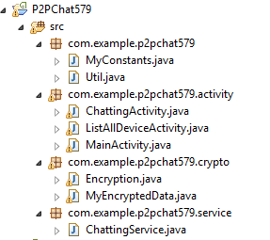
Individual Work

Slide 8
Features that I have been able to implement Successfully..
Bluetooth Connection [Guidance taken from:
http://developer.android.com/guide/topics/connectivity/bluetooth.html]
o Scan for other Bluetooth devices
o Display list paired Bluetooth devices
o Establish RFCOMM channels
o Connect to other devices through service discovery
o Transfer data to and from other devices
Send messages and pictures to anyone around you
End-to-end encryption and decryption of messages so nobody except you
and intended receiver will be able to read the data.

Slide 9
Cont..
Beyond these, I have kept in mind most of the android security perspective in implementation. Such as no third party application or plugin can read or access any data of the application, user needs to allow permission for Bluetooth connection and also in designing implementation such that no information can be leaked.
Last but not the least, the whole GUI of application is designed and coded by me.

Slide 10
Shortcomings and their reasons
I have not been able to implement authentication using ZRTP protocol as I mentioned in my proposal. I tried to implement using openSSL library. But problem was openSSL is in native language. To implement it in android, I needed to learn android NDK (Native development kit) which itself too time consuming and very limited sources are available to learn it. I started to learn and tried to implement but it gave me unexpected exception every time. I was unable to solve those problems because of lack of knowledge of Android NDK development.
I have not been able to implement multiple user Bluetooth connection because of unexpected exception. Application crashes every time when I tried multiple Bluetooth connection.
Other shortcoming is I have used Bluetooth classic API to implement Bluetooth Connection. I could have used Bluetooth low Energy (BLI) API but problem is it is supported to some new devices after android 4.4.3. But I don’t have that latest device to test my code so I used Bluetooth classic API.

Slide 11
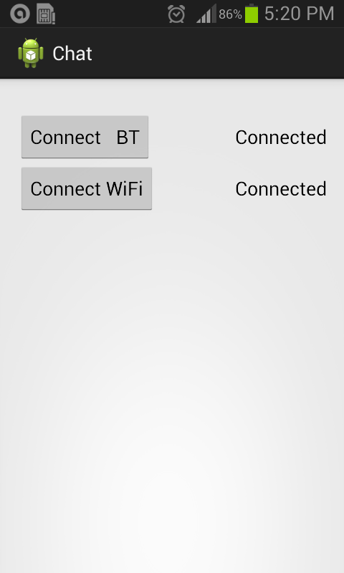
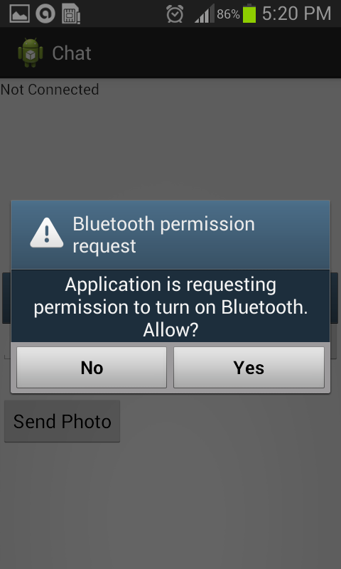
Screenshots of application

Slide 12
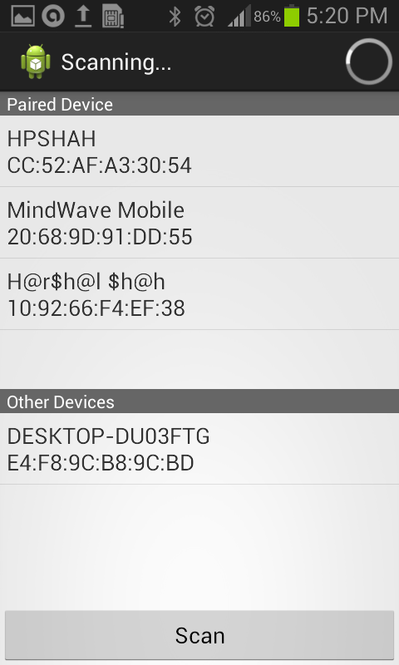
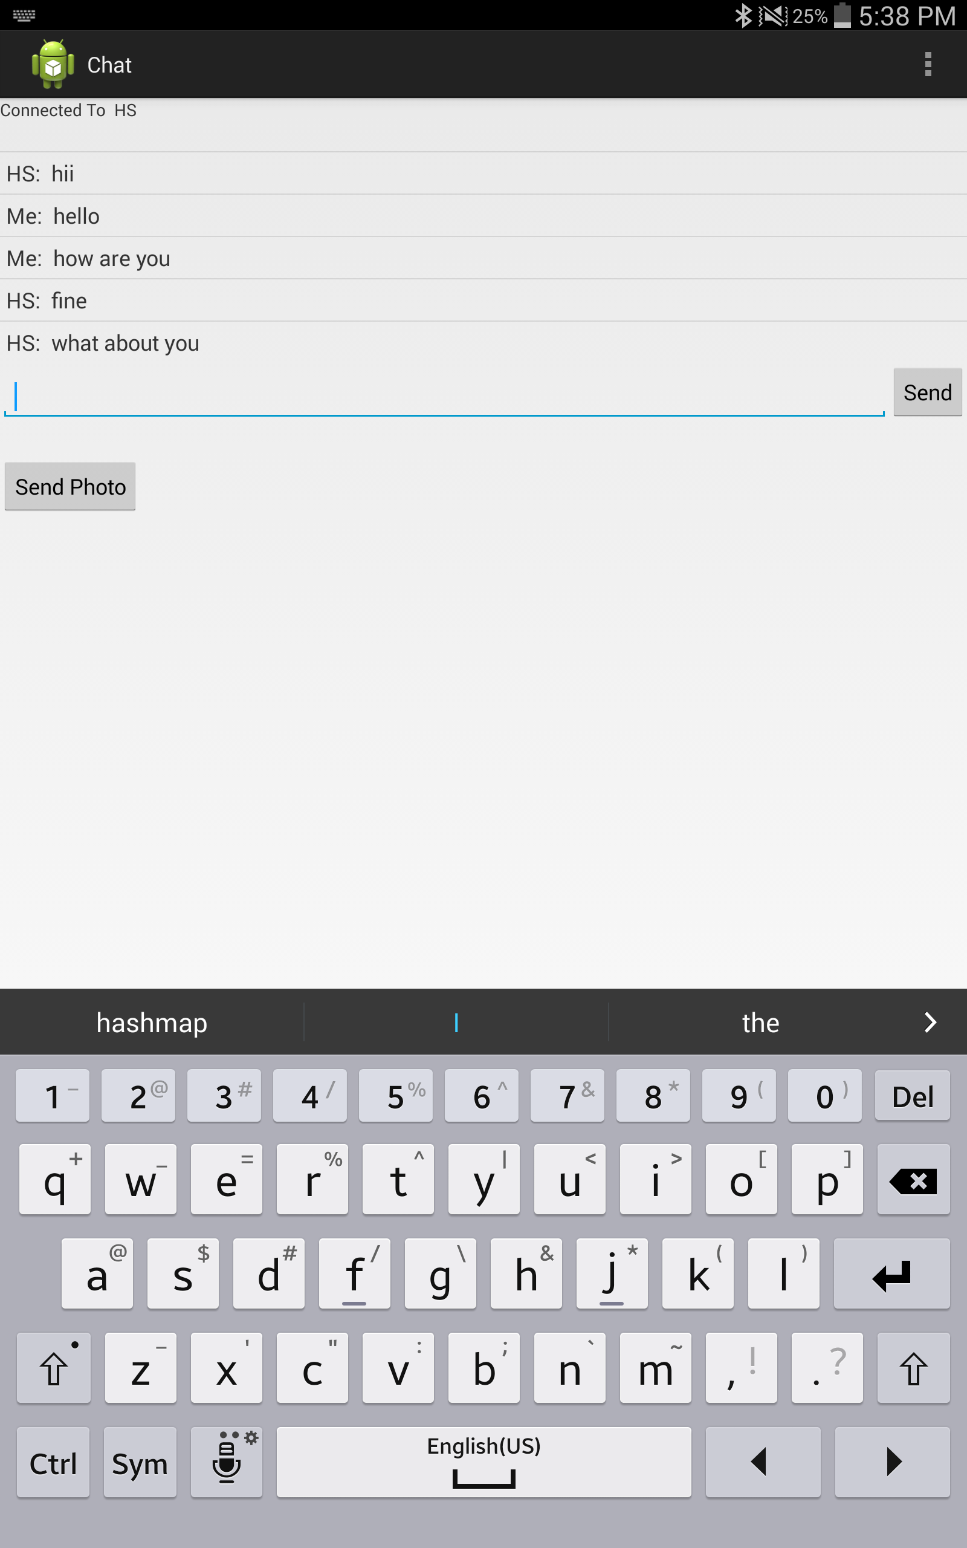
Cont..

Slide 13
Future Work
To implement authentication between device connection using ZRTP protocol
To implement multiple Bluetooth device connection
To implement Group chat room
Make application be able to connect through Wi-Fi direct and create PAN mesh network.

Slide 14
LlVE DEMO

Slide 15
Reference
http://www.scribd.com/doc/6942337/Chat-application#scribd
http://docs.oracle.com/javase/7/docs/technotes/guides/security/StandardNames.html#SecureRandom
http://developer.android.com/guide/topics/connectivity/bluetooth.html
https://play.google.com/store/apps/details?id=com.opengarden.firechat&hl=en
https://itunes.apple.com/us/app/air-chat-encrypted-bluetooth/id583584427?mt=8

Slide 16
Questions ?

