Slide 1
Two Factor Authentication with SMS and Voiceprint Challenges
Created By : HARSHAL SHAH

Slide 2
Introduction
Two-factor authentication (also known as 2FA or 2-Step Verification) is a technology that provides identification of users by means of the combination of two different components.
These Components may be:
Something you know ( PIN or Password )
Something you possesses (Mobile devices or smart card)
Something which is inseparable from you (biometric fingerprint)
There are many approaches developed for two factor authentications. One time password is one of the most general approach adopted by most of the service providers for authentication.

Slide 3
2FA with SMS and voiceprint challenge
Uses a general cellphone as an authentication device.
Possession authentication is achieved by receiving an SMS
Biometric authentication is achieved by calling the telephone number written in the SMS and accompanying voiceprint authentication

Slide 4
Architecture
Architecture : Contains PC, cellphone and server
PC :A general terminal, such as PC/tablet, of a legitimate user (Alice), can be equivalent to a cellphone.
Cellphone: A general cellphone with caller ID has voice communication and SMS functionality.
Server: A server is connected to the PC via the Internet and the cellphone via the telephone network. The server receives a service request from the PC and sends a user authentication request. If the server successfully makes it in user authentication, it offers a service to the PC. The server has many different functions such as WEB server, interactive voice response, voice recognition, voiceprint determination, SMS transmission, and database.

Slide 5
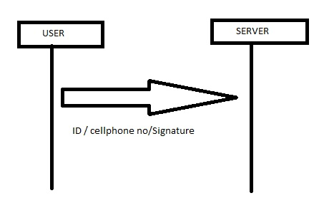
Registration PHASE
STEP 1 Authentication Request : A user writes his/her ID, cellphone number, and his/her signature, sends the information to the server's operator (XYZ-Bank)

Slide 6
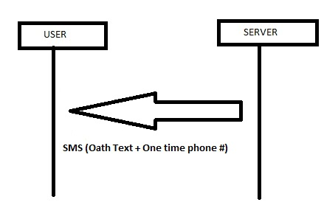
Cont.
STEP 2 SMS: A server sends an SMS that contains the oath text and onetime phone number which will be changed at every session to the phone. For example, "This is XYZ -Bank. Please call 111-1111-1111 and read it in 1 minute. OATH TEXT; I, Alice, register my voiceprint to XYZ-Bank. My birthday is XYZ". The oath should contain text that changes every time, such as the date, to increase the accuracy of the voiceprint registration.

Slide 7
Cont.
STEP 3 Voice call: The user will call the onetime phone number in the SMS, and the server responds to the incoming call.
STEP 4 Oath Recording: User will read the oath; the server checks if the user read the oath correctly by using voice recognition.
STEP 5 Authentication Complete: The server records the oath, voiceprint date, ID, and phone number.

Slide 8
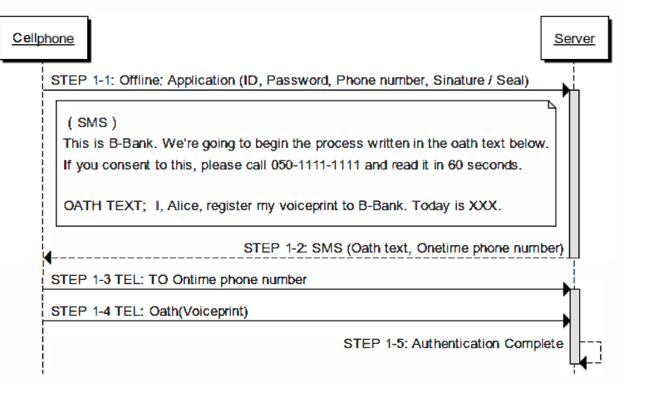
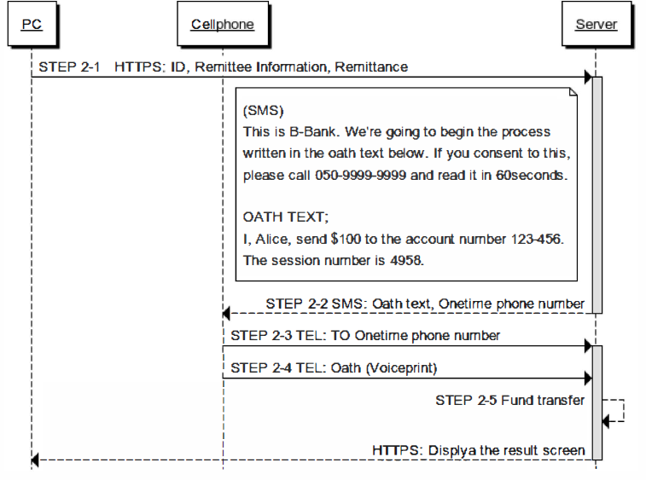
Registration/Login PHASE
Notes:
Image Ref : http://ieeexplore.ieee.org/xpl/articleDetails.jsp?arnumber=6750207 )

Slide 9
Advantages
This method is supposedly effortless in term of memorization and also scalable to user.
This method is supposed to be physically effortless and easy to learn as it only requires to be receiving SMS and reading Oath.
This method is resilient to physical and internal observation, and theft of device because adversary cannot copy the same voiceprint by eavesdropping oath text or SMS or voice calls.
Adversary cannot reuse the voiceprint which is recorded illegally from the legitimate user, because the oath text changes each time.

Slide 10
Drawbacks
This method is not useful for blind person because of reading oath text messages.
Method can be expensive because of SMS charges per user to send the Oath text and also for call back.
System may be expensive because of voice recognition, voice authentication and telephone authentication functionality.

Slide 11
REFERENCE
https://en.wikipedia.org/wiki/Two-factor_authentication
Sagar Gajbhar, Shrikant Aher, Swapnil Auti, Shailesh Hodge “Authentication using Mobile phone generated OTP”, International Journal of Computer Science and Management Research May 2013 , Vol 2 Issue 5 May 2013, ISSN 2278-733X.
https://en.wikipedia.org/wiki/One-time_password
“SV-2FA: Two-Factor User Authentication with SMS and Voiceprint Challenge Response”, The 8th International Conference for Internet Technology and Secured Transactions (ICITST -2013).http://ieeexplore.ieee.org/xpl/articleDetails.jsp?arnumber=6750207

Slide 12
Questions or any suggestions?

Slide 13
Thank you
Guided By : Dr. Mehrdad Aliasgari

