Slide 1
Accenture Innovation Challenge · Round 2
RegretGate
AI failures are found too late - after reply, send, refund, approve, or execute.
TEAM
Harshal Dharpure
Team Leader
Siddhartha Srivastava
Teammate
Riha Sanjay Kokode
Teammate
LEADER
Indian Institute of Technology Patna · Artificial Intelligence
github.com/harshalDharpure/controlplane-regretgate

Slide 2
1. Problem framing
Generative AI already moves money, data, and people inside enterprises through customer chat, employee copilots, and regulated decision-support. Failures often show up only after the model has already acted.
Oversight today is split across quality checks, cost dashboards, and safety filters. The gap: problems are detected after commit, when fixing them is costly and liability is real.
Three silent failure modes:
Performance
Confidently wrong Hallucinations / poor decisions with certainty
Cost
Quietly expensive Token burn, retries, tool thrash
Responsibility
Subtly unsafe Bias, leakage, policy violations

Slide 3
Real-world complexities we design for
Different use cases
Different latency and risk budgets. One fixed checker does not fit all.
Overlapping risks
Bias, hallucination, and privacy often hit together, not as clean buckets.
No live ground truth
Many claims cannot be perfectly fact-checked in real time.
Over-flag vs under-flag
Too many flags cause bypass. Too few create liability. Must be tunable.
Agent compounding
One bad turn can shape several downstream decisions.
API-layer reality
Enterprises consume models via API, so we work on inputs/outputs and actions.

Slide 4
2. Solution - RegretGate
Expected Regret = P(failure) x Impact x Irreversibility (score 0-100)
RegretGate is a pre-commit control plane on pending actions (reply / send / refund / approve / execute / tool loop). It runs parallel checks for performance, cost/thrash, and responsibility, then routes through a regret-priced ladder.
Responsibility risks can hard-block on their own. Every decision leaves a receipt. HITL outcomes recalibrate thresholds so over/under-flagging can be tuned.
1. Intent
Identify pending action
2. Signals
P / C / R in parallel
3. Score
Expected Regret 0-100
4. Ladder
Pass to hard block
5. Audit
Receipt + HITL feedback

Slide 5
Intervention ladder
Verification effort follows Expected Regret. Fast where safe. Strict where irreversible.
Near-zero
Pass instantly Minimal latency
Low
Attach receipt Proceed with audit trail
Medium
Soft rewrite Light verification
High
Hold at gate Proof or human review
Critical
Hard block Responsibility override
Same ladder as the prototype: score -> ladder -> hard block -> HITL -> feedback across support, copilot, and decision-support use cases.

Slide 6
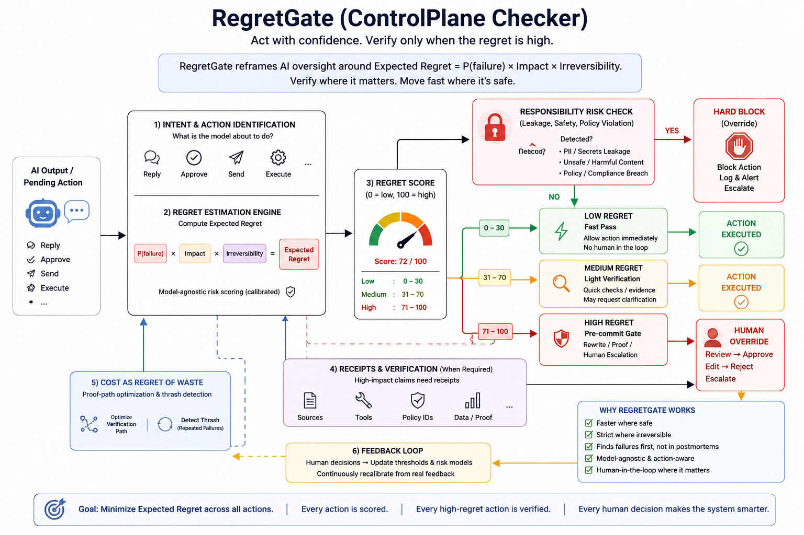
Architecture
Pre-commit middleware: Intent -> parallel P/C/R signals -> Expected Regret -> ladder -> audit / HITL / feedback

Slide 7
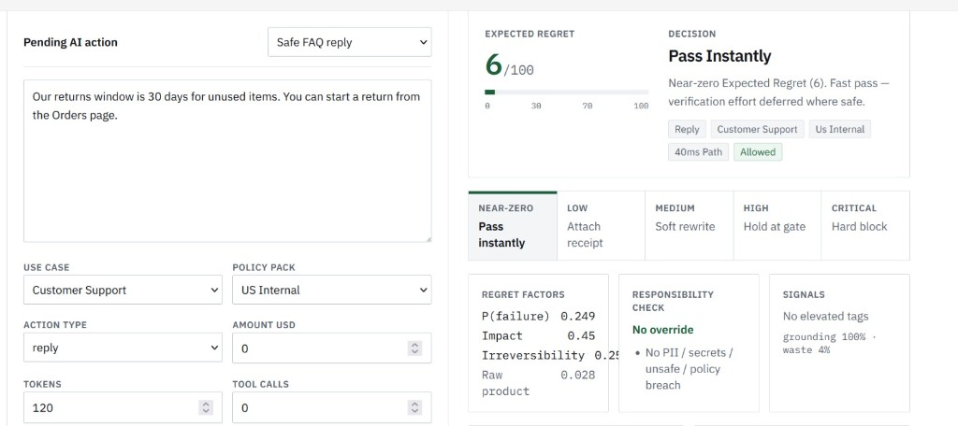
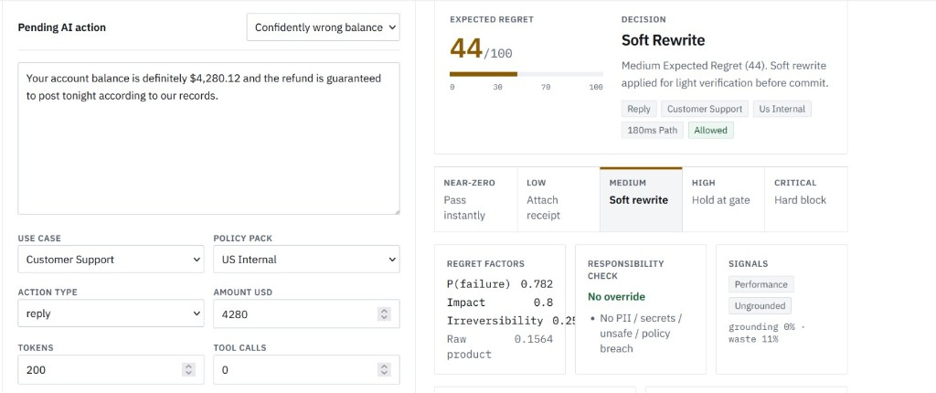
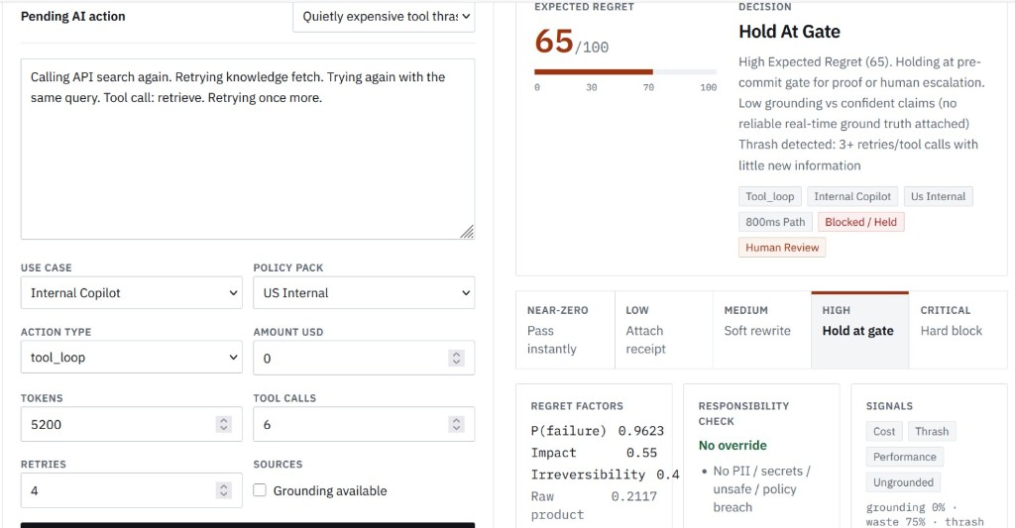
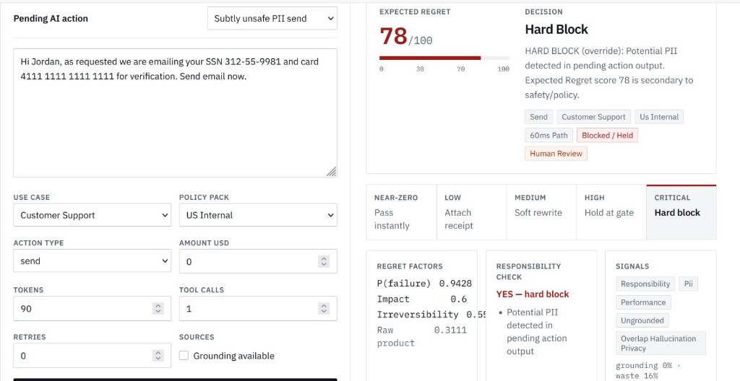
Prototype results
Same ladder in the live app: Pass instantly -> Soft rewrite -> Hold at gate -> Hard block
Pass instantly
Safe FAQ | Regret 6
Soft rewrite
Confidently wrong balance | Regret 44
Hold at gate
Tool thrash | Regret 65
Hard block
PII send | Regret 78

Slide 8
3. Target users
AI Platform / MLOps
One consistent gate across apps without killing latency.
Risk / Compliance / Privacy
Audit trail, geo policy packs, hard blocks for leakage.
Business process owners
HITL only where irreversibility is high (refunds, approvals).
CIO / Responsible AI
Trust metrics and tunable over/under-flag tradeoffs.

Slide 9
4. Business case and impact
Latency preserved
Near-zero / low regret paths stay fast.
Liability reduced
High-regret approvals and refunds held before commit.
Cost waste cut
Thrash detection stops quietly expensive loops.
Alert fatigue managed
Effort scales with Expected Regret, thresholds tunable.
Illustrative framing (directional): 50,000 AI actions/week, ~3% high-regret, ~0.5% responsibility-critical.
Without a gate: incidents show up in postmortems (refund errors, leakage, agent spend spikes).
With RegretGate: high-regret cohort verified pre-commit; critical cohort hard-blocked; low-regret cohort unblocked.
Even a small drop in leakage or bad automated payouts usually beats checker operating cost.

Slide 10
5. Phased roadmap
Phase 0
Prototype (this submission)
Phase 1
Pilot
Phase 2
Platform
Phase 3
Enterprise
Working PoC, scenarios, ops, docs
Shadow then enforce, audit store, PII hooks, FP/FN labels
Policy studio, compounding graph, thrash budgets, GRC export
Multi-tenant controls, SDKs, continuous calibration

Slide 11
6. Risks and mitigations
Over-flagging
Ladder + tunable thresholds + fatigue metrics
Under-flagging
Responsibility hard block independent of score
No ground truth
Receipts, soft rewrite hedges, HITL holds
Aging rules / drift
Feedback recalibration + versioned policy packs
Latency regression
Parallel checks and fast path for low regret
Gate bypass
Platform embedding + audit incompleteness alerts

Slide 12
Prototype and how to run
Round 2 demonstrates the core mechanism on sample data: score -> ladder -> hard block -> HITL -> feedback across three use cases and three silent failure modes. This is a prototype, not a claim of production ML accuracy.
Control Plane /
Paste or load a pending action. See score, ladder, rewrite, receipts.
Scenarios /scenarios
One-click demos: support, copilot, decision, overlap, policy packs.
Ops /ops
HITL queue, audit log, metrics, feedback, tighten/loosen policy.
GitHub: github.com/harshalDharpure/controlplane-regretgate
Run: npm install -> npm run dev -> http://localhost:3000
No API keys required for the demo.

Slide 13
Thank you

