Slide 1
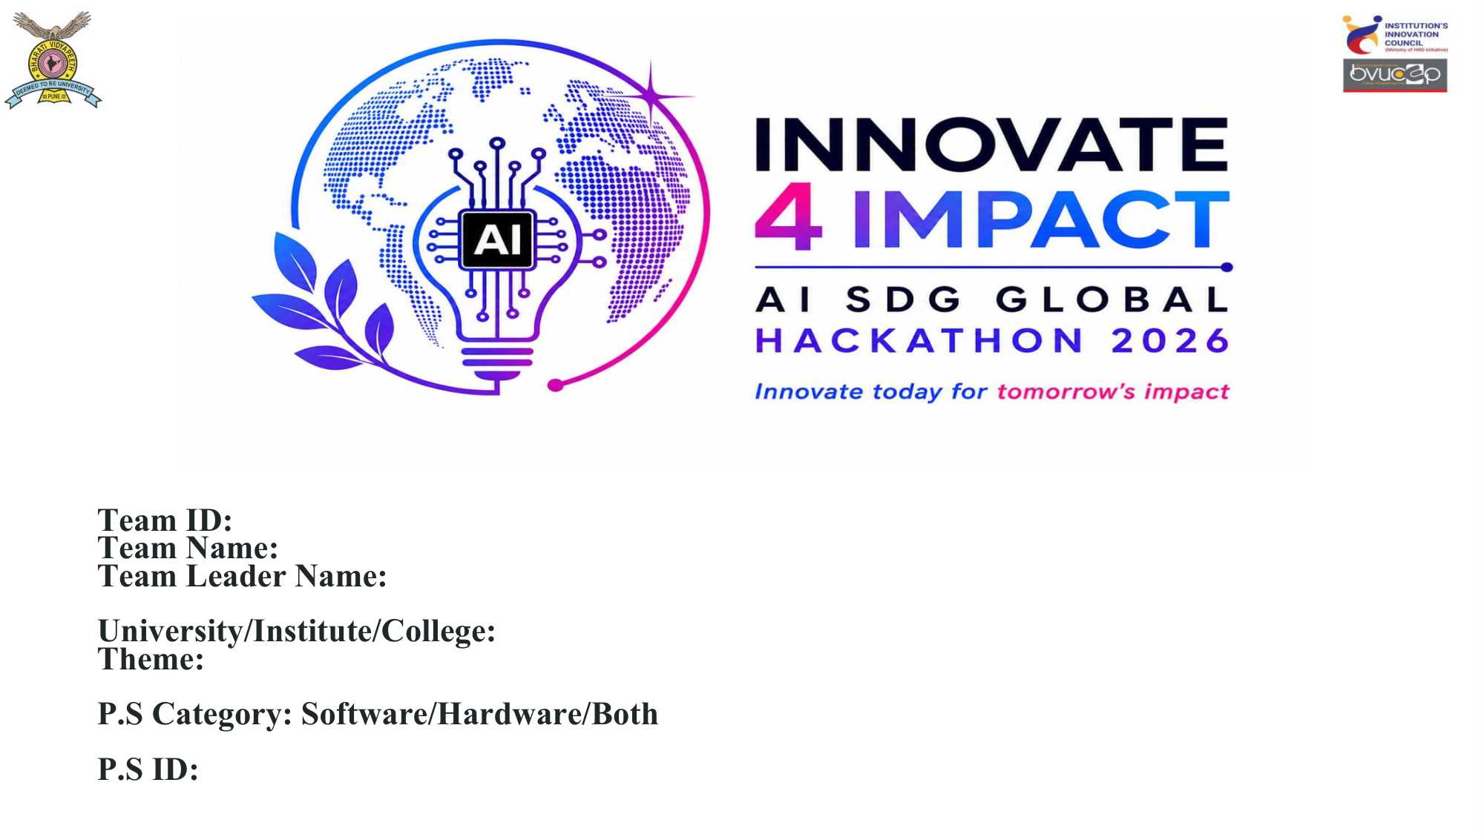
Team ID: [Enter ID]
Team Name: [Enter Name]
Team Leader Name: [Enter Leader]
University/Institute/College: [Enter Details]
Theme: Hardware / IoT
P.S Category: Software/Hardware/Both
P.S ID: [Enter PS ID]

Slide 2
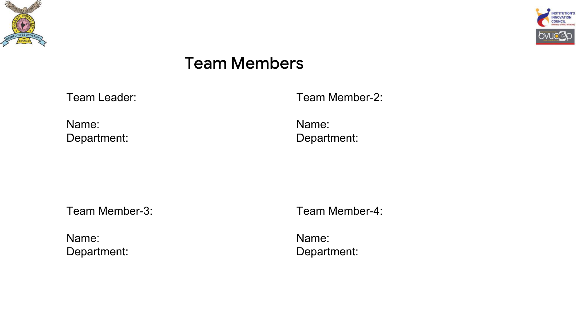
Team Leader: [Name] - [Department]
Team Member 2: [Name] - [Department]
Team Member 3: [Name] - [Department]
Team Member 4: [Name] - [Department]

Slide 3
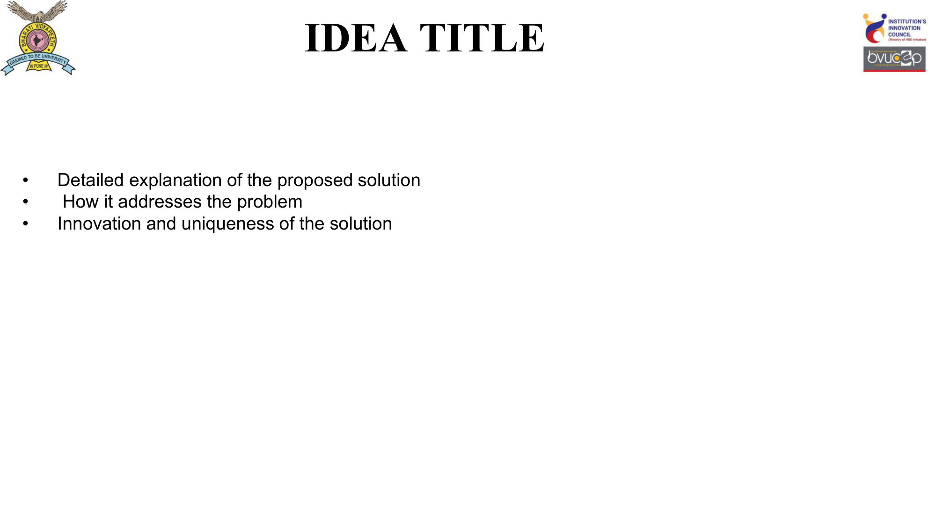
Voice-Guard: Standalone IoT Women's Safety Device
• Proposed Solution:
A discreet, wearable device (ESP32 + SIM800L) that sends instant SOS SMS alerts with location directly to guardians via cellular networks, entirely bypassing the need for a smartphone or Wi-Fi.
• How it addresses the problem:
In emergencies, unlocking a phone or finding an app is nearly impossible. Voice-Guard provides an immediate 1-button panic response.
• Innovation & Uniqueness:
100% Offline operation. Configured securely via a Web-USB app. Includes an Android Guardian App that intercepts the SMS to override silent mode and sound a siren.

Slide 4
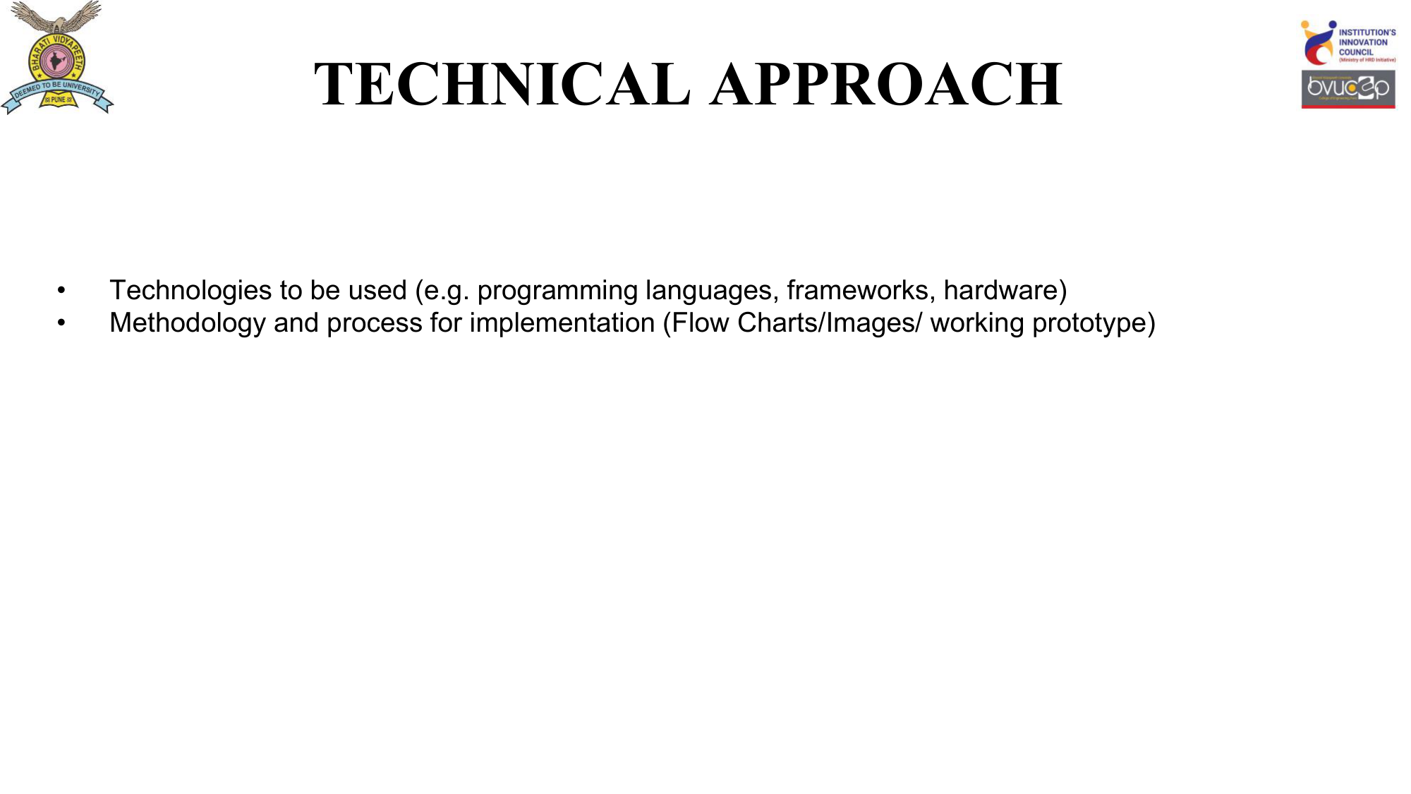
Technologies Used:
• Hardware: ESP32 Microcontroller, SIM800L Module, Li-Po Battery, TP4056.
• Software: C++ Firmware, Web Serial API (Configurator), React Native/Expo (Android App).
Methodology (Flow):
1. Setup: User plugs device into PC -> Web App pairs via USB -> Contacts flashed to NVS memory.
2. Trigger: SOS Button pressed -> ESP32 wakes -> SIM800L dispatches SMS via cell tower.
3. Action: Guardian App receives SMS -> Bypasses silent mode -> Maps live location.

Slide 5
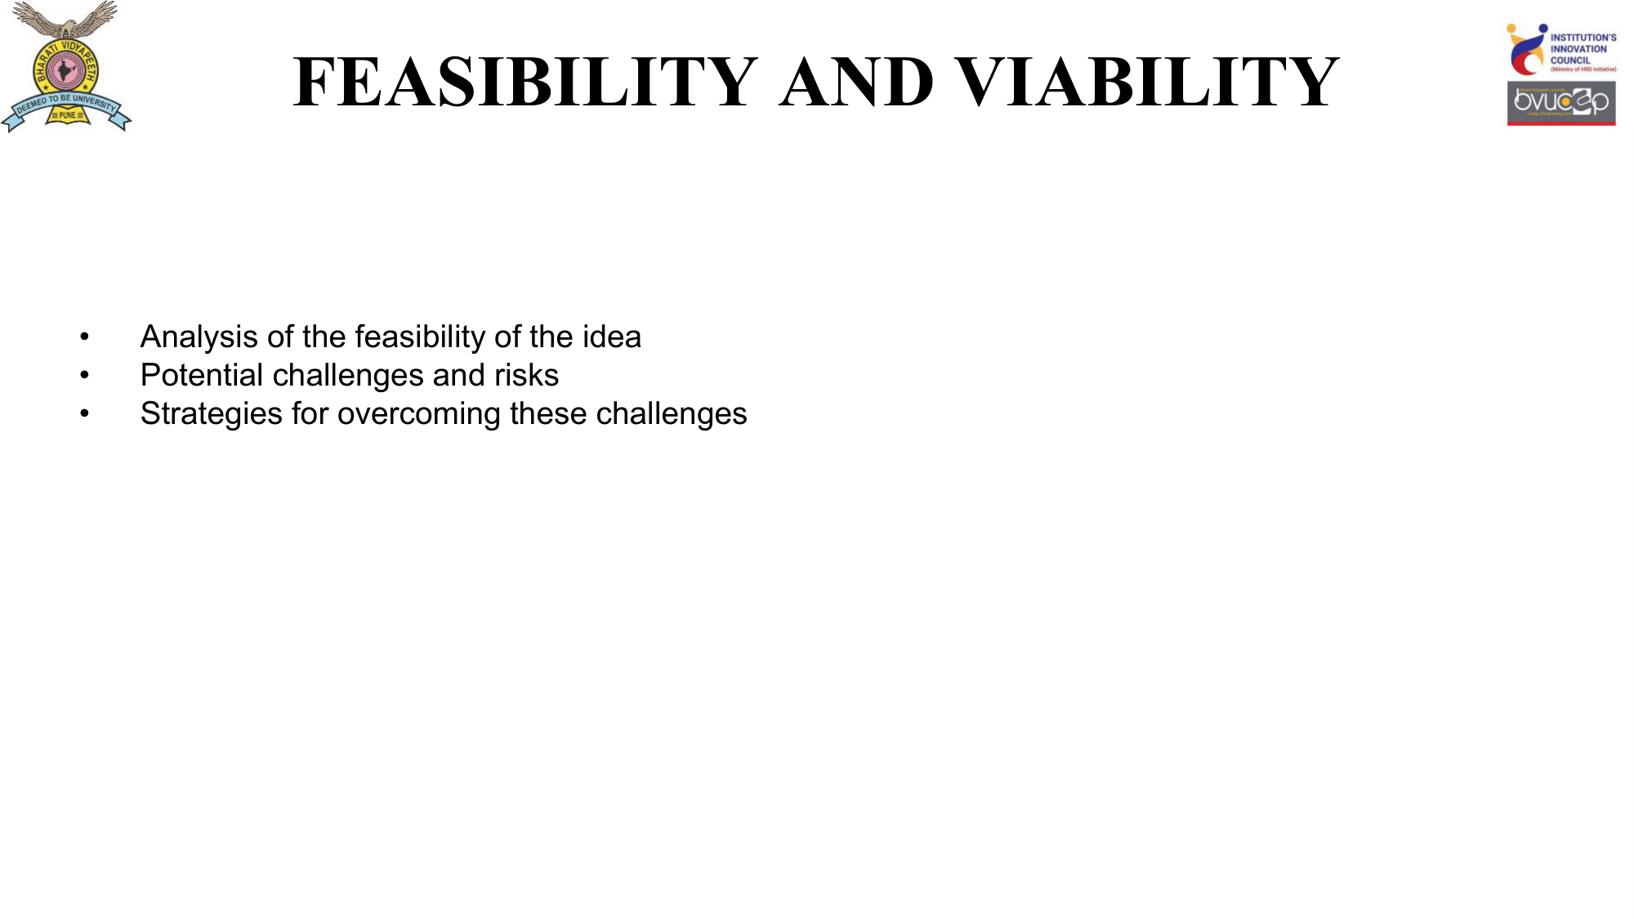
• Feasibility:
Highly feasible. The core components (ESP32 and SIM800L) are inexpensive and mass-produced. Standard 2G/4G networks provide ubiquitous global coverage for SMS.
• Potential Challenges & Risks:
1. Cellular dead zones (basements).
2. Battery degradation over time.
• Mitigation Strategies:
Implemented an ESP32 deep-sleep mode, extending battery life to weeks on a single charge. Added a localized loud buzzer to act as a physical deterrent if SMS fails to send.

Slide 6
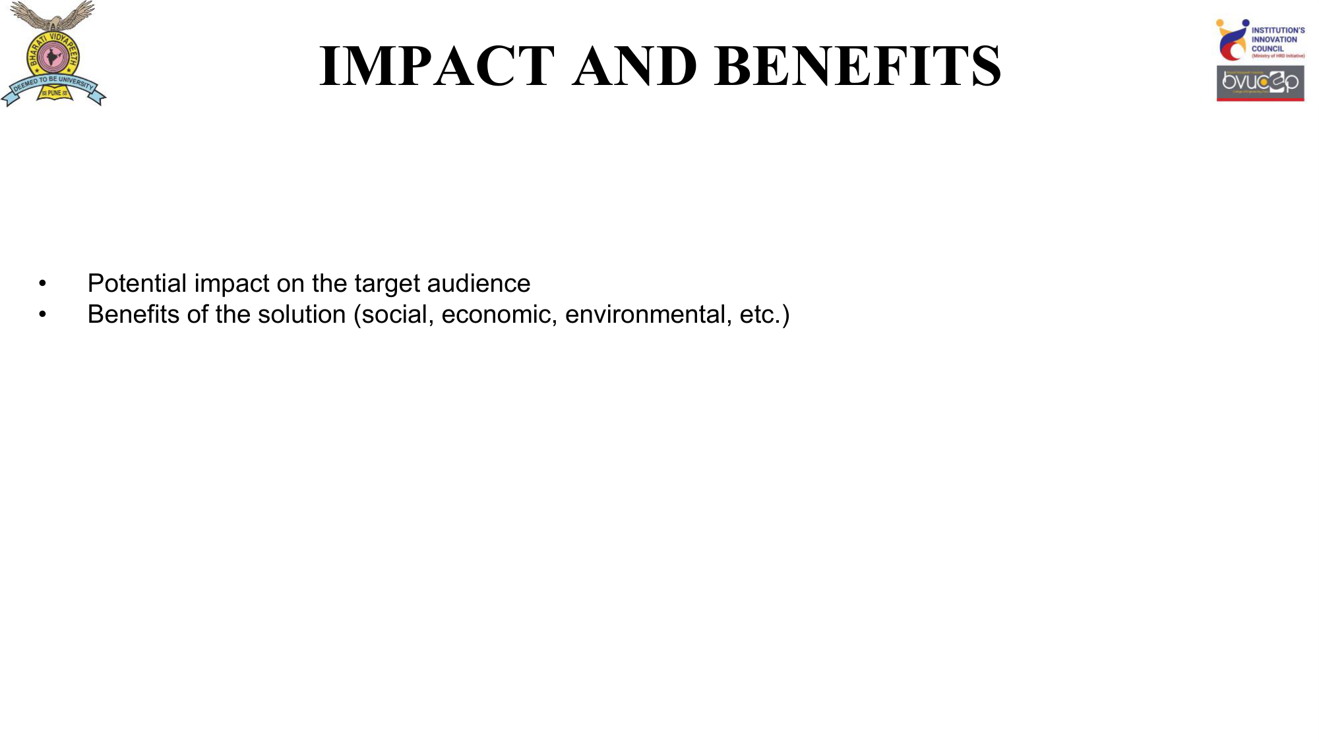
• Potential Impact on Target Audience:
Provides immediate peace of mind for women traveling alone, night-shift workers, and students. Dramatically reduces response times during critical incidents.
• Benefits of the Solution:
1. Social: Empowers users with a reliable safety net, discouraging predatory behavior.
2. Economic: Designed for affordability (~₹650 per unit in bulk), making life-saving tech accessible across all income demographics.
3. Technological: Bridges the gap between raw hardware and consumer-friendly apps.

