Slide 1
Trade the call.
Check the caller.
Buy from the post on X, with the caller's real record right next to it.
xtradingnow.xyz
Notes:
Xtrading puts a trade card and the caller's track record right under a post on X. Trade the call. Check the caller.

Slide 2
Calls travel fast. The proof doesn't.
1
2
3
Someone posts a call
You act on it by hand
If they were wrong, it vanishes
“$ETH to 3k this week.” Thousands of people see it.
Copy the ticker. Open an exchange. Hope they were right.
The post quietly gets deleted. Nothing is left to check them against.
Xtrading closes that gap: the trade and the track record sit on the post itself.
Notes:
Crypto Twitter runs on calls. Acting on one means copying a ticker and hoping. If the caller was wrong, the post quietly disappears.

Slide 3
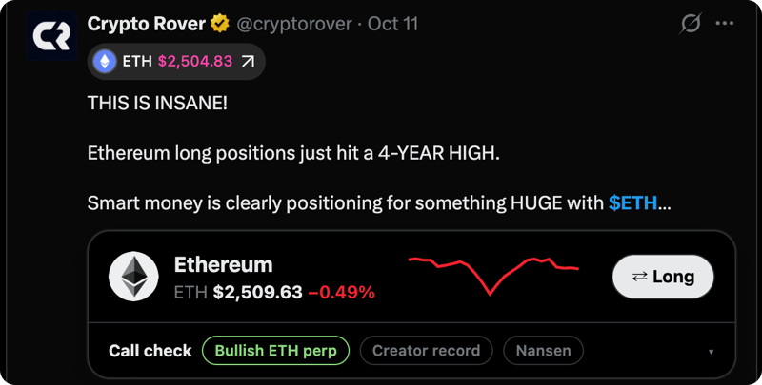


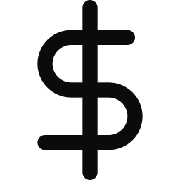
A trade card right under the post
Trade it
Spot on Kuru, perps on Perpl. You approve in your own wallet.
Check the caller
Call record, red flags and a Nansen wallet check, right on the card.
Creators get paid
A real post on X with the Xtrading card under it. The Long button and Call check chips come from the extension.
When a creator has linked a payout wallet, a 0.1–2% fee goes to it in the same transaction as your buy.
Notes:
A bullish ETH post gets a Long card under the text. The chips under it are the call check: what the post says, the creator's record and the Nansen wallet check.

Slide 4






From post to proof in six steps
1
2
3
4
5
6
See the call
Check it
Quote
Sign
Settle
Prove it
A post on X gets a trade card.
Creator record, red flags and Nansen.
Simulated on Kuru's order book. Exact minimum out.
Your own wallet approves the exact amount.
Swap and creator fee in one transaction.
Envio indexes it, checked against the receipt.
Xtrading never signs anything and never holds your keys.
Notes:
X for the post, Nansen for the check, Kuru for the quote, Privy for the wallet, Monad for settlement, Envio for the receipt.

Slide 5
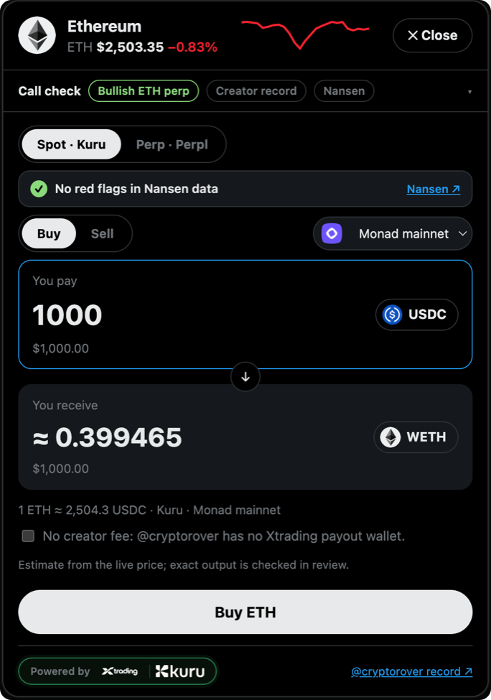
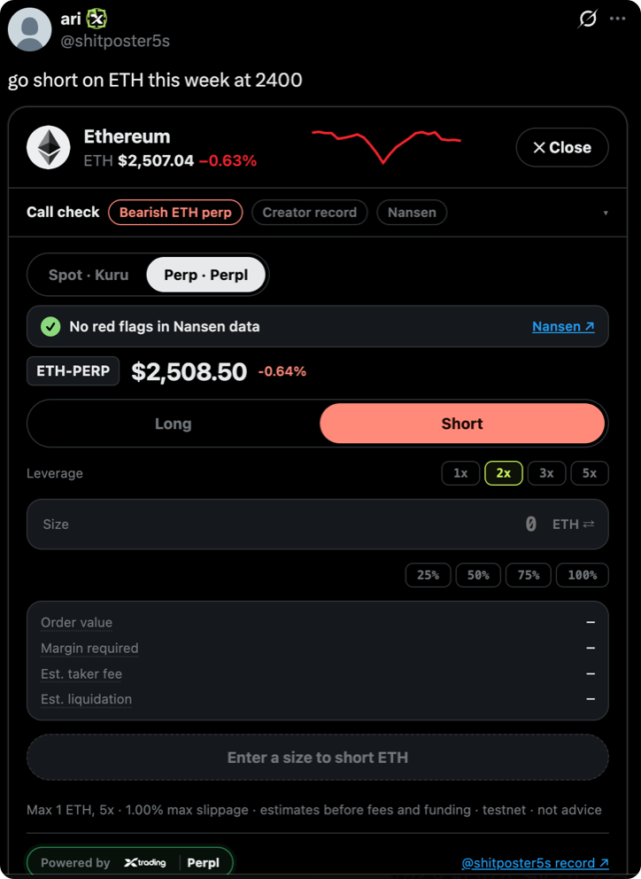
Trade from the post, never leave X
Spot on Kuru
MON, WETH and cbBTC against USDC. The quote is simulated on the live order book, so the minimum you approve is what the chain enforces.
Perps on Perpl
Only when a call says long or short. Leverage from 1x to 5x, with size caps.
Every transaction is shown to you and signed by your own wallet.
Notes:
Spot trades settle on Kuru's order books on Monad. Perps go to Perpl, only when the call explicitly says long or short.

Slide 6
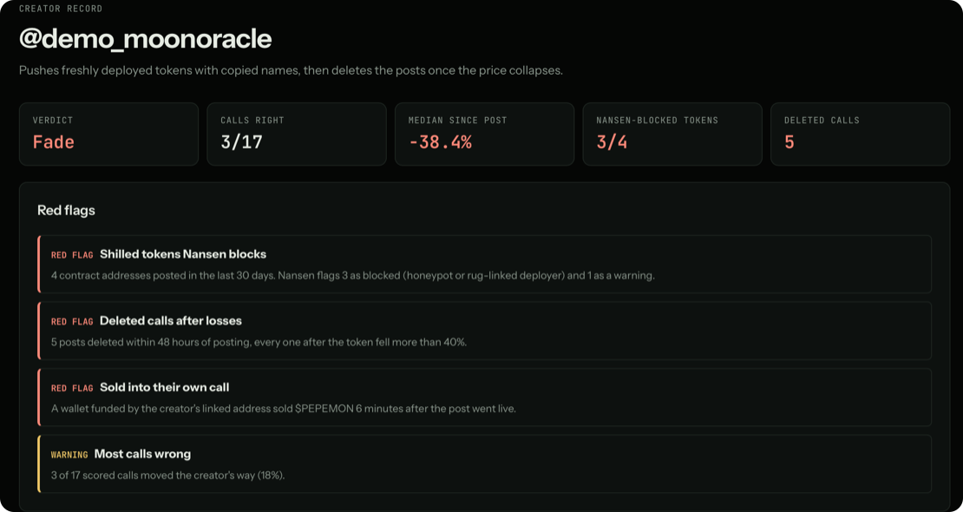
Check the caller before you trade
Call record
Each call is priced when it's posted and scored at expiry. Hit rate comes from prices, not screenshots.
Red flags
Deleted posts, selling into their own call, being wrong most of the time.
Nansen wallet check
Did they buy what they told you to buy, or sell into it?
Demo profile with sample data, as it appears in the trader dashboard.
Notes:
Every creator gets a public page: verdict, hit rate, median move since posting, deleted calls, red flags and Nansen screening of the tokens they shill.

Slide 7
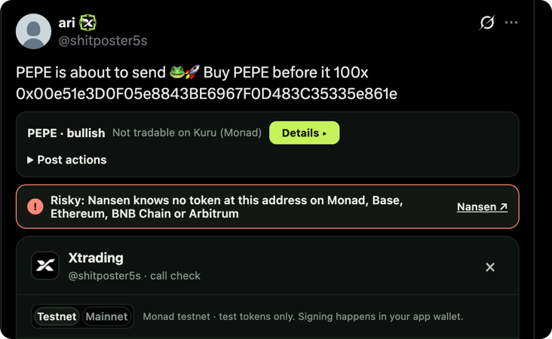
Catch a fake token before you click
A post shills “PEPE” and drops a contract address.
Nansen knows no token at that address on Monad, Base, Ethereum, BNB Chain or Arbitrum.
The card shows a red warning and offers no trade.
For well-known tickers it names the real contract: “The post says PEPE, but this isn't PEPE's contract. The real PEPE is 0x6982…1933 on Ethereum.”
Notes:
The warning appears under the post, before anyone clicks. The token address is checked against Nansen across the chains it covers.

Slide 8
Creators earn a fee on every buy
TIER
CUT OF EACH BUY
WHAT IT TAKES
The fee is paid to the creator's wallet in the same transaction as the buy.
Verified
0.1%
X account bound to a payout wallet
Pro
0.5%
5+ scored calls, 50%+ right
Max
1%
15+ scored calls, 60%+ right, positive median return
No invoice, no payout queue. Envio indexes every payment and each one is checked against the receipt.
Ultra
2%
30+ scored calls, 65%+ right, positive median at 7 days
Red flags demote a creator. No staking needed.
Notes:
Tiers are earned from scored calls and set the creator's cut. The fee is disclosed on the trade card before you sign.

Slide 9

Plug in an agent
ENDPOINT
https://xtradingnow.xyz/api/mcp
Connect Claude Code or any MCP client.
IN CLAUDE CODE
claude mcp add --transport http xtrading https://xtradingnow.xyz/api/mcp
Agents can read a creator's record, spot a trade call in a post and prepare a trade.
They can't sign, withdraw or move funds. You approve every trade.
Notes:
The MCP server is at xtradingnow.xyz/api/mcp. Agents prepare trades; the user signs them.

Slide 10

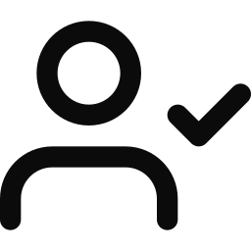

Built to be checked, not trusted
Your keys stay with you
A verified account isn't a track record
Receipts over claims
Xtrading prepares an exact transaction. Your wallet signs it. No hidden relayers, no blanket approvals.
Who someone is, how their calls did and what their wallet made are three separate things. We show them separately.
A submitted order isn't a fill until the chain says so. When a data source is down, the app says so.
Notes:
Three rules the product is built around: keys stay with users, identity is not performance, and receipts beat claims.

Slide 11

Built with
Kuru
Privy
Envio
Spot trades on Monad order books. Kuru Flow pays creator fees in the same transaction.
Sign in with X, embedded wallets and transaction signing.
Indexes swaps and creator payments, checked against receipts.
Nansen
Perpl
Monad
Wallet and token checks on creators and posts.
Perps for explicit long and short calls, from your own account.
Fast enough that trading from a post feels like a button.
Notes:
Kuru, Privy, Envio and Nansen are the core stack. Perpl handles perps and Monad is the chain.

Slide 12
Real trades, live on Monad
Buy MON with 1 USDC on Kuru
0x54a1…13fc
Sell the MON back to USDC
0x496c…6d1e
Buy through Kuru Flow, with a 0.1% creator fee paid to the creator's wallet in the same transaction
0x450e…d64c
No Xtrading contract sits between your wallet and the order book.
Creator payments, live: xtradingnow.xyz/dashboard/onchain
Notes:
These are the transaction receipts listed in the README, viewable on monadvision.com.

Slide 13

Why we're building it
Put the context in the moment of decision.
Traders
Creators
Agents
Inspect the record, then approve your own trades.
Build credibility through evidence, not just attention.
Read the same evidence and prepare trades. You sign them.

Slide 14

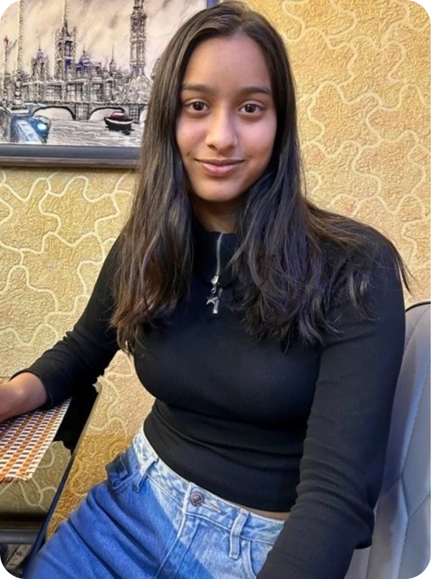
The team
Harshal Bhangale
Anushka Somani
CEO @ Airlegal Technologies
Blockchain Developer
Processed insurance claims for 300K+ claimants at ClaimTech
BS in Data Science & Applications, IIT Madras
45+ hackathon wins across Web3 and AI
IIT Dhanbad, Mnc '28
Former SDE Intern @ Flipkart, GWC 7.0
5x Web3 hackathons, open source contributor
Built for the Monad hackathon, Onchain Finance & Trading track.

Slide 15
Check the call,
not just the caller.
Sign in with X, install the extension and trade from the post.
xtradingnow.xyz
@Xtradingnow on X

