Slide 1
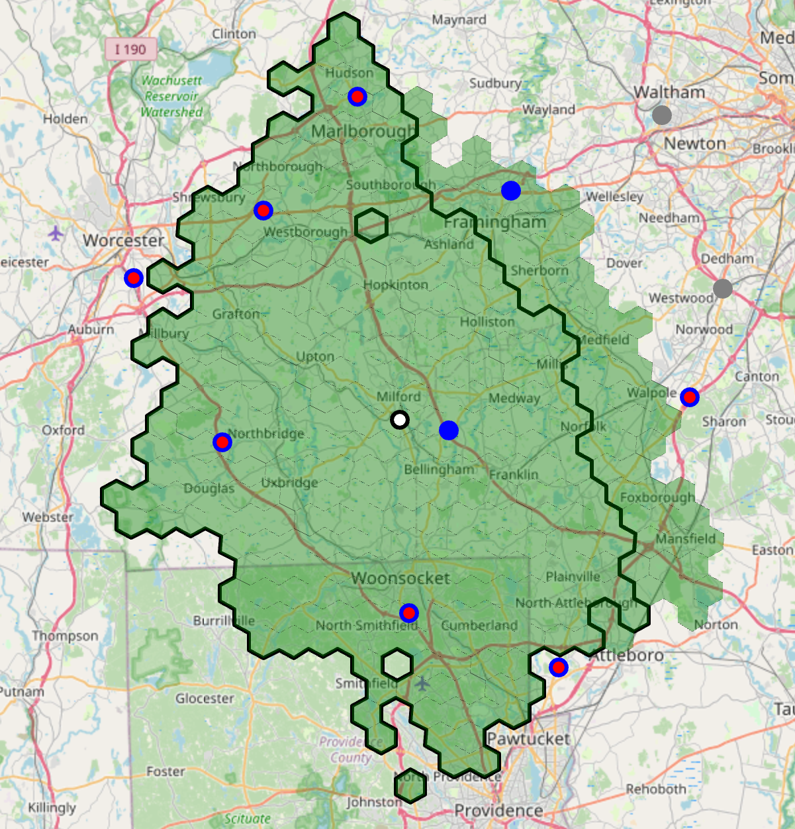
Milford, MA
$2.2M Total Request
$2.2M Capital Investment
$0.0M Opex Investment
Capacity | Speed | Coverage | Assortment
✅​ | ✅​ |  | ​​
Location
Volume Target
 | Year 1 | Year 2 | Year 3
OPD Orders / Day | 320 | 511 | 639
Internalized Parcels | 250 | 300 | 400
Newton
Financials
Westwood
Market 156 GMV: $1.0B (FY25) | Depot
 | Year 1 | Year 2 | Year 3 | Year 7
Depot Increm GMV | $5M | $8M | $10M | $16M
Depot Cannibalized GMV | $3M | $5M | $6M | $9M
Total Depot GMV | $8M | $13M | $16M | $25M
Store Backfill GMV (net) | $3M | $4M | $6M | $9M
Total Increm GMV | $10M | $17M | $21M | $34M
IP GMV | $3M | $3M | $4M | $16M
Gross Profit | $2M | $4M | $5M | $8M
SG&A | ($4M) | ($6M) | ($8M) | ($10M)
IP | $0M | $0M | $0M | $1M
Depot Op Inc | ($3M) | ($2M) | ($2M) | $0M
GP % of Sales | 18% | 24% | 23% | 25%
SG&A % of Sales | 42% | 38% | 35% | 30%
Milford
Approved Walmart Depot
New REC Walmart Depot
Upcoming Walmart Depot
SUP
D1
NHM
Reachable HH (45mins)
Unique HH
Digital Overview
Milford Walmart Depot uniquely covers 270K HHs, with additional 130K HHs overlapping with nearby Walmart Depots
Of the 270K unique HHs, 13% can receive < 30mins delivery promise (15mins drive time)
Guiding Principles
Physical Attributes |  | Deal Terms |  | Business Model
Sq. Ft. | 13.6K | Lease Terms | Good | Volume | Good
Parking | Good | Occupancy | Ideal | Investment | Good
Dock | Ideal | Contingency | Good
MEP / HVAC | Good
Overall | Good | Overall | Good | Overall | Good
Notes:
Add store sales.
Add rank for digital
How many Walmart Depots already approved (Rosedale in Aug, asking for 3 more)
Add when in FY26 we launch Farmingdale (quarters for everything)
Why have we not launched IP already
Add milky way data in the notes
Get a soundbite on incrementality from speed with IP

