Slide 1

Submitted By Harshal Bondre

Slide 2
Things to know before:
Data provided is for strictly 2000 reviews by customers on Skytrax.
Various methods may produce different results.

Slide 3
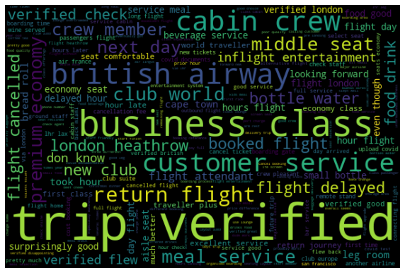
Word cloud:
Findings:
Most of the reviews were done by verified customers. This may conclude that most of the customers are repeters.
Most of the customers use business class
There’s always to talk about cabin crew and customer service
Customers books return flight from same

Slide 4
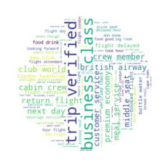
Word cloud #2:

Slide 5
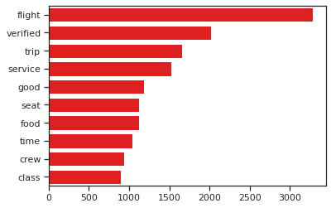
Frequency Distribution of words:
Findings:
As we can see ‘GOOD’ words have actually noticeable frequency among other words. This could mean the customer is satisfied.
Also. Service, food, seat, crew are major focus points according to customers.

Slide 6
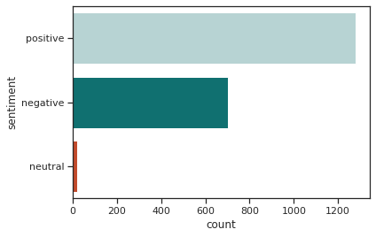
Sentiment results: Bar of Overall sentiments
Findings:
We can clearly see that there are majority of positive reviews by customer.
Although negative reviews are not in majority but we can see than they are nearly more than half of positive reviews. Which is questionable.

Slide 7
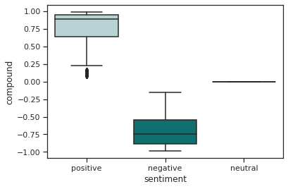
Results #2: Boxplot of Compound by sentiment
Findings:
We can see that all three i.e Positive, Negative and neutral is not evenly distributed. Thus, we need to think about solutions.

Slide 8
Thank You

