Slide 1
Case Studies

Slide 2
Types of chargers
Three main types of chargers mainly: Level 1, 2, DCFC.
Add this intro paragraph (page 4 of ICCT – Assessment paper)
With increasing BEV adoption, more reliance on the public Level 2 and DC chargers will rise from 2025 – 2032
Level 2 at home, workplace, public: 7.2 kW/ 14 kW
DCFC: 50 kW, 150 kW, 350 kW.

Slide 3
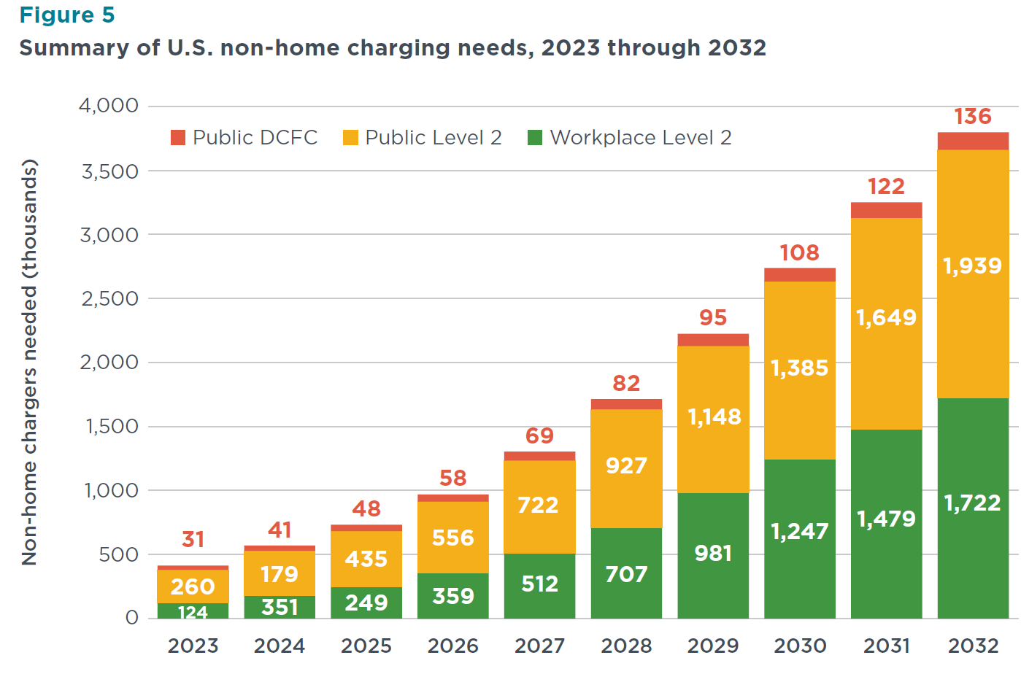
US Non-home Charging Needs
414,000 from 2023 to 2.7 M in 2030 and 3.8 M in 2032.

Slide 4
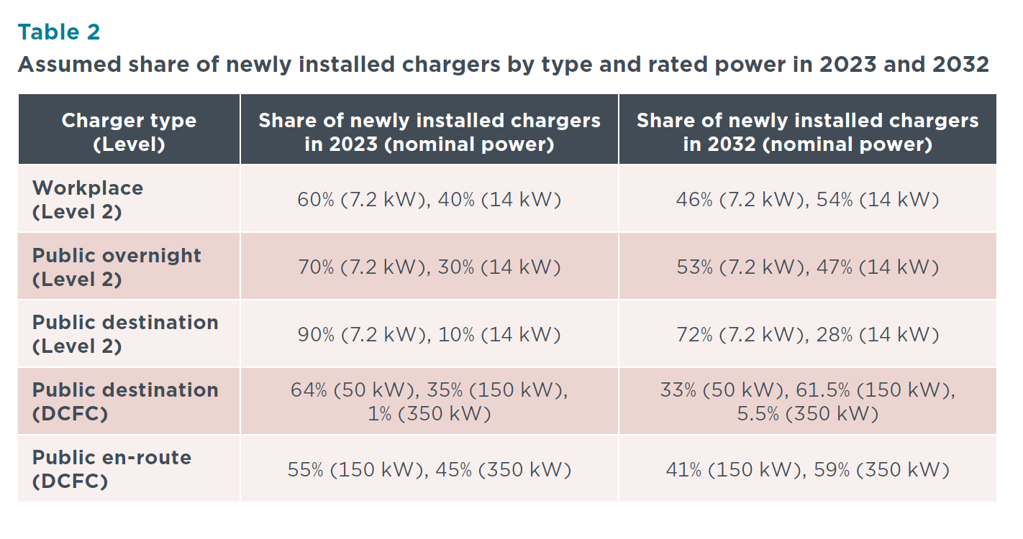
Newly installed chargers by type and power

Slide 5
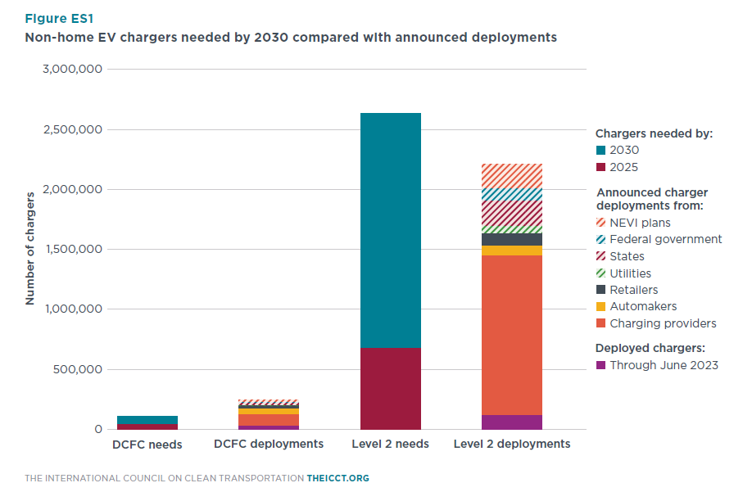
Level 2 expansion
Reference: Assessment of U.S. electric vehicle charging needs and announced deployments through 2032, ICCT

Slide 6
Cost to install chargers
Hardware cost (per charger): $ 3127 for Level 2 (networked).
Installation costs:
1 port per site: $ 2836
2 ports per site: $ 3020
3-5 ports per site: $ 3090
6+ ports per site: $ 2305
Different cases depending on expansion plans:
Experiment and cases: Expansion existing stations and the introduction of new stations
Number of ports

Slide 7
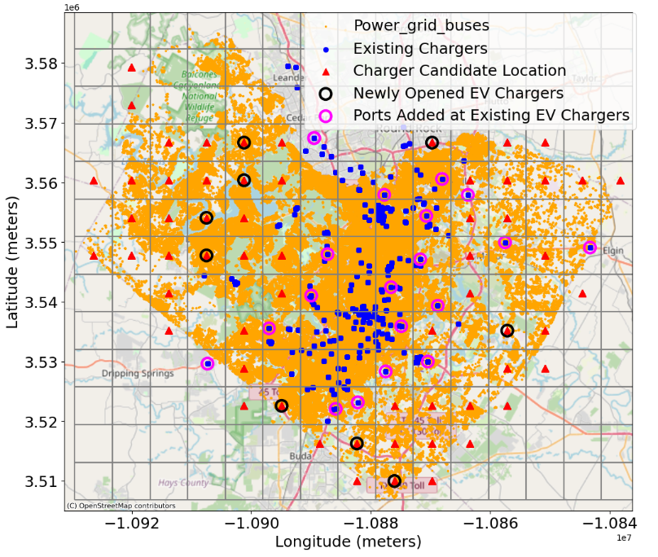
Experiments
Experiment 1: Newly open stations with fixed ports
Experiment 2: Newly opened stations with variable ports

Slide 8
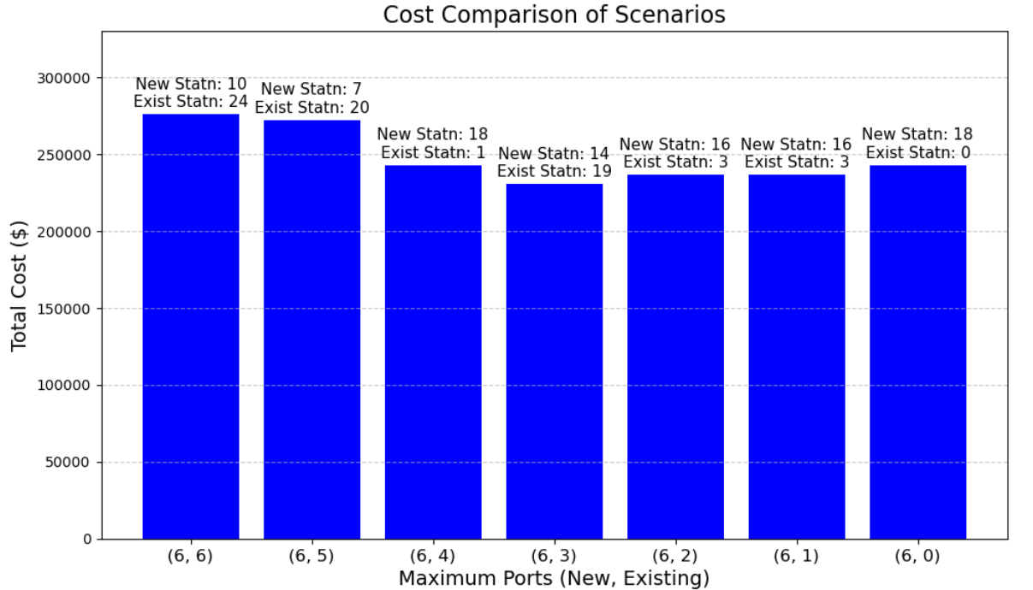
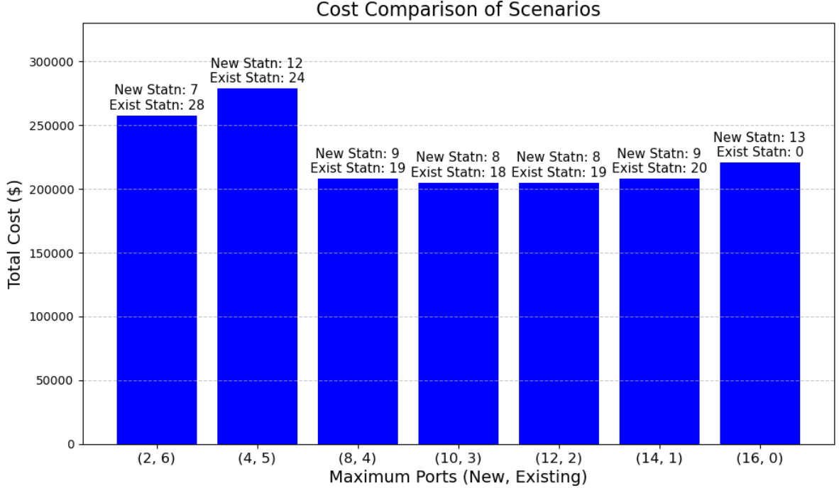
Initial costs
Experiment 1 (Case 4) Experiment 2 (case 3)

Slide 9
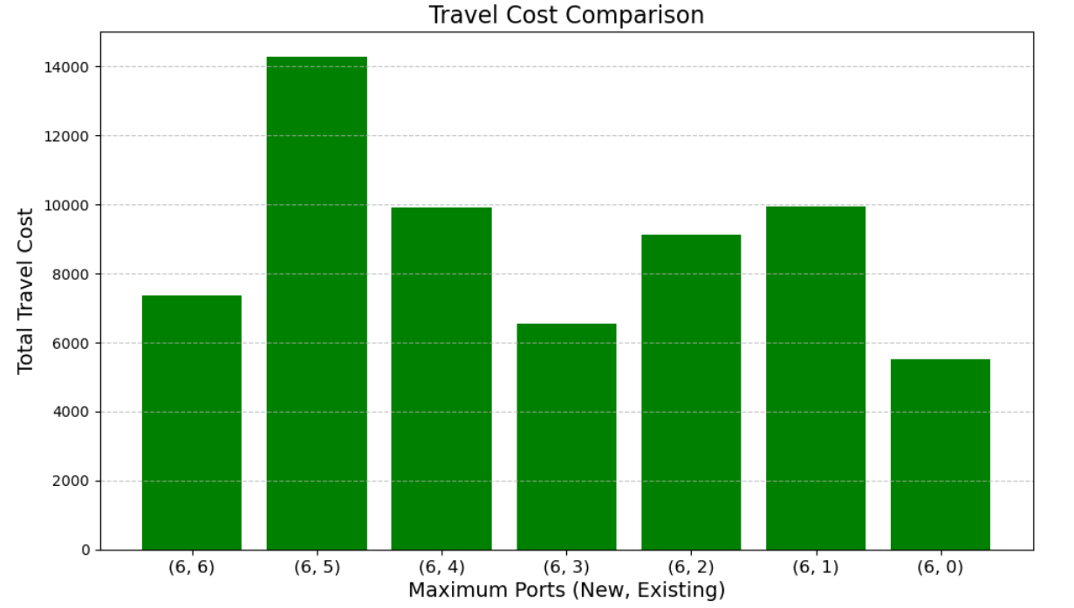
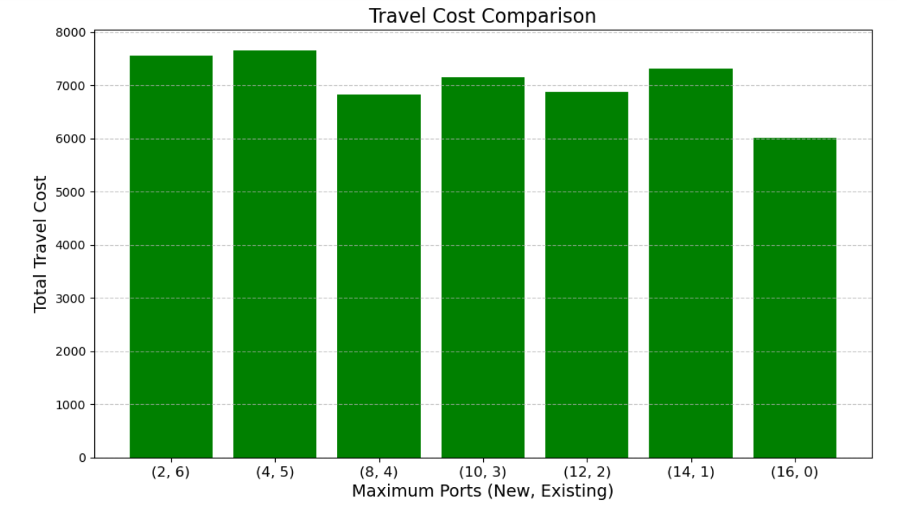
Travel Cost
Experiment 1 Experiment 2

Slide 11
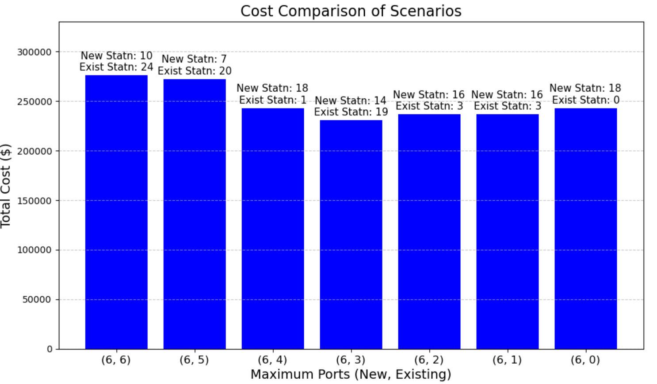
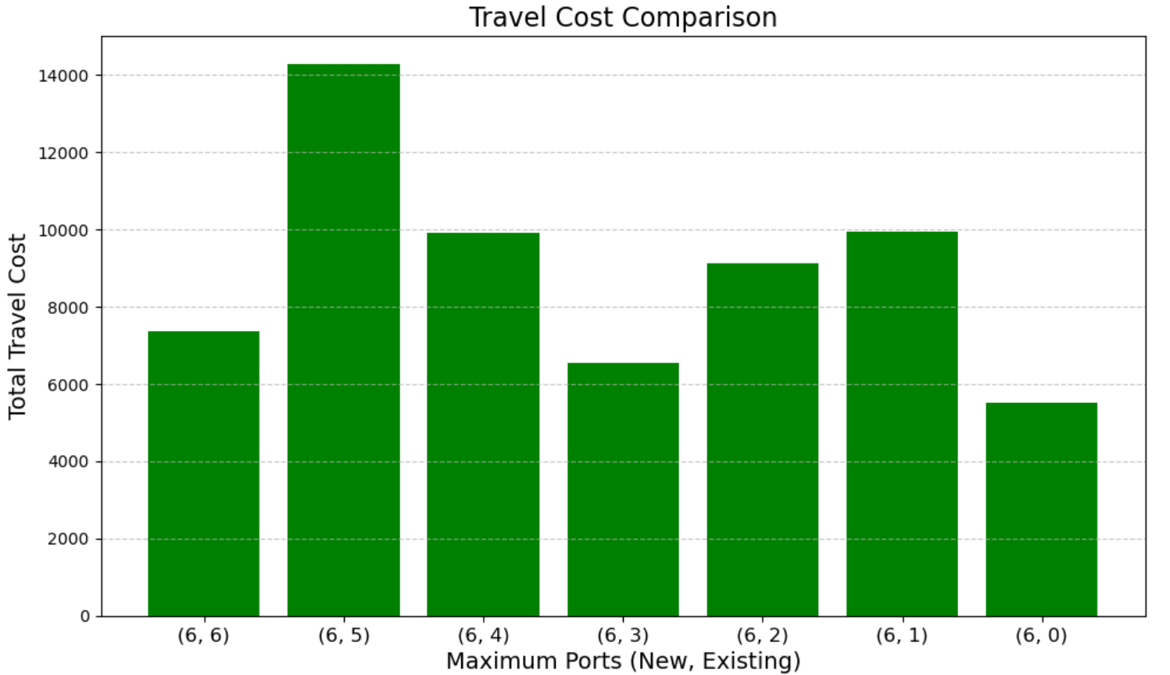
Establishment cost + travel costs: Expt 1

Slide 12
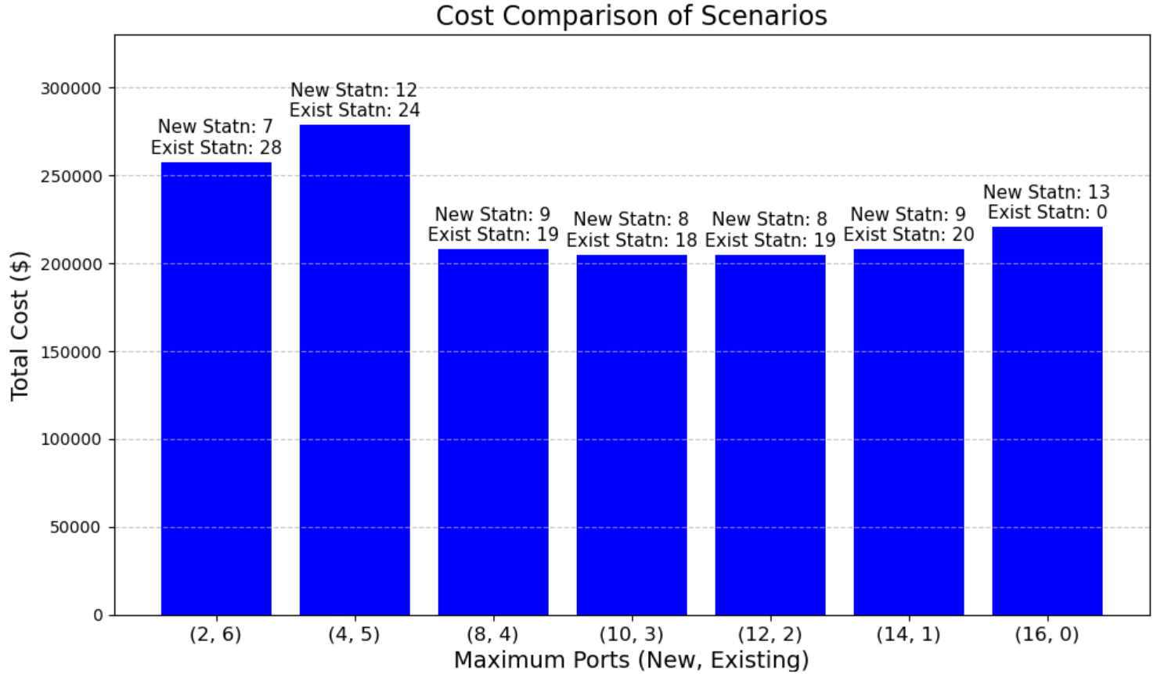
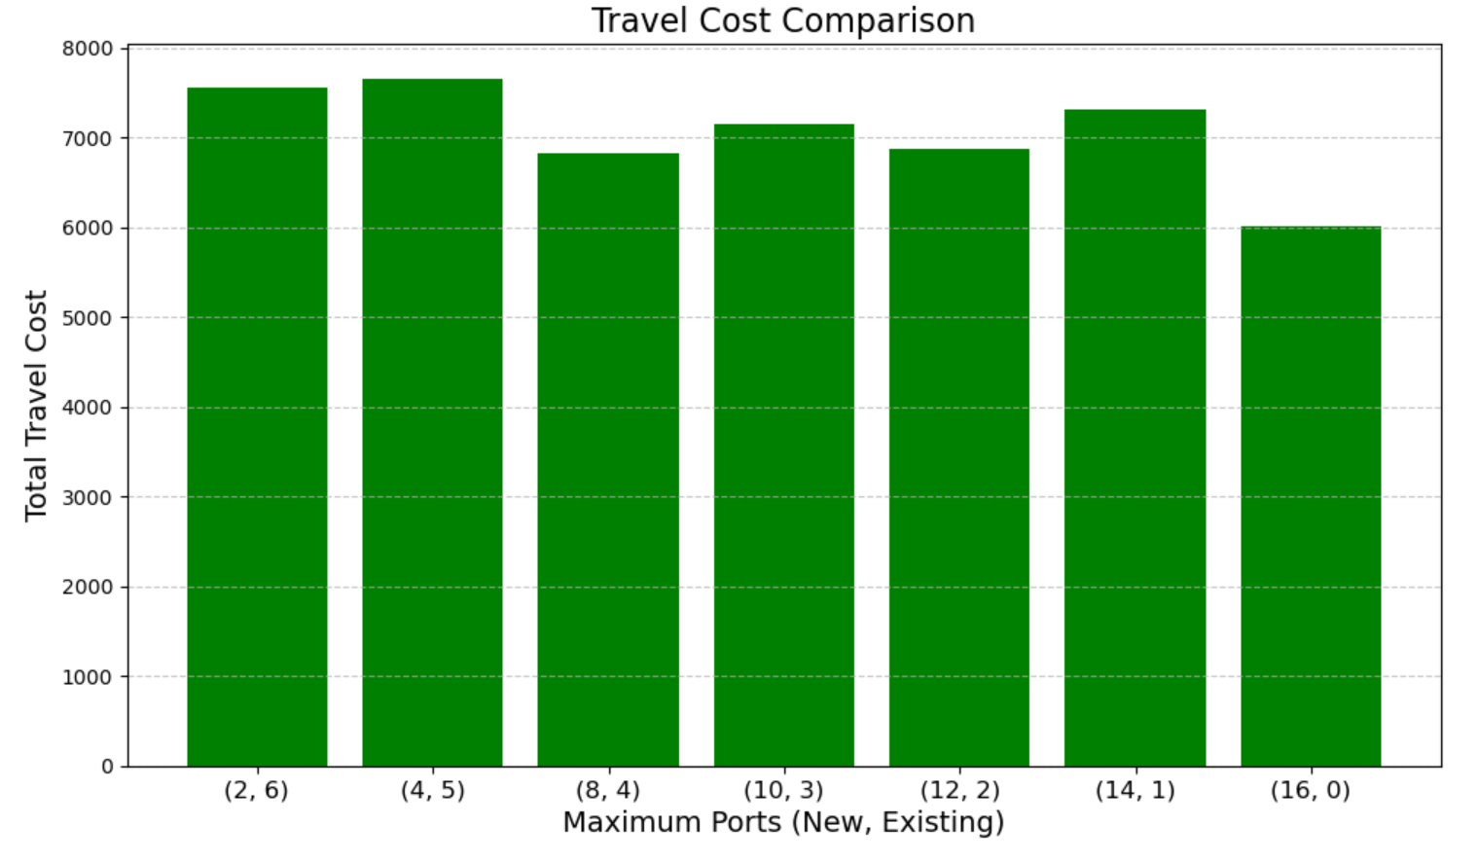
Establishment cost + travel costs: Expt 2

Slide 13
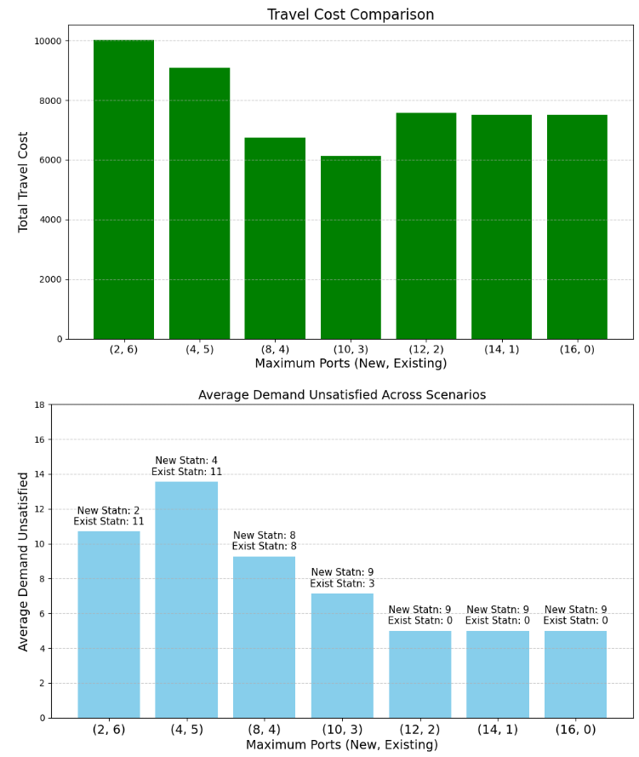
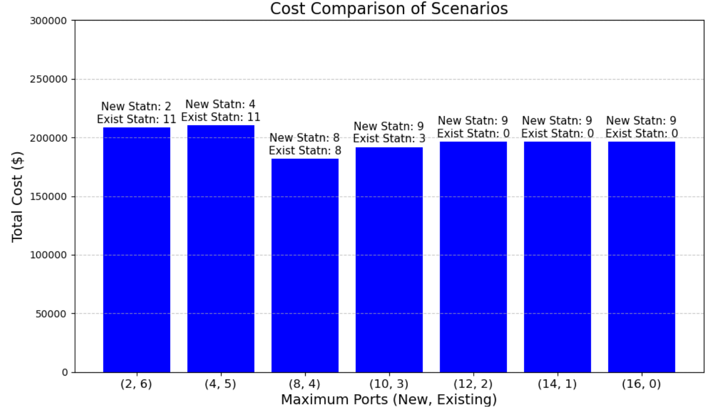
Establishment cost + travel costs: Expt 3

Slide 14
Objective function:
Minimize the fixed establishment cost
Minimize cost per charging port
Minimize waiting time at charging stations
Minimize travel distance for EV users
Select grid nodes such that power grid is not overloaded.
Constraint sets:
Limit maximum traffic at new and existing charging stations.
Ensure the demand at new and existing stations is met within capacity limits.
Budget constraint.
Limit the number of maximum ports per charging station.
Expand the existing charging station
Which charging station should be selected for expansion?
Introduce a new charging station
Where should new charging stations be located?
To what capacity each selected charging station be expanded?
What should be the capacity of each newly introduced charging station?

Slide 15
Expand the existing charging station
Which charging station should be selected for expansion?
Introduce a new charging station
Where should new charging stations be located?
To what capacity each selected charging station be expanded?
What should be the capacity of each newly introduced charging station?
Objective function:
Minimize the total cost.
Minimize waiting time at charging stations
Minimize travel distance for EV users
Prevent the power grid from overload.
Constraint sets:
Limit maximum traffic.
Ensure the charging demand is met.
Budget constraint.
Limit the number of maximum ports per charging station.

