Slide 1
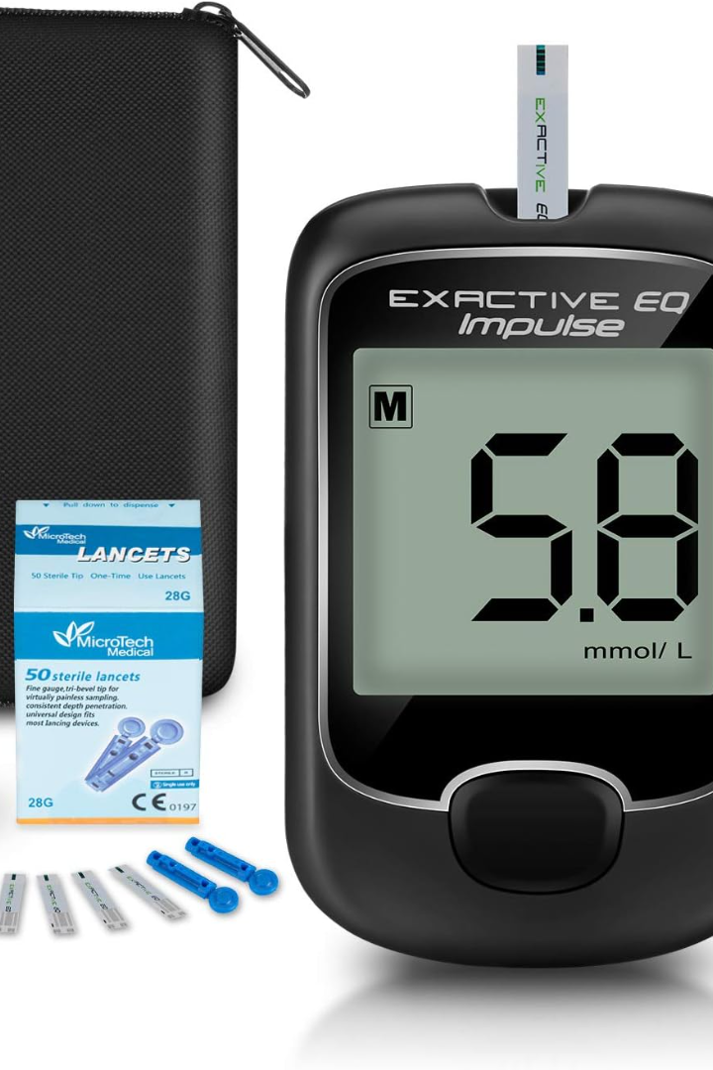

Diabetes Detection Using Machine Learning
Welcome to my presentation on diabetes detection using machine learning algorithms, such as logistic regression, random forest, and decision tree.
By :
Harshali Johari

Slide 2


Introduction to Diabetes
With the increasing prevalence of diabetes worldwide, the need for accurate and efficient detection methods is more crucial than ever. Machine learning algorithms have emerged as powerful tools in this pursuit, leveraging large datasets and complex analysis to uncover patterns and predictive models. By harnessing the potential of these algorithms, healthcare professionals can enhance early detection, improve patient outcomes, and pave the way for more personalized diabetes management strategies.

Slide 3

Overview of Machine Learning Algorithms
There are several machine learning algorithms that can be utilized for diabetes detection. These algorithms analyze patient data, including medical history, lifestyle factors, and genetic information, to identify patterns and make accurate predictions. Examples of commonly used algorithms include logistic regression, decision trees, and support vector machines. By understanding the capabilities of these algorithms, healthcare professionals can implement effective diagnostic tools and improve patient
outcomes.

Slide 4
Architecture of diabetes detection
Importing Libraries
Reading the CSV file
Data Cleaning
Handling missing values
Removing Outliers
Replacing with mean
Separate Features and Target
Split Training and Testing data
Model Building
Algorithms
Logistic Regression
Decision Tree Classifier
Random Forest
Comparing the Performance of each model based on Accuracy

Slide 5
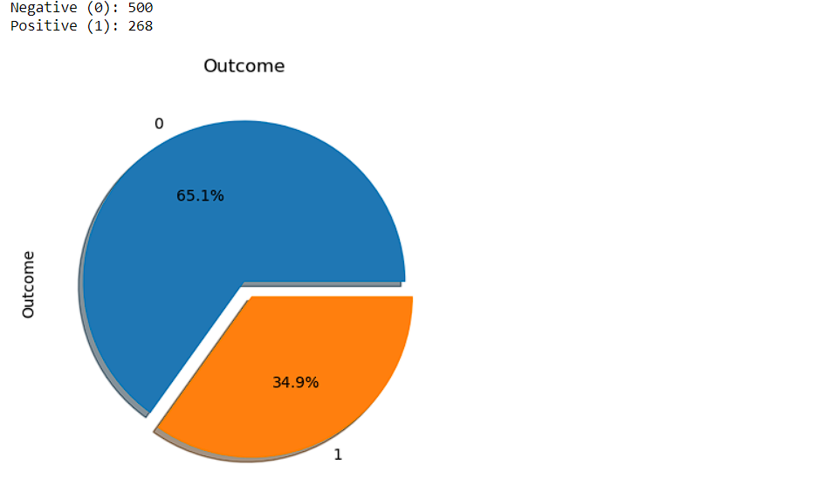
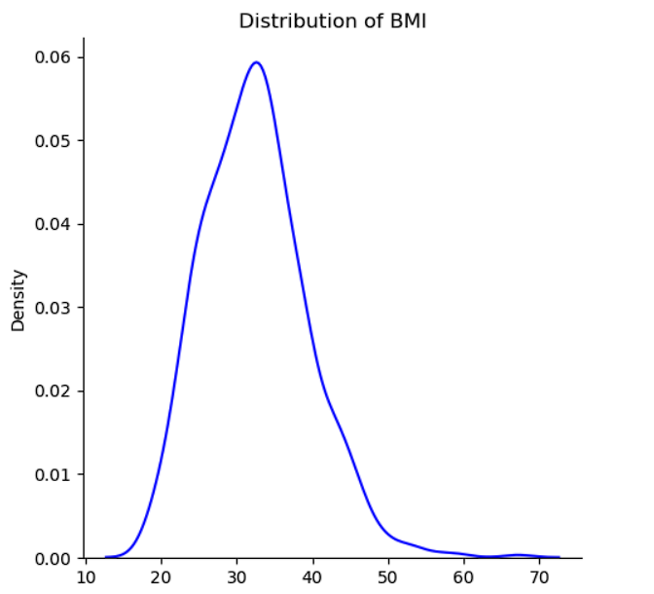
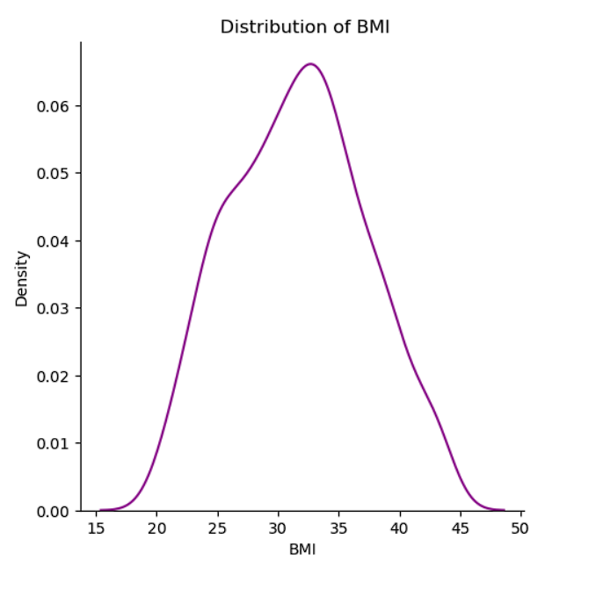
Data Visualization

Slide 6
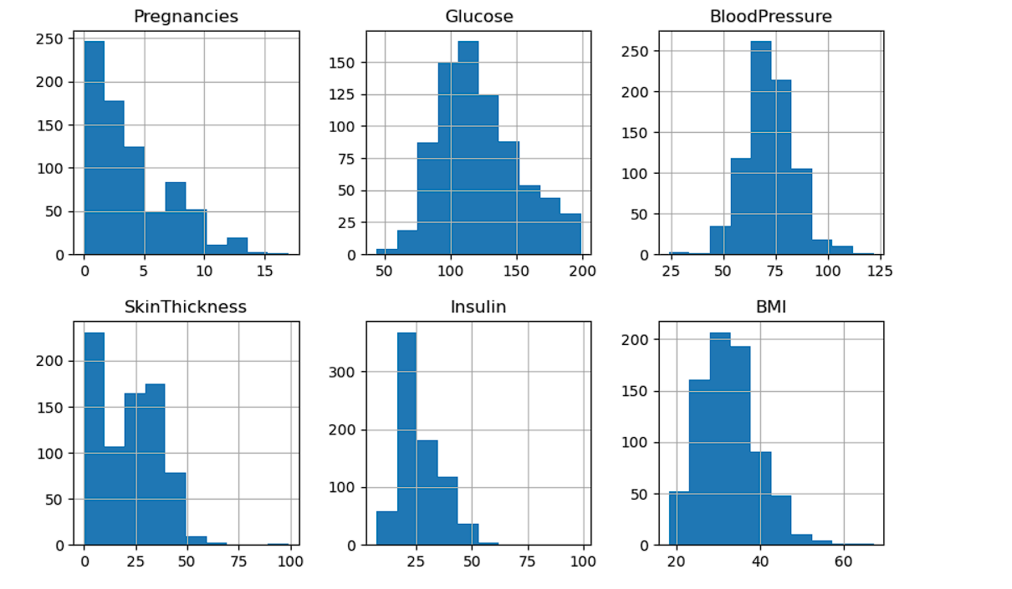

Slide 7
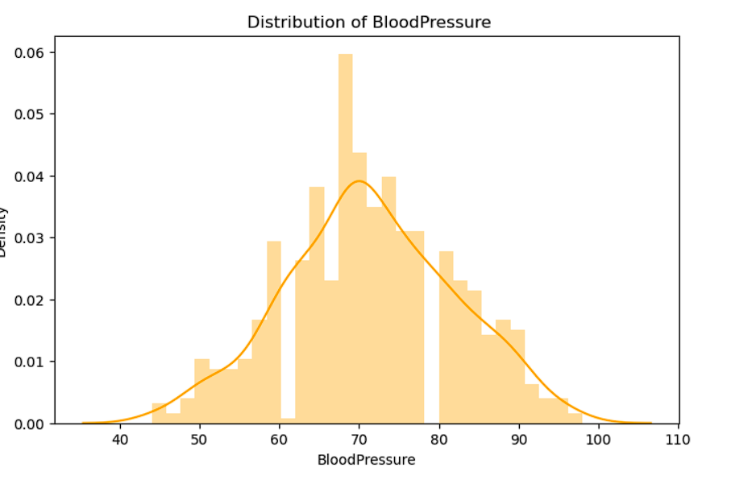
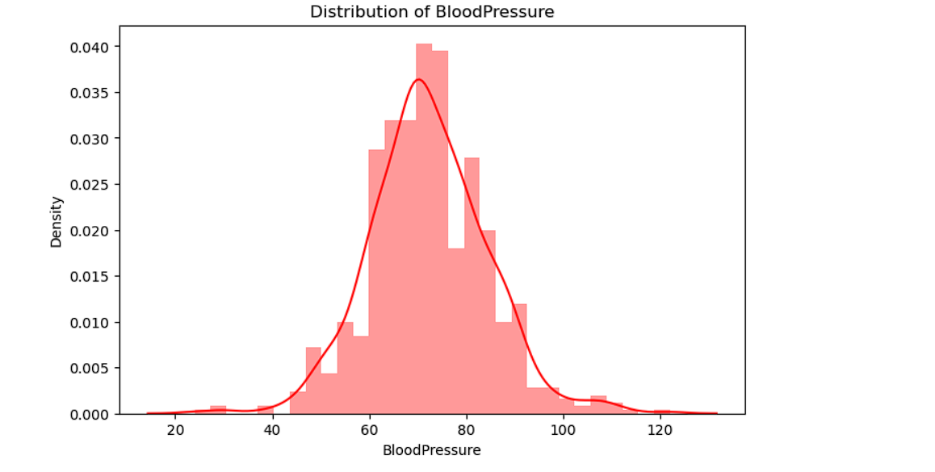

Slide 8
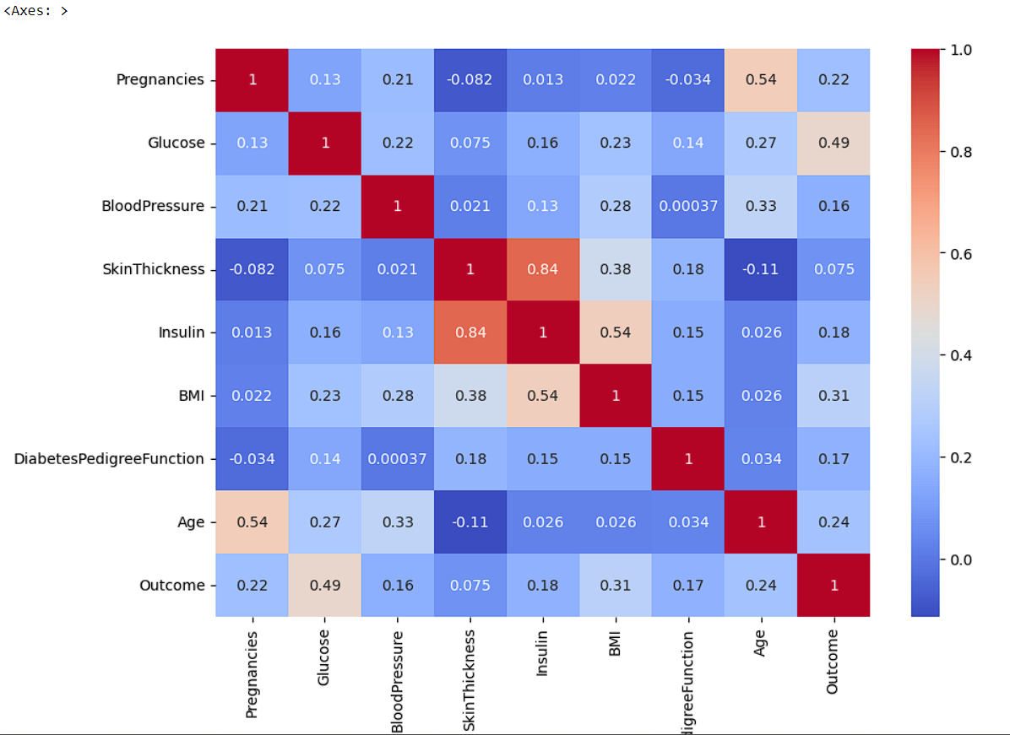

Slide 9
Logistic Regression
Logistic regression is a classification model in machine learning, extensively used in clinical analysis. It uses probabilistic estimations which helps in understanding the relationship between the dependent variable and one or more independent variables.

Slide 10
Decision Tree for Diabetes Detection
The decision tree based classifier models study includes various parameters like
computational overheads consumed
features
efficiency and accuracy
and provides the results.

Slide 11
Random Forest
Random Forest is a popular machine learning algorithm that belongs to the supervised learning technique.
RF is a multifunctional machine learning method. It can perform the tasks of prediction and regression. In addition, RF is based on Bagging and it plays an important role in ensemble machine learning

Slide 12

Comparison of Algorithms
Comparison :
Logistic regression = 78 %
Decision tree classifier = 69.33%
Random Forest = 76%
CONCLUSION :
The most of accuracy is given by logistic regression model.It gives 78% accuracy.

