Slide 1
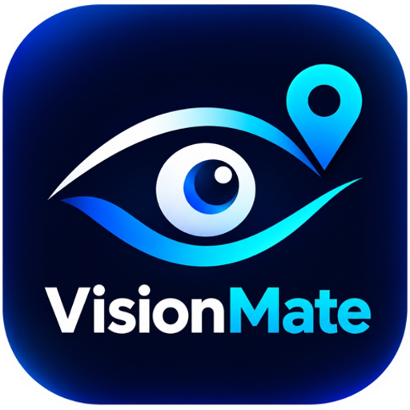
VisionMate 2.0
GROUP DETAILS
Harshal Jadhav
AI-assisted accessibility app for blind and low-vision users
HJ
See Beyond | Live Independently
Yogesh Mahadik
YM
Notes:
Introduce the project and the team.

Slide 2


Problem and Solution
The problem
Our solution
Reading labels, recognising notes, understanding surroundings and asking for help are daily challenges for blind and low-vision people, and most tools need sight to operate.
A voice-first mobile app that uses the phone camera, microphone, GPS and vibration to describe, read, identify, navigate and alert, with spoken answers in three languages.
OBJECTIVES
Voice-first control
EN | HI | MR languages
Haptic + large targets
Notes:
Explain who the users are and why a voice-first design matters. Say the app uses cloud AI plus on-device ML Kit.

Slide 3








Key Features
Describe Scene
Read Text
Currency ID
Object ID
Spoken scene summary
Signs, labels, documents
Rs 10 to Rs 500 notes
Position: left, ahead, right
Image Q&A
Navigation
Obstacle Alerts
Emergency SOS
Ask by voice, hear answer
Walking routes, haptic turns
Warnings without repeats
Call, SMS, live location
Also included: medicine scanner, colour matcher and barcode scanner
Notes:
Name the eight main features. Say that medicine, colour and barcode scanners also exist. Demo the first four.

Slide 4






Technology Stack
Flutter and Dart
Riverpod and GoRouter
Google Gemini API
One codebase for Android and iOS apps
State, dependency injection, 17 routes
Cloud vision for scenes, currency, objects
Google ML Kit
Speech and TTS
Device and Maps
On-device text (OCR) and barcode reading
speech_to_text input, flutter_tts output
Camera, GPS, haptics; OpenStreetMap routes
Notes:
For each item say what it is and why it fits. Be honest: Gemini does the heavy vision work in the cloud; ML Kit runs on the device.

Slide 5
System Architecture
1
2
3
4
5
User
Flutter UI
App Logic
AI and Data
Output
Taps the mic or large buttons
Dashboard, feature screens, camera view
Riverpod services, voice router, safety manager
Gemini API, ML Kit, OSM routing, local storage
Spoken answer and vibration patterns
EXAMPLE REQUEST
WHEN SOMETHING FAILS
Say "read text", take a photo, ML Kit and Gemini read it, the app speaks the result.
No key or network: the app speaks a retry message. OCR falls back to on-device ML Kit.
Notes:
Walk left to right. Then read the two boxes at the bottom: an example request and how errors are handled.

Slide 6
Data Storage
0
Settings
Theme, language, speech rate, haptics
History
Last 50 results saved as JSON text
SQL tables. No database server.
Saved places
Name, address and coordinates
Data stays on the device in SharedPreferences. Photos are sent to Gemini for analysis; history stores text only.
Emergency contact
Name and phone number
API keys
Obfuscated, not strong encryption
Notes:
Say clearly: there is no SQL database. Data is kept in SharedPreferences. Mention that photos go to Gemini and that key protection is only basic obfuscation.

Slide 7
Voice Command Logic
1
Tap the mic
Stops speech, vibrates, starts listening
EXAMPLE
"what is in front of me"
2
Speech to text
Returns the words and a confidence score
Intent: describeSurroundings
Opens the Scene screen
3
Parse the command
Under 0.50 confidence: ask to repeat. Else match keywords (EN, HI, MR)
TRADE-OFF
Fast and predictable, but it only understands known phrases.
4
Dispatch
Vibrate, then open the feature screen. SOS asks to confirm first
Notes:
This is the main logic to explain. It is rule-based keyword matching with a confidence gate, not machine learning. Emergency phrases are checked first.

Slide 8
Live Demo Plan
1
2
3
4
5
Launch app
Describe Scene
Read Text
Identify a Note
Show SOS
Show the voice button and language switch
Point at the room; hear the spoken summary
Scan a label or sign with ML Kit and Gemini
Show a Rs note; hear value and confidence
Open the emergency screen and its confirmation
Notes:
Rehearse this order. Do not call real contacts during the SOS demo; show the screen and the confirmation only.

Slide 9



Limitations
Needs internet and a key
AI estimates, not proof
Most AI features call the Gemini API. Offline, only OCR and barcode scanning can still work.
Confidence and distances are the model's own guess, not measured depth.
Not a mobility aid
SOS needs a manual tap
It cannot replace a cane or guide dog or confirm that a road is safe to cross.
It opens the dialer and SMS app; the user still has to press call and send.
Notes:
Be upfront. Judges respect honest limits. These come from the code and from the project's own limitations document.

Slide 10



Future Scope
On-device models
Train and bundle TFLite models for offline currency and object detection
Safer key handling
Use secure storage and a backend proxy instead of keys on the phone
Reliable SOS
Send SMS and live location through a server with delivery confirmation
Real-user testing
Test with visually impaired users and add more Indian languages
Notes:
These are proposed improvements, not finished work. Choose the two you can best explain.

Slide 11
Conclusion
A voice-first, multilingual assistive app built with Flutter
Combines cloud AI (Gemini) with on-device ML Kit, GPS and haptics
Honest limits: it supports a cane or guide dog and never replaces one
Questions?
Thank you
Harshal Jadhav
Yogesh Mahadik
Notes:
Blind and low-vision users need hands-free, spoken access. The app uses cloud AI plus on-device ML Kit.

