Slide 1

PARALLEL SUDOKU SOLVER Professor : Bhaskar Chaudhary Course : High Performance Computing (CS-301)
Luv Patel (201501459)
Harshal Khodifad (201501461)

Slide 2
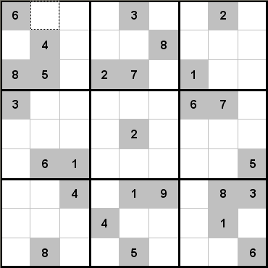
What is a SUDOKU ?
Sudoku is a logical number puzzle. The conventional puzzle consists of a 9x9 grid of smaller squares divided into nine 3x3 grids. These squares are to be filled with a number ranging from one to nine. Some numbers are given, how many you get and positioning alters the diﬃculty of the puzzle.
It is today a popular game throughout the world and it appears in multiple medias..
However, due to its recency, there is relatively little work on parallel implementation.
Also, Sudoku is a NP-Complete problem which means that it is one of a set of computational difficult problems.

Slide 3
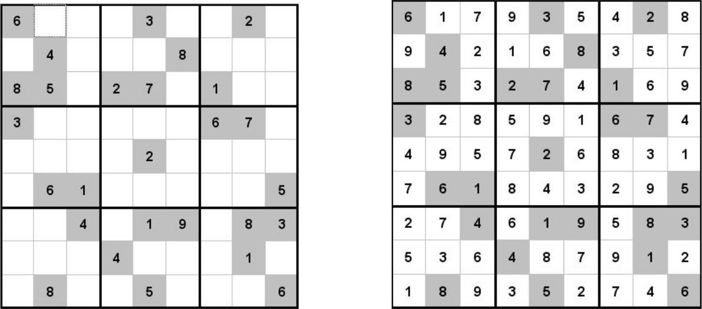
INPUT
OUTPUT (UNIQUE ONLY)

Slide 4
SOLVING TECHNIQUES
Total number of valid Sudoku puzzles is approximately 6.671×10²¹ (9*9 matrix).
Brute force technique - This is a very general problem-solving technique that consists of systematically enumerating all possible candidates for the solution and checking whether each candidate satisfies the problem's statement. Computationally, this technique takes long time; assuming each solution takes 1 micro second to be found, then with a simple calculation we can determine that it takes 211,532,970,320.3 years to find all possible solutions.
Linear system approach- Hard to solve with fewer clues.
Backtracking with DFS approach- The complexity of DFS Backtracking algorithm is O(n ^ m) where n is the number of possibilities for each square (i.e., 9 in classic Sudoku) and m is the number of spaces that are blank.

Slide 5
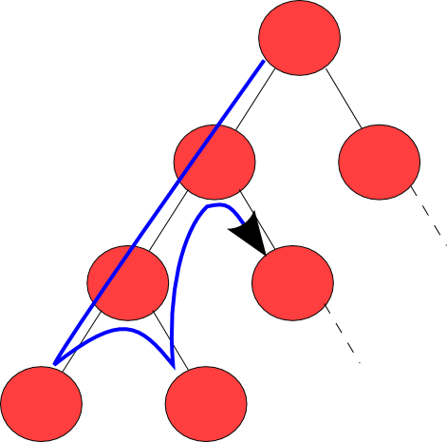
Depth First Search (DFS) (Bactracking Algorithm)
Serial Pseudo-code:
1. Find an empty cell.
2. If there is none, return true.
3. For digits from 1 to 9 a) If there is no conflict for digit at row,col then assign digit to row,col and try filling in the rest of grid.(Next empty cell) b) If all empty cells are filled, return true. c) Else, backtrack and fill the recently filled empty cell with next number possible. 4. If all digits have been tried and nothing worked, return false.

Slide 6
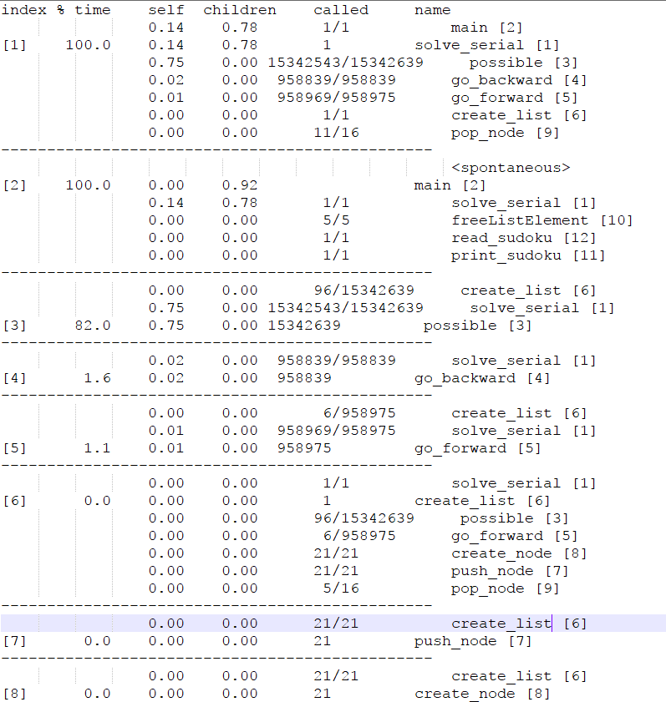
PROFILING INFORMATION
Complete Information of profiling is given in profiling.txt.
From the above given information it is evident that there is a need to parallelize solve_serial() function the function which does the backtracking.
The possible() function checks the allowed values for a given cell.

Slide 7
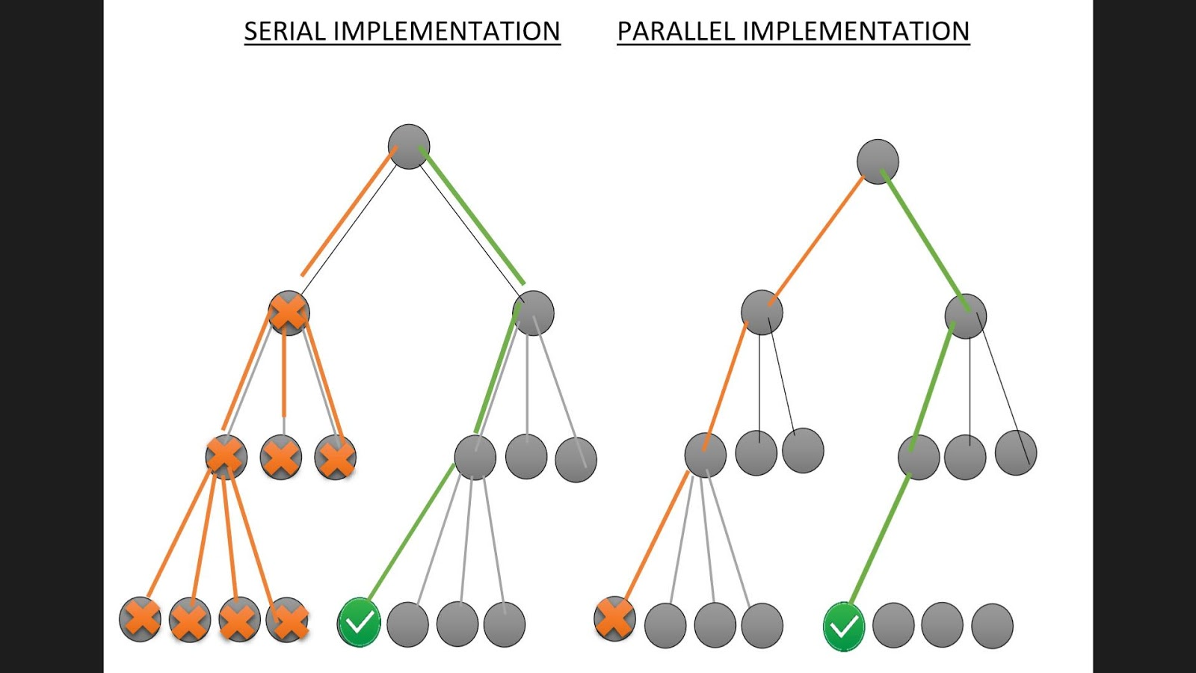
WHY PARALLELIZE AND JUSTIFICATION OF SPEEDUP
SERIAL
1)In serial if there is contradiction we check second part and so on till we get solution.
PARALLEL
1)Whereas in parallel the solution is found in the second branch at the same instant when we get a contradiction in first branch
2) If the solution is located in the first branch or the problem size is small, the parallel algorithm may be slower due to the thread management overhead and executing multiple branches in parallel.

Slide 8
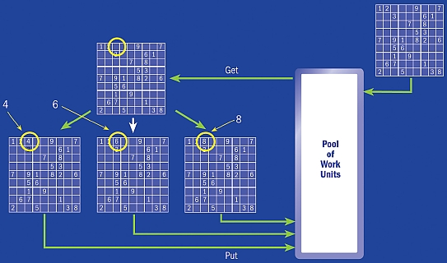
PROPOSED PARALLEL ALGORITHM VISUALISATION
Parallel PseudoCode
1)Select(Get) an Empty cell.
2)Make copies of the original matrix with the empty cell filled with its possible values.
3)Loop till Terminate or Found :
i)Give each copy of matrix to a particular thread to compute the result.(This step is critical)
ii)Execute the Serial Pseudocode in each thread.

Slide 9
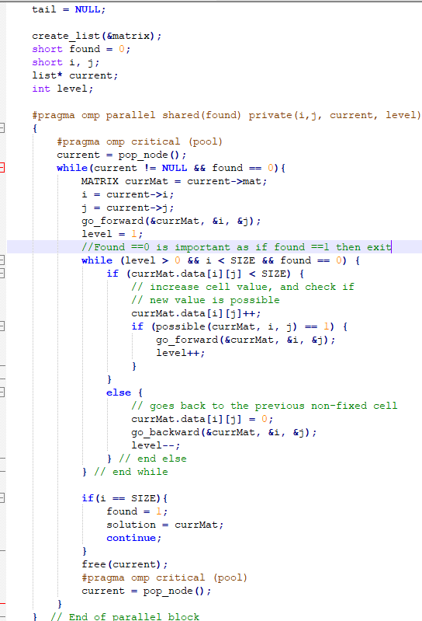
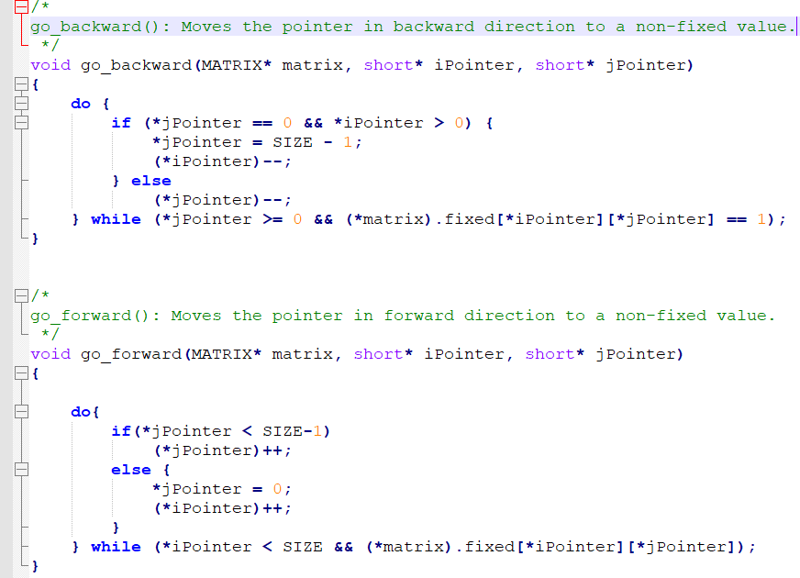
PROPOSED ALGORITHM
For the algorithm we had to build our own versions of go_forward and go_backward.

Slide 10
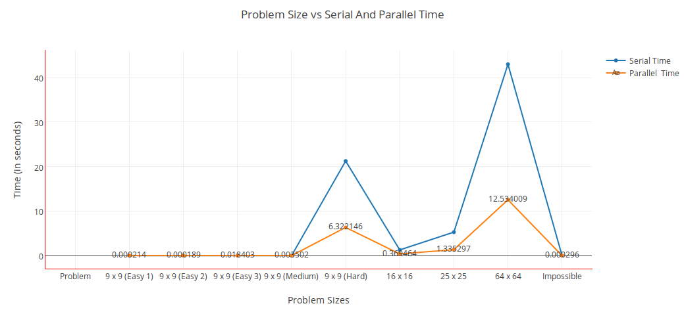
ANALYSIS
ANALYSIS OF GRAPH:
1)As we can see for smaller inputs we have serial and parallel code executing and giving result in same time , infact serial code is better when size is very small.Such behaviour is expected because the relative overhead is high as compared to problem size.
2)When problem size becomes larger and larger that’s when speedup increases in a multithreaded code as the work gets shared among the threads and computation time decreases.
Problem Size vs Serial And Parallel Time for default( 4 cores)

Slide 11
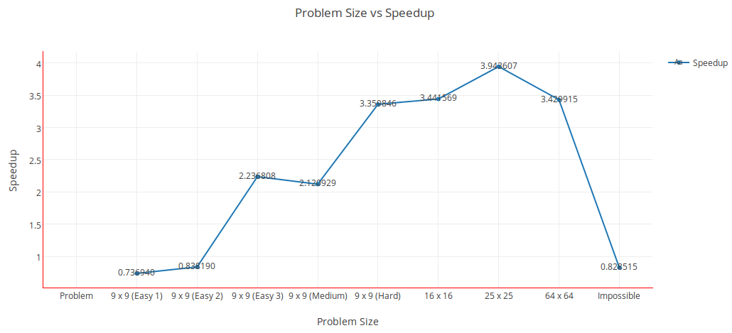
ANALYSIS
ANALYSIS OF GRAPH:
1)Thus we say that parallel computing is very useful in cases where the size of problem is very large.As serial code would take a large time to solve that problem as evident to comparision between ts and tp.
2)The parallel code speedup depends on the number of cores which we have in the hardware machine .In our case it is approaching 3.94 (25x25 case) as we have set the default number of threads to 4.This shows that we are able to utilize the cores properly and able to get a respectable speedup form our code.
Problem Size vs Speedup for default( 4 cores)

Slide 12
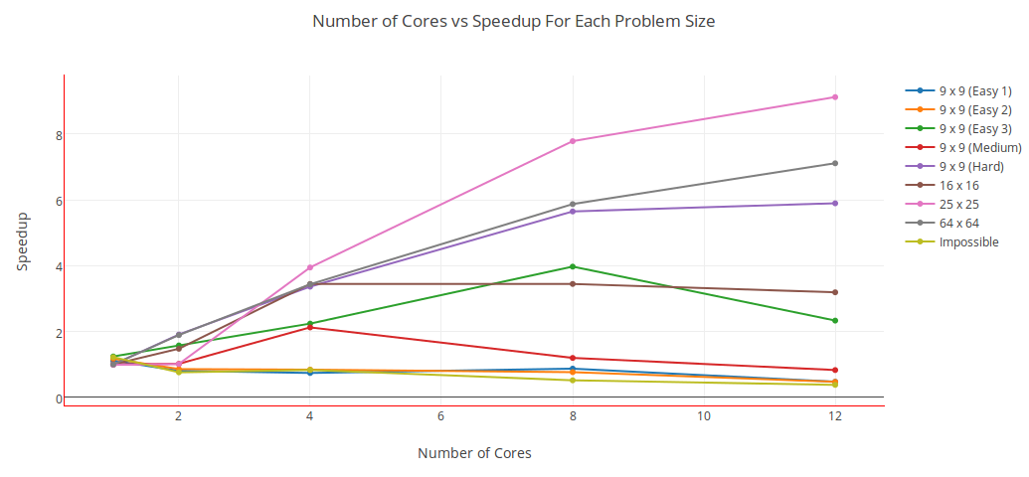
ANALYSIS

Slide 13
ANALYSIS OF ABOVE GRAPH
1)As problem size increases the speedup generally increases for a fixed number of core.This is where the domain of HPC lies as discussed in Analysis 1 .As discussed earlier that problem size is not the size of matrix but it is dependent on the depth of the recursion tree while solving thus we can see that 25x25 input matrix requires more computation than 64x64 input matrix.
2)For a particular problem size the speedup increases when there is increase in the number of cores.But the Efficiency (Speedup / Number of Cores )Decreases this behaviour is expected as Linear speedup is not achievable, in general, because of contention for shared resources, the time required to communicate between processors and between processes, and the inability to structure the software so that an arbitrary number of processors can be kept usefully busy.
3)Figures above Illustrate that the speedup tends to saturate and efficiency drops as a consequence of Amdahl's law as if linear speedup had occurred we would have got the speedup of 12 but we in the best possible case get a speedup of 9 in 12 cores.Furthermore, a larger instance of the same problem yields higher speedup and efficiency for the same number of processing elements, although both speedup and efficiency continue to drop with increasing p.

Slide 14
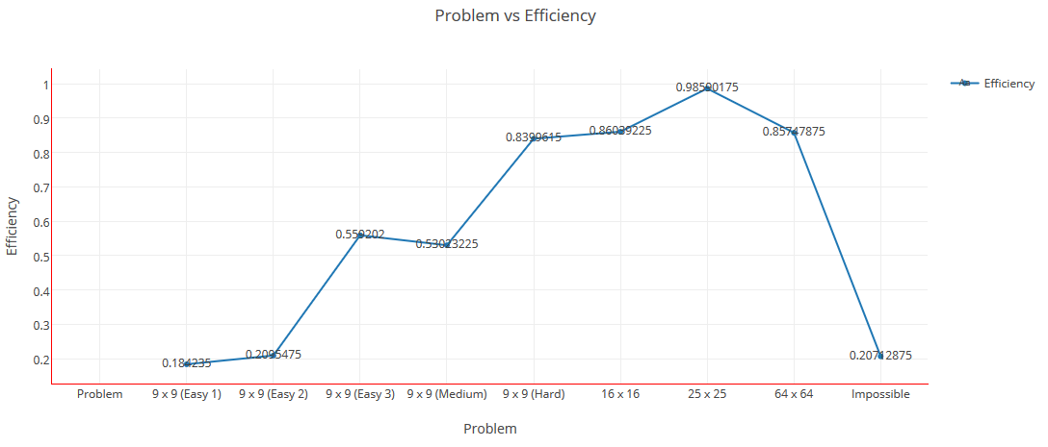
PERFORMANCE METRICS GRAPH 1
Analysis for the graph
1)The efficiency increases if the problem size is increased keeping the number of processing elements constant.
2)For such systems, we can simultaneously increase the problem size and number of processors to keep efficiency constant.We call such systems scalable parallel systems thus our code is scalable.
Figure for default 4 core:The above graph helps us to know if our code is scalable.

Slide 15
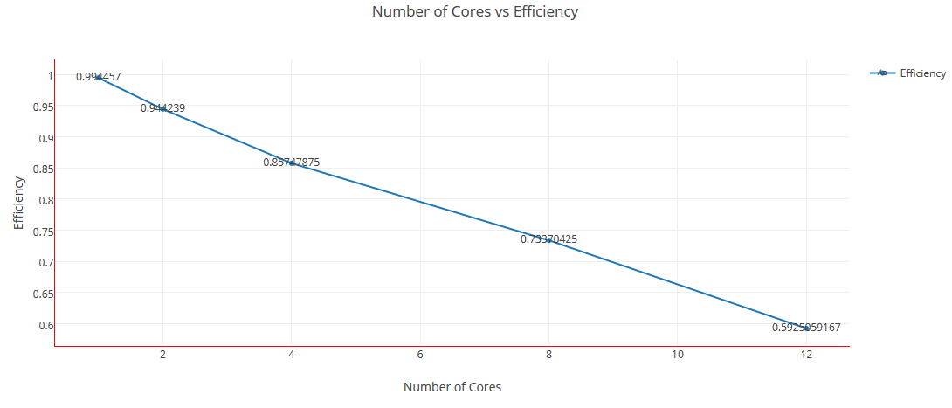
PERFOMANCE METRIC GRAPH 2
Analysis of the graph
1)For a given problem size (i.e., Serial Time remains constant), as we increase the number of processing elements, Total Overhead increases as it is an increasing function of p as discussed earlier in overhead analysis.
2)The overall efficiency of the parallel program goes down. This is the case for all(most) parallel programs.
Number of cores Vs Efficiency

Slide 16
CONCLUSION
1)In this project, we proposed a parallel algorithm for solving an NxN Sudoku grid.
2) The algorithm is designed to maximize the utilization of all cores available on the system.
3) We have shown the efficiency of the algorithm and that it utilized all the available cores on the system.
4)We can conclude that we get speedup when our code is run parallely on different cores.i.e we can parallely solve a sudoku with a considerable amount of speedup.
5)Also by calculating the efficiency for different number of processors and different problem sizes, we can say that our code is scalable.

